Slide 1
PowerPoint 7: Communication
PowerPoint presentation
9. Relationship management in construction
9.10 Methods and styles of communication

Slide 2
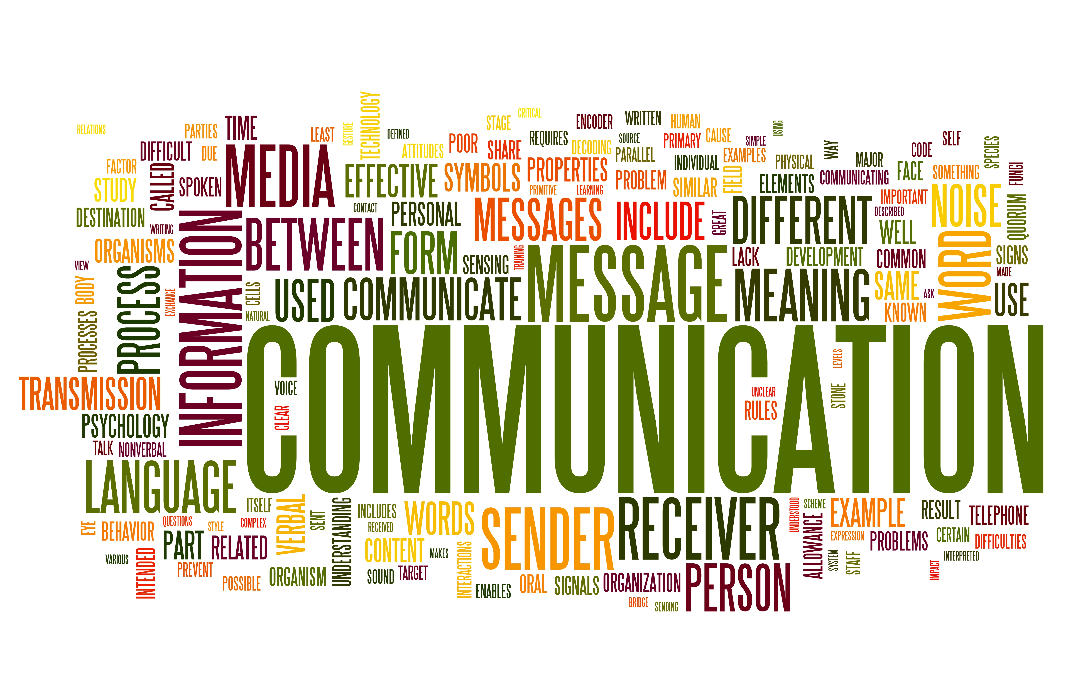
Communication styles
Formal communication is the flow of information through official channels and methods. The flow of information is controlled and often recorded. Formal communication is effective in construction and allows information to be recorded and documented.
Informal communication moves more freely and is often a quick way to communicate. However, unlike formal communication it doesn’t usually provide a paper trail. When creating working relationships, informal communication will normally increase.

Slide 3
Communication
The planning, delivery and execution of a construction project involves many different people who need to clearly and effectively communicate in order to successfully complete a project on time, within budget and to the required quality.

Slide 4
Purpose of communication techniques
Motivation: clear, effective communication can raise motivation and impact positively on productivity.
Instruction: during the construction phase instructions need to be issued continuously to ensure all relevant personal are clear on their roles and responsibilities and complete jobs in line with the most up to date information.
Monitoring: progress needs to be monitored and reported on to ensure a project is on schedule and a high quality of work is maintained.
Cooperation and teamwork: With many personnel involved in a project’s delivery, cooperation and teamwork are essential.

Slide 5
Methods of communication
face to face
email
letter
telephone
walkie talkie
text message
social media
drawn information.

Slide 6
Methods of communication
Different methods of communication will be suitable for different types of information. Communication may be formal such as documented meetings or informal such as chats to discuss personal issues or circumstances.
Face-to-face meetings: provide information and discuss and resolve problems. Action plans can be explored and created, and relevant personnel can pose questions and visually check project progress if appropriate.
Regular site meetings: the principal contractor and subcontractors will liaise with the workforce and each other to ensure clear information is communicated between all relevant personnel. Often meetings are held face to face or virtually depending on the situation.
Courier services: can be used to deliver confidential packages of information quickly and efficiently.

Slide 7
Methods of communication
Emails are regularly used in industry to communicate information between personnel. As there are many different people involved in the planning and delivery of a project this can be an effective way to relay information and resolve issues. Emails can be accessed via mobile phones, tablets and computers, meaning information is readily available. Spell-checking emails and only sharing information with concerned parties are key points here.
Text messages are often used to clarify or confirm minor details. This is a quick way to communicate small pieces of information.
Fax is not as common as the above forms of communication but is still used to send copies of documents, although email attachments are growing increasingly popular.

Slide 8
Poor communication
Failure to communicate effectively can have a negative impact on the delivery of a construction project leading to issues such as:
low morale
reduced productivity
more accidents and injuries
increased risks
incorrect work carried out.

Slide 9
Verbal communication
When communicating verbally it is important to:
Consider your pitch and tone of voice. Shouting or raising your voice will increase the chance of conflict arising. Remaining calm and measured will inspire confidence and trust. Offensive language should not be used in the workplace and all personnel should be considerate of this and act in a professional manner.
Listen to the other person in the conversation. Listening is a skill. In your next conversation consider how often you are thinking of what you will say next, rather than taking in what the other person is saying.
Check understanding: confirm you have heard and understood.
Take notes of information you may need to look back on for clarification.
It is important to document verbal communication with emails or hand-written site instructions, to avoid conflicts due to lack of supporting evidence.

Slide 10
Non-verbal communication
Non-verbal communication is just as important as verbal communication. Forms of non-verbal communication include:
facial expressions
body language
eye contact
gestures.
Positive body language and facial expressions can increase the likelihood of building good working relationships. These are an essential part of working in the construction industry.

Slide 11
Open and closed question techniques
You should ask questions if any information is unclear and be clear and concise when delivering information.
Open questions require a free-form response. They can be used to obtain full and detailed answers such as a description of a problem or to understand another person’s opinion or perspective, eg ‘How do you feel the project is progressing?’
Closed questions require a yes or no response. They can be used to obtain clear, definitive and factual answers, eg ‘Will the roof tiles be delivered on Tuesday afternoon?’

Slide 12
Digital project management
With advances in technology and the rise in uptake and use of BIM in the industry, digital project management is now a key part of the construction sector. Through connected data environments, people can communicate information quickly and efficiently.
Advantages:
communicate project variations faster than traditional methods
streamlined communications
document -sharing tools.

Slide 13
Any questions?

