Slide 1
PowerPoint 6: Negotiation and conflict management
PowerPoint presentation
9. Relationship management in construction
9.8 Negotiation techniques
9.9 Conflict management techniques

Slide 2
Conflict management
Many people are involved in the planning and delivery of a construction project, and conflicts may arise.
Clear and effective communication can help avoid conflict and provide clear information to all personnel involved in the project process. If conflicts arise you must act professionally and try and resolve any issues as soon as possible.

Slide 3
Preventative measures
However, measures can be taken to prevent conflict arising in the first place, such as:
ensuring that agreements and contracts are clear and unambiguous so misunderstandings do not occur
careful planning of a project before it begins (using software or other methods) to anticipate issues and build contingency
maintaining good communication to manage expectations
being open to compromise and demonstrating flexibility
controlling conflict before it escalates: facing problems head on, rather than hoping they will go away!

Slide 4
Conflict management
Clients
Conflicts may arise with clients for several reasons. Usually this may be due to quality of work, falling behind the work programme or design issues such as the installation of incorrect fittings.
To avoid conflict with clients you must ensure you are communicating clearly, keeping them informed of project progress and making them aware of any issues that arise. Having open and honest conversations can ensure you fully understand the client’s perspective and can try to calmly resolve conflict.

Slide 5
Conflict management
Suppliers
Conflict may arise with suppliers for reasons such as damaged items, wrong items and quantity issues. To avoid conflict, paperwork must be completed, stored and retained safely. You must check prices are in line with the original quotation and when issues arise contact the supplier by phone or email to discuss and resolve the issue.

Slide 6
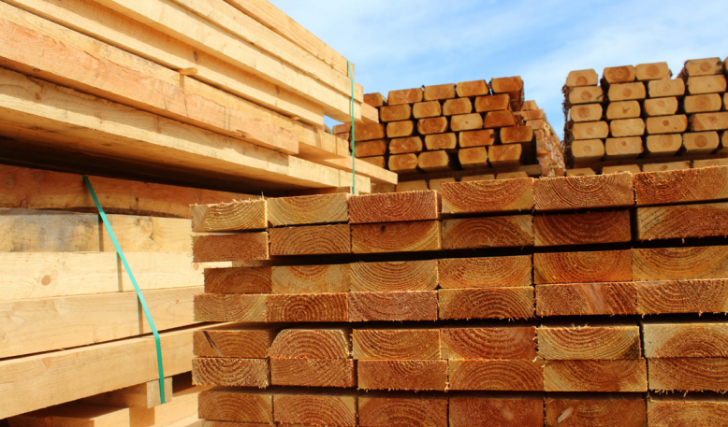
Conflict management
Material or other resource shortages
During the construction process you may encounter resource shortages that have a knock-on effect on labour and cause delays to the working programme. To avoid delays and shortages you should keep in contact with suppliers and confirm delivery dates as well as ordering materials well in advance.

Slide 7
Conflict management
Trade workers
There are many trade workers involved in the construction phase of a project and conflicts may arise over working areas, working equipment and delays with the working programme that result in trades not being able to complete their work in line with the agreed deadline.
To avoid conflict, clear effective communication is key. Holding regular meetings and liaising with the trade supervisor to discuss issues can help prevent conflict and build collaborative working practices.

Slide 8
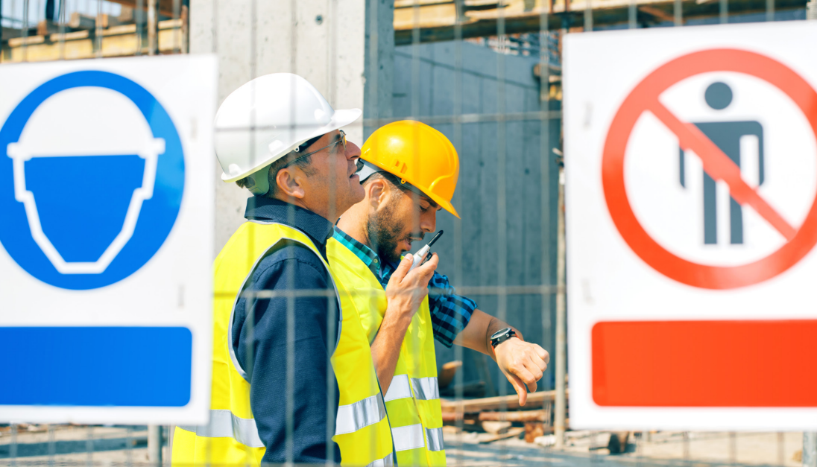
Conflict management
Site constraints
Site constraints can cause delays and limitations to the working programme. A well considered site layout plan can be a way to avoid issues. On some sites in certain locations these must be considered and planned around. Site security and safety is a primary element of planning.

Slide 9
Potential reasons for conflict
Ambiguous contract terms.
Breach of contracts.
Late supply of materials.
Programme delays.
Quality and workmanship.
Site conditions.

Slide 10
Conflict resolution strategies

Slide 11
Conflict resolution techniques
Negotiation: the involved parties try to solve problems and negotiate between themselves in informal discussions.
Mediation: a third party is assigned to assist in resolution of disputes.
Adjudicative process: a third party decides the final outcome and imposes a binding decision.

Slide 12
Conflict resolution techniques
Conciliation is another term for mediation used in construction. The conciliator acts as a mediator to facilitate a settlement between the involved parties. Any settlement that is agreed will be documented in a formal contract.
Arbitration is where the involved parties will present their evidence and arguments to a resolution practitioner who acts as the arbitrator.

Slide 13
Conflict prevention
Good management.
Clear contract documentation.
Good client management.
Collaborative working practices.
Regular reporting.
Record-keeping.

Slide 14
Unforeseen circumstances
Circumstances may arise that are unforeseen and cause time delays including:
weather conditions
material shortages
site constraints
staff shortages due to accidents or sickness.

Slide 15
Weather conditions
Weather conditions can affect the construction phase of a project and potentially cause time delays. Effective management can avoid this by looking at weather reports and forecasts to identify conditions that may impact the construction process. The project and site managers can update the programme and communicate with the workforce to take this into consideration and plan for it.
It may be appropriate to acquire more labour to avoid falling behind the work programme.
At the planning stages of a project a site layout plan can clearly identify sheltered storage areas to avoid plant, equipment and materials being damaged by the weather.

Slide 16
Building information modelling (BIM)
The construction industry has been slow to adapt and incorporate technology compared to other industries. The rise of BIM has allowed for integrated communication and the identification of clashes related to health and safety and design at an earlier stage, which can prevent conflicts from arising.

Slide 17
Negotiation
In construction negotiation is a big part of the construction process. Examples of when negotiation may take place include:
acquiring land
securing planning permission
awarding contracts
scheduling appointments
resolving disputes.

Slide 18
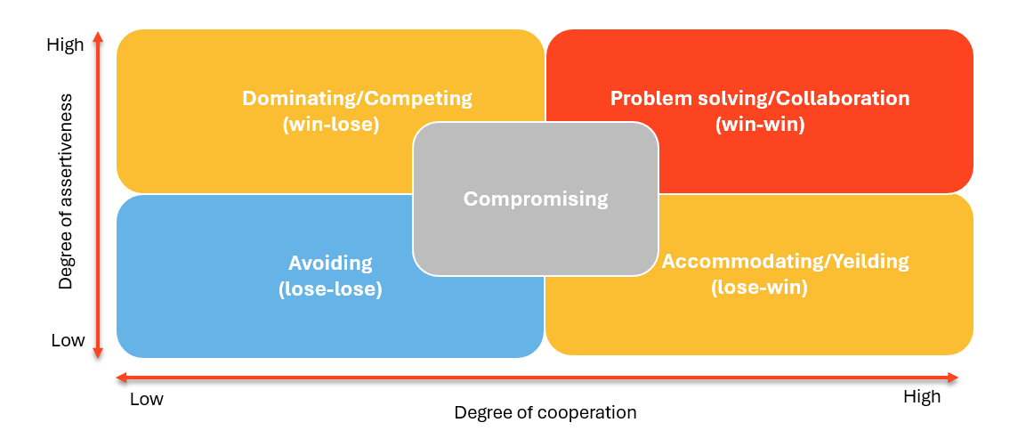
Negotiation
Compromise is a basic negotiation process. In compromise situations neither side gets all of what they wanted but each makes concessions in order to reach an agreement that is acceptable to both parties.

Slide 19
Negotiation
Win–win: when each side of the dispute feels they have won and have benefited in some way.
Lose–lose: where all parties end up being worse off.
Win–lose: where one side feels the outcome is positive and has benefited in some way.
Lose–win: where one party’s loss is another party’s gain.

Slide 20
Contract negotiation
Contract negotiation is the process of discussion between parties to finalise the terms of the written contract (agreement). Parties involved in construction contracts may include clients, contractors and suppliers, and all might have separate interests.
Construction contracts will specify budget, obligations of the parties and a programme of works.
A contract is a legally binding agreement, so the terms and conditions need to be clearly understood and negotiated between all parties. The terms of the contract can be enforced in the event of non-compliance.

Slide 21
Negotiation skills
Negotiation skills
Good memory
Able to gain trust
Good at handling stress
Efficient at preparing information
Able to listen effectively
Good intuition
Able to be flexible

Slide 22
Any questions?

