Slide 1
PowerPoint 4: Team dynamics
9. Relationship management in construction
9.5 Teamwork to team and project performance
9.6 Team Dynamics
PowerPoint presentation

Slide 2
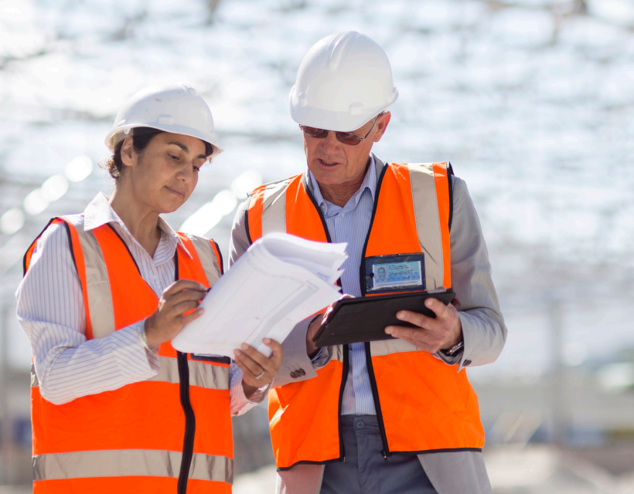
Teamwork in construction
The construction process involves many people working together in collaboration to ensure successful project delivery. Teamwork involves sharing information and building trust. Effective teamwork can help improve productivity, morale and quality of work.

Slide 3
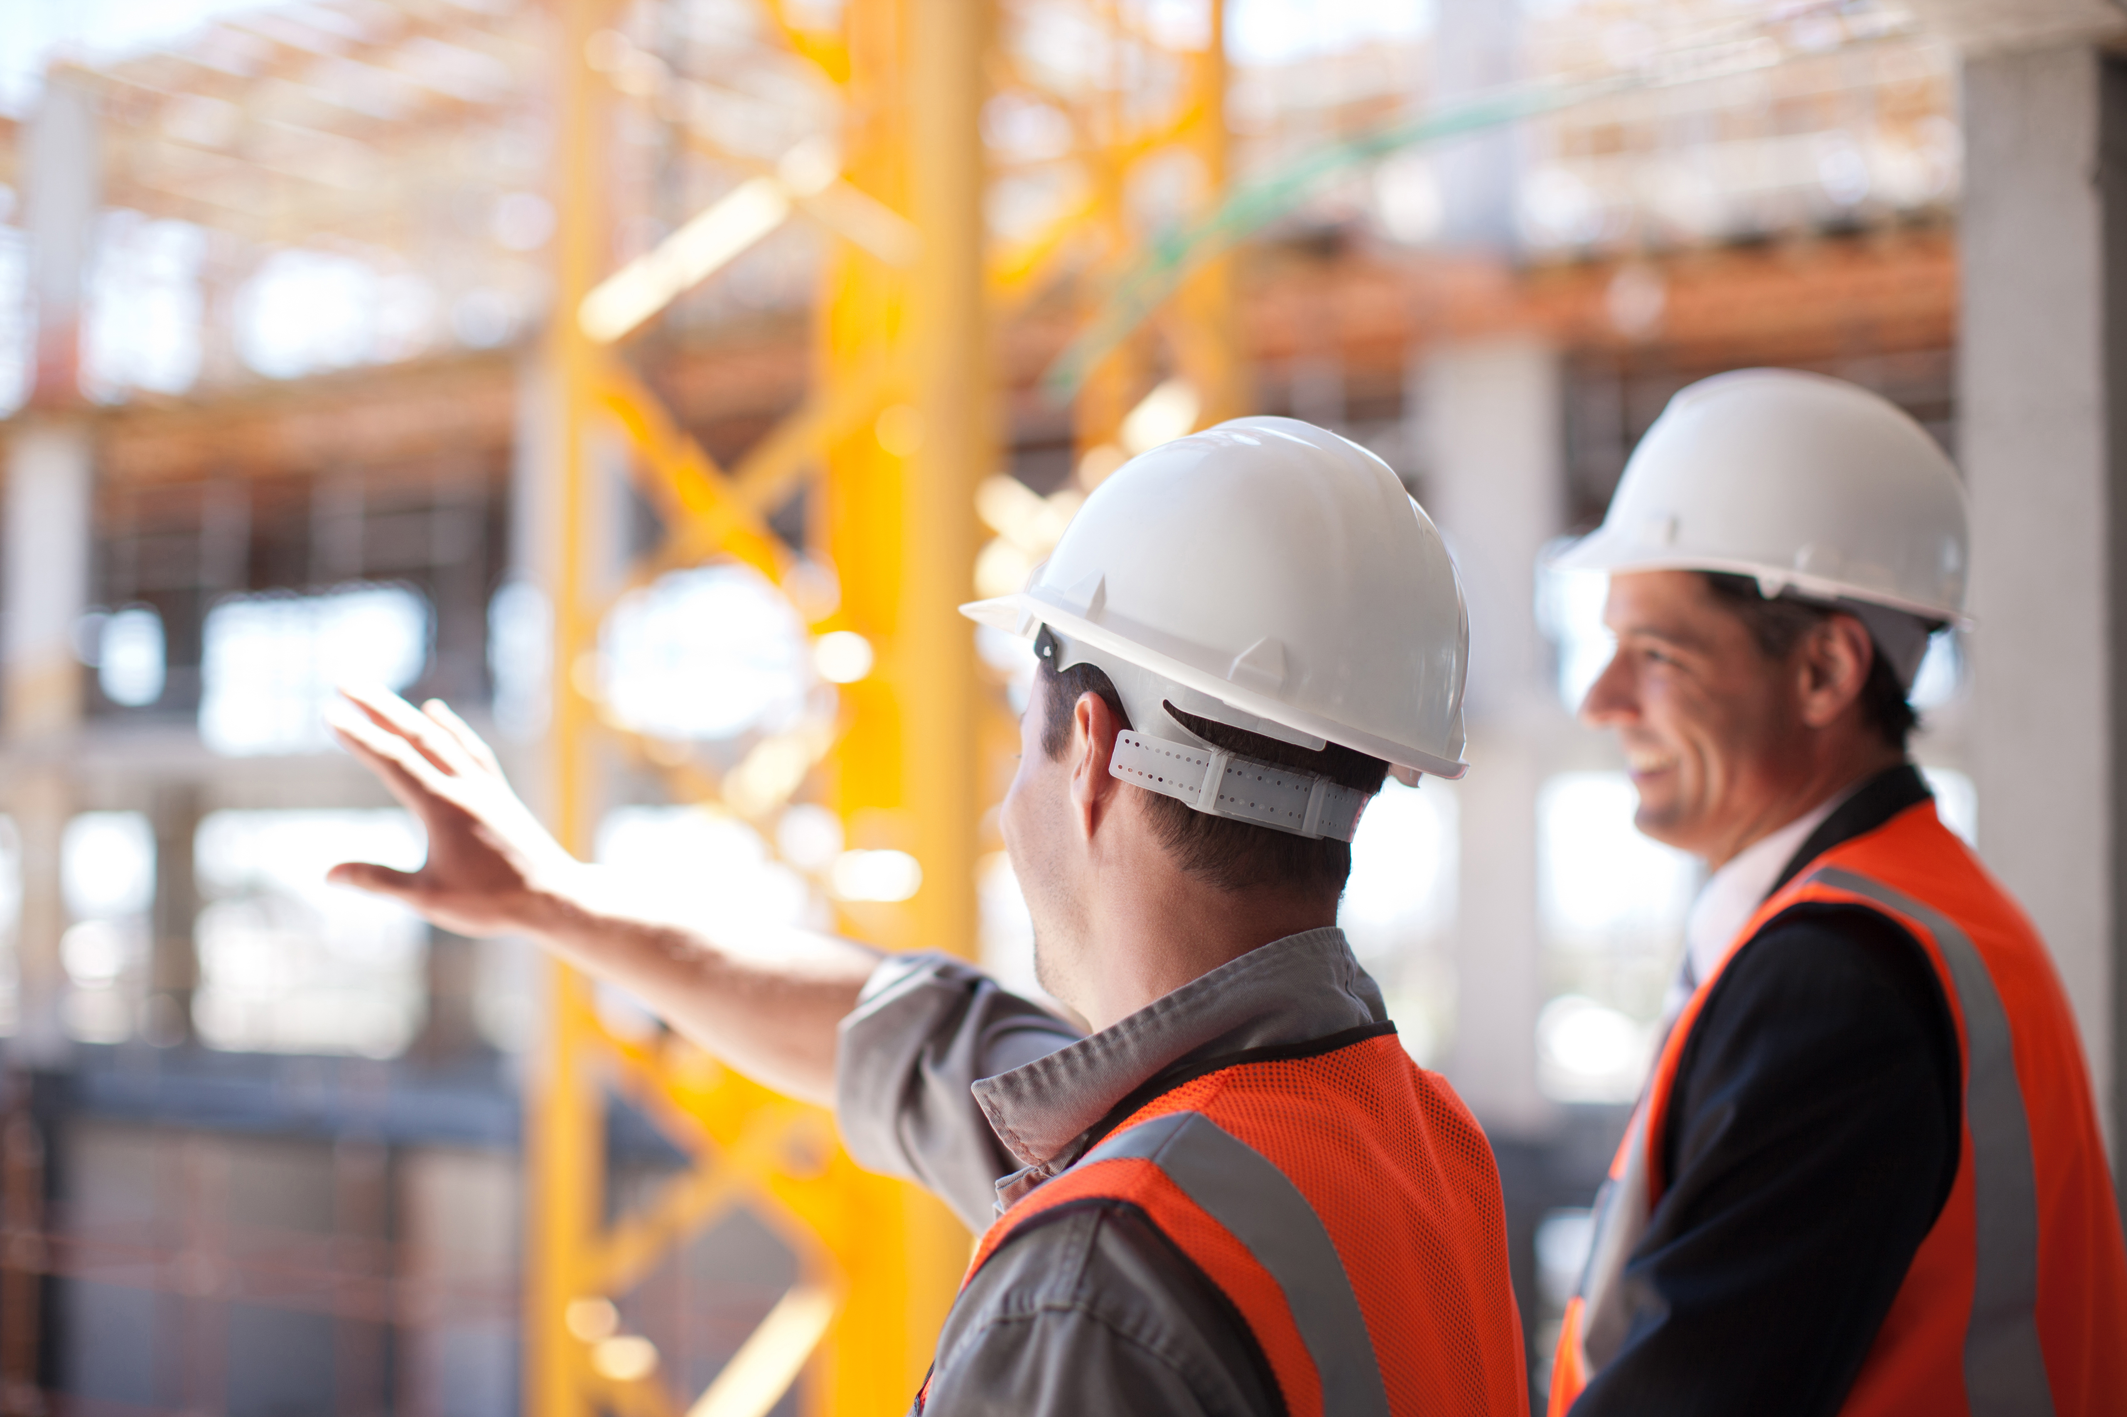
Principles of teamwork
Effective communication between team members.
Constructive working relationships.
Positive attitudes.
Mutual respect.
Reliable team members.
Positive approach to equality and diversity.

Slide 4
Poor teamwork in construction
Ineffective teamwork can lead to many different issues in the construction process including:
conflict and tension
lack of trust
low engagement and productivity
increased risk of accidents and injuries
project delays
low engagement
poor working relationships.

Slide 5
Collaboration and participation
Effective collaboration is most likely to occur with shared values and vision. Team members should be willing to do what it takes to get the job done and possess trust, honesty and mutual respect for one another. Clear, effective communication is key along with the sharing of information.
Promoting collaboration
Promote equal contribution.
Employee suggestion schemes.
Focus on solutions.
Respect and share opinions.
Create a positive working environment.

Slide 6
Team members
Each team member brings a specific skill set and expertise to the project. All construction team members should have:
a complete understanding of the common goals and project timeline
open and honest communication (moving away from a blame culture and encouraging learning)
commitment to the quality and value of the project
respect for and trust in the other team members.

Slide 7
Team interaction
Interrelationships and team interaction are key parts of teamwork. It is important that communication about project progress is:
Regular and frequent
Daily updates on site noticeboards.
Onsite meetings to discuss progress and plans.
Clear and simple
Notices should be clear, concise, short and informative for all personnel to interpret.

Slide 8
Valuing others
All team members should feel valued and promote a culture of trust and loyalty. There should be a common commitment to making the project successful. Valuing others and being aware of the benefits of diversity in the team involves making a real effort to ensure that everyone is treated fairly and equally.
A company that values its workforce should ensure it provides a healthy and safe environment, appropriate equipment and opportunities for personal development and career progression.

Slide 9
Good Team Dynamics
Good team dynamics are essential for achieving shared goals and fostering a productive work environment. A strong team is built on a foundation of trust, where members feel confident in each other’s intentions and abilities. Effective communication ensures that ideas, feedback, and concerns are clearly expressed and understood, while active participation encourages everyone to contribute their skills and perspectives. Accountability and reliability mean that each member takes responsibility for their tasks and can be depended upon to follow through. Cooperation and support create a collaborative atmosphere where individuals help one another and work towards common objectives. Teams also thrive when members have a solid knowledge of the trade, business, product, or service, allowing them to make informed decisions. Finally, adaptability enables the team to respond to challenges and changes with flexibility and resilience. Together, these qualities create a dynamic, high-performing team.

Slide 10
Any questions?

