Slide 1
PowerPoint 2: Collaborative working
PowerPoint presentation
9. Relationship management in construction
9.3 Collaborative working to project delivery and reporting

Slide 2
The importance of collaboration
Collaborative working practices are an essential component in the construction process. Establishing collaborative practices is particularly important when creating building design.
The construction phase of a programme involves many different disciplines working together and alongside one another to deliver the project requirements. Good collaboration and working relationships can aid productivity and improve quality of work.

Slide 3
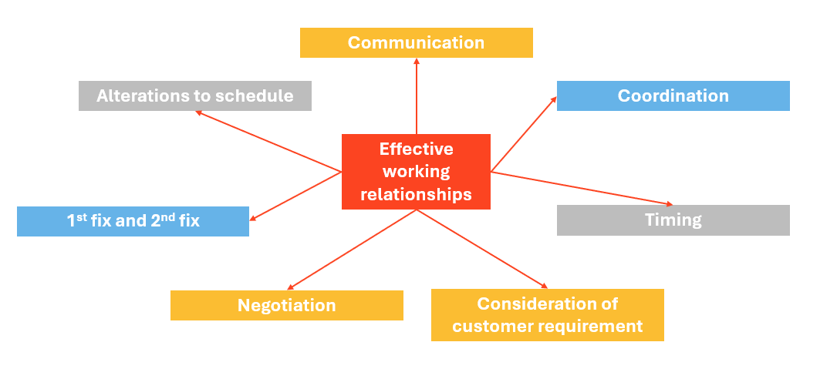
Effective working relationships

Slide 4
Benefits of collaborative working practices
Good quality of work.
Positive public and industry reputations.
Projects delivered in line with agreed timelines.
Good cost control.
Less issues arising during the construction process.
Increased productivity and morale.

Slide 5
Building information modelling (BIM)
The use of BIM is growing in the construction industry. Adopting BIM processes allows for information to be clearly disseminated between the people involved in the project planning, design and delivery.
Using BIM can create a collaborative working platform that identifies clashes and enables information to be stored on one platform.

Slide 6
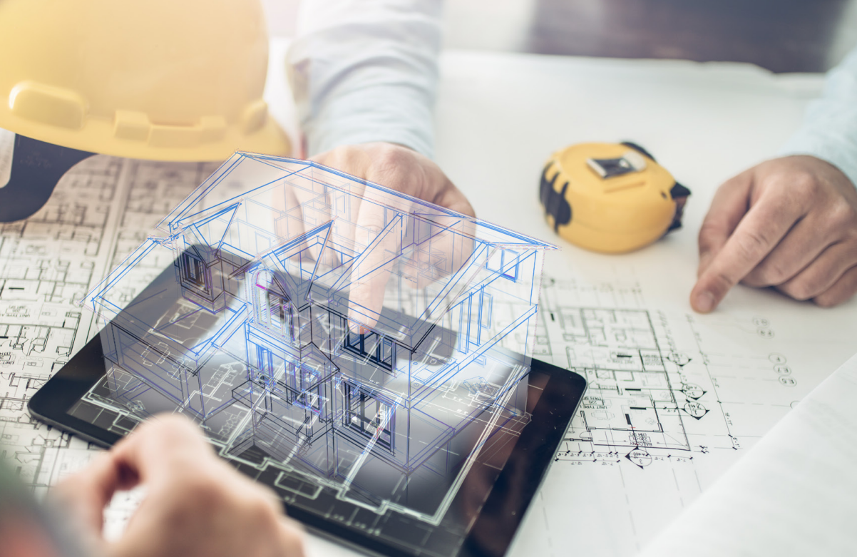
BIM Level 2
The government has now made BIM Level 2 mandatory on all public projects to embed more collaborative working practices in the industry. BIM Level 2 means information is shared and accessible within the project team. By using BIM on publicly-funded projects the government hopes to increase uptake, reduce issues relating to design and minimise waste: all significant problems in the construction sector.
Contractors involved in publicly-funded projects must demonstrate compliance before funding can be released.

Slide 7
Promoting collaborative working
Regular site meetings: to relay information between project team members and the client.
Toolbox talks: regular or daily informal meetings to discuss health and safety issues, working equipment or general project information.
Structured working programme: many disciplines are involved in the construction process. A well-structured programme can reduce conflict between trades during construction.
Workflow software packages can optimize results and thus improve communication with staff.
Staff appraisals can encourage positive working relationships.

Slide 8
Any questions?

