Slide 1
PowerPoint 1: Roles and responsibilities
9. Relationship management in construction
9.1 Stakeholders
9.2 Roles expectations and interrelationships
PowerPoint presentation

Slide 2
Stakeholders
The term ‘stakeholder’ refers to anyone who has an interest in a project and can influence its success. Construction projects can be complex and involve different types of stakeholder.

Slide 3
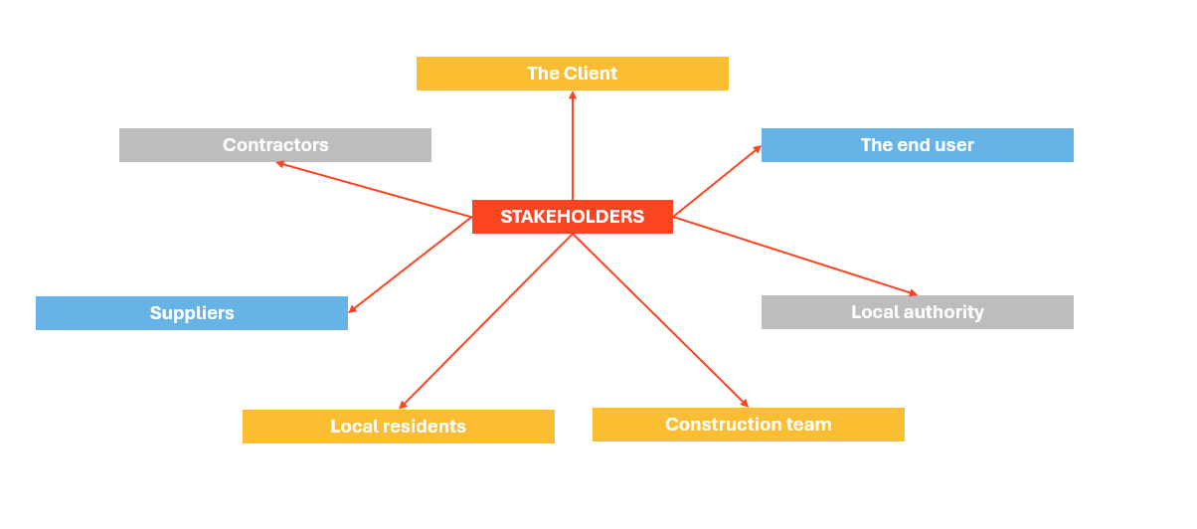
Stakeholders
Stakeholders can differ depending on the size and scope of a project. Project stakeholders may include the following.

Slide 4
Types of stakeholder
Direct stakeholders are those who are directly involved or associated with a project.
Indirect stakeholders are those indirectly involved in a project – for example, local government, professional bodies and support staff.
Positive stakeholders are those who are likely to have a favourable impact on a project, such as contractors who are gaining financially from a project’s delivery.
Negative stakeholders are those who are not directly involved in a project but who are affected by the project, such as local residents who may be adversely affected.

Slide 5
Stakeholder management
For the successful planning and delivery of a project, stakeholders must be clearly identified and their involvement and needs addressed. Failure to communicate effectively with stakeholders may lead to issues with finances and project timelines.
Management strategies should be in place to try and meet the needs of all relevant stakeholders so as to to avoid disputes and conflicts arising.

Slide 6
Stakeholder management plan
Points to consider …
Who are the stakeholders?
What responsibilities are there towards the stakeholders?
What strategies are in place to manage and communicate with the stakeholders?
What threats or challenges do the stakeholders present?

Slide 7
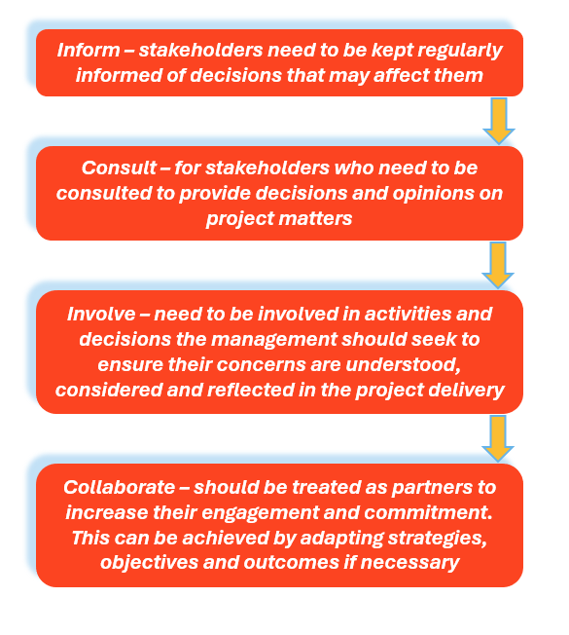
Stakeholder management process

Slide 8
Project management hierarchy
The project management hierarchy involves professionals being ranked from top to bottom in relation to their roles and responsibilities. This enables clear understanding of the project structure and expectations.
The project team should be clearly structured and outlined to promote collaborative practices.

Slide 9
Corporate social responsibility (CSR)
Corporate social responsibility or CSR is the belief that companies should have a positive impact on the surrounding and local community.
Many construction companies now employ ‘social value managers’ to oversee how a company is contributing to the local environment (positive or negative).

Slide 10
What does CSR involve?
Creating well designed buildings that contribute to quality of life and wellbeing.
Supporting education providers and programmes.
Contributing to and participating in charitable events and activities.
Minimising waste.
Supporting apprenticeships and work experience programmes.

Slide 11
Cost control measures
Cost control is a key part of construction management and involves managers monitoring and keeping track of labour, materials and overhead costs to ensure the project finishes on budget.
A cost plan can be used to monitor expenses. The purpose of a cost plan is to allocate the budget to the main elements of a project to provide a basis for cost control.

Slide 12
Measures to improve cost control
Thorough estimates.
Effective communication.
Appointing trusted subcontractors.
Limited variations.
Regular meetings and updates.

Slide 13
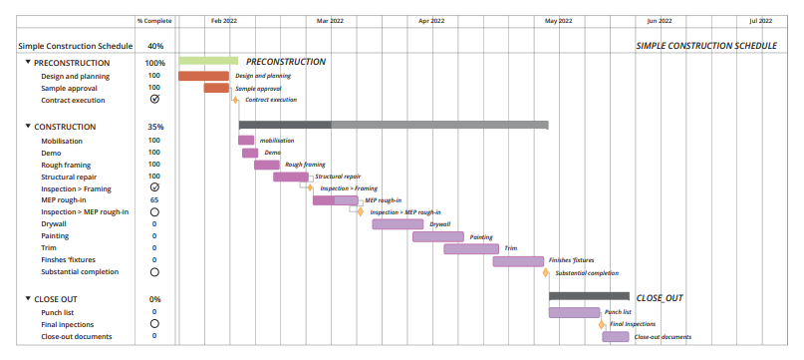
Time management methods
Time management is a crucial part of a construction project to ensure you are meeting deadlines, managing the budget and achieving profitability. If time is not managed efficiently, unnecessary costs and delays may result.

Slide 14
Time management planning
Time management planning should take account of:
accident and emergencies
staff upskilling and training
equipment breakdowns
missed and delayed deliveries by suppliers
poor weather conditions
staff holidays and sickness.

Slide 15
Handover
The handover of the site to the client takes place once the works defined in the contract are complete. A handover meeting should be scheduled to take place following an inspection of the site.
During handover, the client should be issued with:
Any keys, fobs or controls for the property
Key documents such as a draft building owner’s manual, building logbook, building user’s guide
All certificates, warranties and statutory approvals
Equipment test certificates (e.g. for lifts, boilers, air conditioning, etc)

Slide 16
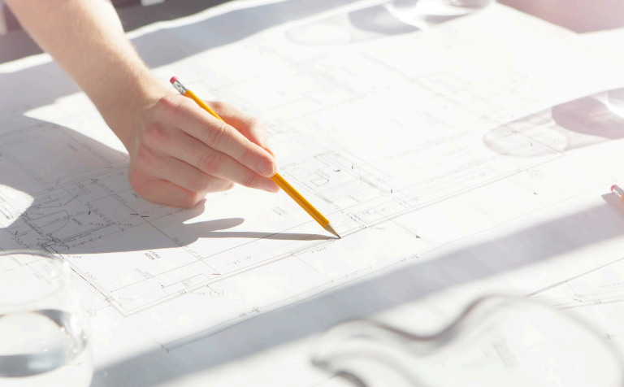
Handover and BIM
If BIM has been used in the development, data will also be handed over to the client at this time.
BIM data at handover provides the client with a complete record of the building including:
floor plans
materials used
required maintenance schedules for products and services.
Notes:
See https://www.designingbuildings.co.uk/wiki/Handover_construction_site_to_the_client.

Slide 17
Follow up
Measures should be taken to ensure a smooth transition from the construction stage to the occupation of the building.
For example, a defects reporting procedure should be agreed, and access arrangements should be arranged for defects to be resolved.
Depending on the agreements made at the start of the project, there may be additional aftercare requirements. These can be short term or long-term depending on the contract and building type.
Aftercare might include helping the occupants understand the features of the development, fine-tuning the building systems, or helping facilities managers learn to operate the building.

Slide 18
Project management roles
The architect is responsible for the design and aesthetic vision of the project, ensuring it meets both client needs and regulatory standards. The clerk of works acts as the client’s on-site representative, inspecting workmanship and materials to ensure quality and compliance with specifications. The quantity surveyor manages project costs, preparing estimates, budgets, and financial reports to ensure the project remains financially viable. The contracts manager oversees contractual agreements, ensuring all parties meet their obligations and resolving any disputes that arise..

Slide 19
Project management roles
The site manager handles the day-to-day operations on-site, coordinating trades, managing schedules, and ensuring health and safety regulations are followed. Finally, the project manager leads the overall planning, execution, and completion of the project, coordinating between all stakeholders to ensure objectives are met on time and within budget. Each role is vital to the smooth and successful execution of a construction project.

Slide 20
Any questions?

