Slide 1
PowerPoint 6: Structural science principles
PowerPoint presentation
2. Construction science principles
2.6 Structural science principles

Slide 2
The effects of forces on buildings
Gravity, weather elements, earthquakes and occupation all transmit forces onto a building’s primary superstructure.
It is critical that calculations during building design ensure buildings and materials used can withstand the forces acting upon them.
Loads can be live or dead. Dead loads are static, and might include walls, ceilings and floors. Live loads are variable or moving and come from the occupation of the building (eg furniture, equipment, people).
Beams and columns are the main parts of a structural frame. Beams transfer the total load to the columns, and columns carry it to the foundations, providing stability to the structure.

Slide 3
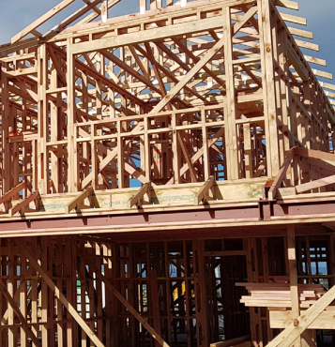
Forces
Compression and torsion stress – compression is the force ‘crushing’ a material and torsion is the twisting force applied by rotation.
Tension is a ‘tearing apart’ force and acts, for example, on ties and struts in a roof.
Bending is the amount of force and its distance from the reaction point: the ‘bending moment’.
Shear – when a bolt grips two structural members together it can be sheared in half by any axial force.

Slide 4
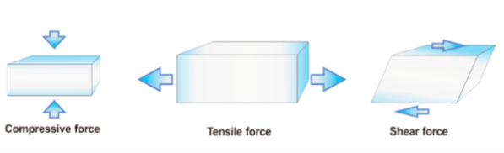
Compression, tension, shear

Slide 5
Loads and material properties
Three types of load will act upon structures.
Vertical – a vertical load is a ‘straight-down’ force acting under gravity.
Horizontal – forces such as the wind pressing on the side of a building or structure.
Longitudinal – forces along a length, such as tension in a railway rail due to heat expansion in the summer.

Slide 6
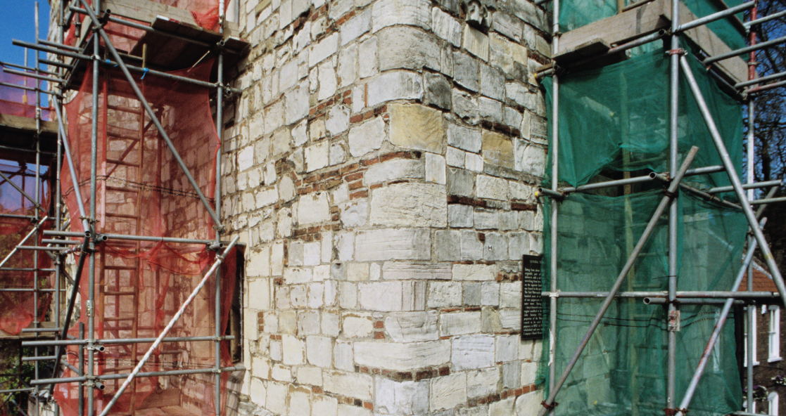
Load-bearing structures
Structures within a building can be load-bearing. A load-bearing wall supports vertical load and is an active structural element of a building.
It transfers loads from other parts of the structure to the foundations. Loads supported include those from the roof, the walls and the floors.
The use of load-bearing walls dates back to the earliest forms of construction. ‘Skeleton frame’ construction is used in high-rise buildings instead, which allows for multiple floors and greater building heights.

Slide 7
Material properties for load-bearing
Wrought iron (that has been heated and worked into shape) has a much higher tensile strength than cast iron (molten metal poured into a mould). Because it resists fatigue, it was used for horizontal beams in construction (eg bridges). Steel is now more commonly used instead.
Strength – the ability of a material to withstand forces exerted upon it (comparisons can be made across a range).
Malleability – the ability of a material to be changed in shape without failing (eg buckling).
Hardness – the ability of a material to resist impact and remain undeformed.
Elasticity – the ability of a material to stretch and then return back to its original shape.
Notes:
Tutor notes:
An eraser coming back to its original shape after being pressed (Hooke's Law, defines elastic properties of materials but only when force and displacement are proportional. )

Slide 8
Dead and live loads
A dead load is the weight of the structure itself, eg the self-weight of walls, floors, beams, etc.
A live (or imposed) load consists of all the extra loads which are placed on the structure, such as people, furniture and machines, as a result of the building being occupied. These loads move around and change frequently.

Slide 9
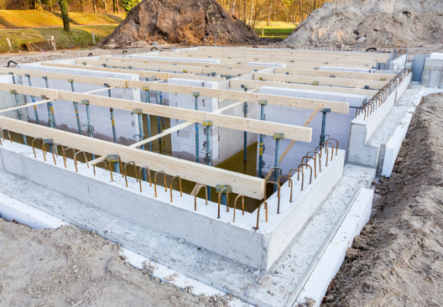

Structural members
Footings, also known as foundations
Walls

Slide 10
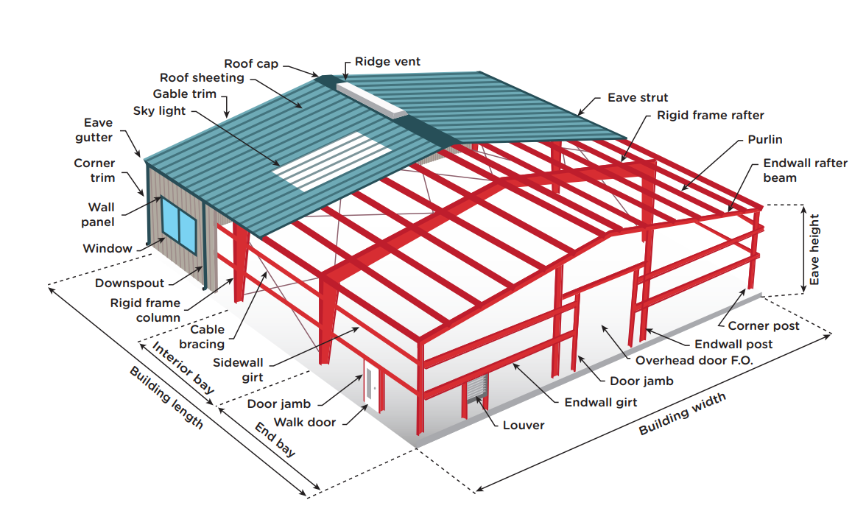
Structural members
Beams and columns

Slide 11
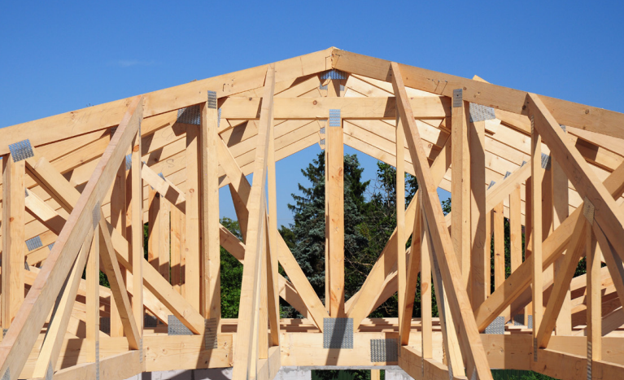
Structural members
Roof trusses
Notes:
https://www.pasquill.co.uk/products/room-in-roof-trusses/

Slide 12
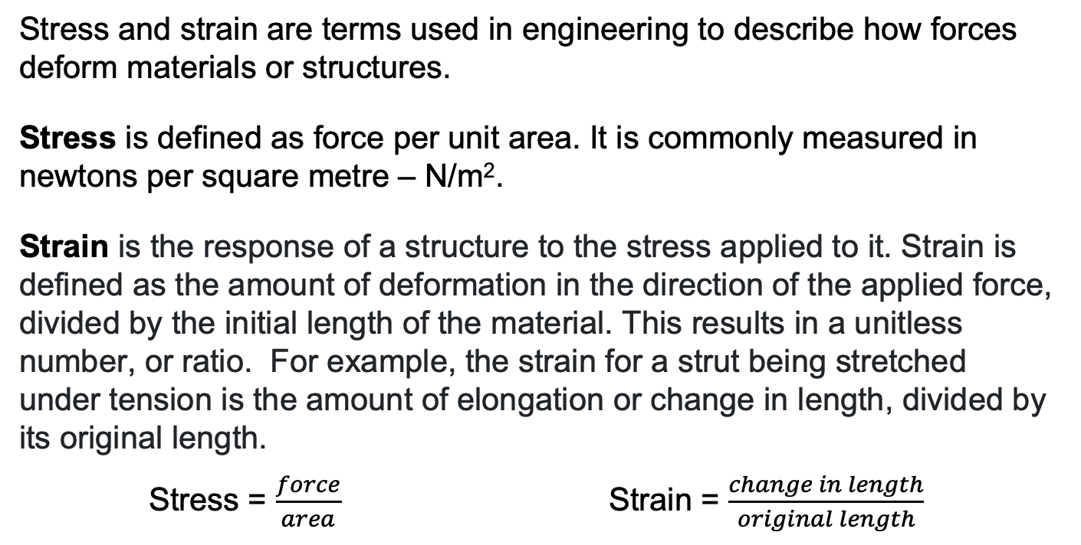
Stress and strain
Stress and strain are terms used in engineering to describe how forces deform materials or structures.
Stress is defined as force per unit area. It is commonly measured in newtons per square metre – N/m².
Strain is the response of a structure to the stress applied to it. Strain is defined as the amount of deformation in the direction of the applied force, divided by the initial length of the material. This results in a unitless number, or ratio. For example, the strain for a strut being stretched under tension is the amount of elongation or change in length, divided by its original length.
Stress = $\frac{force}{area}$ Strain = $\frac{change in length}{original length}$

Slide 13
Calculations for holes and notches
When installing pipework or cabling, floor or ceiling joists may need to be notched or drilled. But this could weaken joists to such an extent that they become structurally unsound.
It is crucial to understand and calculate permitted notching zones and maximum depths of holes and notches.
The location and depth of the hole or notch will depend upon the span of the timber joist and the depth of the timber.
For example, timber of a depth of 200mm can have a hole no larger than 50mm diameter and 25mm depth. Such calculations are subject to quite complex guidance.

Slide 14
Holes and notches
The link below provides a guide to safe hole and notch locations and relative hole sizes.
https://www.labc.co.uk/news/how-get-it-right-notches-holes-solid-timber-joists

Slide 15
Approved document A: Structure
Important calculations conducted in structural design are those for beam, load and column.
Calculations are required by building control in order to comply with Approved document A: Structure which is an approved document from the building regulations.
Calculations must prove that sufficient safety factors have been engineered into a structure so that it is safe for occupation.
Part A covers structural work in steel, concrete, timber, masonry and aluminum, dimensions and thicknesses required, and requirements for foundations, wall cladding and roof covering.

Slide 16
Documentation
Approved document A can be found here:
BR_PDF_AD_A_2013.pdf (publishing.service.gov.uk)
You should thoroughly familiarise yourself with this document.
Notes:
https://www.pbctoday.co.uk/news/category/guides-reviews/building-regulations-documents/

Slide 17
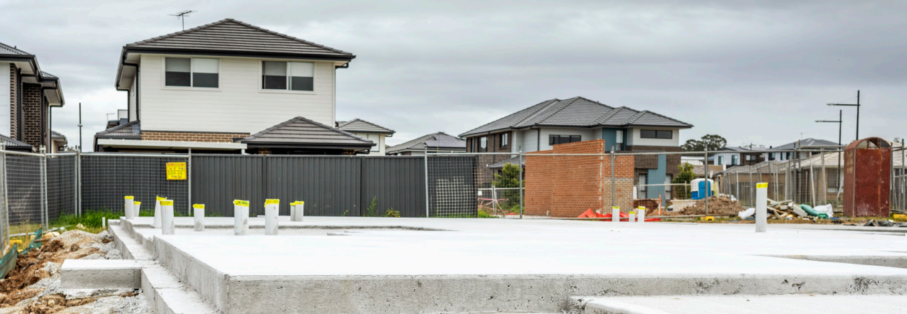
Effects of adjacent structures and environment
It is important to appreciate the effects of adjacent structures, trees, drains, sewers and ground conditions on the design of foundations.
Ground conditions are an important consideration for determining how surface loads are transmitted into the ground safely for the lifespan of the structure. Factors include settlement (compressibility) of the ground, or climatic conditions.
Building over a drain or sewer could cause damage or make access difficult for maintenance or repair. There are therefore regulations governing what is permitted.

Slide 18
Foundations and trees
The link below provides a guide to building near trees and the precautions required in relation to foundations. The growth of nearby trees and roots can cause damage to foundations. This can be avoided by locating structures and services at a safe distance.
NHBC Standards Chapter 4.2 – Building near trees | New Build Inspections

Slide 19
Any questions?

