Slide 1
2.5 Electricity principles
PowerPoint 5: Electrical theory
int entation
2. Construction science principles

Slide 2
Units of measurement revisited
The base SI unit of amperes (A) – often shortened to ‘amp’, measures is the flow of electrons and therefore electrical current (I). For example, standard lighting circuits typically draw about 5A, whereas typical socket outlets are rated at 13A.
Volt (V) is the derived unit for electric potential, electric potential difference (voltage) and electromotive force (generator or battery output). Voltage can be thought of as ‘electrical pressure’.

Slide 3
Units of measurement revisited
An ohm (Ω) is the derived unit of electrical resistance.
A watt (W) is an SI unit of power used to measure the rate of energy transfer.
A coulomb is the derived unit of electrical charge.
A joule is the SI unit for energy over time (ie the amount of electrical power used over time).

Slide 4
Resistance
All conductors show some opposition to electrical current. This opposition to current is called resistance. There are several factors that affect the resistance of a conductor such as:
material – copper is a better conductor than steel as it has a lower resistance, although silver is the best conductor of all
thickness – wires with smaller diameters have greater resistance
length – the longer the wire, the greater the resistance
temperature – heating a wire increases its resistance.
The two main ways of increasing the current in an electrical circuit are by increasing the voltage or by decreasing the resistance.

Slide 5
Conductivity and resistivity
Electrical conductivity is a measure of a material’s ability to conduct electricity – current flow.
Resistance is in opposition to current flow.
Resistivity relates to the conductor material, and is a constant value for a given conductor, measured in ohms/meter (Ω/m).
Think of it in these terms:
Conductors resist very little,
while insulators resist a lot.

Slide 6
Formula for resistance
The resistance formula shown here is very important because it shows that:
resistance is directly proportional to length
resistance is indirectly proportional to area.

Slide 7
Formula for resistance
Increasing the length
increases the resistance
Increasing the area (size)
decreases the resistance

Slide 8
Calculating circuit resistance
When calculating the resistance of a circuit, it is important that its length, size and resistivity are in the same unit.
However, although length and resistivity tend to be represented in metres (m), the sizing of electrical cables tends to come in mm² (cross-sectional area).
As m² = m x m (with each metre = 1000mm), in total there is a six decimal place difference. In other words, when we convert, we divide our cable size in mm² by 1,000,000. In general, it is easier to attach a ‘magic number’: 10ˉ⁶.
Therefore, when converting a 1.5mm² cable it becomes 1.5 x 10ˉ⁶m.

Slide 9
Ohm’s law
Ohm’s law states that voltage (V) = current (I) x resistance (R)
V = IR
The symbol for resistance is R. Resistance is measured in ohms (Ω).
The symbol for voltage is V, it is measured in volts (V).
The symbol for current is I, it is measured in amperes (A).
Example
A torch uses a 3V battery which takes a current of 0.3A.
Calculate the resistance.
V = IR
3 = 0.3 x R
R = 3/0.3
R = 10 Ω
Notes:
For more on Ohms Law see Ohm's Law and resistance - Ohm's Law - National 5 Physics Revision - BBC Bitesize

Slide 10
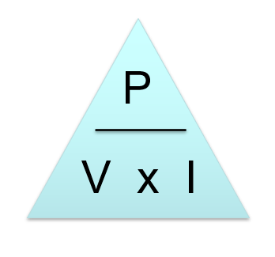
Ohm’s law triangle
The relationship between voltage (V), resistance (R) and current (I) is defined by Ohm’s law and can be show as a simple formula. To help transpose this formula it can be placed into a triangle. To determine a property of a circuit (eg voltage), cover over the V in the triangle with the associated ÷, and you are left with I × R.

Slide 11
Voltage, current and resistance: in series
Current – the amount of current is the same through any component in a series circuit.
The total resistance of any series circuit is equal to the sum of the individual resistances.
The supply voltage in a series circuit is equal to the sum of the individual voltage drop.
Notes:
https://www.allaboutcircuits.com/textbook/direct-current/chpt-5/simple-parallel-circuits/
https://www.allaboutcircuits.com/textbook/direct-current/chpt-5/simple-series-circuits/#:~:text=Current%3A%20The%20amount%20of%20current,of%20the%20individual%20voltage%20drops.

Slide 12
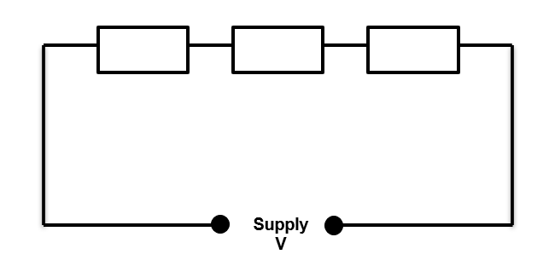
Resistors in series
In the ‘old fashioned’ way of wiring Christmas lights, if one filiment failed, every light went out.
A series circuit of lights is shown here.

Slide 13
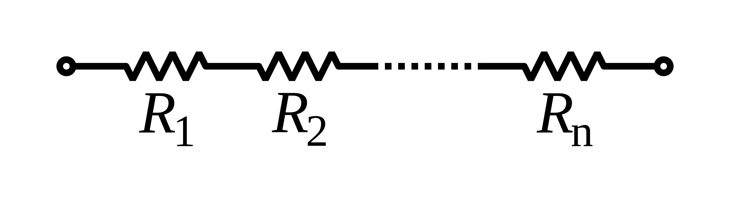
Resistors in series
In series, current is common to all resistors. Unless the resistors are equal, the majority voltage will develop across the biggest resistor.

Slide 14
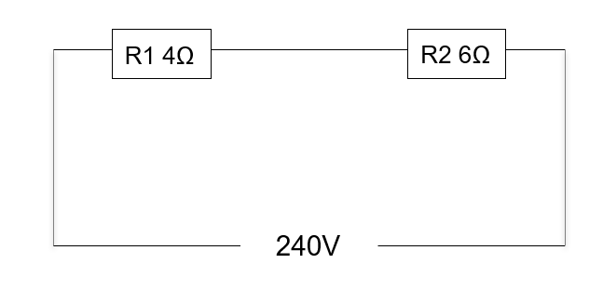
Resistors in series: total resistance
The total resistance for the circuit shown here is calculated as:
Total resistance (RT) = 4 + 6
= 10 Ω

Slide 15
Resistors in series: volt drop
The drawing shows how to calculate the volt drop across each resistor the circuit.
RT = 10Ω
I = 23 A
VD = I x R1
VD = I x R2
VD R1 = 23 x 4
= 92V
VD R2 = 23 x 6
= 138V

Slide 16
Resistors in parallel
In a parallel circuit the voltage is equal across all components.
The total circuit current is equal to the sum of all the individual branch currents.
Individual resistances diminish to equal a smaller total resistance rather than adding together to make the total.
In other words, the total resistance is always less than the smallest value.
This has implications when measuring a given point in a circuit.

Slide 17
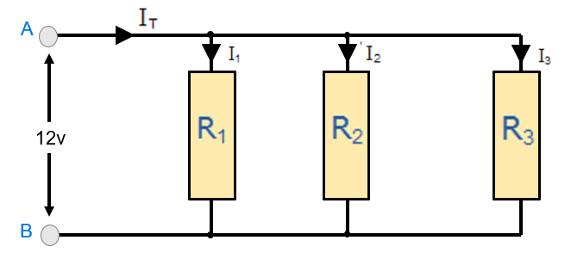
Resistors in parallel
In a parallel circuit:
Voltage is the same and common to all resistors.
Current divides through separate branches.
The total is always less than the smallest value.
Unless resistors are all equal, the majority of the current will flow throught the branch with least resistance.

Slide 18
Calculating resistances in parallel
R1 12Ω
R2 6Ω
40V
You cannot just add the resistor values in a parallel circuit to calculate resistance, and the required equations are complex. Therefore. the easiest method is to use a calculator with mathematical functions.

Slide 19
Look for the Xˉ¹ or 1/x function
R1 12Ω
R2 6Ω
40V
Enter the value of each resistor followed by Xˉ¹:
RT = 12 Xˉ¹ + 6 Xˉ¹
RT = 0.25, then press Xˉ¹ one more time: RT = 4Ω

Slide 20
Given RT = 4Ω
R1 12Ω
Given RT = 4Ω, then,
R2 6Ω
I = V
R
I = 40
4
I = 10A
40V

Slide 21
To calculate the current through each branch
R1 12Ω
IR1 = 40 = 10A
6
IR2 = 40 = 6.67A
6
R2 6Ω
40V

Slide 22
The power triangle
Like the Ohm’s law triangle, the power triangle helps you to remember how to calculate I (current).

Slide 23
Using the power triangle
I = P
V

Slide 24
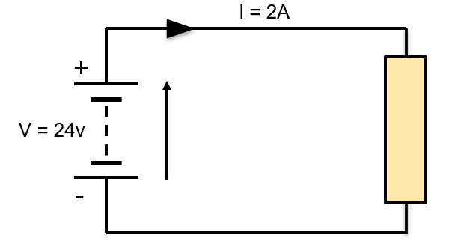
Calculating energy
How much energy is produced over a period of 5 minutes?
Formula for energy:
E = V x I x time in seconds
E = 24 x 2 x 5 (min) x 60 (secs)
E = 14400J or 14.4kJ

Slide 25
Calculating efficiency
Notes:
Speaker notes
Efficiency is expressed as a percentage, and it indicates the relationship between the amount of power that goes in and the amount of power produced. This allows us to compare machines for efficiency. If a machine has a lower percentage rating it is said to be less efficient and therefore has more losses.

Slide 26
Efficiency: calculation example
To calculate the efficiency of a motor if its accepts 3kW of input power but produces 2kW:
Eff = 2000 x 100
3000
Eff = 66.6%

Slide 27
Ammeters
Ammeters measure current (amps). In a circuit it is critically important that the ammeter is connected in series.
In other words, the ammeter is connected within the circuit, and the circuit current flows through it, very much like water flowing through a water meter.
If an ammeter is connected in parallel, then the circuit current could take an alternative route through the ammeter and could possibly destroy it.

Slide 28
Any questions?
Copyright in this document belongs to and is used under licence from the Department for Education, © 2025.
‘T-LEVELS’ and ‘T Level’ are registered trademarks of the Department for Education.
WJEC is authorised by the Department for Education to develop and deliver this T Level Technical Qualification.
WJEC operates in England under the name Eduqas which is a registered trademark of WJEC.

