Slide 1
PowerPoint 1: Tools, equipment and materials and their maintenance requirements
    14. Tools, equipment and materials
PowerPoint presentation
14.1 Methods used to ensure tools, equipment and materials are fit for purpose
14.2 Maintenance of tools, equipment and materials

Slide 2
Objectives
At the end of this session learners should be able to:
  identify the methods to ensure tools, equipment and materials are fit for purpose and the required checks that are undertaken to ensure this
  understand the procedure that should be applied for tools and equipment that fail safety checks
  state the methods of safe supply for electrical tools and equipment on site
  understand the maintenance requirements of tools, equipment and materials.

Slide 3
Tools, equipment and materials
When working in the building services engineering sector of the construction industry, it is important to ensure that all tools, equipment and materials are maintained regularly and are fit for purpose.This is also be known as ‘servicing’ and can be achieved by:
  regular maintenance
  cleaning
  calibration
  safe and correct storage of the tool/equipment.
These routine maintenance principles will increase the working life of tools/equipment and ensure that their accuracy is maintained.

Slide 4
Tools and equipment
If your tools and equipment do not work as intended, you will not be able to complete the job, and you will not get paid.
Poorly maintained tools and equipment can be dangerous and cause harm to yourself or others. Therefore, it is imperative that all the tools and equipment be correctly maintained. In addition, if tools are provided by the employer, they need to comply with the Provision and Use of Work Equipment Regulations 1998 (PUWER).
  If the tool or piece of equipment is blunt, sharpen or change it.
  If the tool or piece of equipment is dirty, clean it.
  If the tool or piece of equipment needs calibration, calibrate it.
  If the tool or piece of equipment needs oiling, lubricate it.

Slide 5
Changing drill bits
When using your drill, the drill bit will soon become blunt and need replacing. It is very important that this procedure is carried out safely to minimise the risks to yourself and others.
Remove drill from the power supply/remove battery to ensure that the drill doesn’t operate when changing the bit.
Ensure that the drill bit is not hot to the touch as this could cause a burn.
Wearing gloves, remove the old bit and replace with the new bit, ensuring it is tightened/inserted correctly.
Reinstate power/battery.
Safely use the drill.

Slide 6
Changing cutting blades
Similarly, your saw/cutter blade will become blunt and need replacing. It is very important that this procedure is carried out safely to minimise the risks to yourself and others.
For a power tool, ensure it is electrically isolated a (always switch off for mechanical maintenance).
Wearing gloves and following any manufacturer’s guidance, remove the old/damaged cutting blade.
Wearing gloves and following any manufacturer’s guidance, fit the new cutting blade, ensuring that it is tightened/inserted correctly.
Safely use the saw/cutter.

Slide 7
Portable appliance testing (PAT)
All electrical power tools or equipment (110V) on a building site must have a PAT test to ensure that it is safe to use. These tests must be completed every 3 months. While most electrical safety defects
can be found by visual examination, some can only be detected by testing, such as:
  Breakdown in insulation, damage to cable sheath
  or badly terminated inner conductors.
  Plug incorrectly wired, incorrect rating of fuse.
As laid down by the Institution of Engineering and Technology (IET) Code of Practice for In-Service Inspection and Testing of Electrical Equipment, all equipment must have its own unique serial number, and all results must be recorded in an appliance register.

Slide 8
Calibration
Most electronic testing equipment requires calibration as stipulated by the manufacturer, usually every 12 months, to ensure it is still working correctly. Calibration is usually completed by the manufacturer of the test equipment, and a calibration certificate may be requested by the Health & Safety Executive (HSE) if there is an incident or accident. Below are examples of electronic equipment that require calibration.
  electronic gas combustion analysers
  electronic gas manometers
  electrical test equipment
  electronic measuring devices.

Slide 9
Cleanliness checks
Another important maintenance requirement is to keep your tools clean. You may be working in a dirty, dusty or wet environment, and must always ensure your tools are clean.
If a tool is dirty:
  defects may be hidden
  it may be dangerous (eg blocked air-ports causing the tool to overheat)
  it could slip out of your hand
  it could clog up and bind.
Your tools are your responsibility.

Slide 10
Daily tool and equipment checks
All tools and equipment should be visually checked for safe operation every day and before and after each use: some may have become damaged since they were last used or be too worn.
Some engineering environments utilise a daily tool check register, whereby tools are checked or accounted for at the beginning of work, halfway through the shift and at the close of work.
  If the tool or piece of equipment is blunt, sharpen or change it.
  If the tool or piece of equipment is dirty, clean it.
  If the tool or piece of equipment needs calibration, calibrate it.
  If the tool or piece of equipment needs oiling, lubricate it.

Slide 11
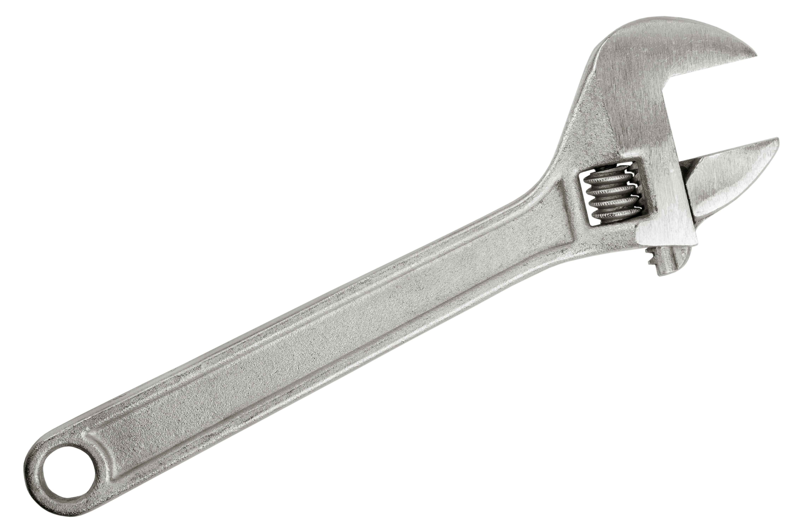
Maintenance of tools
How to maintain an adjustable spanner
Step 1 – Inspect the adjustable spanner.
Step 2 – Remove debris, dirt and corrosion.
Step 3 – Remove worm drive and adjustable jaw.
Step 4 – Replace any worn parts.
Step 5 – Replace the jaw and tighten the worm drive.
Step 6 – Lubricate the spanner.

Slide 12
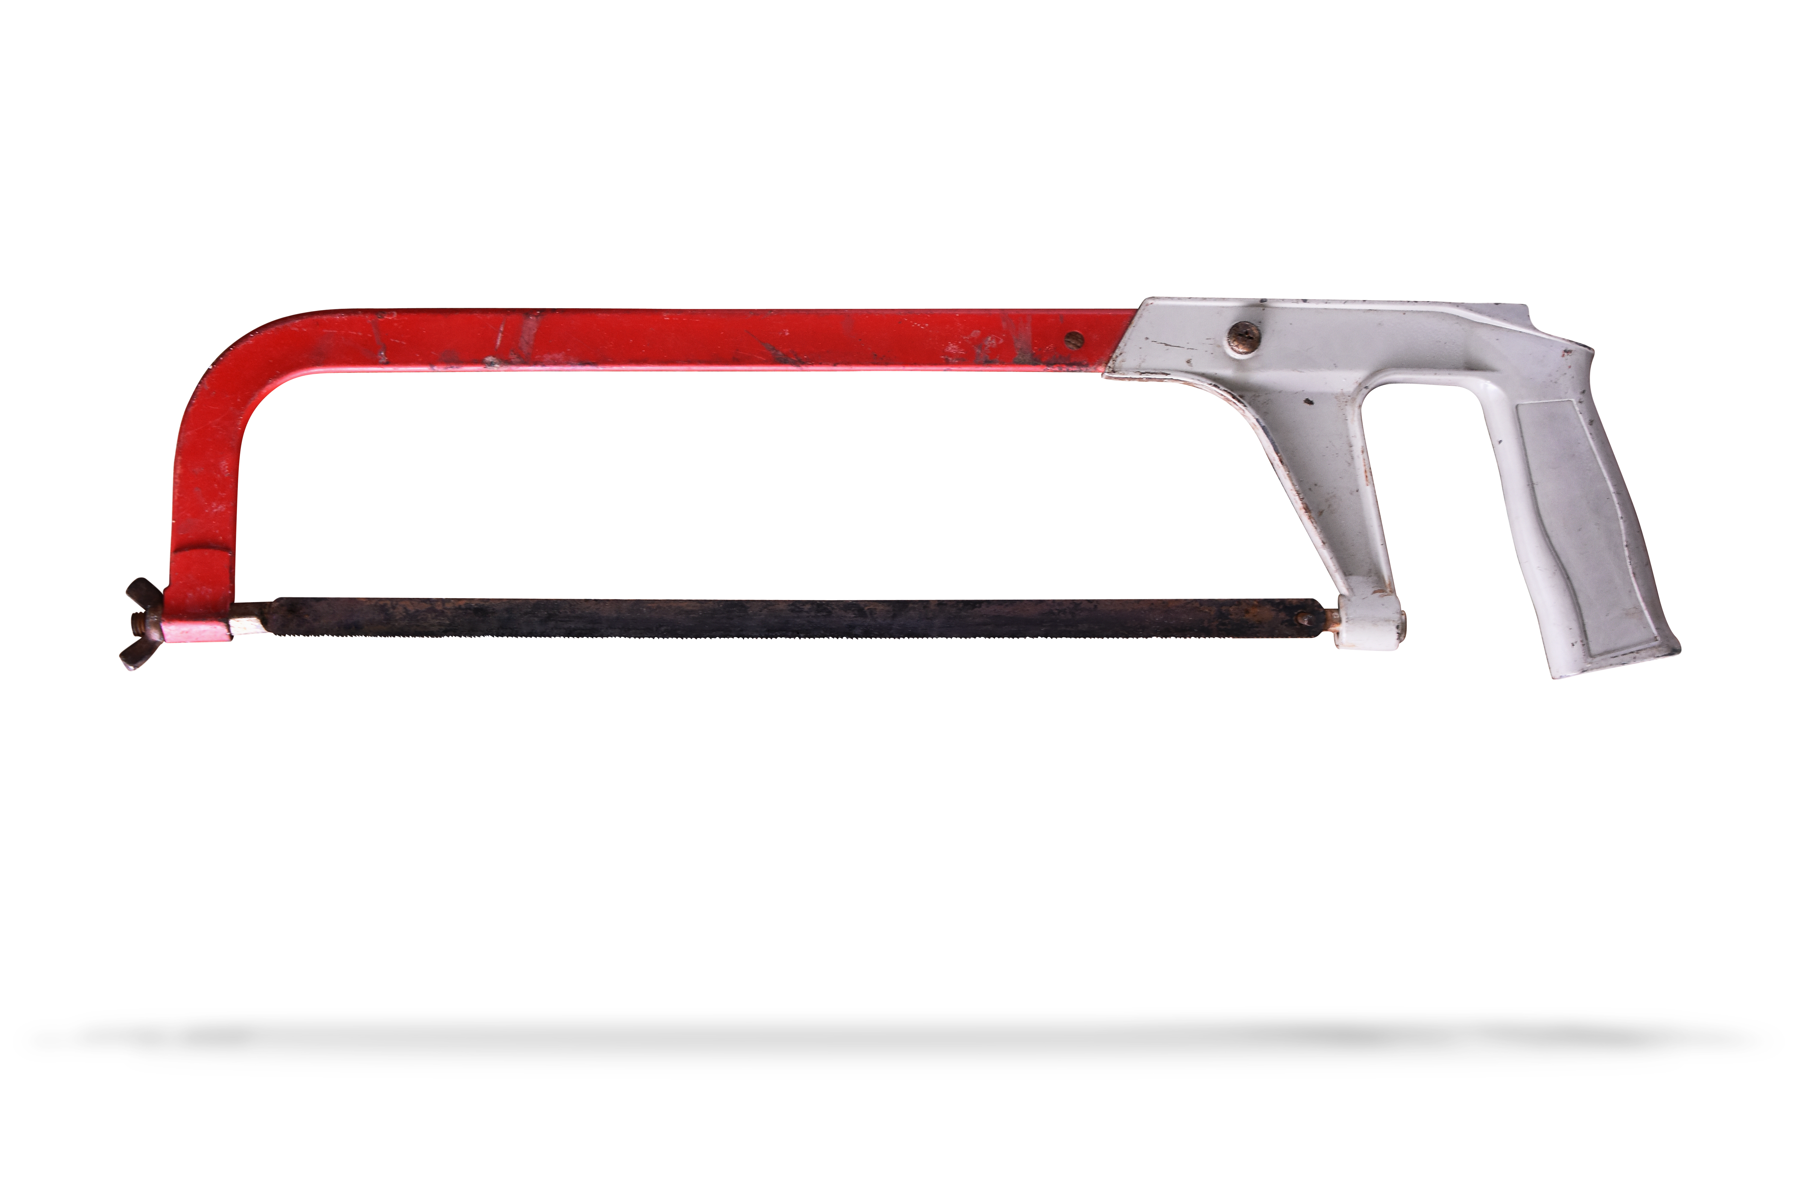
Maintenance of tools
How to maintain a hacksaw
Step 1 – Inspect the hacksaw.
Step 2 – Remove debris, dirt and corrosion.
Step 3 – Remove old cutting blade.
Step 4 – Replace any worn parts.
Step 5 – Replace with new blade.
Step 6 – Lubricate any bolts.

Slide 13
Maintenance of tools
How to maintain a combustion analyser
Step 1 – Inspect the combustion analyser.
Step 2 – Return to service centre annually.
Step 3 – Use as per manufacturer’s guidelines.

Slide 14
Safe storage of tools
You should strive to store your tools safely and carefully so that they will last a long time and be ready for use when required.
If a tool has a storage box/container, use it if possible to provide protection. If not, store the tool where it will not get damaged.
Replacing good quality tools can be expensive: always take good care of them.

Slide 15
Condition reports
A condition report is completed as part of the planned preventative maintenance schedule for a tool or piece of equipment and details the condition of the tool or piece of equipment and whether any remedial maintenance is required. The focus is commonly on areas such as:
  damage to the outside of the tool or piece of equipment;
  whether any parts need replacing
  whether any fluid levels need topping up
  whether the tool or piece of equipment is within its calibration period.
These areas are assessed, and the report is provided to the client to carry out any remedial work required.

Slide 16
Asset registers
An asset register is a resource that details all the different assets owned or managed by a company. For example:
  tools
  equipment
  materials
  vehicles
  offices.
An asset register is an important document for evaluating how much a company is worth.

Slide 17
Materials
When carrying out work in the BSE sector of the construction industry, it is important to remember that your role is to provide the services into the property – plumbing, gas, electricity, drainage, communications, etc. As you are responsible for installations it is important that all materials used:
  are fit for purpose – eg whether they comply with CE (European standards), BS (kite mark for British standards) and/or BASEC (British Approvals Service for Cables)
  are safe: they do not present any hazards to the installation
  are sized and ordered correctly, eg, pipe and cable sizes
  allow for any special requirements, ie any possible future extensions to the installation, such as more radiators or additional bathrooms.

Slide 18
Materials
When taking delivery of any materials, it is important to check their condition, and that the delivery note matches the requisition order. This is because any defects identified on delivery can be discussed immediately. Do not sign for an order until you are satisfied that it is complete and of the correct standard.
Always survey the job and order the correct number of materials to keep costs down and minimise wastage, promoting sustainability.
If there are any unused materials, ensure they are stored correctly and carefully, as they could be used for a different job, saving money and reducing wastage.
Remember: ‘measure twice and cut once’.

Slide 19
Tools that fail safety checks
Any tool that fails a safety check should either be repaired or replaced. This is important as the continued use of that tool will constitute a
danger to you and possibly someone else.
  Tools such as chisels, which are liable to impact damage, need to be checked to ensure their head is not split or mushroomed.
  If a drill bit is broken, it can either be resharpened or replaced.
  If a cutting blade is blunt, it can either be sharpened (chisel, etc) or replaced (hacksaw, etc). This can create waste if copper pipe or electrical cable is cut incorrectly.
  If an electrical power tool is damaged it can either be repaired or replaced.
Any such failure must be actioned immediately.

Slide 20
Tools that fail safety checks
If a tool fails a safety check, take the following steps.
  Remove from service.
  Label as being inoperative.
  Lock away.
  Arrange repair.

Slide 21
Electrical supply
There are three types of electrical supply for power tools and equipment on site:
  230V ac
  110V ac
  4.5V to 54V dc (using a rechargable battery).
All of these can be dangerous, to different extents.

Slide 22
230V supply
Electrical tools that are powered by 230V ac supplies are the most likely to deliver a fatal electric shock if damaged or used incorrectly.
All 230V electrical power tools utilise a 3-pin plug, designed to be plugged into the electrical sockets of a domestic property.
However, in accordance with the Electricity at Work Regulations 1989, 230V power tools are not allowed to be used on construction sites.

Slide 23
110V supply
Electrical tools powered by 110V ac are safer to use than 230V because the voltage is lower. However, they can also be very dangerous if damaged or used incorrectly.
All 110V electrical power tools utilise a yellow industrial socket (‘commando socket’), which is very robust and especially appropriate for hazardous environments. Such sockets must comply with IEC 60309.

Slide 24
Battery power
Batteries for electrical tools can vary in power from 4.5V to 54V dc. This type of power supply is the safest way of powering tools due to the low voltage and use of direct current. However, it is important to note that these tools can be dangerous if damaged or used incorrectly.
All battery powered electrical power tool cells are charged using a battery charger, which can be powered by 230V or 110V.

Slide 25
Any questions?

