Slide 1
PowerPoint 1: Types of maintenance
PowerPoint presentation
13. Maintenance principles
13.1 Types of maintenance

Slide 2
Learning objectives
At the end of the session learners should be able to:
  understand the different types of maintenance
        planned preventative maintenance (PPM)
        reactive maintenance (sometimes referred to as corrective maintenance)
  understand the different types of maintenance plan
  describe typical timeframes between maintenance tasks.

Slide 3
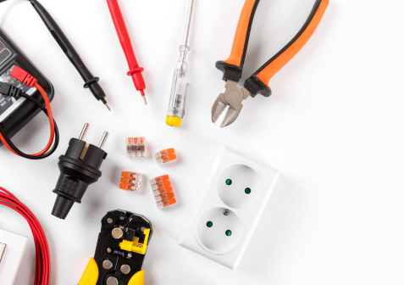
Question
Why do you think it is important to complete regular maintenance on tools, machinery and appliances?

Slide 4

Types of maintenance
Maintenance falls into two categories:
  planned preventative maintenance (PPM)
  reactive maintenance.
These have important roles to play in the BSE sector.

Slide 5
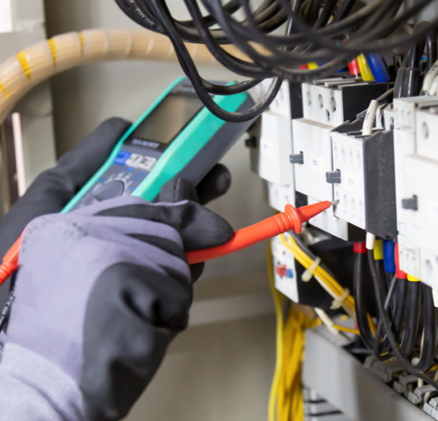
Planned preventative maintenance (PPM)
On larger BSE installations and systems, it may be beneficial to have a planned maintenance schedule, which allows the installation to be checked and serviced at regular intervals to:
  identify any possible failing components
  ensure the system is working at optimum performance.
All maintenance activities should be
recorded in a maintenance logbook,
including the results of any tests
conducted, and the results documented
for future reference.

Slide 6
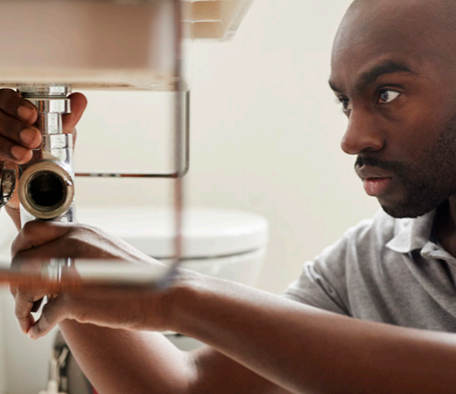
PPM
For example, typical PPM activities for a gas, plumbing and heating engineer include:
  checking and setting float-operated valves to the correct levels
  cleaning out sediment in cold water cisterns
  routine boiler maintenance/servicing
  checking and re-washering taps
  testing above-ground drainage systems
  checking the operation of any safety valves
  and external controls such as stop taps, motorised valves and thermostats.

Slide 7
Reactive maintenance
Typical reactive maintenance scenarios for a gas, plumbing and heating engineer would include:
  burst pipes
  boiler breakdowns
  blockages
  dripping taps
  running overflows
  no heating or hot water.

Slide 8
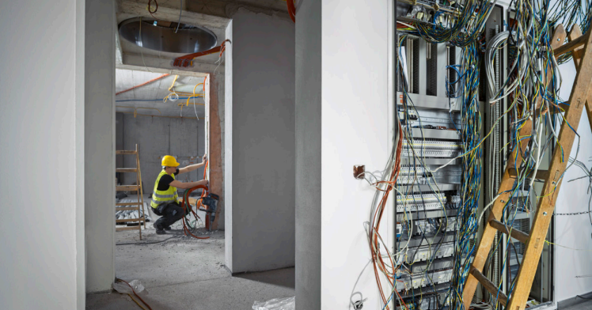
System types
There are many different systems in the building services engineering sector which all require different PPM as well as having potential reactive maintenance requirements.
These include:
  heating systems
  boiler systems (service and repair by a
  Gas Safe registered engineer)
  water services
  firefighting equipment
  fire detection and smoke alarm systems
  intruder alarm systems.

Slide 9
System types
Other systems in the sector requiring PPM and possible reactive maintenance are:
  wiring and electrical installation systems
  ventilation systems
  air conditioning systems
  drainage systems
  lighting systems, including emergency lighting
  communication and data systems.
PPM ensures continuous and uninterrupted system functioning.

Slide 10
Timeframes for PPM
The timeframes set for PPM activities are usually set in relation to how often the system or component will be used and for how long.
For example, if a domestic central heating system in a holiday home is only used for 12-hours a day for 3-months of the year then a yearly check would be adequate. However, if an industrial/commercial central heating system in a hospital is running for 24-hours a day, 365-days a year, then the timeframes between PPM activities will need to be reduced to, say, every 3-months.
In addition, for systems such as those in hospitals, there should be a back-up supply to ensure continuity of service, should the primary system fail.

Slide 11
Any questions?

