Slide 1
PowerPoint 9: Natural and mechanical ventilation systems
PowerPoint presentation
12. Building services engineering (BSE) systems
12.1 Building services engineering systems

Slide 2
Objectives
By the end of this session learners should be able to:
explain why ventilation is provided in buildings
list the main types of ventilation systems in buildings
describe the operation of two types of ventilation system
discuss the advantages and disadvantages of ventilation systems.

Slide 3
Why ventilate a building?
Provide air for respiration.
Preserve the correct level of oxygen in the air.
Control the carbon dioxide content in the air.
Control moisture content in the air.
Remove excess heat from rooms.
Dispose of odours, dust, smoke, etc.
Remove stagnant air.

Slide 4
Natural and mechanical ventilation
Natural ventilation is brought about by:
the wind effect (natural external air currents)
the stack effect (warm air is displaced by cold air).
Mechanical ventilation is brought about by:
extraction systems (eg in kitchens, toilets etc)
supply systems
balanced ventilation systems.

Slide 5
Natural single-sided ventilation
Single-sided ventilation occurs due to the ‘stack effect’ created by less dense warm internal air being displaced by denser external colder air.
Vents or louvres are installed at the top or bottom of window frames or in the building’s fabric.
This type of ventilation is not recommended for deep rooms.

Slide 6
Natural cross ventilation
Cross ventilation is driven by wind pressure on the windward side of the building forcing fresh air through louvres into the room and out the other side (to the leeward), where the external air pressure will be reduced.

Slide 7
Natural and passive stack ventilation
Natural stack ventilation occurs naturally in tall buildings such as factories.
Inlet louvres at low level allow external air to be drawn into the space.
Permanent louvres on the roof allow vitiated warm air to flow out of the building.
Passive stack natural ventilation is commonly found in bathrooms and kitchens simply because heat rises.

Slide 8
Combined stack and cross ventilation
Combines stack (warm air rising) with wind, to maximise ventilation.
Unlike cross ventilation, stack ventilation allows some passive cooling in the summer.

Slide 9
Adjustable permanent vent
This type of vent provides natural ventilation by allowing fresh, cold air to be mixed with recirculated room air, utilising a natural convector installed beneath a window frame.
Such vents are built into the window frame, giving the user some control over the amount of air entering the building.
Ventilation is driven by the wind and stack effects.

Slide 10
Mechanical wind catcher
As the name suggests this ventilator is designed to ‘catch’ the wind flow.
The wind pressure forces fresh air into the building which in turn displaces the vitiated internal air.
Directional diffuser vanes direct away from the exhaust air.
Efficiency depends upon the wind velocity.
In no wind situations, a stack effect will give some venting.

Slide 11
Mechanical tempered air supply ventilation
Tempered air supply ventilation is a type of displacement ventilation providing sufficient air to maintain a safe and healthy internal environment.
An air handling unit, which is normally installed on the roof, contains a fresh air inlet, a filter to remove dust, a heater battery to warm the air prior to circulation and a centrifugal fan.
The amount of air supplied is based on the expected population of the building, i.e. 10-litres per second per person.
Duct sizing is based on the amount of air required per room.
The building will have an additional heating system for the heat loss.

Slide 12
Extraction: mechanical heat recovery
Commercial kitchens generate a large amount of heat through the cooking process, which has to be removed by mechanical extraction. The working environment would be very uncomfortable if this heat was not removed.
In addition, gas appliances require a large amount of air for combustion in the ovens.
Heat generating appliances are grouped beneath a canopy to capture the vitiated air for extraction.
The energy used in the extraction process preheats the fresh air being supplied by passing through a heat exchanger in the air handling unit.

Slide 13
Mechanical fume extraction at source
An extraction hood close to a workstation removes fumes and pulls fresh air past the worker’s face.
The hood will either be connected to a single fan or a header system.

Slide 14
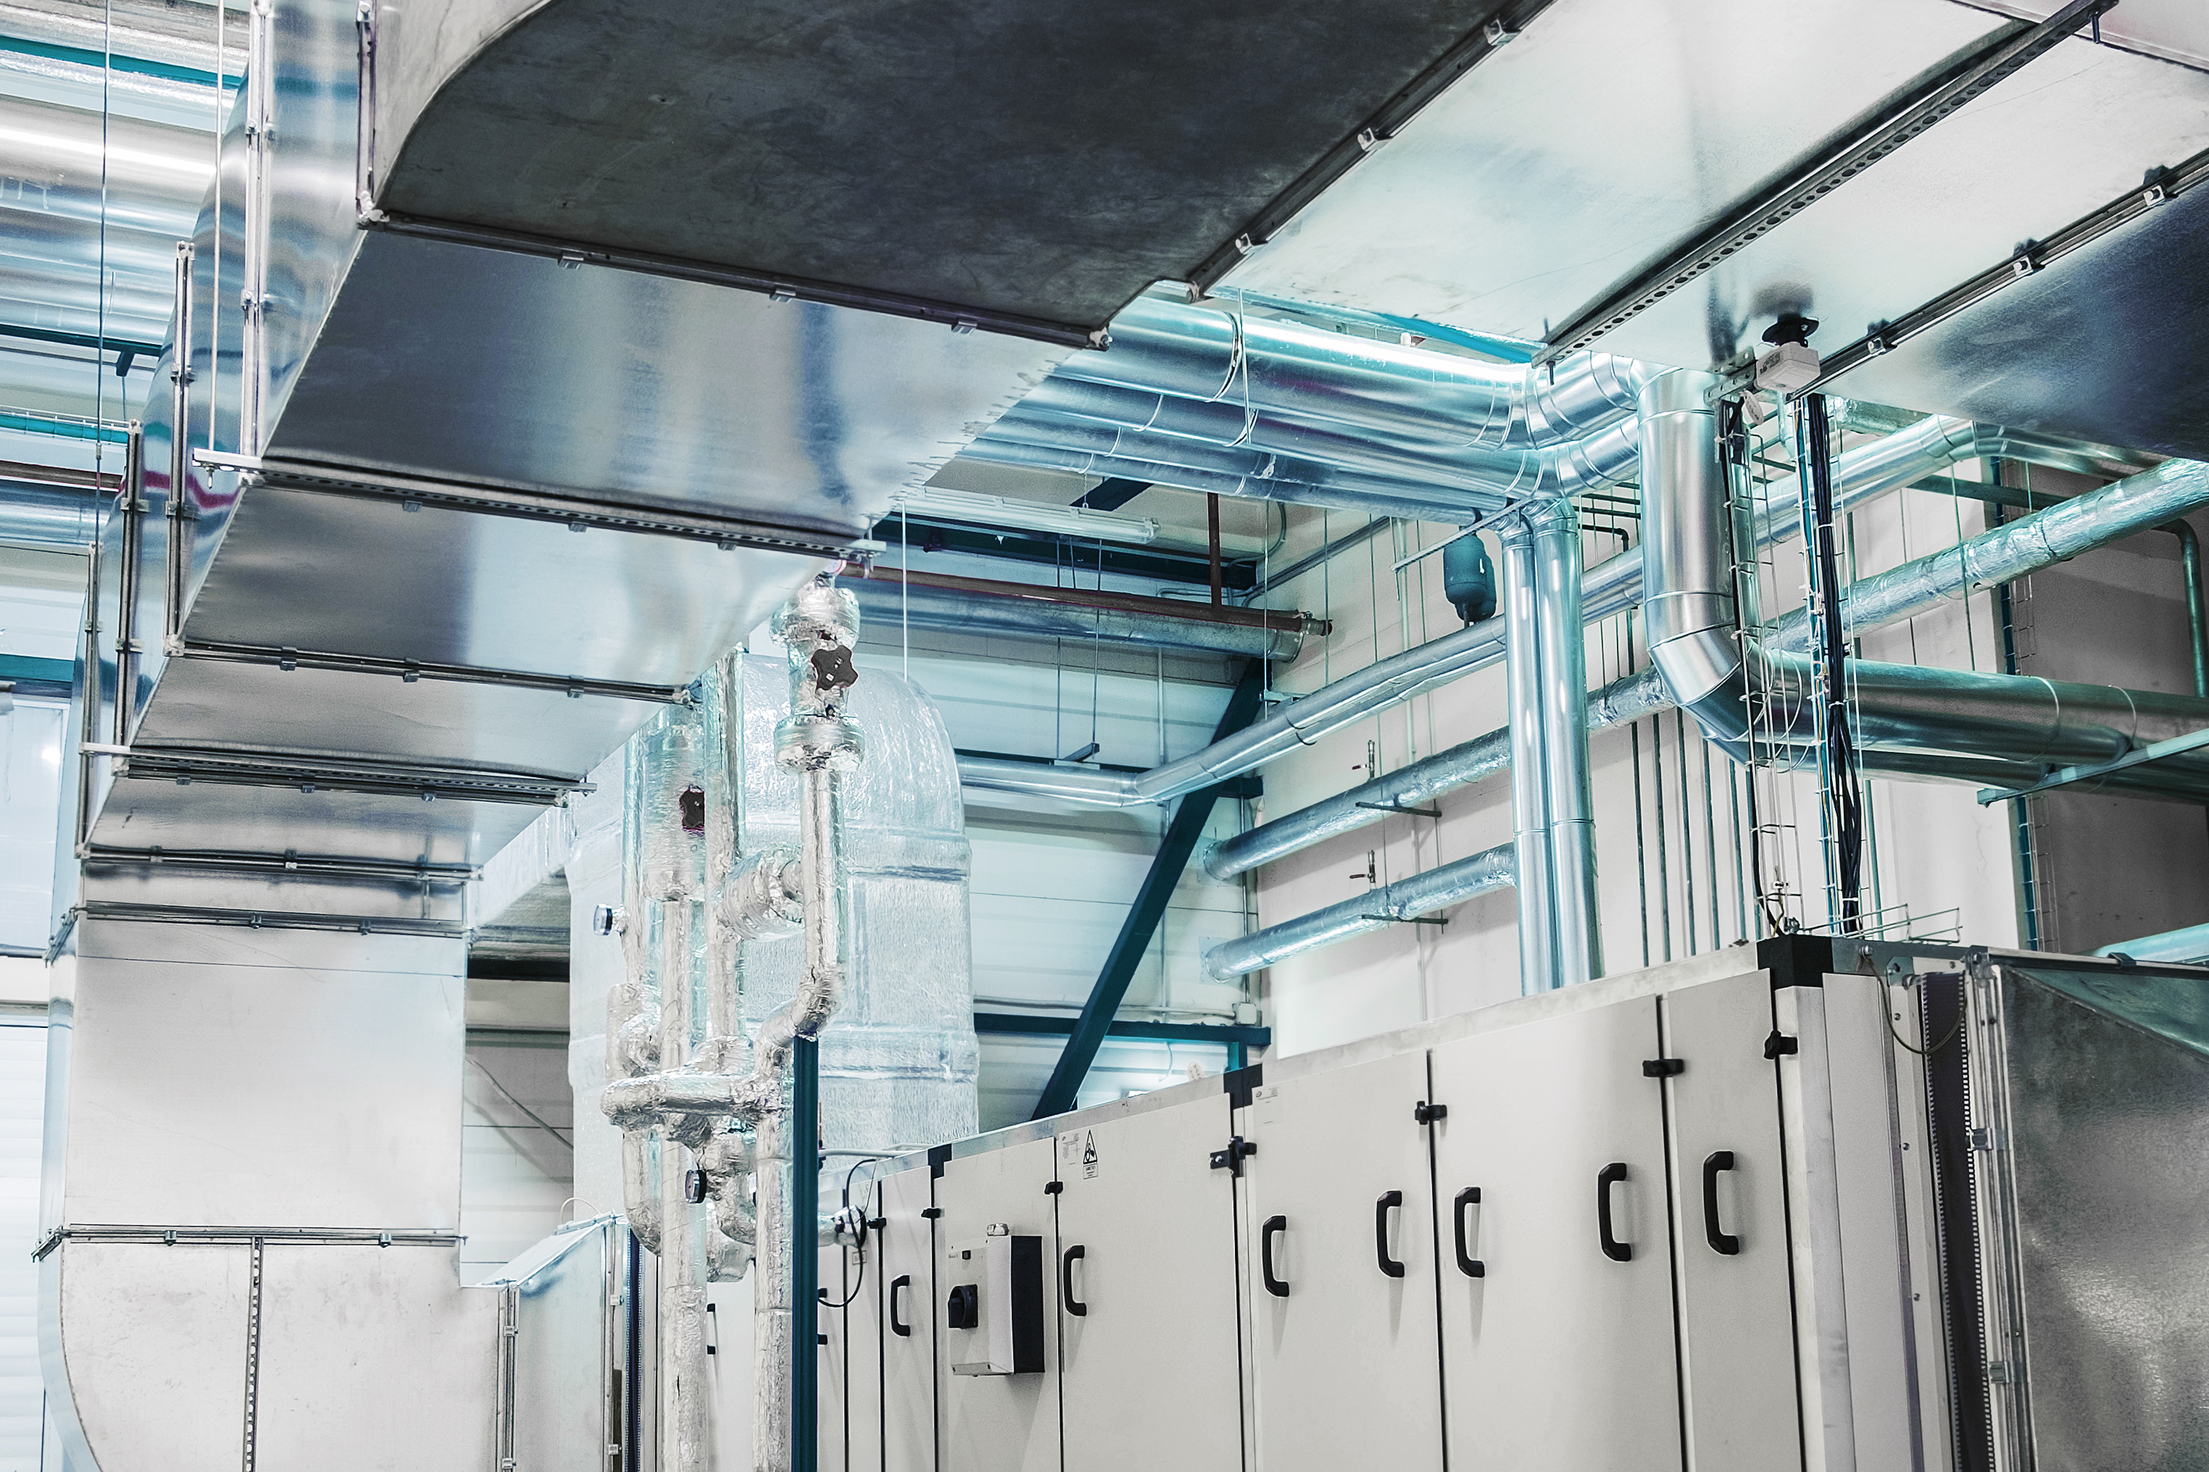
Air handling unit
The image shows a typical bespoke air handling unit (AHU) to match the ventilation design.
These units are prefabricated offsite and craned into the plantroom, where they are connected to the ductwork, hydronic systems and the building energy management (BEM) system if applicable.

Slide 15
Balanced mechanical ventilation: recirculation
Balanced mechanical systems have two separate ductwork networks, one for distributing fresh tempered air and another for extracting vitiated air from the building.
The ductwork sizes will diminish from the AHU to the final zone and increase from the final zone back to the AHU.
To make economies, 25% of the extracted air will be recirculated and mixed with the cold fresh air inlet. This is referred to as ‘direct heat recovery’.
The proportion of fresh air to recirculated air is controlled by dampers, and will depend on the room and external conditions.

Slide 16
Balanced mechanical ventilation: indirect heat
Using indirect heat is a more recent approach to heat recovery. Here, the heat exchanger is incorporated with the packaged AHU.
This removes the need to install a recirculation duct and dampers.
Heat recovery is achieved by means of a plate heat exchanger with air flow across the plates to prevent the two air flows from mixing with one another.

Slide 17
Any questions?

