Slide 1
PowerPoint 8: Refrigeration systems
PowerPoint presentation
12. Building services engineering (BSE) systems
12.1 Building services engineering systems

Slide 2
Objectives
By the end of this session learners should be able to:
describe the principle of the vapour compression cycle
list the main components in a vapour compression system
explain the principle of heat recovery in air systems using refrigeration
sketch the layout of a chilled water system plant
discuss the advantages and disadvantages of refrigeration systems.

Slide 3
Refrigeration systems
Refrigeration systems are highly reliable, and natural refrigerants (hydrocarbons) don’t deplete the ozone layer. When used as a refrigerant, air is cheap, although the running costs of refrigeration units can be high.
While there is no fire risk from leakages, safe disposal of old units is an issue due to risks of pollutant contamination. From an environmental point of view, another downside is that due to the cost of repairs, units are often deemed not to be economically repairable, increasing the amount of waste as old units are replaced by new ones.

Slide 4
Desirable properties of a refrigerant
A chemical such as difluoromethane (R32) is a refrigerant, which means it has favourable thermodynamic properties.
Refrigerants must be non-corrosive to mechanical components, safe, (including freedom from toxicity and flammability) and must not contribute to ozone depletion or climate change.
The desired thermodynamic properties of a refrigerant are a boiling point below the target temperature, a high heat of vaporisation, a moderate density in liquid form, a relatively high density in gaseous form and a high critical temperature. Since boiling point and gas density are affected by pressure, refrigerants may be made more suitable for a particular application by the appropriate choice of operating pressures.

Slide 5
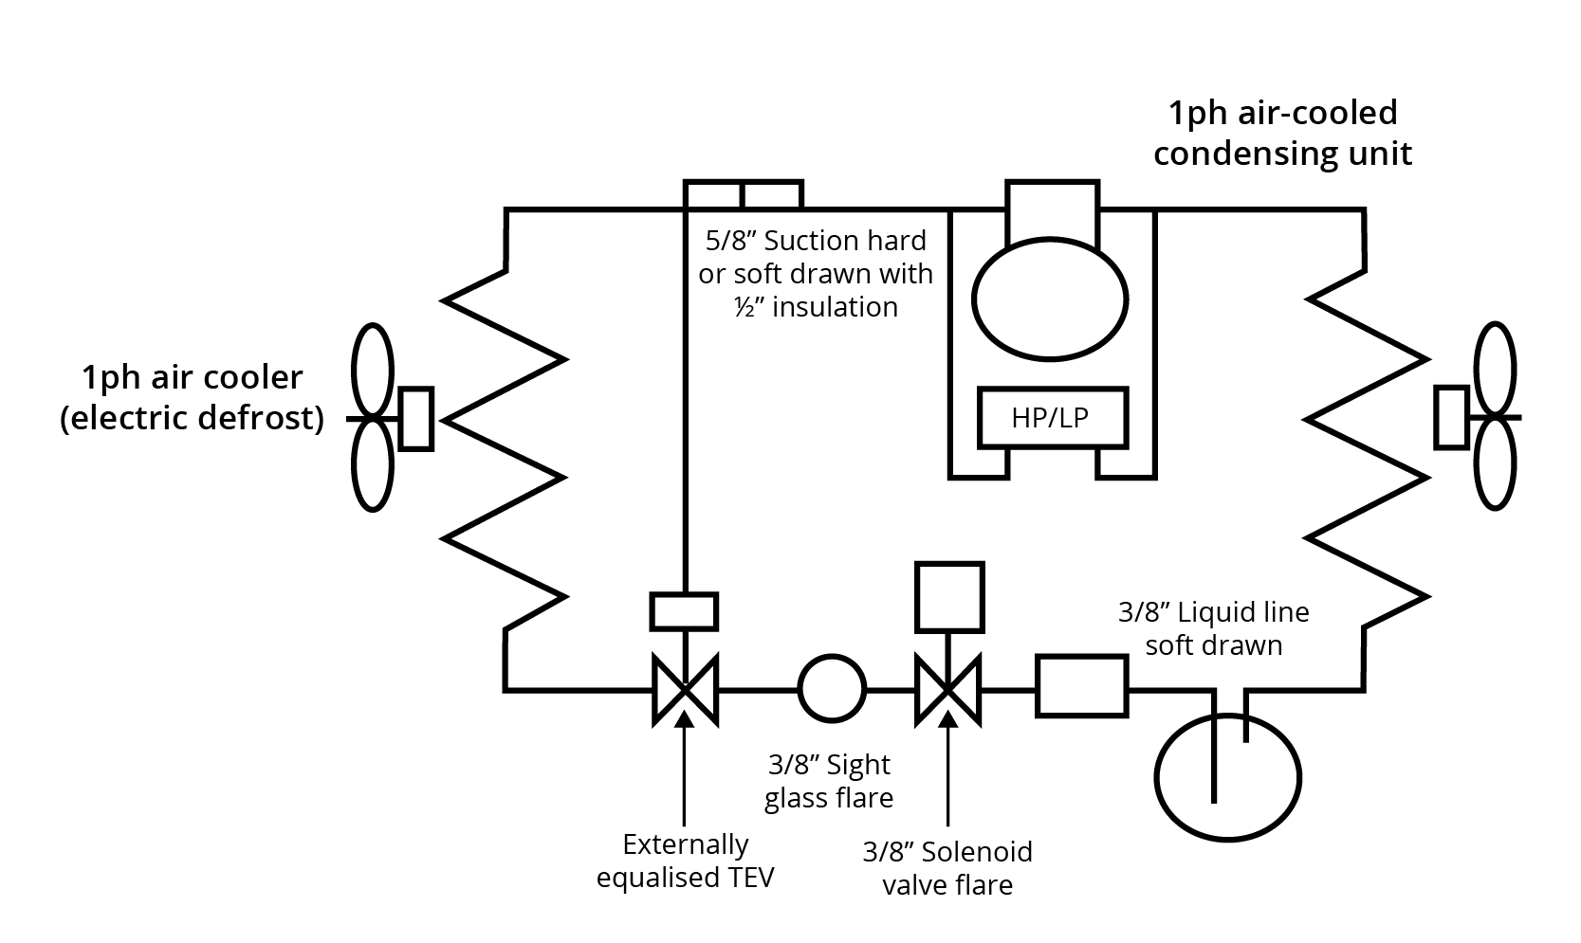
The vapour compression cycle
The vapour compression cycle is a thermodynamic process used in refrigeration systems to transfer heat from one environment to another. The refrigerant is subjected to a closed process of compression, cooling (via condensation), expansion and heating (via evaporation).

Slide 6
The vapour compression cycle
The cycle is a system comprising four quadrants: 1) gas/liquid at low pressure; 2) gas at low pressure; 3) gas at high pressure; 4) liquid at high pressure.
The evaporator has a cooling effect where heat is absorbed by the refrigerant to phase change to gas.
The compressor increases the gas pressure and elevates the heat capacity of the gas.
The condenser causes heat to be rejected by the gas which changes back to a liquid.
Expansion increases the liquid volume and therefore reduces its pressure and its heat capacity.

Slide 7
Compression cycle evaporation and condensation
Evaporation
Heat is removed from the targeted fluid (ie water or air) by passing the refrigerant through a pipe coil or finned pipe coil.
The refrigerant is effectively boiled into a gaseous phase.
Condensation
The high level of heat in the high-pressure refrigerant passes through a heat exchanger, where heat is rejected.
The refrigerant is returned back to a liquid at high pressure.
The difference between heat absorption and rejection indicates the efficiency of the system.

Slide 8
Installation of a refrigeration system
The material for system pipework is generally installed using soft copper coiled pipe.
Completed pipework is purged with oxygen free nitrogen to prevent internal oxygenising when joins are brazed.
The system is then purged of any gases to create a vacuum prior to being filled with refrigerant gas/liquid.
The system is then tightness tested to ensure no atmospheric pollution of refrigerant gas.
Post-Brexit, permissible refrigerant gases in Great Britain will still broadly adhere to the EU F-GAS Regulation 2020.

Slide 9
Hermetically sealed refrigerant compressor
This type of compressor is typically found in domestic refrigerators and freezers, along with split-air room conditioning units.
Each unit is manufactured with a factory sealed vacuum, making it ready for installation.
Industrial compressors are more complex in their constituent parts, as shown on the next slide.

Slide 10
Refrigerant expansion valve
An essential part of a refrigeration system is the expansion valve, which restricts the flow of refrigerant entering the evaporator, so as to produce a cooling effect from the higher pressure liquid. High pressure refrigerant liquid enters the expansion valve from the condenser.
The expansion valve reduces the pressure of the liquid, thus expanding its volume, which in turn alters its thermodynamic properties. A sensing bulb is connected to the expansion valve via a capillary tube of extremely small diameter, which allows the sensing fluid (mercury vapour) to measure small differences in temperature by expansion and contraction.
The sensing bulb is attached to the outlet tube of the evaporator heat exchanger, allowing the opening or closing of the expansion valve to regulate the refrigerant.

Slide 11
Reciprocating chiller
Large air conditioning (AC) and chilled water installation systems use reciprocating chiller units, either singly or in multiple, depending on the system.
A reciprocating chiller consists of an electric motor which drives compressor pistons to suck the refrigerant out of the evaporator.
The evaporator and the condenser are shell and tube calorifiers – tube bundles in a large diameter chamber, usually with a contraflow operation.
Chilled water leaves the evaporator at approximately 7ºC.

Slide 12
Refrigeration cycles and AC
We looked at AC systems in detail in Session 1, where you learned about central plant, constant and variable air volume systems (CAVs and VAVs), induction systems and VRV (variable refrigerant volume) systems.
For AC systems, refrigeration cycles are very effective in performing heat recovery from one air source to another – up to 36% of heat leaving a building can be recovered and transferred into the supply air. This means that with reversible vapour compression and a runaround coil, an air conditioning system can have winter and summer modes.
This presentation concludes with two simple schematics showing how these systems work.

Slide 13
Any questions?

