Slide 1
PowerPoint 7: Protection systems
PowerPoint presentation
12. Building services engineering (BSE) systems
12.1 Building services engineering systems

Slide 2
Objectives
By the end of this session learners should be able to:
explain how surveillance systems operate in domestic and commercial buildings
describe the operation and components of a fire protection system
explain how intruder alarm systems work
explain how access systems operate and describe their components.

Slide 3
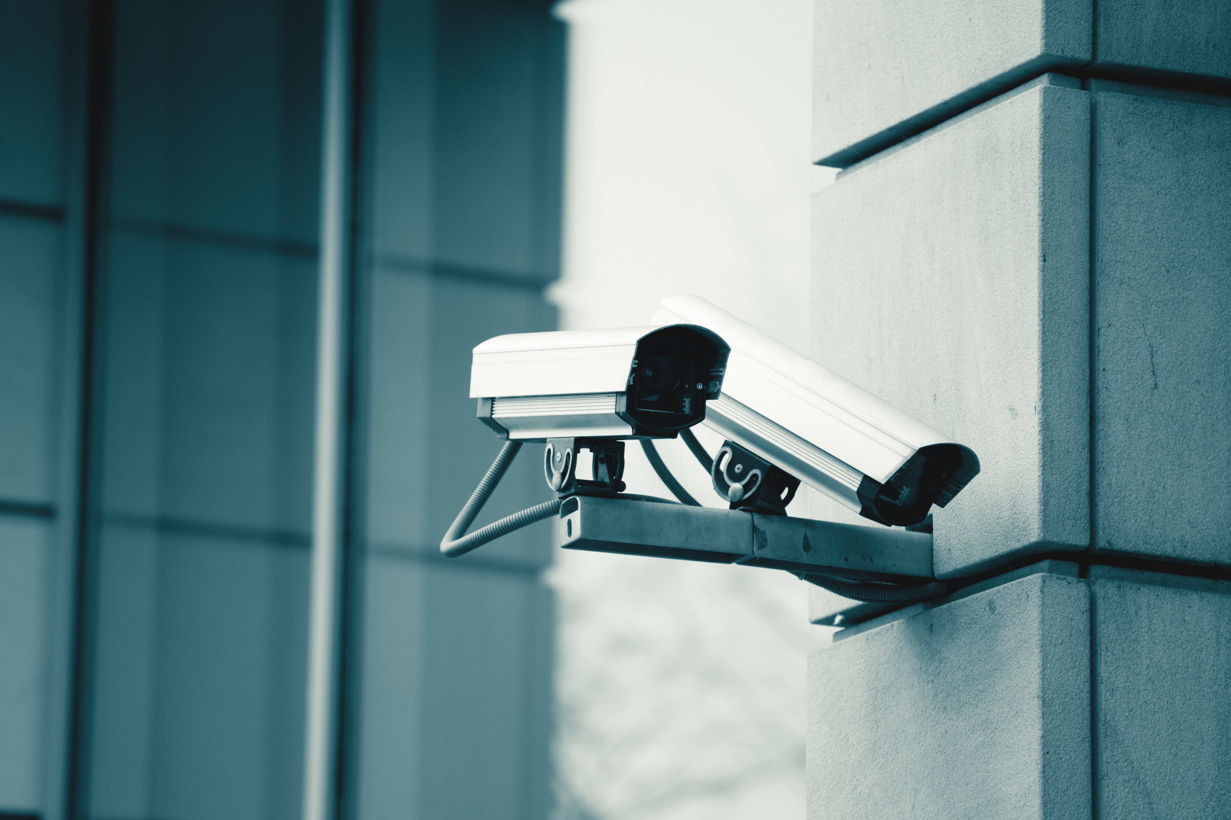
Commercial surveillance cameras
Security cameras, mounted on the exterior of a building or within, relay images to a manned control room, where a bank of screens can be observed by security operatives.
Some cameras are capable of rotating and tilting for greater coverage.

Slide 4
Domestic surveillance cameras
Cameras designed for home use work on similar principles to commercial models in order to monitor the exterior of a home. The homeowner views the images on a tablet provided with the equipment, or on their own tablet or mobile phone using a downloaded app for the purpose.

Slide 5
Fire protection systems
Fire protection systems are designed on the one hand to prevent fire and on the other to alert people to the presence of fire. The former are called passive systems and the latter active systems.
Fire alarms are a form of active fire protection. They work by detecting smoke or heat and sounding an alarm, and may also be able to activate an extinguishing system (such as sprinklers) and alert the fire service.

Slide 6
Elements of a fire protection system
Active fire protection systems vary in complexity according to context (i.e., commercial or domestic), but have common elements (i.e., audible alarms, smoke detectors/sensors), which in more sophisticated systems will be linked to a control panel.

Slide 7
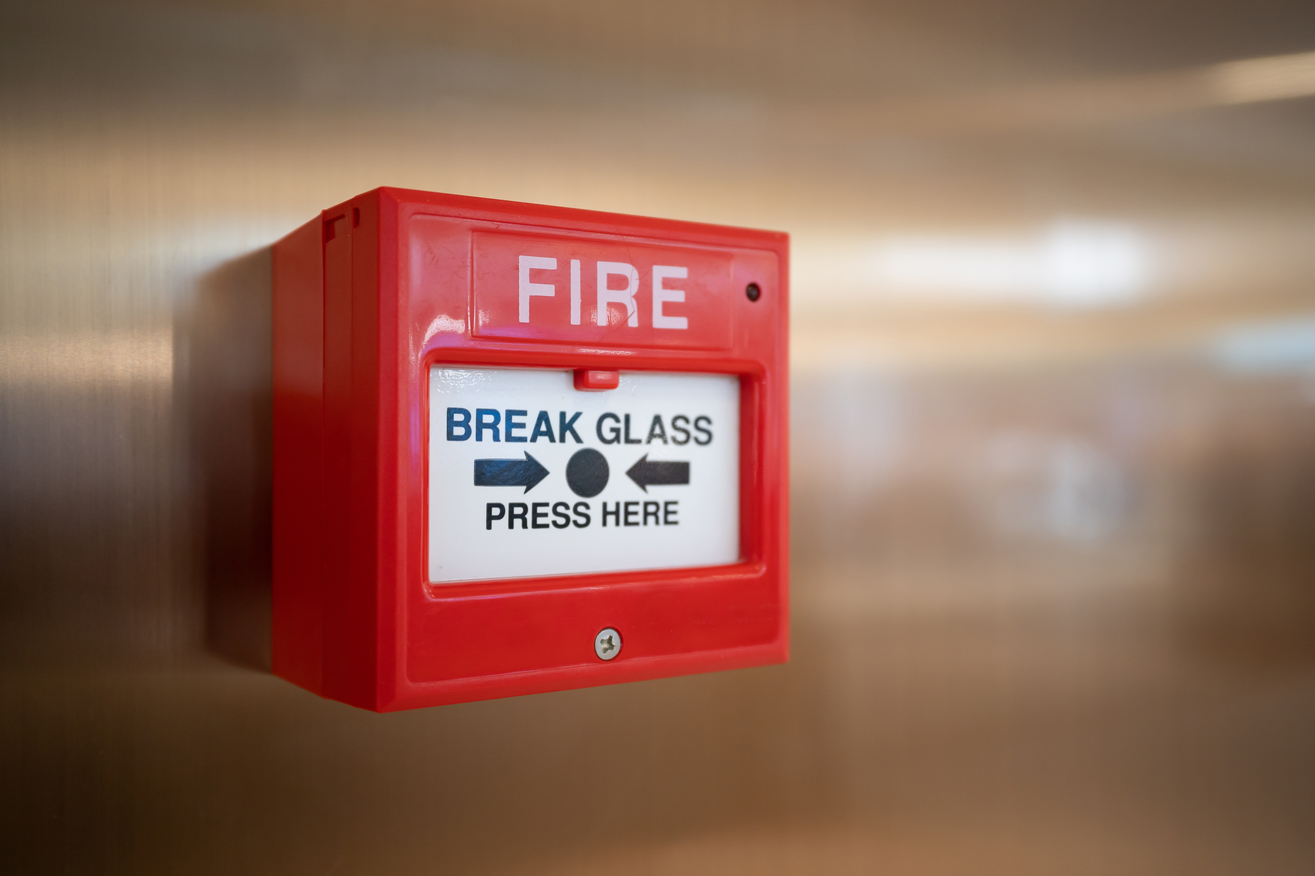
Manual fire alarm system
Manual fire alarms are a common sight in public buildings.
They are wired using FP200 cabling in accordance with BS7671 (wiring regulations). The cables are strongly insulated to ensure the alarm will continue to work during a fire.

Slide 8
Fire protection heat sensors
Heat and smoke detectors (or sensors) are commonly found in domestic dwellings. There are two types: rate of rise (which senses very quick changes in temperature) and fixed temperature. Fixed temperature sensors are best suited to rooms where heat may already be present, such as a kitchen, and rate of rise sensors are suited to other rooms around the house.
Sensors operate using a bimetal strip mechanism. In the cold position the strip is isolated, but when the sensor is subjected to heat the strip bends, causing two contacts to meet and allowing current to flow in the alarm circuit, which activates the alarm.

Slide 9
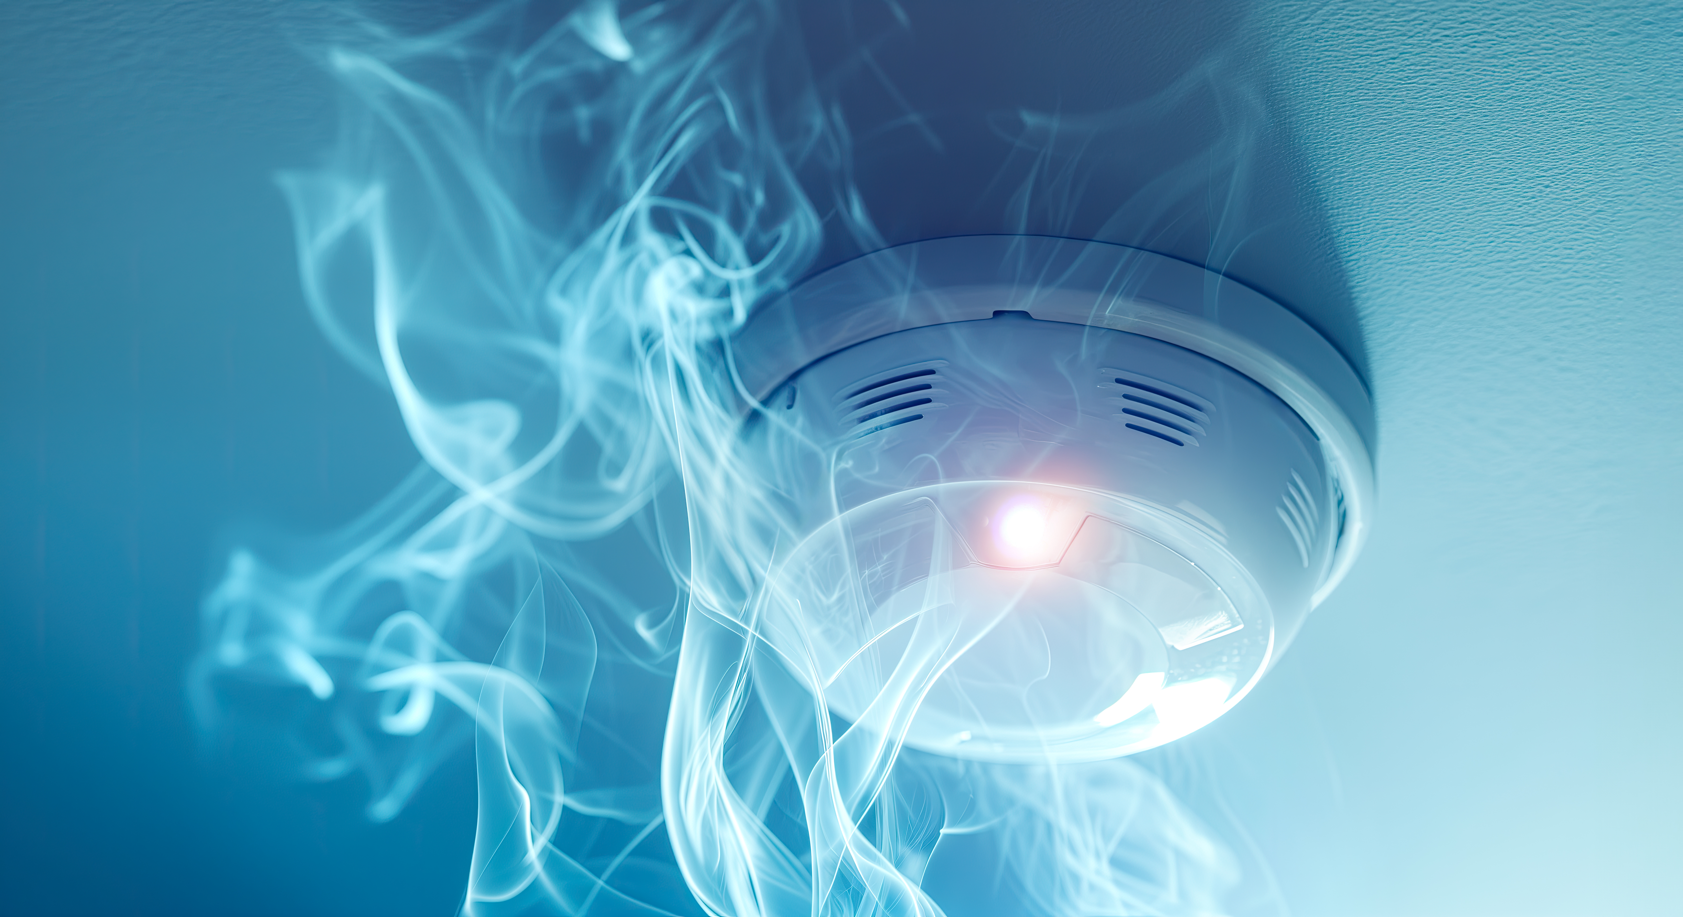
Smoke detectors
A smoke detector works by detecting smoke, not heat.
Optical smoke detectors have a light source that shines onto a photocell. If the light beam is deflected by smoke entering the sensor, the alarm is triggered.
Ionisation smoke detectors operate by monitoring an electrical current which falls to a pre-set level when smoke is present.

Slide 10
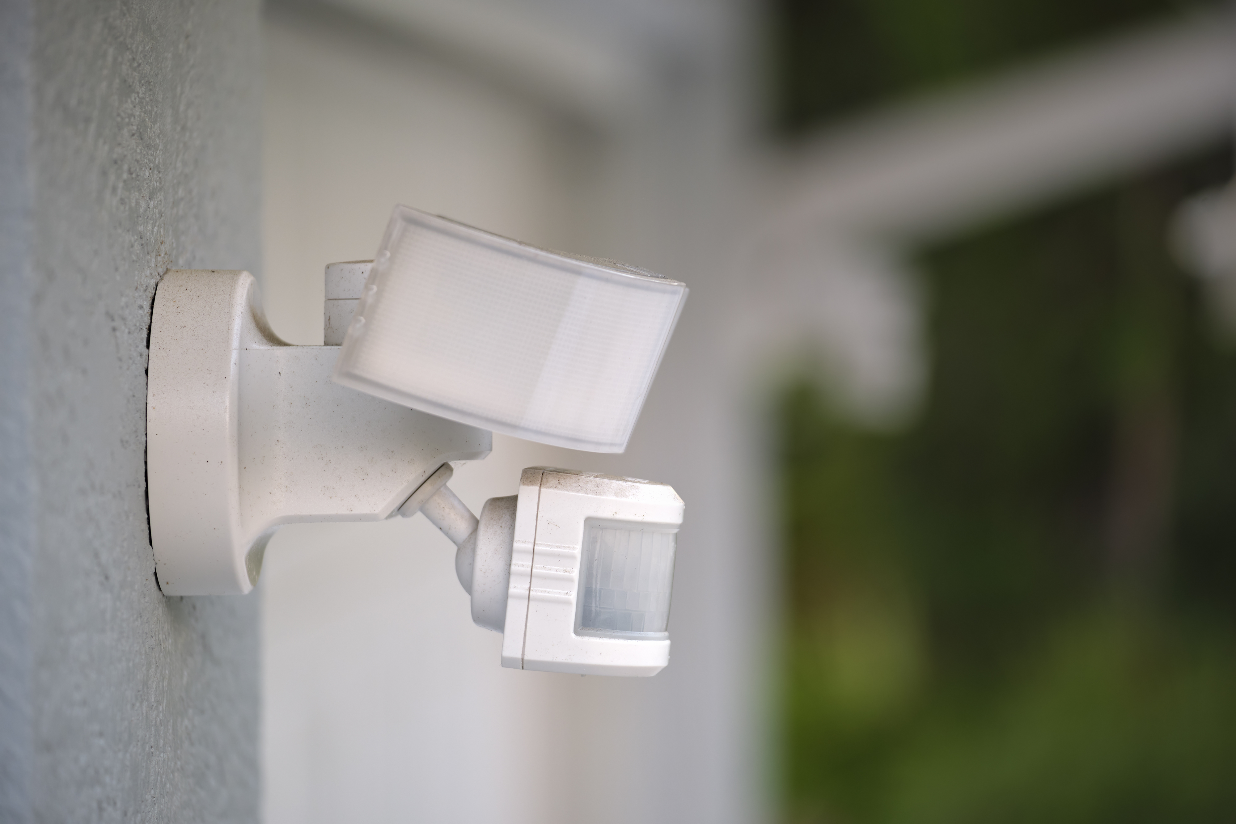
Domestic intruder alarm systems
Such systems can range from a simple alarm to a complex interlinked surveillance setup.
Passive infrared (PIR) sensors can be mounted inside and out, and doors and windows can be alarmed using contact-based systems.

Slide 11
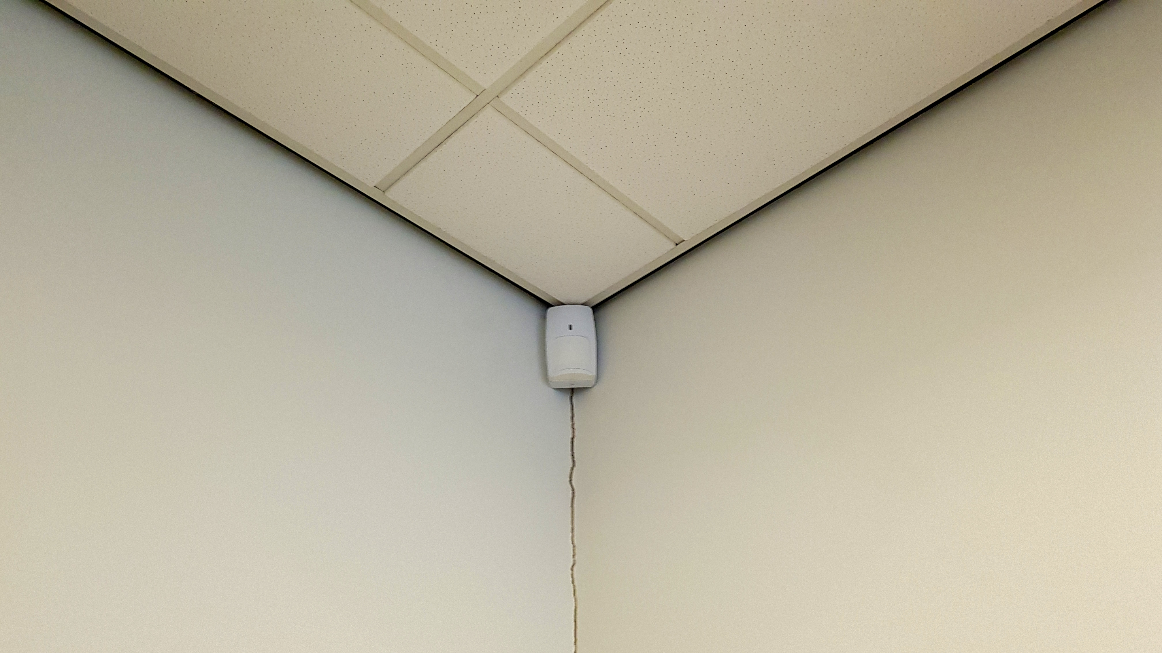
Internal PIR intruder alarm
The diagram shows the range of a series of PIR movement sensors over the ground floor of a house.
These sensors will trigger the alarm if they detect movement within their range.

Slide 12
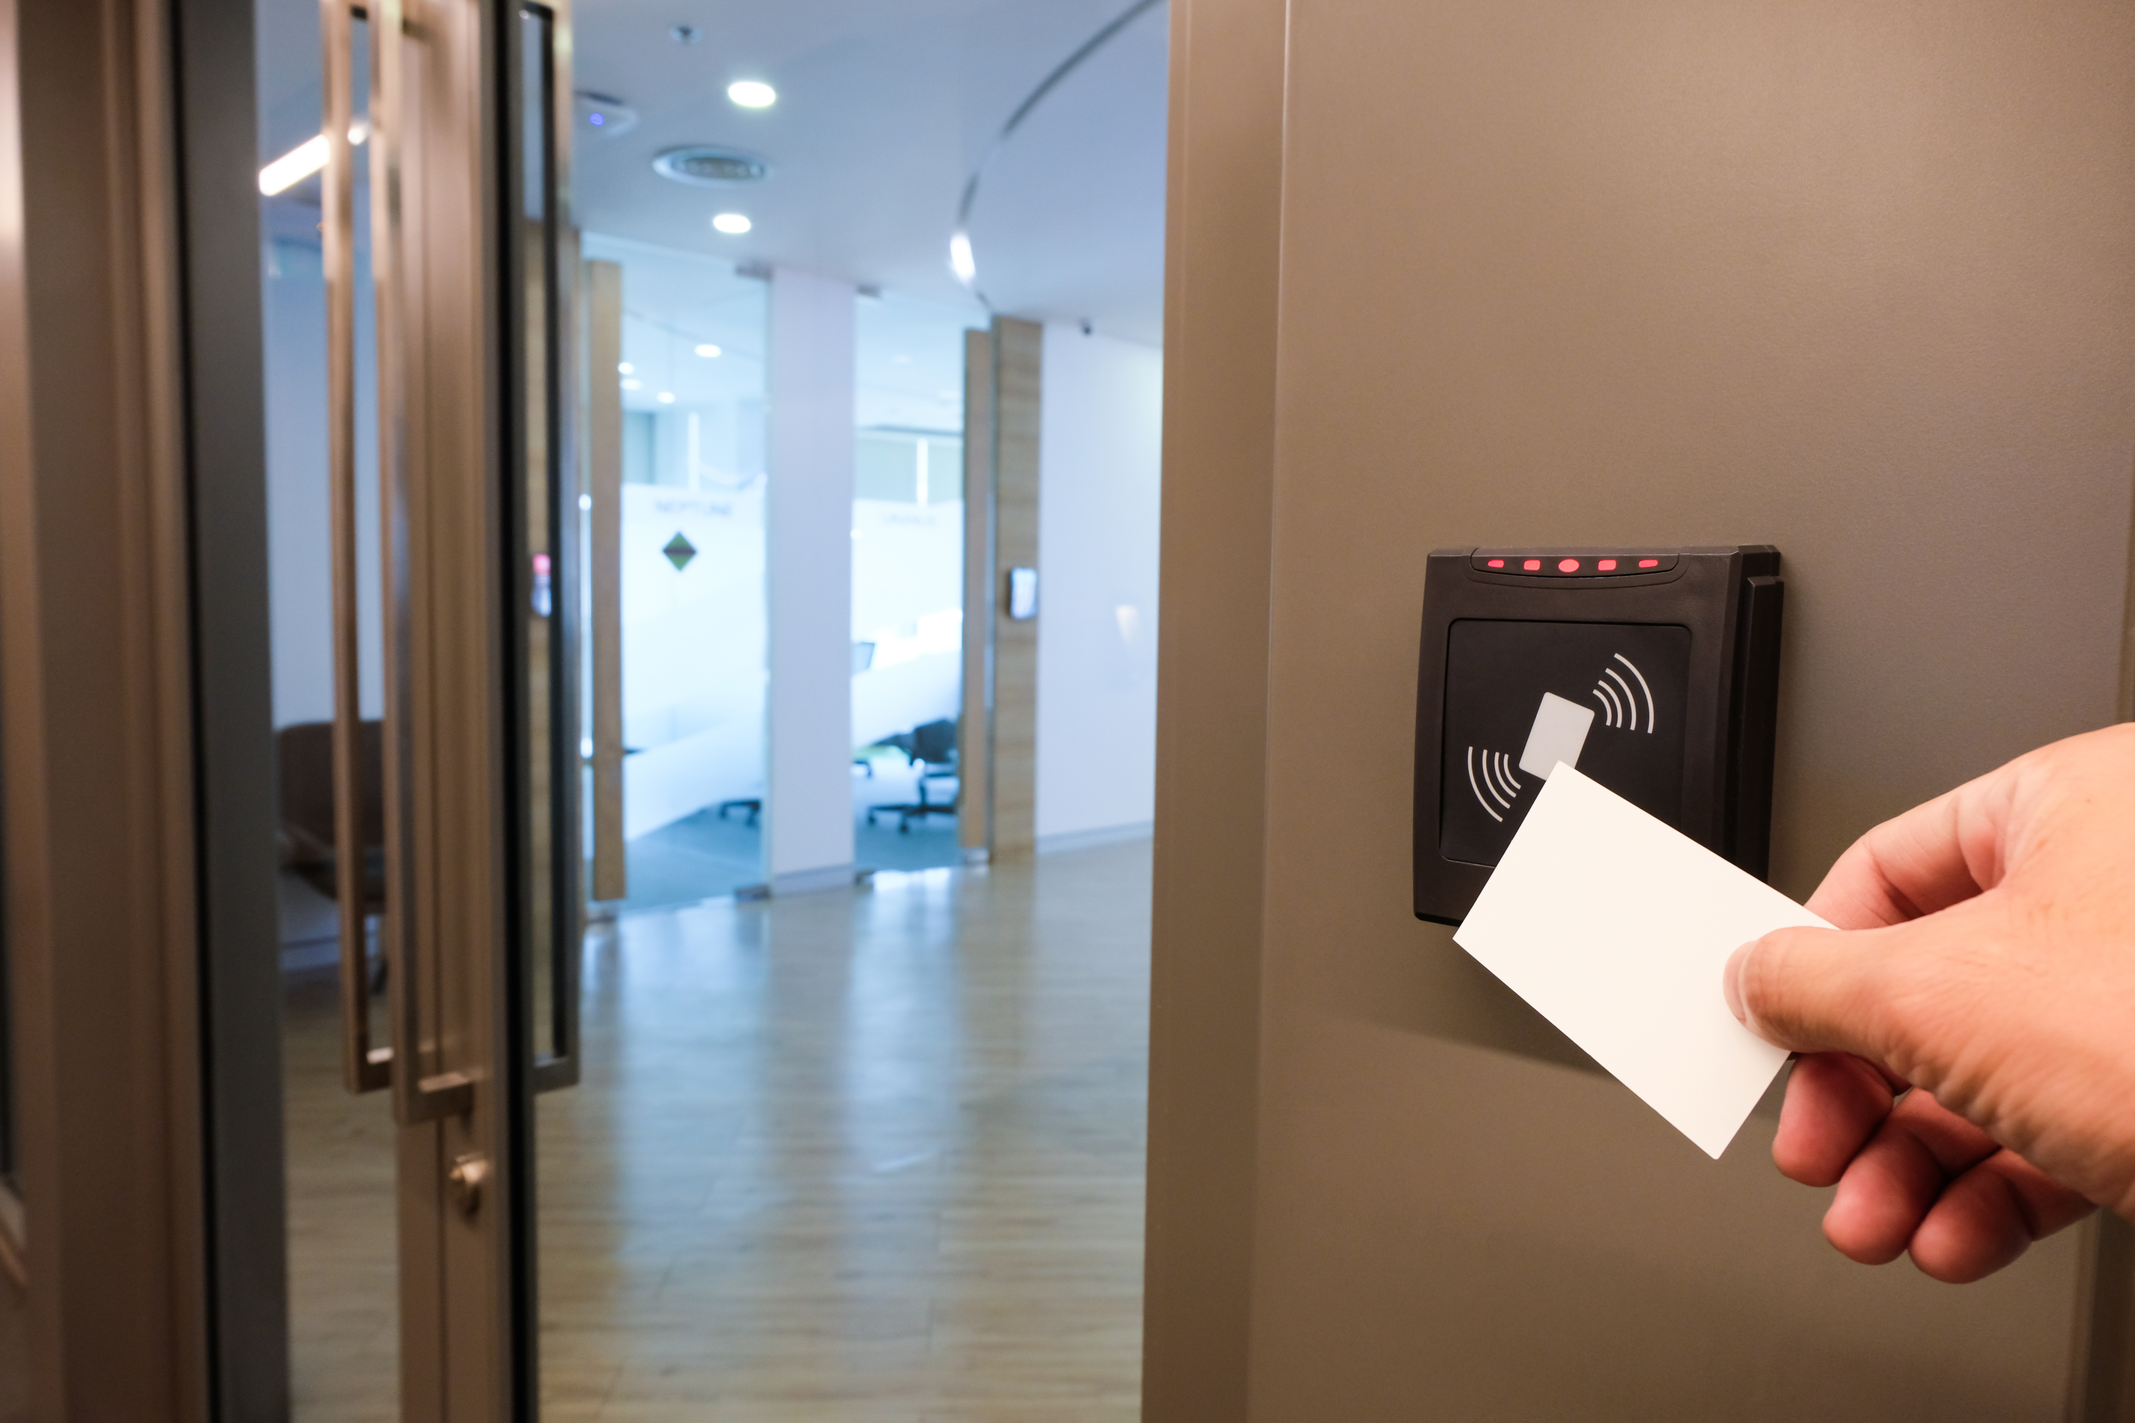
Access control systems
Authorised access to a property can be made far more secure than a simple key. Modern systems can be linked to a central security hub or management centre, and access to the building regulated by highly personalised card readers or fob sensors, or more traditionally by a keypad code.

Slide 13
Any questions?

