Slide 1
PowerPoint 6: Plumbing systems
PowerPoint presentation
12. Building services engineering (BSE) systems
12.1 Building services engineering systems

Slide 2
Objectives
By the end of this session learners should be able to:
understand how water is supplied to a property and the different fluid categories
explain the concepts of cold and hot water systems in domestic dwellings, sketch a layout of each and understand the commissioning process
understand methods of providing above-ground drainage and sanitation and the system and components for draining rainwater from buildings
describe the variety of sanitation fittings in common use and their operation.

Slide 3
How water is supplied to a property
A communication pipe connects the ferrule (a valve on the water main) to the boundary stop valve. This part of the system is the responsibility of the water supplier (the water company).
A supply pipe connects the boundary stop valve and the internal stop valve (immediately after which is a drain valve). The pipe is buried at between 750mm and 1350mm and has a ducted entry to the property to facilitate removal and replacement. In the past, copper pipe was used, but modern supply pipes are made from plastic. This part of the system is the responsibility of the property owner.

Slide 4
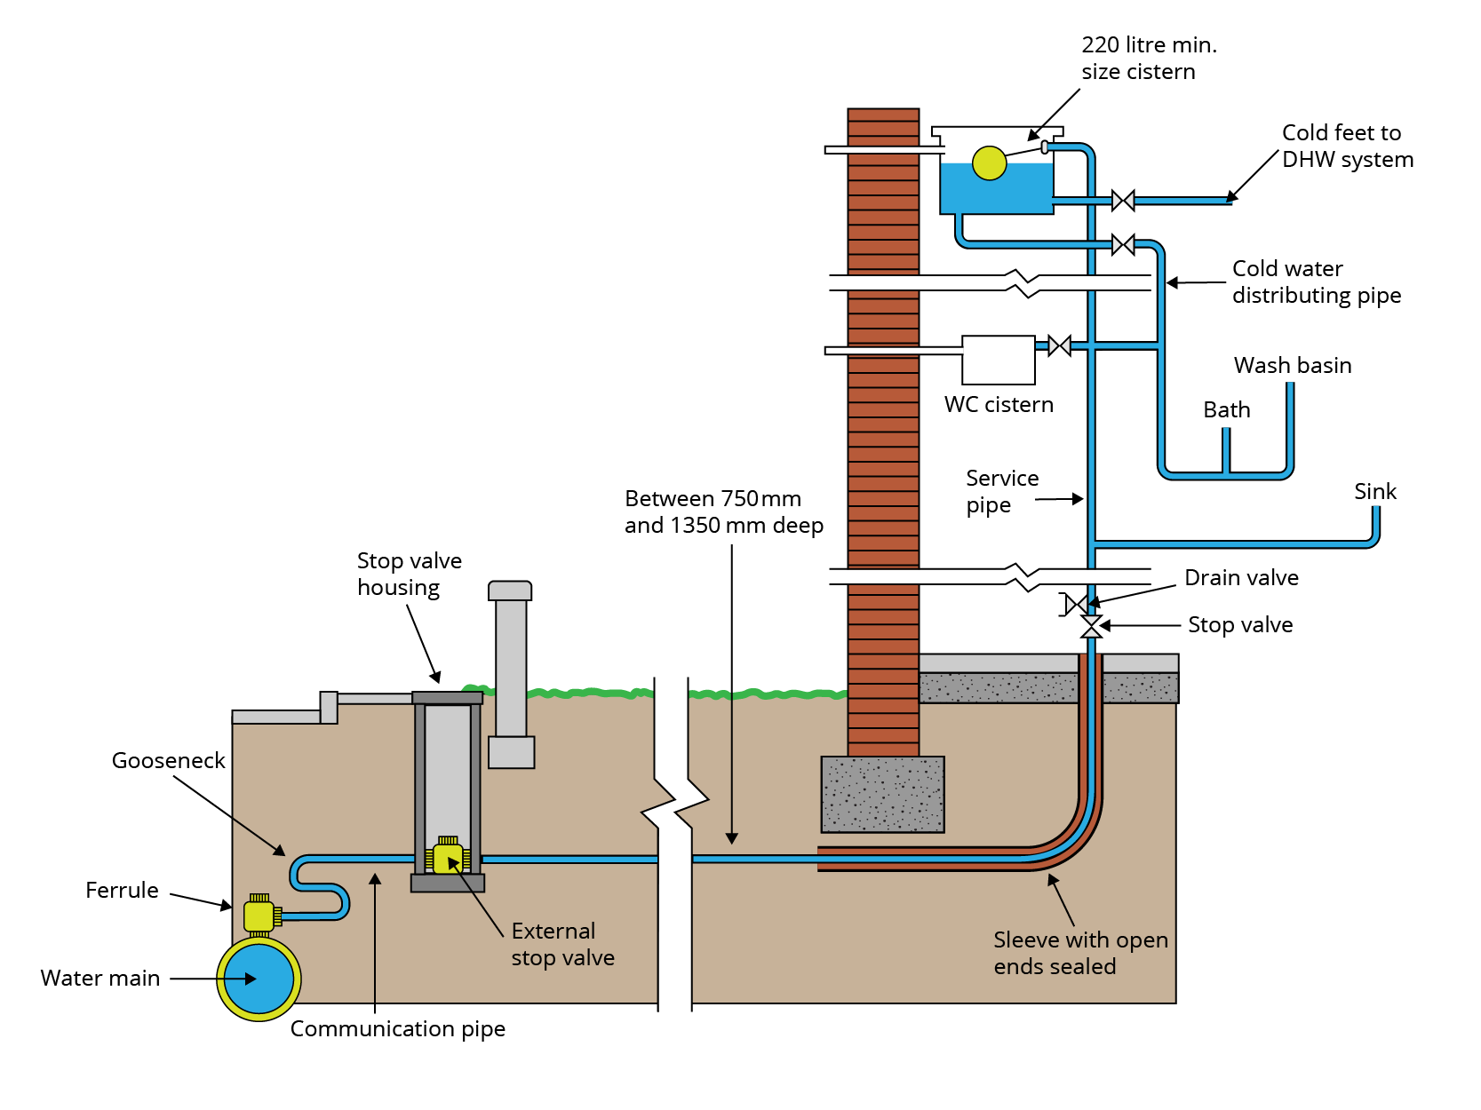
Water service (supply) to a property

Slide 5
Water meters
Water meters, installed by the water company, are normally placed in the external stop valve chamber. The meter is used to measure the amount of water consumed by the property and is also a useful means of detecting leaks. When water is drawn off by the property, it rotates an impeller which in turn operates a mechanical device that moves the dials of the meter.
Traditional meters have to be read in person. Smart meters can be read remotely via the internet.

Slide 6
Direct cold water system
In this system of cold water supply, all the sanitary appliances and the cold water storage cistern are connected to the rising main, which supplies them with fresh water at mains pressure.
This minimises pipework and pipe diameters, making the system cheaper to install.
In areas of low mains pressure and reliability of supply, a direct system can be a disadvantage, especially in periods of high demand.
In this system the only water that needs to be stored is that for the hot water system.

Slide 7
Indirect cold water system
In this system the only tap connected to the mains supply is the cold outlet at the kitchen sink, providing fresh water for food preparation and drinking.
The only other connection to the rising main is a float-operated valve at the inlet to the cold water storage cistern. The water stored here then feeds the needs of the hot and cold water systems.
In this system the cold water pipe diameters will generally be larger than a direct system.

Slide 8
Indirect cold water system

Slide 9
Standard fluid categories
Fluid categories reflect the quality of the water. They are defined by the Water Supply (Water Fittings) Regulations 1999.
Fluid category 1 is the desired quality of water for human consumption and food preparation.
Fluid category 2 is of a lower quality but no threat to health, eg when hot and cold water are mixed in a shower or basin.
The remaining three categories are designated health hazards and must not be allowed to mix with wholesome water.

Slide 10
Standard fluid categories chart
Fluid category | Description | Examples in domestic premises
1 | Wholesome water provided by water company
2 | Water with aesthetic quality changed (temperature, taste or colour) | Mixed hot and cold water from mixer taps; water from base exchanger softener.
3 | Fluid that represents a slight health hazard | Water in primary CH circuits; water in the bowl of a bath, basin or shower tray; handheld hose used with a hose union tap; contents of a washing machine or dishwasher.
4 | Fluid that represents a significant health hazard | Water used in a mini-irrigation system, such as a porous hose or sprinkler with head less than 150mm above ground level.
5 | Fluid that represents a serious health hazard | The contents of a sink bowl, WC pan or bidet.

Slide 11
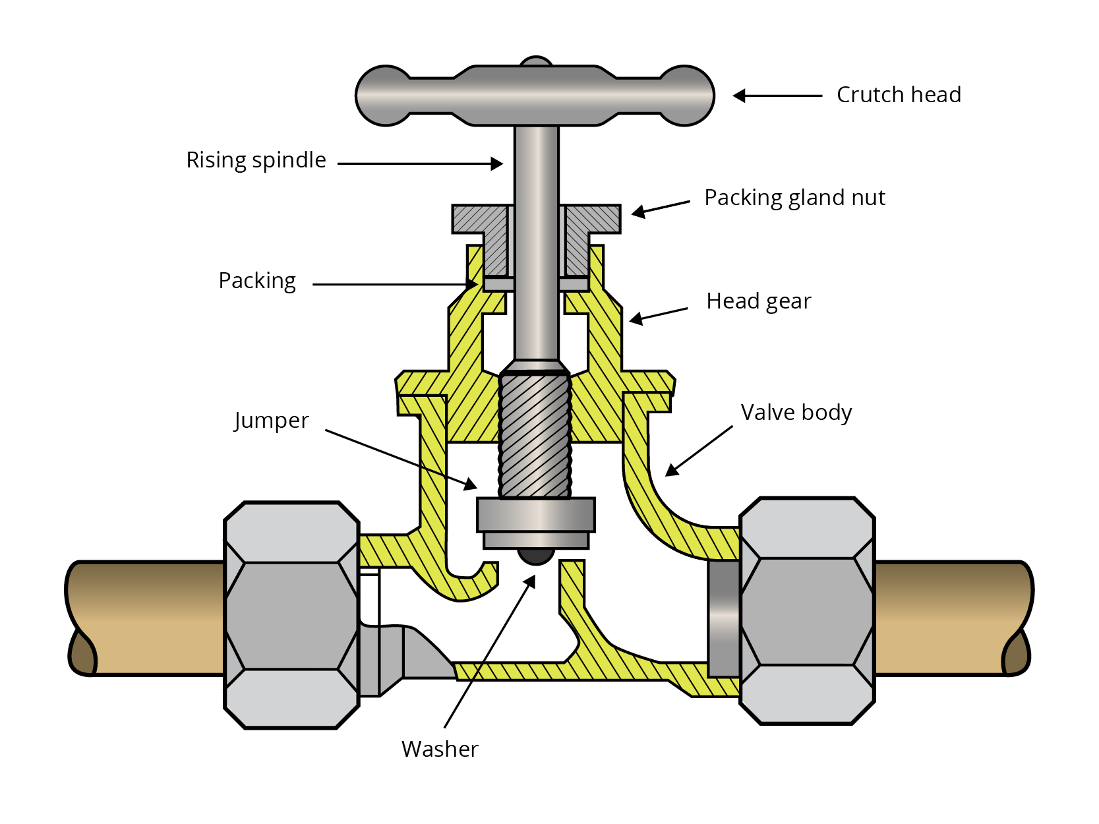
Water valves
Pressure system stop valve BS1010
Stop valves are used to isolate the water supply for maintenance or replacement of components.
Stop valves operate by manually turning the crutch head clockwise to close the valve and anticlockwise to open it.
A stop valve has a washer held within the jumper, which presses down on the valve’s seating to shut off the supply.

Slide 12
Water valves
Float operated diaphragm valve BS1212
Diaphragm valves are used in toilet cisterns, overhead tanks feeding central heating systems or copper storage cylinders to automatically replenish water. They operate by means of a plastic float attached to the end of a lever.

Slide 13
Boosted cold water system
Boosted cold water systems are used in high rise buildings which have floors above the limit of the water mains pressure. The break tank holds sufficient potable water to supply the expected flow rate and also prevents backflow into the mains.
The water supply is regulated by a delayed action float-operated valve which prevents continuous flow into the tank. Duplicated pumps enable duty and standby operation. There is a check valve at the base of the riser to prevent the riser draining back into the tank.

Slide 14
Vented hot water storage system
The stored cold water in the storage cistern provides the head pressure to force water from the taps once opened.
The cold feed pipe makes up the drawn off hot to the storage cylinder. It is also the route for expanded water volume to flow to the cold water storage cistern. Blocking this pipe can cause pressure related problems.
The open vent pipe maintains atmospheric pressure in the pipework when water is drawn off through a tap.
Vented systems are suited to areas with low water pressure but have a high installation cost and require hot water to be stored at height.

Slide 15
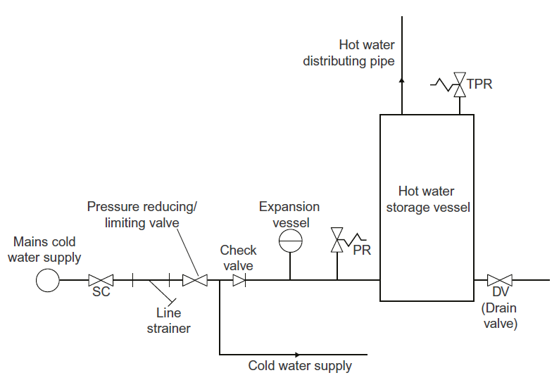
Unvented hot water storage system
The advantages of an unvented system are very strong water pressure, fast recovery time and the fact that hot and cold-water pressure is equal. The downside is cost. Below is a schematic layout of an unvented hot water installation.

Slide 16
Unvented hot water storage system
The basic system components are as follows.
Line strainer – this component prevents materials carried over from the water main obstructing the control components.
Pressure reducing valve – this valve gives a constant pressure in the cold and hot water systems (typically 3 bar).
Check valve – prevents expanding water flowing back to the mains.
Expansion vessel – takes up the expanded volume on heating, keeping pressure constant.
Pressure relief valve – opens if internal pressure exceeds 4 bar.
Temperature/pressure relief valve – opens when pressure exceeds 5 bar or if water temperature reaches 95ºC (manual reset).

Slide 17
Unvented hot water unit
These units are supplied ready to fit, with all the controls and safety devices in place, ready for connection to the external pipework.
Alternatively, a cylinder can be supplied with a bundle of the safety devices as a package.
Building regulations prohibit installation of safety devices not supplied by the unit manufacturer.
Only installers with appropriate qualifications and competence are permitted to install such systems.

Slide 18
Commissioning
Commissioning hot and cold water systems
The commissioning process follows these steps in this order:
visual inspection
soundness testing
flushing and disinfection
performance testing
final checks and handing over.

Slide 19
Commissioning
Rigid pipes
In brief, the BS6700 test procedure is as follows:
test pressure = 1.5 times maximum operating pressure for a test period of one hour
ensure there is no visible leakage and no loss of pressure.
For elastomeric pipes (plastics), BS6700 sets out two alternative test methods, procedures A and B, on which the pipe manufacturer can advise.

Slide 20
Pressure testing rigid pipes
This is always part of the commissioning process to ensure system integrity.
  Ensure sure any open-ended pipes are sealed (eg vent pipe).
  Once the system has been filled it should be allowed to stand for 30 minutes to allow the water temperature to stabilise.
  The system should then be pressurised using hydraulic testing equipment to a pressure of 1.5 times the maximum system operating pressure.
  Testing should take place when new installations have been completed or on completion of a major extension to an existing system.

Slide 21
Pressure testing with a hydraulic pump
Before any new pipework is put to use, a pressure test is required to ascertain whether there are any leaks.
A hydraulic test pump has a gauge to read the amount of pressure created, an isolation valve and a drain valve.
An integral reservoir introduces water into the pipework, with the pump eliminating any connection to the supply.
The reservoir is filled with water; a pressure hose is connected and the lever pumped to pressurise to the desired level.
It is important to ensure that all ends are sealed or capped, and all valves turned off, if required.

Slide 22
Pressure testing a domestic cold water system
A cold water installation should be tested from the service pipe to all the draw-off points.
The hydraulic pump is connected to the end of the service pipe prior to being connected to the boundary stop valve.
The system is pressurised 1.5 times the working pressure and left for 30 minutes before observing for any pressure drops and inspecting all joints.

Slide 23
Pressure testing a hot water system
A similar procedure is used to test a hot water system: blank off all valves to the tank, connect the pressure gauge, pump up to 1.5 times the working pressure, leave for 30 minutes. Then observe for pressure drops and visually inspect all joints.

Slide 24
Above-ground drainage: sanitation systems
The single stack system of above ground drainage was developed by the Building Research Establishment and is designed to enable all sanitary appliances in a dwelling to be connected to one downpipe.
Up to three storeys can be connected to the same downpipe without causing any siphonage or backflow problems.
The stub stack system is an internal system for a single ground-floor toilet and hand basin. The terminal of the stack must be above the flood level of the toilet and the basin.
An air admittance valve is an alternative method of termination.

Slide 25
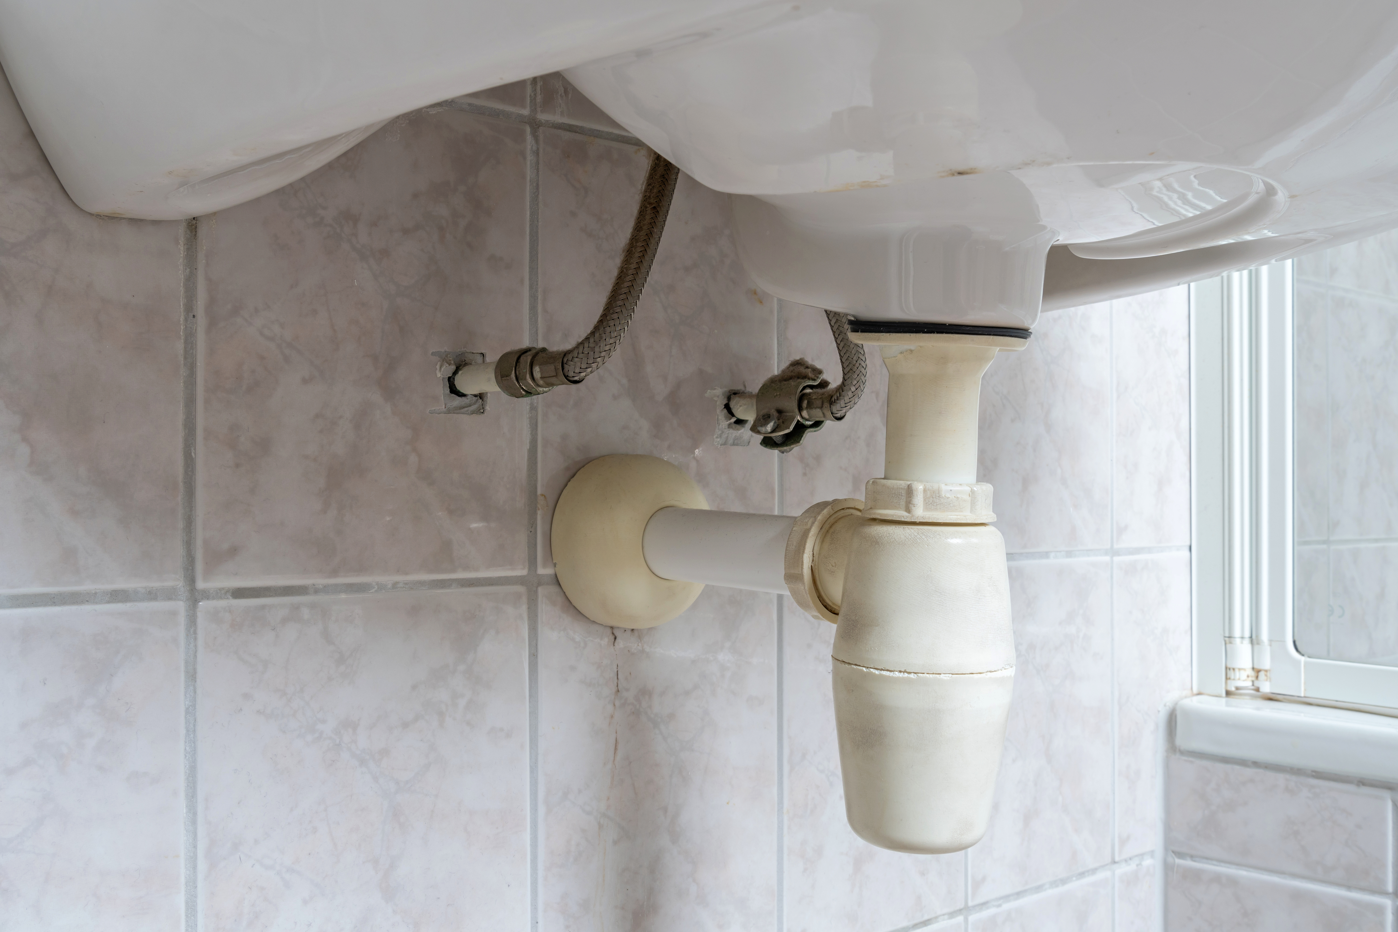
Sanitary traps
Sanitary traps are used as a barrier to prevent foul air entering a dwelling from the drainage system.
The correct waste pipe gradients and lengths are vital to prevent siphonage.
Bottle trap

Slide 26
Air admittance valve
Air admittance valves (AAVs) allow air into the dry vent pipe of an above-ground vertical stack pipe (a dry vent) when the discharge system is running.
These valves only allow air to flow in when negative pressures are present, so that foul air cannot flow outwards.

Slide 27
External stack pipe: termination point above eaves
Typical termination locations for ventilating pipes to prevent ingress of foul air into a building.

Slide 28
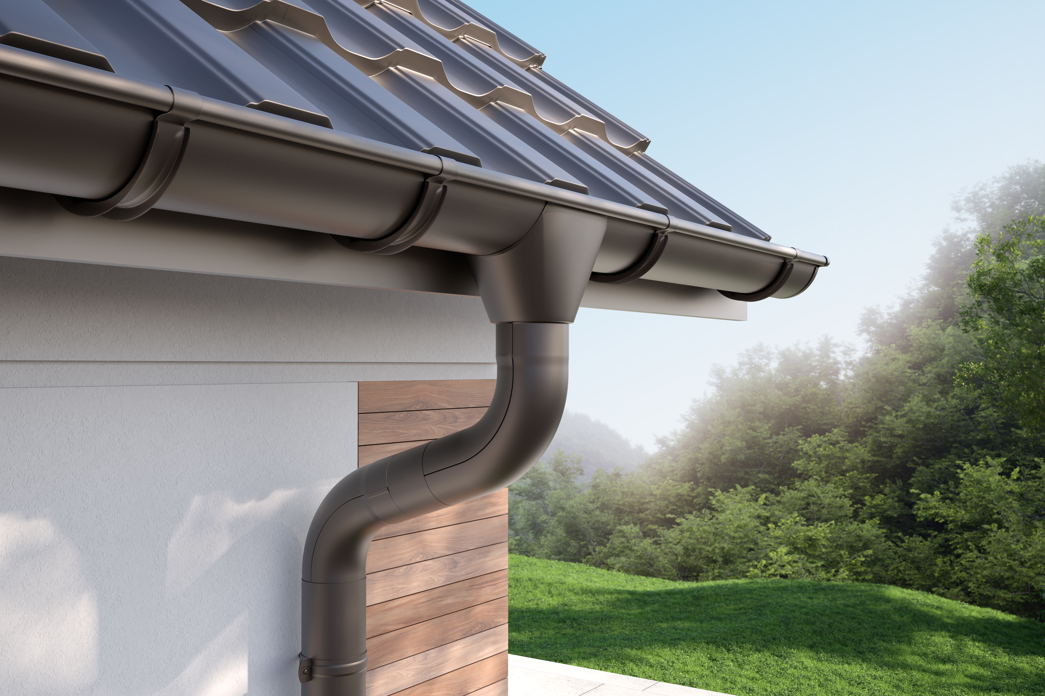
Above-ground drainage: gutters and fall pipes
For every 600mm of horizontal gutter pipe, a fall of 1mm is required.
The clipping distance should be a maximum of 1m. The slope of the roof and/or its area will dictate the size of the guttering and the number of outlets.

Slide 29
Any questions?

