Slide 1
PowerPoint 4: Domestic heating systems
PowerPoint presentation
12. Building services engineering (BSE) systems
12.1 Building services engineering systems

Slide 2
Objectives
By the end of this session learners should be able to:
describe domestic hydronic heating systems
list the main components of a hydronic heating system
sketch out a domestic hydronic heating system
explain how a domestic system works
explain the advantages and disadvantages of different heating systems.

Slide 3
Why heat your house?
  Domestic dwellings are heated to provide comfort for the inhabitants. Thermal comfort is related to:
      air temperature
      mean radiant temperature
      relative humidity
      air velocity.
  All four combine to provide comfort. Heating a building using a hydronic (water-based) system (ie central heating/hot water) can also prevent surface condensation and mould growth, therefore inhibiting damage to surfaces and to the whole structure as it prevents interstitial condensation.

Slide 4
Domestic combi heating systems
Combi (combination) boilers provide instantaneous hot water and heat, without the need for bulky tanks or cylinders.
Combi boilers operate with a pressurised system utilising a heat exchanger.

Slide 5
Combi systems
Combi systems are suitable for smaller dwellings with one bathroom and a cloakroom/toilet. They eliminate the need for hot water storage and associated plumbing.
The heating is usually a two-pipe parallel return system with convector panel heat emitters.
Hot water is heated instantaneously: when a tap is opened, cold water flows through a plate heat exchanger which is heated within the boiler casing. Hot water is therefore available at any time.
The suitability of combi boilers is restricted by their low flow rate (ie they are not suitable for large houses with many rooms, multiple bathrooms, etc).

Slide 6
Benefits of a combi
Constant instantaneous hot water.
No energy loss from a storage cylinder.
Heating can be finely controlled by a cordless programmable thermostat unit.

Slide 7
Fully pumped heating systems
Like combi boilers, those forming part of a fully pumped system can be wall mounted to save space. These are condensing boilers and require more components, such as water and header tanks, as the diagrams on the following slides show.

Slide 8
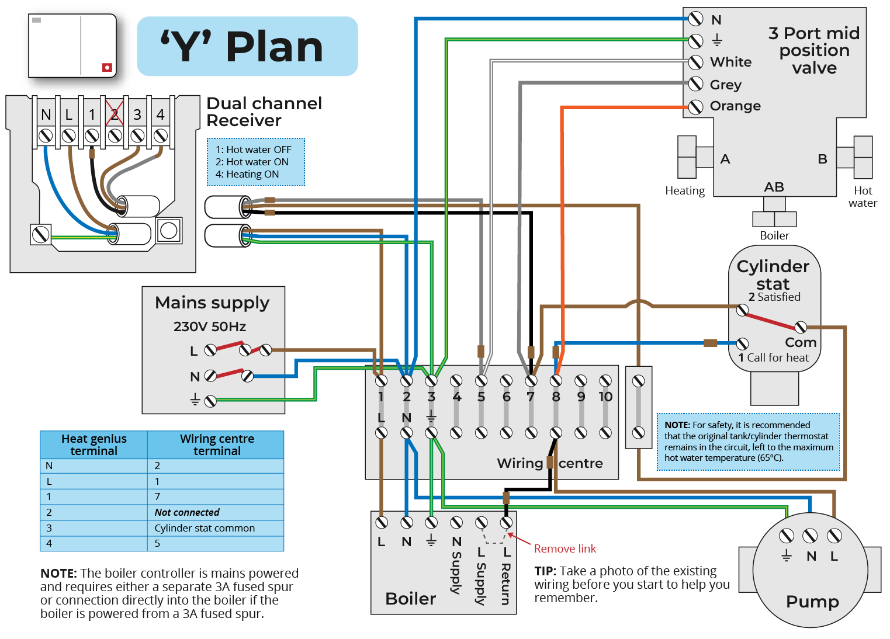
‘Y’ plan fully pumped system
A ‘Y’ plan system incorporates a thermostat to control room temperature and a cylinder stat (boiler sensor) to control water temperature. The flow to central heating and hot water is regulated by a single three-port electromechanical valve.
An outdoor sensor is a weather compensator that monitors boiler operation, and regulates the output of the boiler, depending on the weather conditions: high output in cold weather, and a lower output in mild conditions.

Slide 9
‘Y’ plan system
The key element of this system is the three-port mid-positional motorised valve which splits the flow of water from the boiler to the hot water storage cylinder and the heating system, as and when there is a call for heat.
When a zone’s heat requirement is satisfied the motorised valve will close the port feeding that zone. In the event that both zones are satisfied the valve will close down the boiler and pump until there is a demand for heat for whichever zone.

Slide 10
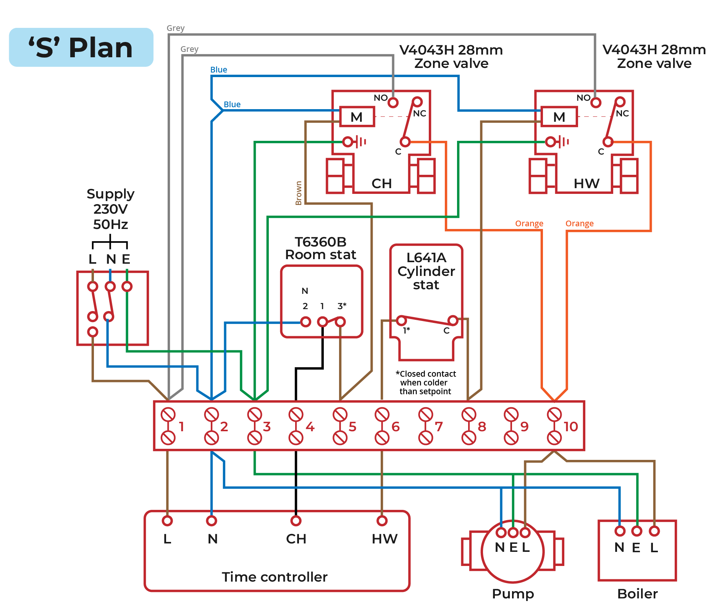
‘S’ plan fully pumped system
An ‘S’ plan system is similar to the ‘Y’ plan but incorporates separate valves for the hot water system and the central heating.

Slide 11
‘S’ plan system
The key elements of this system are the two double-port motorised valves which control the flow of water from the boiler to the hot water storage cylinder and the heating system.
When a heating zone’s heat requirement is satisfied the motorised valve closes the flow to that zone. In the event that both zones are satisfied, both valves will close down the boiler.
The heating system pipework is normally arranged in a two-pipe parallel return configuration. Alternately it may supply heating to an underfloor heating manifold.

Slide 12
How a fully pumped system works
A fully pumped system uses two zone valves: one to control the hot water, which is activated by the cylinder thermostat, and a second which is activated by the room thermostat.
A zone valve acts as an isolator, closing off the flow of water. If a property is over 150m² an additional heating zone valve should be fitted to allow independent control of upstairs and downstairs. An automatic bypass is fitted to the system.

Slide 13
Heating programmer
Electronic programmers such as the one shown here automatically switch the heating and hot water circuits in a fully pumped system on and off as required.
The programmer runs both system circuits to a pre-set programme dictated by the user.

Slide 14
Circulator pump
As their name implies, fully pumped systems require a centrifugal action glandless circulator pump.
The pump is mounted on the flow pipe from the boiler.
It has adjustable head settings to suit different systems.
Positive pressure throughout the system prevents the ingress of air through micro leaks.

Slide 15
Two-port motorised valve
Used for fully pumped heating systems with separate zones – ie primary flow to a hot water storage cylinder and heating zones.
Valves are operated by either a cylinder stat or a room stat.
The valve head contains a micro switch which operates the boiler and pump.
The motorised head is replaceable, therefore there is no need to drain off the system for repair.

Slide 16
Three-port motorised valve
Water enters the valve through the bottom port.
The two horizontal ports are connected to the primary flow to the hot water storage cylinder and the other port to the heating circuit.
The head has two micro switches which can independently operate the boiler and pump.
Each outlet port can be closed independently when the desired temperature is reached.

Slide 17
Magnetic system filter
Magnetic filters are designed to combat the damaging effects of system debris and pollutants.
The filter is installed on the return pipe below the boiler.
The filter chamber can be removed and cleaned without draining the system.

Slide 18
Radiators
Convector panel heat emitters are commonly known as radiators, yet only 10% of heat emissions are by radiation.
Convector panels are available in many widths and heights to match the heat loss from a space.
Radiators are manufactured from sheets of pressed steel, welded together.
Each is controlled by a flow and return valve.

Slide 19
Radiator control valves
Each radiator is fitted with two valves for isolation and control.
The emitter pipe will be fitted with a thermostatic valve which has several settings, indicated by a range of numbers (1 to 5 etc). The valve will open and close depending on the room’s air temperature.
A lockshield valve is fitted on the return pipe and is used to balance the system to give the correct flow rate to the emitter.

Slide 20
Kitchen plinth fan convector heater
Heaters of this type are designed to fit into the plinth below a kitchen unit, freeing up wall space.
The heater consists of a finned pipe coil to which the heating flow and return pipes are connected, and a centrifugal impeller powered by a small electric motor.
The fan is controlled by a low limit stat to prevent cold air blowing and a high limit stat to prevent the kitchen from overheating.
It recirculates air to conserve energy.

Slide 21
Underfloor heating systems
In an underfloor system the boiler heats the water, which is pumped to the manifold. The manifold then blends the water and distributes it through the heating circuits. The pipes warm up, the screed warms up, the floor warms up, the room warms up.
Underfloor heating provides a lower, more even temperature. The crucial factors are flow rate (set by the manufacturer), correct heat transfer, ensuring the flow rate is slow, and temperature difference – approximately 60ºC.

Slide 22
Underfloor heating
Underfloor heating works differently to conventional heat emitters. The floor becomes the heat emitter when it is heated up by pipework that has been laid under the screed or boards.
Underfloor heating is energy efficient. However, the heat is concentrated at floor level, and the main disadvantage is that it takes time for heat to generate or dissipate when a system is turned on or off.

Slide 23
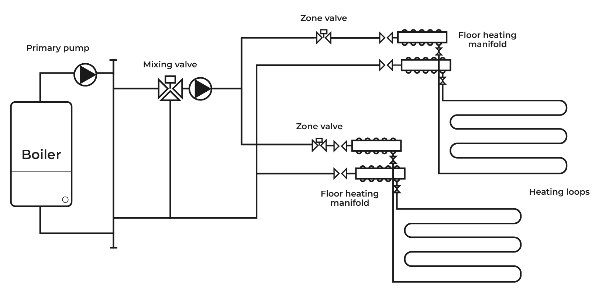
Underfloor heating: solid floor pipe coils
Plastic pipe coils are laid either within a solid floor structure or directly underneath a wooden floor structure.
Each coil is a single length of pipe with no joints, except at the manifold.
The floor temperature is maintained at approx. 35ºC.

Slide 24
Underfloor heating: manifold
The underfloor heating manifold is connected to the heating system flow and return pipework.
There is a pump to circulate water independently through the coils and a thermostatic mixing valve to maintain a pre-set temperature.
The flow and return manifolds have regulating valves to maintain pre-set flow rates, and an automatic air vent valve.

Slide 25
Any questions?

