Slide 1
PowerPoint 3: Gas systems
PowerPoint presentation
12. Building services engineering (BSE) systems
12.1 Building services engineering systems

Slide 2
Objectives
By the end of this session learners should be able to:
understand the requirements for installing gas pipework systems
list the procedures for tightness testing of installation pipework systems
describe a variety of BSE gas system components (meters, boilers, fires and cooking appliances).

Slide 3
Gas pipework
Gas pipework is generally installed using half-hard copper tubing with capillary soldered joints.
Compression fitting must only be used where the pipework is exposed.
Pipework passing through walls and floors should be via the shortest route and contained in a pipe sleeve sealed on one surface. No joint should be present within the sleeve.
Pipework must be adequately supported and positioned to avoid impact or corrosive atmospheres.
Pipework must not be installed in a cavity or unvented duct.

Slide 4
30 millibar ‘U’ gauge or manometer
The ‘U’ gauge is simple to use and extremely accurate at measuring gas pressure in pipework (as compared to atmospheric pressure). It is used by gas engineers to commission gas appliances.
As the name suggests it is a clear U-shaped glass or plastic tube. Behind the tube is an incremental scale which measures millibars (mbar): 1mbar is 9.81mm on the scale.
This gauge normally reads to 30mbar, but longer gauges are available for higher pressures (ie propane).

Slide 5
Tightness testing of new pipework
The pipework should be charged with air to 20 to 21mbar with a manometer connected to a test nipple.
The pipework should stand for one minute to allow for temperature stabilisation, then the gauge pressure should check.
Top up the pressure to 20 to 21mbar and leave to stand for two minutes.
If after two minutes the pressure drops bellow 20mbar the leak should be traced and rectified and the test repeated.
When no pressure drop occurs the pipework is sound and ready for the gas.

Slide 6
Tightness testing of existing pipework
Fill with gas to between 7 and 10mbar on the manometer and leave for two minutes. This is a ‘let-by’ test for the emergency control valve. If the pressure rises the gas supplier must be notified.
If no let-by occurs, elevate the pressure to 20mbar for one minute for temperature stabilisation. If the pressure drops, top it up to 20mbar.
The tightness test then lasts for two minutes. If gas appliances are connected the permissible pressure drop is 4mbar.
If the pressure reading is within the permitted drop, the system is sound unless gas can be smelled.

Slide 7
Gas isolation valves
All gas appliances must have a means of isolating them from the installation pipework.
Gas isolation valves are normally made from brass.
In the valve shown here, the valve handle is in line with the flow, indicating the valve is open.
This valve mechanism is a plug type, which has a 90º action.
Compression fitting should only be used where access is open.

Slide 8
Service governor and emergency control valve
The service governor is mounted on the inlet of a gas meter.
It has a stainless-steel flexible pipe, referred to as the ‘anaconda’.
The service governor includes the emergency shut off valve for isolating the system from the mains supply. When the valve handle is in line with the valve, the valve is open. It must be turned downwards to close the valve.
The outlet of the governor is set at 25mbar pressure.
A constant pressure governor. When gas is used in the property there will be a constant working pressure of 21mba (mb +- 2 (19–23) mbar).

Slide 9
Constant pressure gas governor
Governors are installed on all gas appliances to enable gas engineers to set the burner pressure for complete combustion to take place.
A spring-loaded diaphragm has a valve attached to it which moves up and down on the valve seating to regulate and maintain a constant pressure.
The top of the governor is where the adjustable spring is housed.

Slide 10
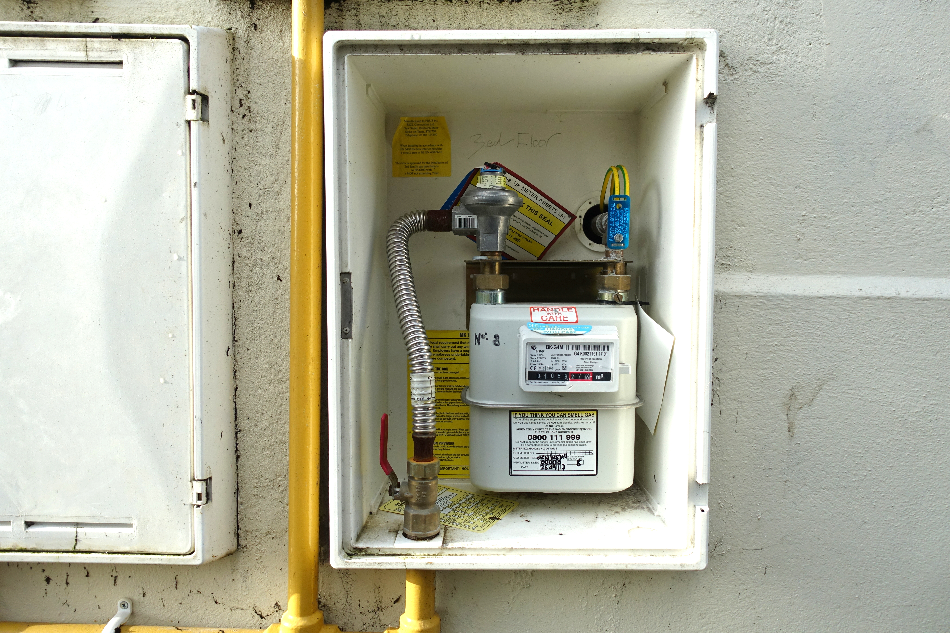
Domestic E6 digital meter
Gas meters record the amount of gas used, for billing purposes.
An E6 meter can supply 6m³/hour of gas.
On the outlet (top right) there is a test nipple which enables a gas engineer to test the integrity of the installation pipework, to ensure there are no leaks.
The red part of the meter reading is where appliances can be gas rated.

Slide 11
Domestic U6 diaphragm meter
On this type of meter the reading is by means of a mechanical display and mechanism. There is a test dial which is used to gas rate the appliance.
Like the digital meter there is a test nipple for checking integrity.

Slide 12
Heating systems: combi boilers
Inside the boiler jacket of a combi boiler is the combustion chamber.
The flue fan pushes the products of combustion through the preheater, causing condensation to take place.
The expansion chamber allows the water in the heating system to expand without opening the pressure relief valve.
Internal controls are behind a white control panel.

Slide 13
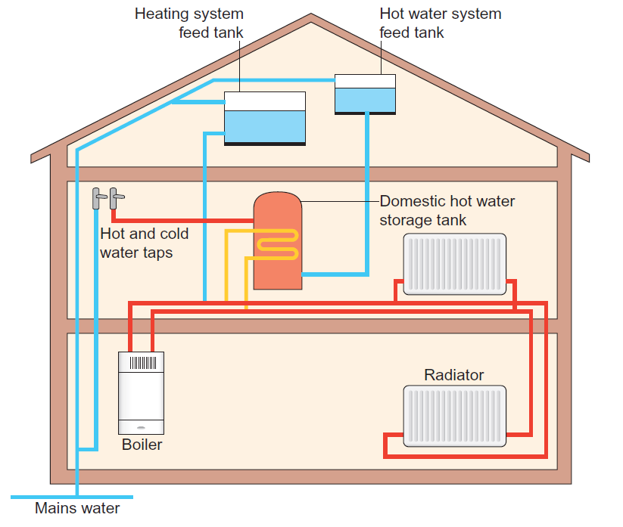
Heating systems
Heat-only boilers make use of a cistern tank, which stores hot water and feeds tanks in the loft. The system typically incorporates a circulation pump. The stored water is heated up and stored again until it is used.

Slide 14
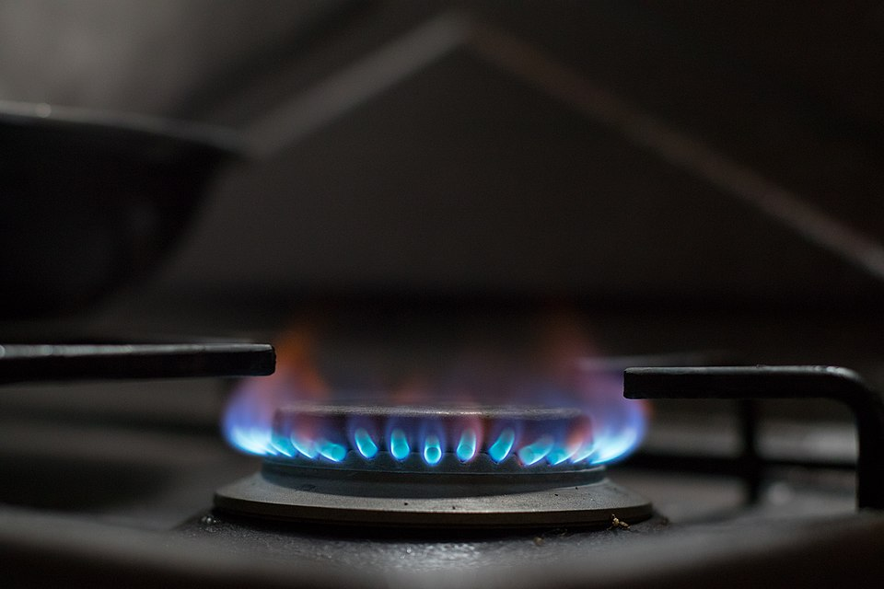
Cooking appliances
The burner head of a gas hob is where gas and primary air are mixed to enable complete combustion to occur outside the burner ports.
Secondary air is taken from outside the burner.
Because this type of appliance is flueless, it is essential that the only products of combustion are carbon dioxide and water vapour.
The components include the jet (equivalent to a fuel injector), which is drilled to allow a certain flow of gas, the burner head or crown (silver in colour), which mixes air and gas together, and forms the shape of the flame, and the burner plate (black metal plate on top of the crown), which influences the shape of the flame and inhibits foreign objects getting into the jet.

Slide 15
Cooking appliances
In a fitted gas hob, each of the burners has a flame failure device built in, which is designed to shut the gas supply off in the event of the flame being extinguished.
The flame failure device is known as a thermocouple and requires heating initially to maintain supply to the burner.

Slide 16
Heating appliances
There are two main types of gas fire.
Conventional flue fires have to be connected to a chimney so that air can be drawn for combustion. Waste gases are sent up the chimney into the atmosphere.
Balanced flue fires do not necessarily need a chimney, because waste gases are expelled through a concentric flue, which itself is connected to the top of the fire and through to an outside facing wall.

Slide 17
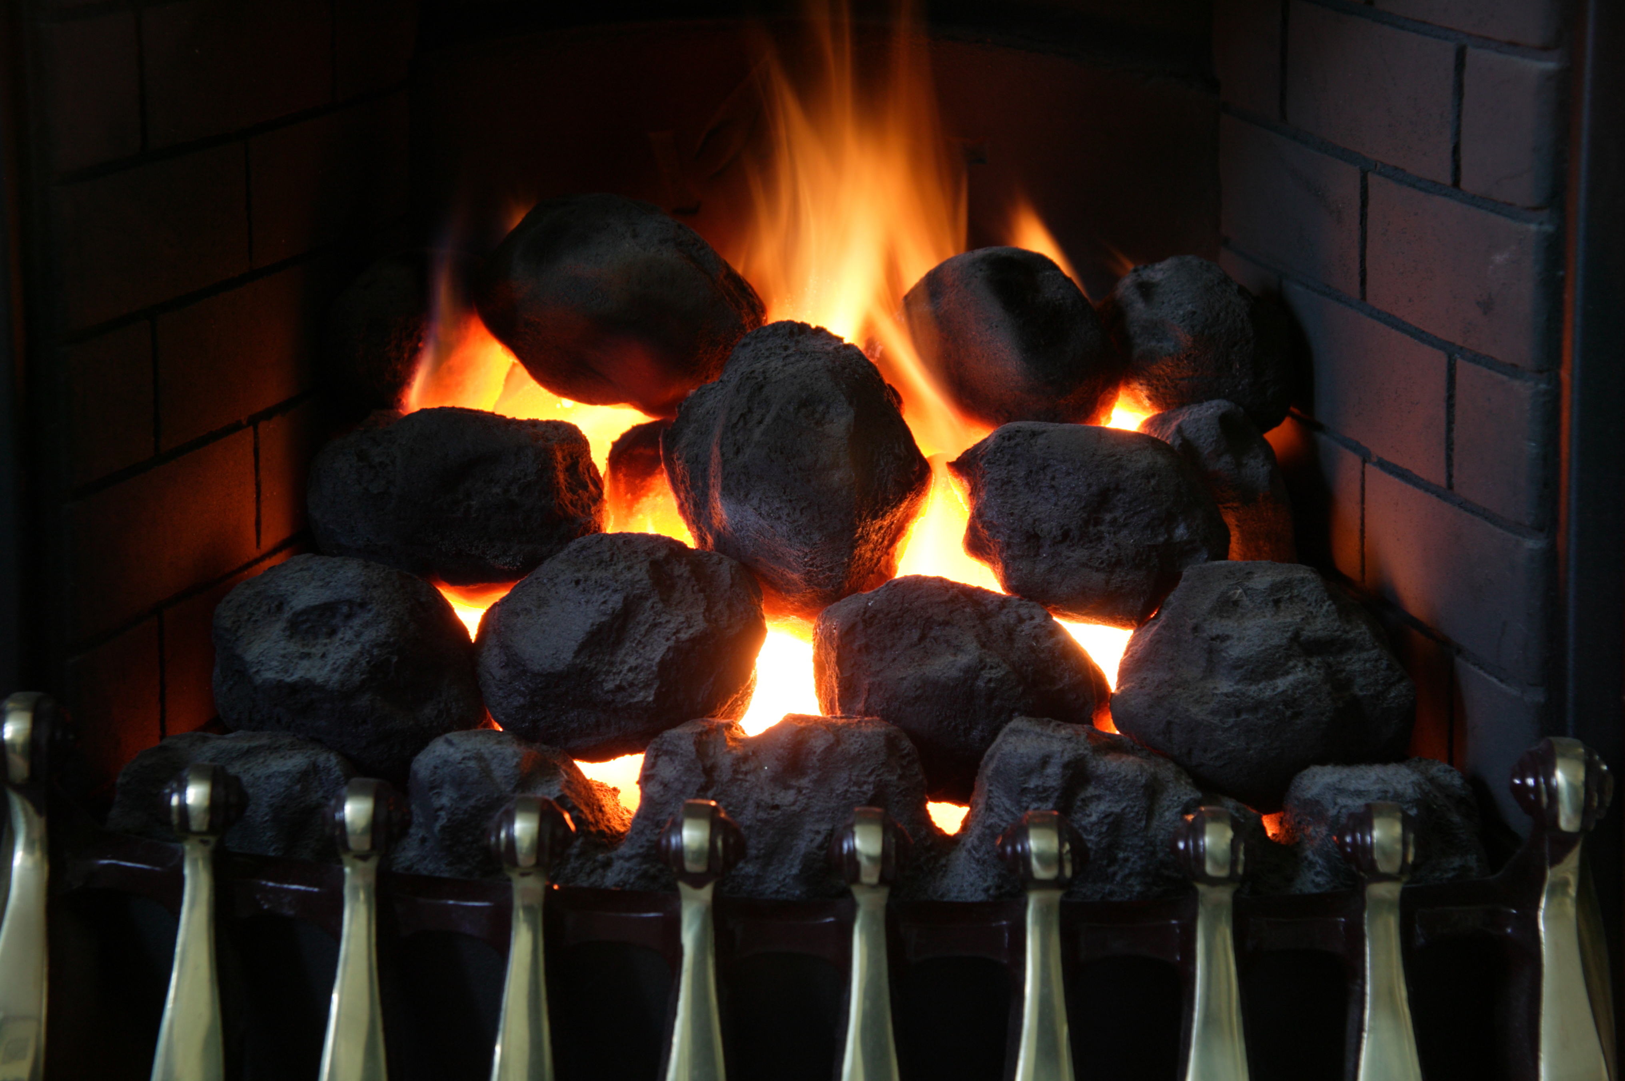
Heating appliances
Shown here is a decorative fuel effect (DFE) fire.
The hearth (firebox) serves as an attachment point for the gas burner.
The air mixer draws combustion air for the burner.
The burner orifice supports the flow of natural gas.
The gas valve control uses an induced electrical charge to operate an electromagnet and open the valve.
The spark igniter ignites the gas flow to a pilot light.

Slide 18
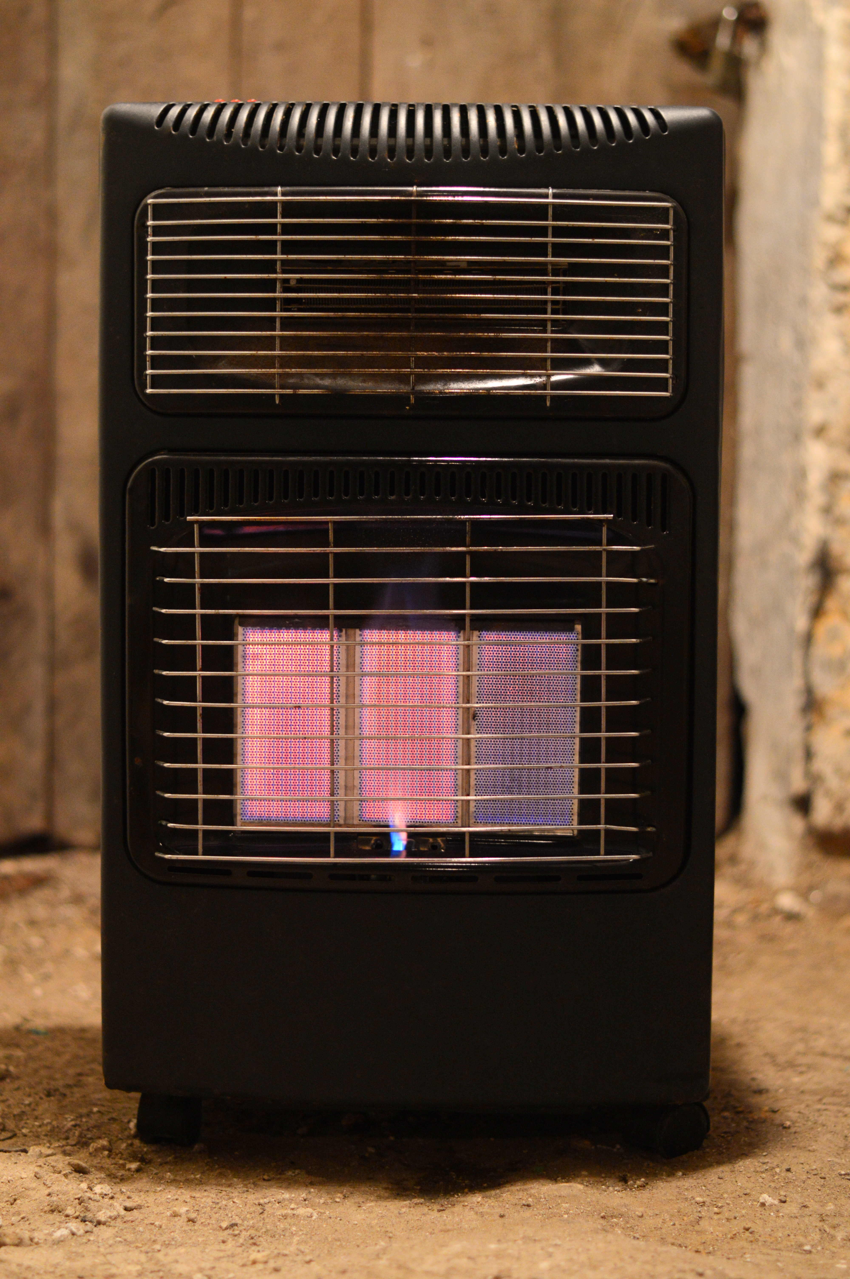
Heating appliances
In a gas fired radiant tube heater the basic components are gas valve, piezo ignition and pre-aerated burner.
A radiant tube heater produces infrared radiation via radiant tubes and contains an open flue.

Slide 19
Gas safety: thermocouple flame failure device
Thermocouples are made using two dissimilar metals – copper and invar steel – joined at both ends.
At each end is a hot junction (flame sensor) and a cold junction (connected to the gas valve).
A flame at the hot junction produces a micro voltage (10mV DC).
The cold junction is connected to an electromagnet which opens the gas valve and keeps it open until the flame is extinguished. This prevents unburnt gas infiltration.

Slide 20
Gas safety: oxygen depletion device
An oxygen depletion device is fitted to gas fires to prevent carbon monoxide poisoning from inadequate ventilation into a room with a gas fire.
If there is a lack of oxygen in the room, the pilot flame becomes unstable and unable to keep the thermocouple active.

Slide 21
Any questions?

