Slide 1
PowerPoint 2: Electrotechnical systems
PowerPoint presentation
12. Building services engineering (BSE) systems
12.1 Building services engineering systems

Slide 2
Objectives
By the end of this session learners should be able to:
describe the components of an electrotechnical circuit
describe the layout and basic components of electrical power circuits
describe the layout and basic components of lighting circuits
describe data networks and their uses in BSE systems
describe heating systems and their control
discuss electrical appliances in common use.

Slide 3
Components of an electrotechnical circuit
An electrical circuit comprises the following main components.
A source of supply, AC or DC.
A fuse or circuit breaker which will cut off supply if too much current flows. This is called circuit protection.
A device which needs current to make it work. This is known as the load.
A switch to turn the circuit on and off. This is called circuit control.
Conductors through which the current will flow. Two or more conductors embedded in a protective sheathing is called a cable.

Slide 4
Electrical power circuits
An electrical power circuit is any circuit that distributes power for utilisation elsewhere, such as sockets, cookers, showers, industrial plant, fans, etc.
In the majority of installations the ring final circuit is the most common power circuit. It is a continuous ring (ie it starts and ends in the same place). All wiring starts and finishes at the same point. A common rule in domestic installations involving ring circuits is that there should be a separate ring circuit for every 100m² of floor.
Another circuit to be found in power circuit installations is the radial circuit. This circuit has a looped shape as opposed to a ring, and does not offer the same level of distribution.

Slide 5
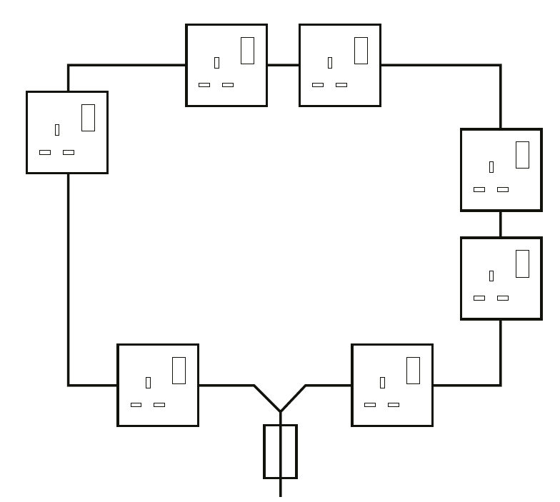
Ring final circuit

Slide 6
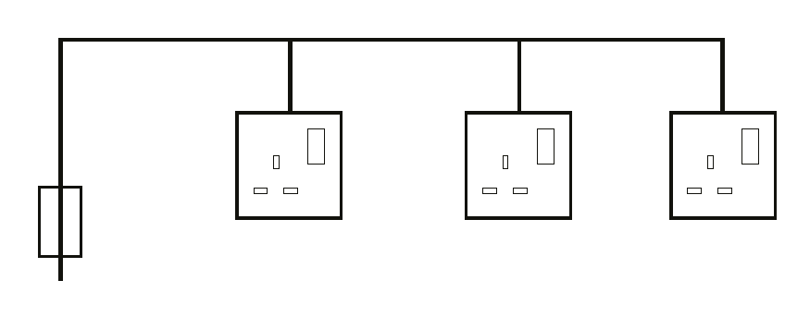
Radial circuit

Slide 7
Three-phase power distribution
Three-phase power distribution in industry usually involves three-phase steel wire armoured (SWA) cables or contained busbar installations. Where the demand is for 400V motors, all three phases are directly connected to the distribution system.
When 230V single-phase voltage is required (eg ring main final circuits or single-phase lighting), alternate phases will be connected to local distribution boards to balance the supply.

Slide 8
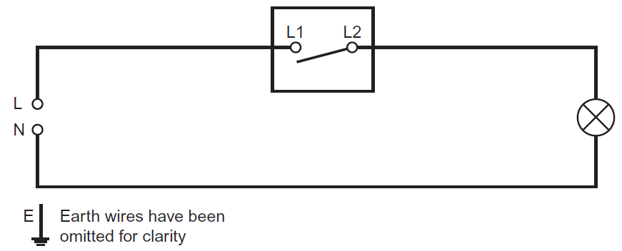
Lighting circuits
Electrical lighting or illumination is the use of electrical circuits to achieve practical or aesthetic effects and can include sources like lamps and light fixtures.
The wiring diagram shows a lighting circuit in its most basic form.

Slide 9
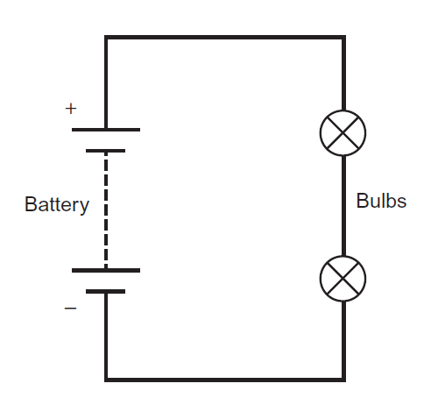
Lighting circuits: series
This lighting circuit is a series circuit, which means that the current is the same at all points of the circuit.

Slide 10
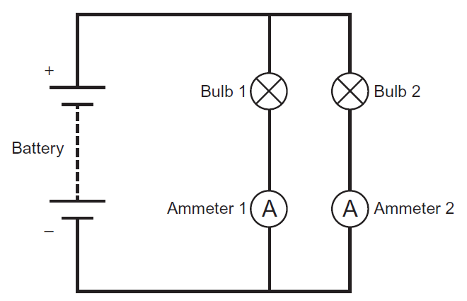
Lighting circuits: parallel
This is a parallel circuit. The current flowing out of the supply has a choice of where to go: either to bulb 1 and ammeter 1 or to bulb 2 and ammeter 2.
This means that the current measured at ammeter 1 will be different to the current measured at ammeter 2. However, if the current measured at ammeter 1 is added to the current at ammeter 2, this will equal the total current coming out of the supply.

Slide 11
Lighting circuits: switches
In order to control the lighting, we need to introduce a switch in the line side of the circuit, effectively breaking or making the circuit whenever we need the light on or off.

Slide 12
Lighting circuits: multiples switches
Sometimes it is necessary to have two switches controlling one light –for example, at the top and bottom of a staircase. This is known as two-way switching.
Intermediate switching occurs where three switches are required – for example on multi-level staircases or in long corridors – a different switch with four terminals is used in such situations.

Slide 13
Lighting
Sodium vapour lamps are commonly used for street lighting, especially on motorways, because they are highly efficient and penetrate mist and fog particularly well. As the bulb warms up, the sodium vapour becomes excited, emitting a characteristic yellow light at a wavelength of 589 nonometres (nm). Such lights are now being replaced by light-emitting diode (LED) alternatives.

Slide 14
Lighting
Fluorescent tube lighting integrated into suspended ceilings is gradually being replaced by LED luminaires (a luminary is an industry term for a light-giving body) because fluorescent tubes are expensive to run and generate unwanted heat. They can also seriously affect people’s health due to flicker effects causing photosensitive epilepsy.
Large banks of fluorescent lights draw a lot of current when they are switched on (high inrush current). To prevent a circuit breaker tripping, such circuits are protected by a type C breaker, which is designed to withstand such surges.
Fluorescent lights are classified as hazardous waste, because they contain low pressure mercury and phosphorus. Their replacement will therefore be beneficial to the environment.

Slide 15
Lighting
LED luminaires are increasingly replacing filament lamps and tubes because of their high efficiency and reduced heat emission when illuminated.
Typically, a 100-watt (W) filament lamp would be replaced by a 5W LED. LED lamps have a lifetime of 10,000 hours compared to 200– 300 for filaments.

Slide 16
LED downlighting
LED lights operate through electroluminance. Inset downlights are designed for installation in suspended ceilings. They are usually rated at 5W or 8W and generally provide better overall illumination of a room.
Modern LED downlights are firestop rated, providing protection for the ceiling void from potential fires below.
The advantages of installing LED lighting are its long life, no ‘phantom effect’ and the fact that if one light fails the others will continue to provide illumination.

Slide 17
Halogen security lighting
Halogen lights incorporate a regeneration effect, whereby a chemical reaction maintains the life of the tungsten filament. Halogens are
not as efficient as LED lighting.
In practice, security lighting is installed to the exterior of a building and is usually triggered by a PIR (passive infra-red) sensor, which detects the movement of a heat source. They are typically set to illuminate for a limited time to prevent energy wastage. Once again, such lights are increasingly being replaced by LED alternatives.

Slide 18
Data networks
A data network is a system designed to transfer data from one network access point to another via data switching, transmission lines and system controls.
A network is created when more than one device is connected together. A network can be a small collection of computers connected within a building (eg a school, business or home) or it can be millions of computers connected on the internet around the world.
Data networks and data networking solutions impact nearly all modern-day communication, such as telecommunications and the internet.

Slide 19
Data networks: LAN and WAN
There are many different types of network.
A LAN (local area network) is a network of computers within the same building, such as a school, home or business. A LAN is not necessarily connected to the internet.
A WAN (wide area network) is created when one or more LANs are connected. This requires media such as broadband cables and can connect organisations based in different geographical places. The internet is a type of WAN.

Slide 20
Data networks: VPN and WPAN
A VPN (virtual private network) is usually hosted securely on another network, such as the internet, to provide connectivity. VPNs are often used when working on secure information held by a company or school.
A WPAN (wireless personal area network) allows an individual to connect devices (such as a smartphone) to a desktop machine, or to form a Bluetooth connection with devices in a car.

Slide 21
Modern data cables
Data network cables are designed for use in control systems for information and data transfer.
Fibre optic cables transmit light, not electricity, and have a very high rate of data transfer.

Slide 22
Containment and routing of data cables
Data cabling is easily and neatly grouped together using a cable basket, or tray. The data cables are tied together, and to the tray, using cable ties.
This method is particularly useful in ducts and ceiling spaces.

Slide 23
Electrotechnical data controls
Building energy management systems (BEMs)
Also known as operational technology networks, these are common in the commercial sector, with a focus on reducing energy consumption and CO² emissions. They control heating, ventilation, air conditioning (AC) and more. Markets include education, healthcare, data centres, retail, sport and leisure, along with offices and commercial buildings.
The illustration on the next slide shows a constant volume variable temperature control system. All the control components, data and control cabling connect to a out-station feeding data to a BEM network via a modem. This transmits data on the internal and external temperatures and the flow water temperature.

Slide 24
Electrotechnical data controls
Constant volume variable temperature control system
The BEM temperature sensors constantly send data to the central processing unit (CPU) to maintain a constant temperature in the building. Many control systems can be connected to the BEM.

Slide 25
Electrotechnical data controls
The BEM display screen shows digital images of a particular aspect of the system within the building (eg a plantroom or process). The operator can adjust the parameters to provide the most comfortable conditions. This can be done either from the control centre or remotely through the internet.
Many large facilities management contractors will have the capability to respond to faults or alarms generated by the BEM system.

Slide 26
Electrotechnical controls
Stop-start switches are used to control the three-phase motors used for pumps, fans and other industrial machinery and plant.
The switch has a single-phase electromagnetic coil which, when energised, pulls the connector contacts together to start the motor.
The stop button breaks the supply to the electromagnetic coil and terminates the supply to the motor.

Slide 27
Electrotechnical controls
In a three-phase motor, when the start button is pressed a current flows through a coil around the trip rod and pulls the trip rod to close the phase lines, thus starting the motor.
As the phases are at 120º there is always one phase in negative voltage; therefore, the used power can return.
Pushing the stop button opens the trip mechanism and stops the motor.
This is known as a DOL (direct on-line) starter. These are used for small motors of 5kW or less.

Slide 28
Electrotechnical controls
Programmable ‘roomstats’ are used in central heating installations and are ideal for combi-boiler systems.
They incorporate a single channel, automatic, timed boiler switching control for the heating circuit.
In combi systems the hot water supply is instantaneous and available at all times.

Slide 29
Electrotechnical controls
Two-channel programmers control domestic hot water and heating circuits and are used in fully pumped ‘Y’ and ‘S’ (non-combi) systems.
These heating programmers require hard wiring into the external control system.

Slide 30
Electric heating systems
The diagram shows electric heating using off-peak electricity to heat storage heaters overnight, which then release the heat into the building during the day.
Hot water is provided using metered electricity. Stored hot water is controlled by a time clock, giving the user control of when water is heated. If a direct acting water heater is connected, water will be available on demand.

Slide 31
Appliances
Storage heaters utilise off-peak electricity (available between 12.00pm and 7.00am).
The casing is filled with concrete blocks which have heating elements within them.
Heated throughout the night, they then emit heat during the daytime hours.

Slide 32
Appliances
An oil filled towel rail with an electric heating element has an integral thermostat maintains a constant pre-set temperature.
A double-pole isolation switch will be located outside the bathroom and the circuit is protected by a residual current device (RCD).
BS7671 wiring regulations limit the positioning (zone) of such units in a bathroom, because bathrooms are considered a ‘special location’ within the regulations.
Instantaneous water heaters and showers only heat the water inside them, and electric showers normally have their own dedicated supply.

Slide 33
Any questions?

