Slide 1
PowerPoint 15: Earthing arrangements
PowerPoint presentation
12. Building services engineering (BSE) systems
12.6 Earthing arrangements

Slide 2
Objectives
By the end of this session learners should be able to:
understand the meaning of basic protection and fault protection
describe the concept of equipotential bonding and the consequences of not having it in place
explain the hazards of inadequate earthing of electrical systems and appliances
demonstrate three methods of mains earthing.

Slide 3
Electric shock
Most hazards can be seen or heard, but not electricity: there is no advance warning!
There are four basic ways that we protect a person from making direct contact with live electrical parts, and this is known as basic protection.
We surround conductors with insulation.
We place live parts out of reach.
We place live parts within an enclosure.
We place a barrier between a person and live parts.

Slide 4
Exposed and extraneous live parts
All metallic objects pose a threat to people if they become live.
We classify metallic objects that form part of an electrical installation as exposed conductive parts.
We classify metallic objects that do not form part of an electrical installation as extraneous conductive parts (e.g. copper piping).
A metal consumer unit is exposed and therefore needs earthing.
A metal gas pipe is extraneous and therefore needs bonding.
Earthing and bonding collectively bring about what is known as fault protection.

Slide 5
Protective conductors
Protective conductors connect all exposed and extraneous metalwork together. There are four types of protective conductor.
Main earthing conductor (16mm² in size for a modern property).
Equipotential bonding conductor (10mm²).
Circuit protective conductor (depending on circuit).
A supplementary conductor (6mm²) is needed if a property is without residual current device (RCD) protection – when all extraneous pipework in kitchens and bathrooms are bonded together.
Aside from RCD protection, a long lead must be used to ensure that pipework from kitchens and bathrooms registers very low values of resistance.

Slide 6
Earthing
Earthing is defined as a deliberate means of:
providing a low resistance path, through which
a large fault current will flow, in order to
operate a protective device, which then
shuts off the supply.
In other words, earthing brings about automatic disconnection of the supply (ADS).

Slide 7
Main equipotential bonding conductors
The principle of electrical bonding is that if all extraneous conductive parts are linked to the earthing system, then all exposed and extraneous metallic parts will be at the same potential.
This then reduces the possibility of dangerous voltages forming. In essence, a building becomes a Faraday cage.
The same principle explains why birds are not electrocuted when they perch on overhead power lines.

Slide 8
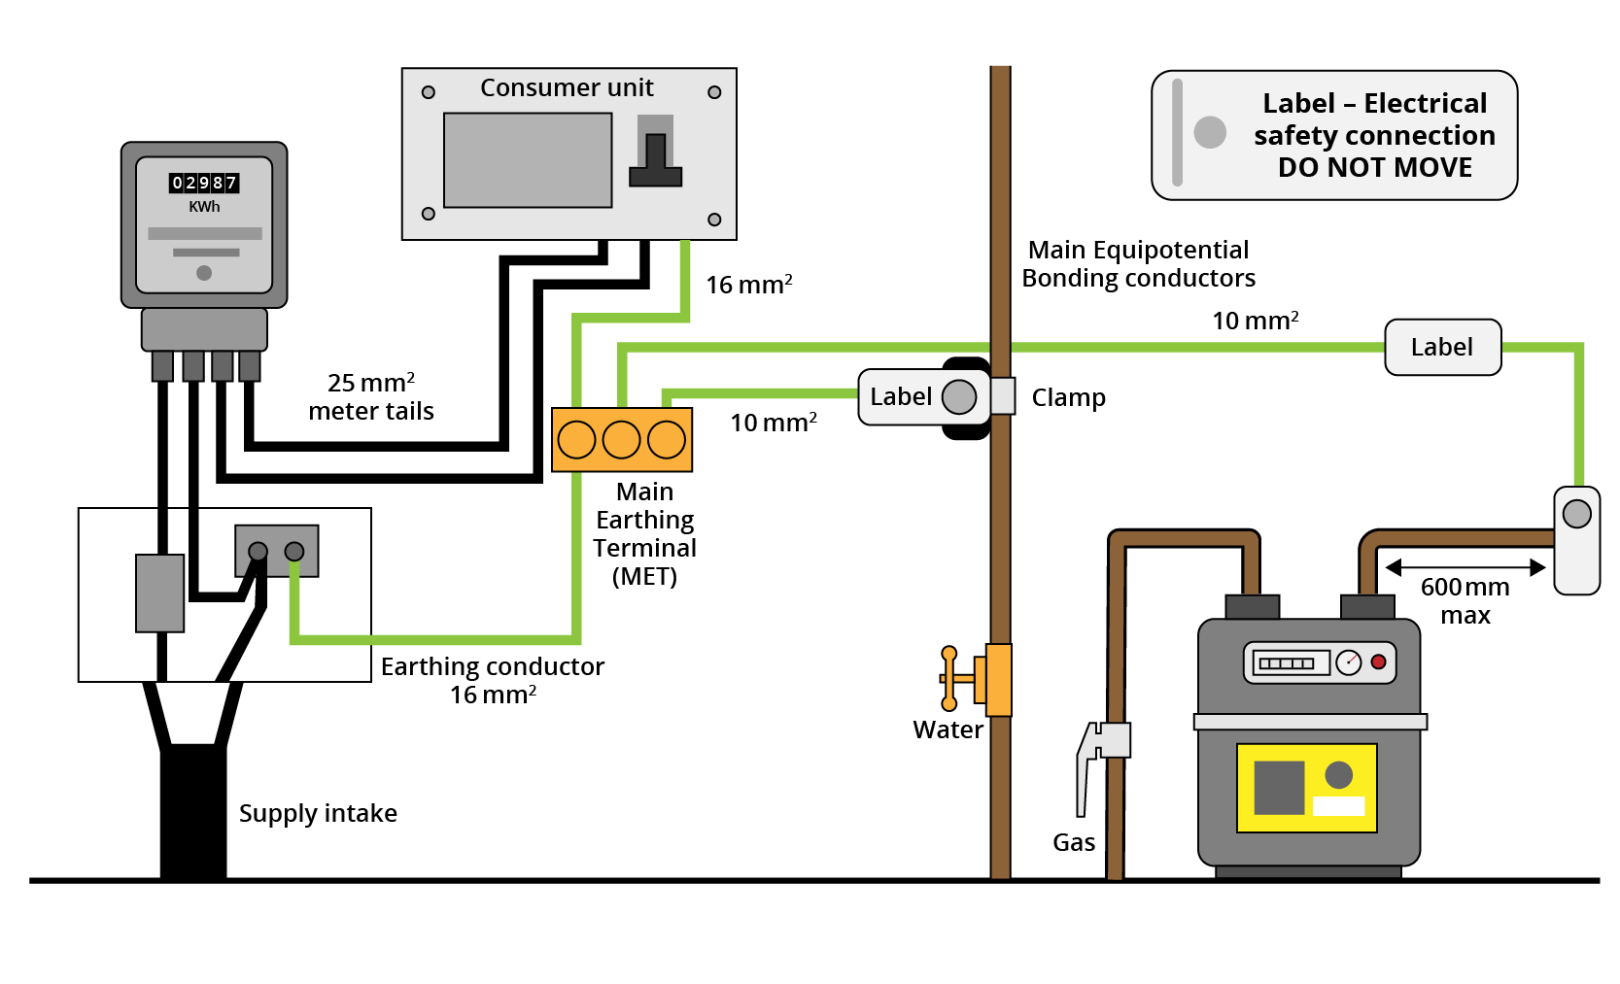
Equipotential bonding

Slide 9
TN-S, TN-C-S and TT earthing
TN-S, TN-C-S and TT are three types of common earthing arrangement, where:
T = earth (from the French word terre, which means ground)
N = neutral
S = separate
C = combined.
Modern installation systems have done away with an external main earthing terminal, and instead connect directly to the earthing bar
within the consumer unit.

Slide 10
TN-S earthing
This earthing system uses the metal armour of the supply cable as the earthing conductor.
The armour is then connected to the main earthing terminal (MET), by way of an earthing conductor, which then feeds the earthing bar in the consumer unit.
All circuit protective conductors and equipotential bonding conductors are also connected to the earthing bar.
A fault current will flow back to the supply transformer through the supply cable armour.

Slide 11
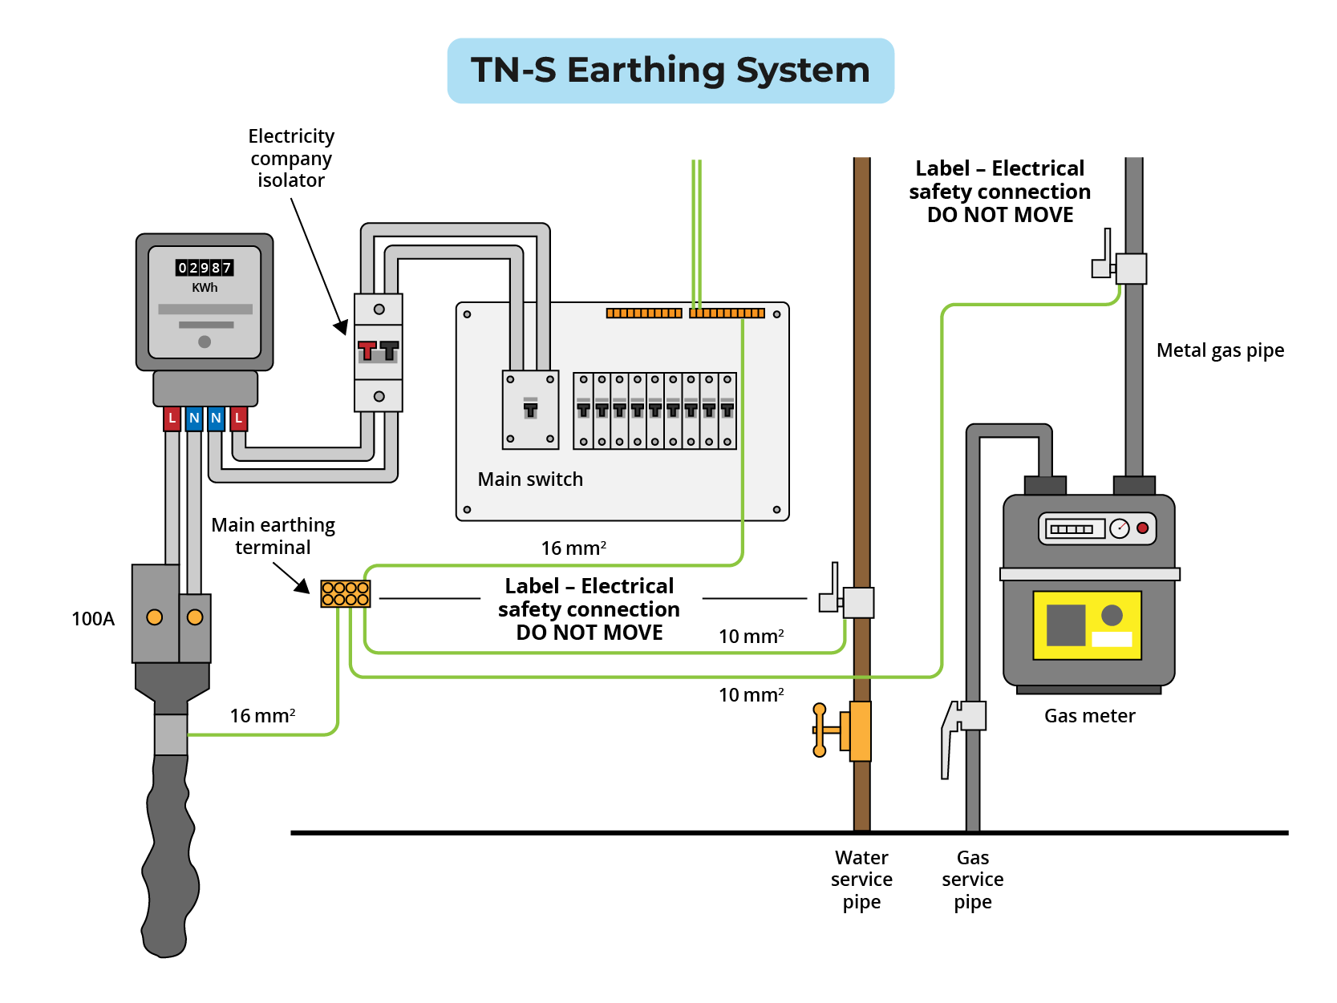
TN-S earthing

Slide 12
TN-CS earthing
This earthing system uses a PEN (protective earthing neutral) to create a link between the earthing conductor and neutral.
Because neutral and earth conductors are combined, a fault current flows back to the supply transformer through the neutral.
This system is sometimes referred to as PME (protective multiple earthing).
TN-CS is not authorised for use in petrol stations, marina pontoons or caravan parks as it is thought the system presents too high a risk in such locations.

Slide 13
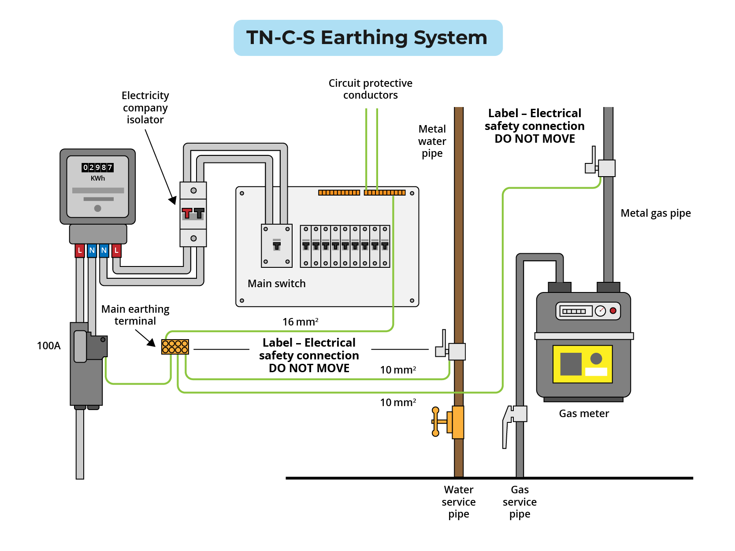
TN-CS earthing

Slide 14
TT earthing
This earthing system is used mostly in rural areas, when the supply system is yet to be upgraded.
TN-CS and TN-S not being an option, the earthing terminal block is connected to an external phosphor bronze electrode driven into the ground with a small connection chamber for the earth conductor.
Because this system literally uses the ground to return a fault current to the supply transformer, RCD protection must be in place, whenever the fault path resistance (earth loop impedance) is too high.
Because TT does not involve the supply cable, the consumer is responsible for the earth electrode.

Slide 15
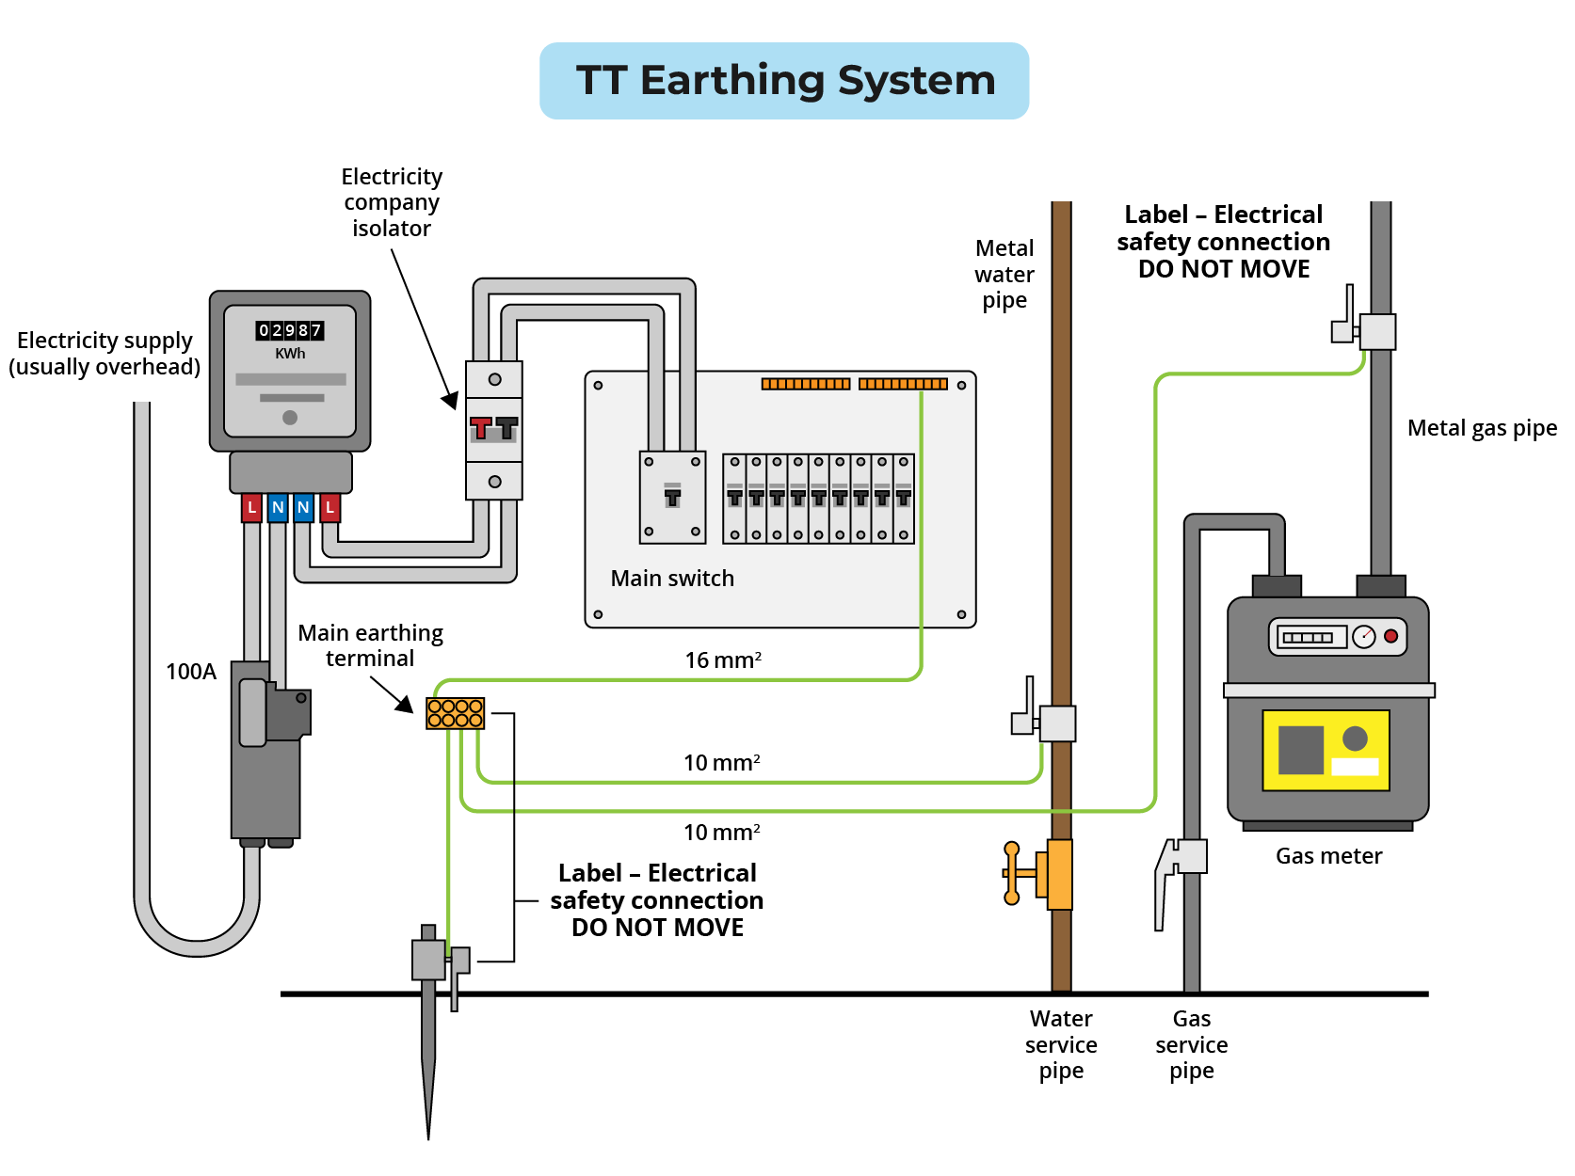
TT earthing

Slide 16
Earth paths
An electrical supply that relies on a negative conductor to complete a circuit will work perfectly when the circuit is put to use (i.e. running through a resistor).
This could be a light fitting, a water heater element or motor which is adequately insulated, meaning a short circuit fault cannot exist.
With adequate insulation a faulty appliance will not be a danger to the person using it.

Slide 17
Earth paths
In cases where cable or appliance insulation is compromised, there is a potential for a short circuit to occur and the current will find a direct path to earth, returning to the generator or substation through the earth’s conductive low resistance.
So, if a person bridges the gap between the fault and the earth the short circuit current will flow through them to the power source, possibly resulting in death (in excess of 50mA flowing through a human body will result in death).
This emphasises why circuit protection devices are so important and always an integral part of electrical circuits.

Slide 18
Any questions?

