Slide 1
PowerPoint 14: Electrical supply
PowerPoint presentation
12. Building services engineering (BSE) systems
12.5 Electrical supply

Slide 2
Objectives
By the end of this session learners should be able to:
describe sources of electrical power
describe phased power distribution
list the voltage supplies for electrical installations
compare the advantages or otherwise of different voltages in BSE systems
understand the concepts of neutral and balanced supply
explain the concept of three-phase electricity supply.

Slide 3
Electricity: AC and DC
The two types of electrical current are:
AC (alternating current) supplied through the mains, which directly powers devices such as fridges and dishwashers.
DC (direct current) converted from AC by the device (TVs, computers etc use DC electricity).
AC is fed to a wide variety of equipment in domestic, commercial and industrial environments. The amount of power required depends on the context (eg domestic homes, community buildings, industrial premises).

Slide 4
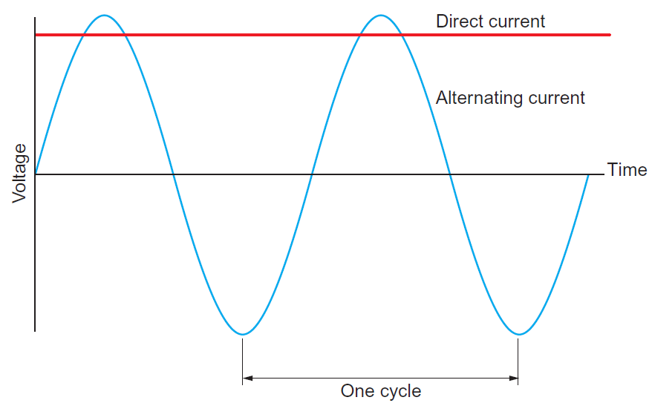
AC and DC
DC has a constant value and travels in one direction.
AC alternates from zero to a positive peak, back to zero, then to a negative peak, and back to zero again.
The number of these cycles completed in a second is known as the frequency. The mains frequency for single and three-phase systems is set at 50 hertz (Hz).

Slide 5
How do we generate power?
Power is generated by using electromagnetism.
In a power station, generators are driven by very high-pressure steam created by burning fossil fuels or using nuclear reactors.

Slide 6
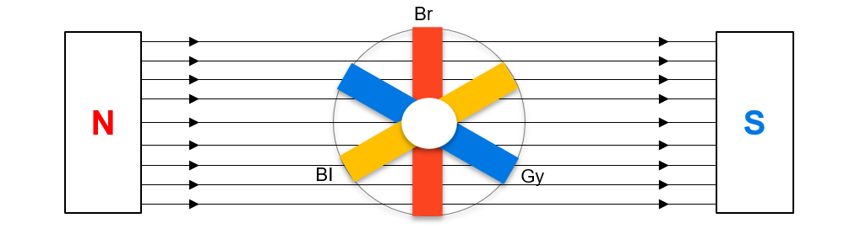
Generation and transmission
Spinning a loop of wire inside a magnetic field creates an electromotive force (EMF).
Spinning three loops inside a magnetic field generates three phases. Each loop will be mounted on the same rotating shaft, 120 degrees apart.
Each loop will create an identical sinusoidal waveform, or three identical voltages, each 120 degrees apart.

Slide 7
Transforming electricity
Electricity goes from an alternator to a transformer.
The output of most alternators is about 25,000V (25kV) and it must be transformed to:
400kV/275kV for the super grid
132kV for the original grid
66kV/33kV for secondary transmission/heavy industry
33kV /11kV for low voltage distribution/light industry
11KV/400V/230V for commercial consumer supplies
230V for domestic consumer supplies.

Slide 8
Transmission: delta
At this stage of distribution, we use the delta configuration as the load is balanced. In a delta connected, balanced, three-phase load, we are able to state the following:
VL = VP IL = √3 × IP IP = IL
√3

Slide 9

Worked example: delta connected resistive load
A three-phase, balanced, delta connected resistive load is supplied from a transformer at a line voltage of 400V and draws a line current of 13.86A. Calculate:
a) the phase voltage (VP)
b) the phase current (IP)
c) the resistance of the load.
Reminder:
Resistance is measured in ohms (Ω).

Slide 10
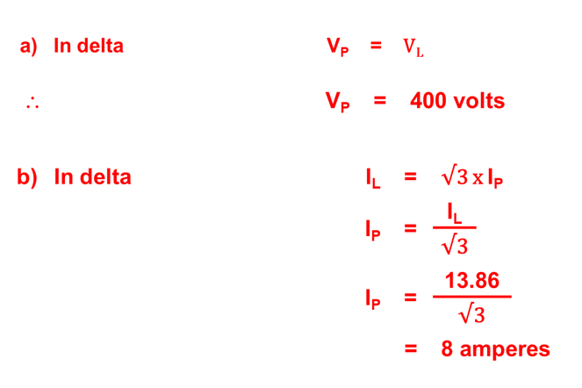
Answers to worked example

Slide 11
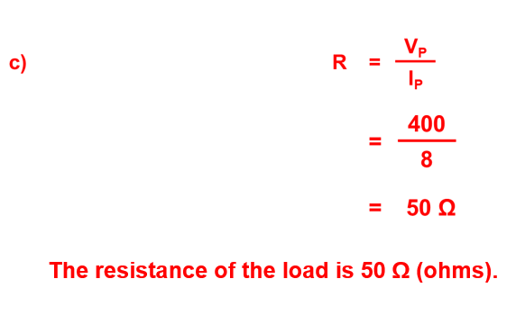
Answers to worked example

Slide 12
Power distribution
After we have transmitted the electricity across the National Grid, our requirements change for distribution.

Slide 13
Power distribution: star
Single phase (230V) and three-phase (400V) supplies are obtained from a star distribution system. When the voltage is measured from the brown, black or grey phases to neutral, this provides 230V.
When the voltage is measured from the black to brown phase, the black to grey phase or the grey to brown phase, then this provides 400V.

Slide 14
Power distribution: star
In a star distribution, we now have a neutral, which provides an earthing system. In a star-connected load, we are able to state the following:
IL = IP VL = √3 × VP VP = VL
√3

Slide 15
Worked example: star connected transformer
A three-phase, four wire, star connected transformer has a line voltage of 520V and supplies a line current of 25A. Calculate:
the phase voltage of the transformer
the phase current in each winding.

Slide 16
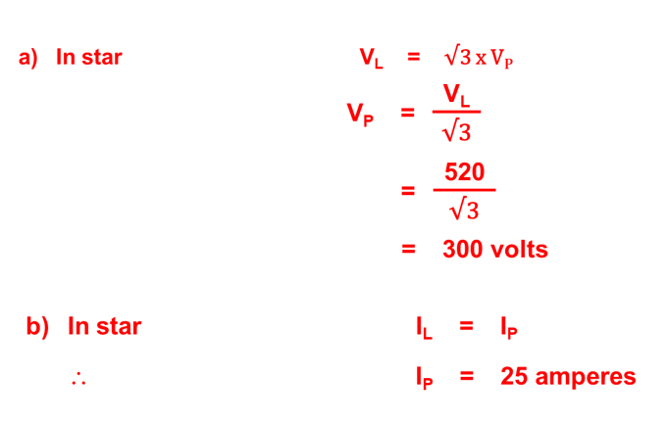
Answers to worked example

Slide 17
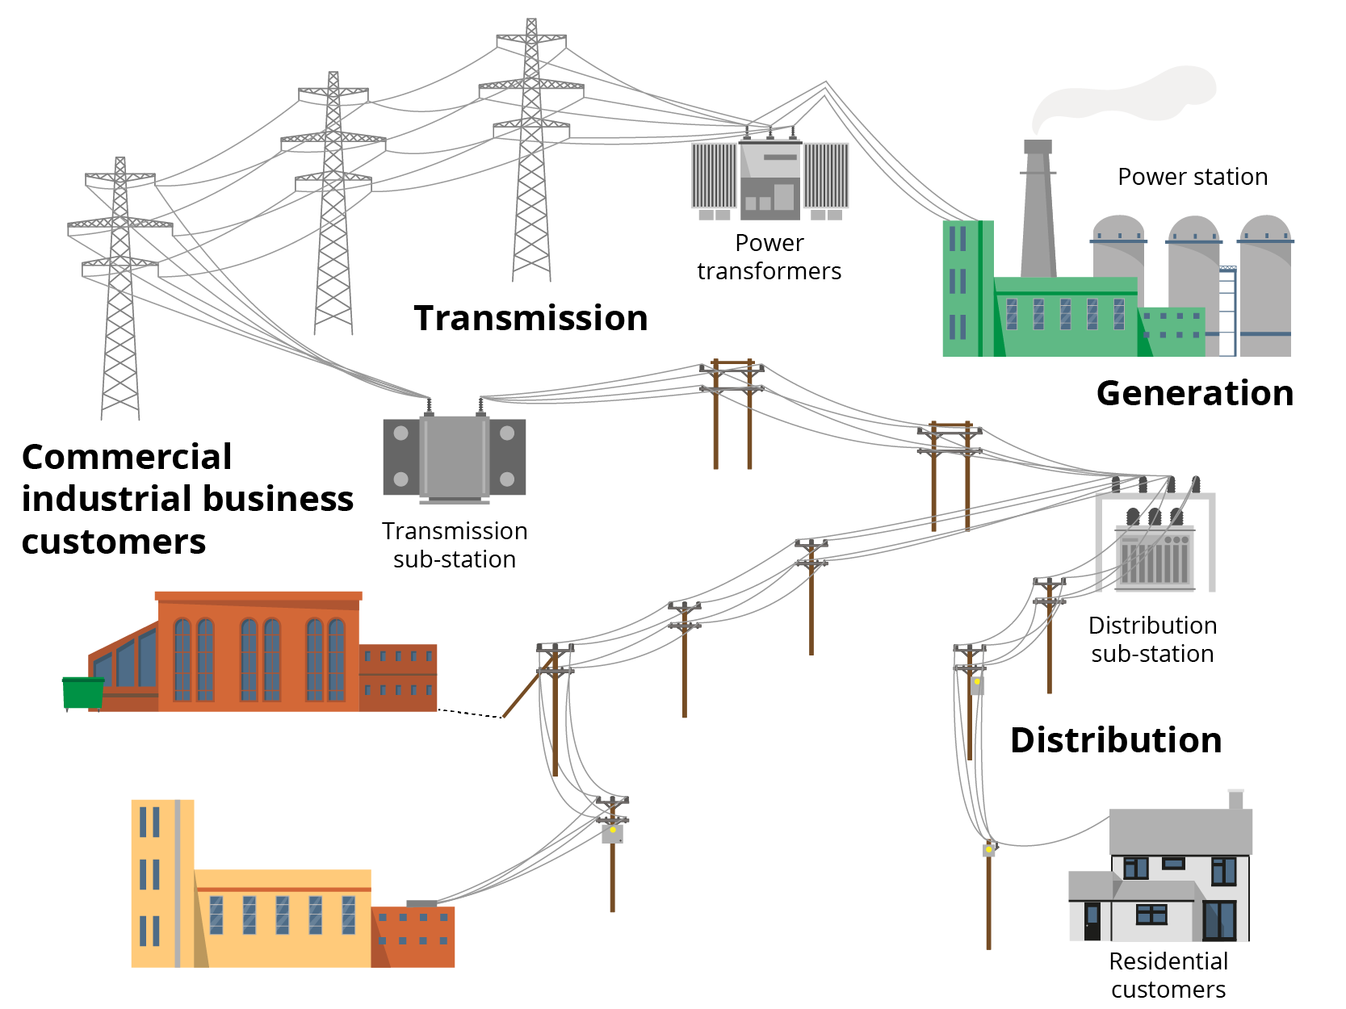
Electrical distribution network
The diagram shows how power is distributed around a district from a substation.
A single-phase supply goes to small commercial properties and domestic dwellings, while
larger commercial premises require a three-phase supply connected to all four conductors.

Slide 18
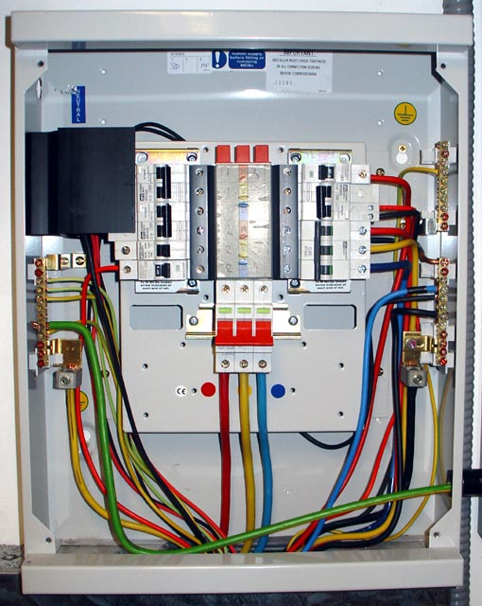
Three-phase distribution boards
In larger buildings electrical power is distributed throughout the building as three-phase power fed to distribution boards, where all the final circuits are connected to circuit protection devices.
Large open plan commercial spaces with high lighting requirements are split into three sub-areas which are then connected to three separate phases to balance the demand on the supply.

Slide 19
Domestic single-phase consumer units
All domestic consumer units are now required to be fire resistant to contain any fire caused by the internal wiring and components.
The circuit protection devices are connected to the line busbar. Banks of miniature circuit breakers (MCBs) are protected by a residual current circuit breaker with overload protection (RCBO) rather than a residual current device (RCD).
Mains cables (‘tails’) connect the consumer unit and the utility meter. The system is isolated by a double-pole switch.
Line conductors of the final circuits are connected to the MCBs.
The neutral conductors are connected to the neutral bar.
The earth conductors are connected to the earth bar.

Slide 20
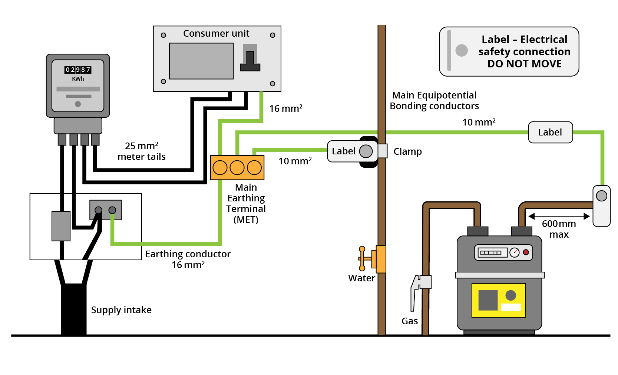
Domestic supply: service positions
Distribution board.
Service meter.
Meter tails.
Service fuse.
Service head.
Main supply cable.
Double-pole 100A installation isolation switch.

Slide 21
Typical voltage supplies for BSE systems
You can see from the table that many BSE systems will require both single- and three-phase voltages to power the necessary components.
BSE equipment | Typical voltage
Domestic heating pump | 230V single phase
Booster pump | 400V three phase
LED lighting | 12V DC transformed from 23V single phase
Heating controls | 230V single phase
Air conditioning fan | 400V three phase
Chiller unit motor | 400V three phase
Fluorescent lighting | 230V single phase
Hot water heater | 230V single phase
Fire exit signs & emergency lights | 24V, 50V or 110V DC

Slide 22
Balancing loads
Every effort should be made to equal all loads between the three phases. In doing so, all three-phase conductors can be of equal size, and all switchgear will handle similar currents. In addition, when three-phase loads are closely balanced, this means the neutral current is very small.
This is turn means that the neutral conductor can also be minimised. If a neutral was not present, then the unbalanced current would circulate within the system and possibly cause overheating. This is why 400V three-phase loads must include a neutral conductor.

Slide 23
Balancing loads
Designers try to ensure each phase is given the same amount of load. This is known as balancing.
Any difference in load current is known as the ‘out of balance’ component and this is the current that will be found on the neutral conductor.

Slide 24
Renewable power: wind
The blades of wind turbines rely on the wind strength to generate power. Very low wind velocities will not generate enough power, while in very high winds turbines have to be turned off. Between these two extremes the turbines generate DC electricity which is converted to AC by a rectifier.
Step-up transformers then increase the voltage for transmission to the National Grid. The advantages of wind-generated power are that wind is free (although installation of course is not), and completely renewable, so set-up costs can be recouped over time.
On the downside, ‘wind farms’ are often deemed to spoil the landscape, are noisy and of course rely entirely on the strength of the wind to operate effectively.

Slide 25
Renewable power: solar
Photovoltaic (PV) arrays produce electricity by converting daylight into electrical energy. The intensity of the light will determine the amount of electricity generated.
Vast numbers of arrays can be connected to produce large amounts of electricity. Surplus electricity can then be directed into the National Grid.
Advances in battery technology mean that solar energy can be stored for use at night. PV-plus batteries are also a useful source of power for electric vehicles.

Slide 26
Pros and cons of solar power
Sunlight is free. Therefore, as with wind power, installation costs can be recouped.
Owners of photovalic systems can be paid for any excess energy.
Solar-generated electricity is green and renewable, but …
        the initial installation cost can be high
        in the northern hemisphere, solar panels need to be south facing
        tariffs are set by the government
        solar cells have a finite life.

Slide 27
Hydroelectric power
Hydroelectric power (power generated from flowing water) requires the construction of large dams in a mountainous area, where water is collected in reservoirs. The water is then piped to a power station, where the flow of water turns turbines to generate electricity.
The Dinorwig hydro scheme in North Wales is a good example of a modern hydroelectric plant using natural lakes at different levels and six turbines and aqueducts to circulate the water flow. The turbines have a terminal voltage of 18kV, stepped up to 420kV for entry into the Grid.
Power from Dinorwig is capable of going on stream within six-minutes and is used boost the Grid in times of high demand.
Notes:
For more information on Dinorwig power station, see https://www.engie.co.uk/power-storage/dinorwig-power-station/

Slide 28
Any questions?

