Slide 1
PowerPoint 13: Outdated cables, accessories and equipment
PowerPoint presentation
12. Building services engineering (BSE) systems
12.7 Cables, accessories and equipment used in older electrical installations

Slide 2
Objectives
By the end of this session learners should be able to:
list the conductor colour coding for electrical installations prior to 2004
describe the various types of cables and conduits encountered in older existing electrical installations
describe the implications regarding rewireable fuses in terms of safety.

Slide 3
Colour coding of electrical cables before 31 March 2004
The colour coding of electrical cables was changed in 2004 (see PowerPoint 12). Up to that point, cables were coded as follows.
Three phase circuits
Conductor designation | Conductor colour
Line 1 | Red
Line 2 | Yellow
Line 3 | Blue
Neutral | Black
Earth | Green / yellow
Single phase circuits
Conductor designation | Conductor colour
Live | Red
Neutral | Black
Earth | Green / yellow

Slide 4
Comparing to the Coding from 31 March 2004
Three phase circuits
Conductor designation | Conductor colour pre-2004 | Conductor colour post-2004
Line 1 | Red | Brown
Line 2 | Yellow | Black
Line 3 | Blue | Grey
Neutral | Black | Blue
Earth | Green / yellow | Green / yellow

Slide 5
Comparing to the Coding from 31 March 2004
Single phase circuits
Conductor designation | Conductor colour pre-2004 | Conductor colour post-2004
Line | Red | Brown
Neutral | Black | Blue
Earth | Green / yellow | Green / yellow

Slide 6
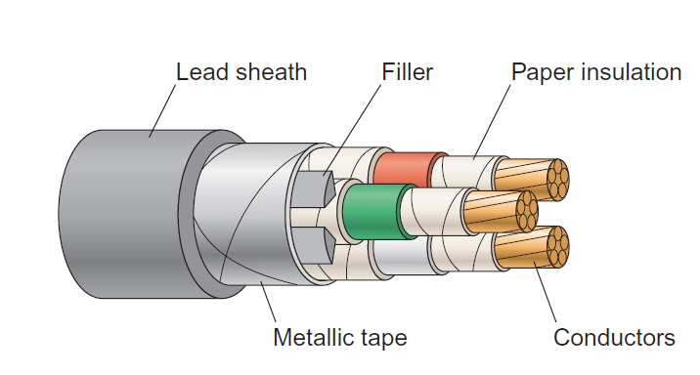
Paper-insulated cable
Up to the mid 1960s, paper-insulated cables were used extensively as power cables. This type of cable was eventually replaced by steel wire armoured (SWA) cable.

Slide 7
Lead sheathed cable
Lead sheathed cable with rubber insulation was used extensively in the past and would normally be a twin and earth cable – red for phase and black for neutral, with a bare earth conductor in the centre.
Lead is a soft metal which reacts to changes in temperature and will expand and contract accordingly.
This will result in the lead becoming embrittled, causing it to crack and allowing moisture to enter the sheathing.

Slide 8
Vulcanised India rubber (VIR) cable
VIR cables were used to install electrical wiring systems and are subject to deterioration from heat, abrasion and even being eaten by vermin.
Some level of caution needs to be employed when working with or around such installations.
They have the same colour coding as lead sheathed cables.

Slide 9
PVC flat twin and earth cable (pre-31 March 2004)
 | Old colour | New colour (post-March 2004)
Live | Red | Brown
Neutral | Black | Blue

Slide 10
Surface mounted steel conduit wiring enclosure
Surface mounted steel conduit is a means of protecting electrical conductors from heat and impact damage.
The conductors used inside are PVC singles, and must never be used outside of the conduit, because they are deficient of a sheath. PVC singles are normally drawn through together from one box to another.
No longer seen as best practice, the conduit can be used as the earth conductor but unless it is maintained, low values of resistance associated with earth continuity increase, making it potentially dangerous to work nearby.

Slide 11
Consumer unit with rewire fuses
Now referred to as semi-enclosed fuses, rewireable fuses (BS3036) are cheaper than circuit breakers and cartridge type fuses but normally take a current of twice their rating to operate (fuse).
This means that circuits can potentially remain live for longer during fault conditions.

Slide 12
Mains supply with service cutout and neutral link
Old houses may have meter tails that are 16mm² in size. The main service fuse will be rated at 80A. Although the house may function normally, should the householder install an extension, or an extra-large load such as an electric cooker or shower, then this could cause the meter tails to overheat, given that they are not large enough to accommodate the increased current demand.
Given older meter tails may be made from braided cable, or even twin and earth rather than dedicated single core cable, such installations should be replaced as soon as possible.

Slide 13
Plastic clad consumer unit
Plastic consumer units currently installed in dwellings are now deemed to be substandard.
Replacements (and new installations) must now be in the form of metal-clad fire-rated consumer units (BS7671).
Electric fires caused by loose connections or short circuits cannot be contained in a plastic unit and may cause extensive fire damage to a property.

Slide 14
Rewireable fuses
Rewireable fuses operate by detecting a fault in a circuit and melting the fuse wire.
If a fault occurs the rewire may be made using a higher-grade wire (to stop the fuse melting again).
This greatly increases the fault rating and could be lethal. For example, changing the size of wire used could increase the fault rating from 5A to 100A!
This is not safe and is a reason why such fuses are no longer used.

Slide 15
Cable sizes
Cables are normally sized in relation to the power (W) rating of the electrical load they feed.
Cable sizes are also standardised, for example, 2.5mm² for power sockets (ring) and 1.5mm² for lighting circuits in an average sized house.
Older cables were measured using the imperial system – see this link:
https://www.shrinkpolymersystems.co.uk/pdfs/Cable_Conversion_Chart.pdf

Slide 16
Commissioning and decommissioning
Paper insulation cables use an oil-wrapped outer sheath, which is toxic to the touch, and must be decommissioned and replaced.
When exposed to extreme heat, modern polyvinyl chloride (PVC) cables can release harmful contaminants.
Polychlorinated biphenyls (PCBs) are chemicals that were once common in capacitors and transformers, hence the need to replace old components such as these.
These examples show why both commissioning and decommissioning buildings always involves environmental and safety considerations. It is essential that all interested parties (users) should be kept fully informed, in particular if such work leads to possible loss of services, especially essential systems.

Slide 17
Any questions?

