Slide 1
PowerPoint 11: Pipework and ductwork
PowerPoint presentation
12. Building services engineering (BSE) systems
12.8 Pipework and ductwork, components and systems

Slide 2
Objectives
By the end of this session learners should be able to:
list the different types of ductwork and related components
appreciate the range of pipework skills
list the different types of pipework and related components
describe a range of pipework valves.

Slide 3
Ductwork
Rigid ductwork is manufactured offsite from galvanised low carbon steel (LCS) sheet and installed onsite by duct fitters.
The sections will either be square or rectangular. They are manufactured to meet the air flow rates from the design and also to suit the available space in the building structure.
Spiral wound ducting is circular or flat oval in cross-section and manufactured from strips of galvanised LCS. The jointing method is welted.
Flexible ducting is manufactured from aluminium or plastics and can be insulated or uninsulated.

Slide 4
Ductwork
Rigid or metal ductwork is useful for permanent heating, ventilation and air conditioning (HVAC) systems.
A fibreboard (fibreglass) air duct is mostly preferred for heating and cooling (refrigeration) systems because it is insulated.
Flue gas ducts are made from durable polyethylene material which provides strength, is lightweight and offers excellent flexibility.
Aluminium ductwork is very light, easy to install and can be customised as required.

Slide 5
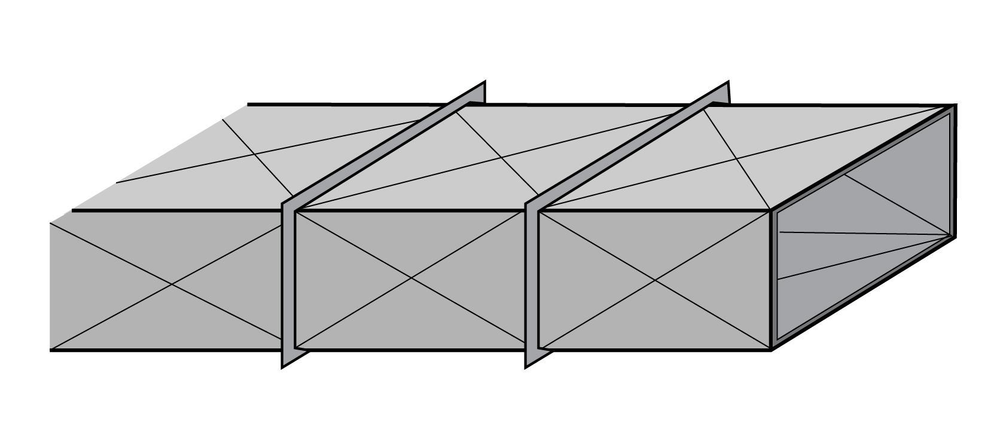
Galvanised steel rectangular ducting
This type of ducting is used in many HVAC systems.

Slide 6
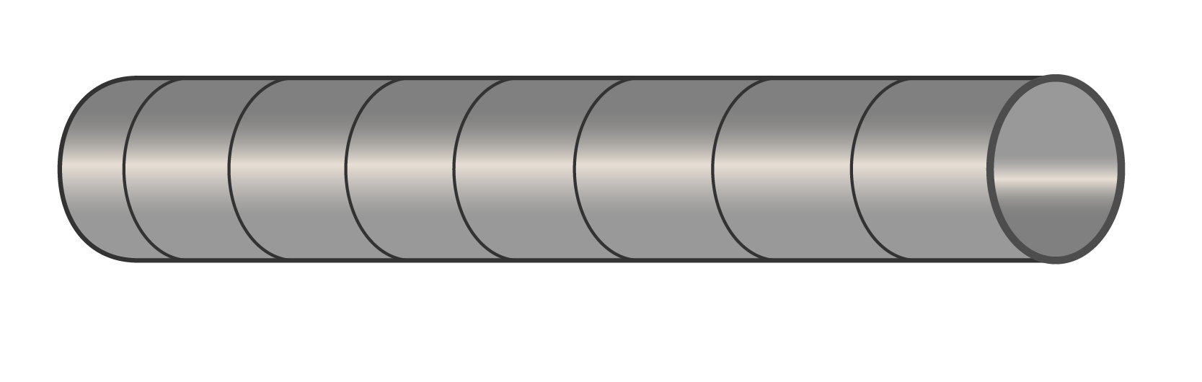
Spiral wound galvanised steel circular ducting
Manufactured offsite, this type of ducting is easy to install and support. It is used for HVAC systems.

Slide 7
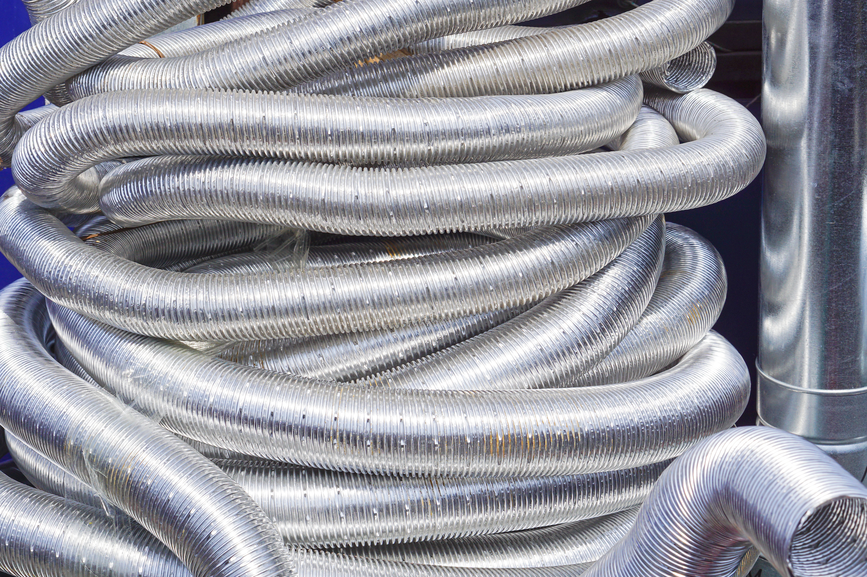
Uninsulated flexible aluminium ducting
Due to its inherent flexibility, this type of ducting is a convenient method of connecting rigid ductwork to appliances and overcoming obstacles in the building structure.

Slide 8
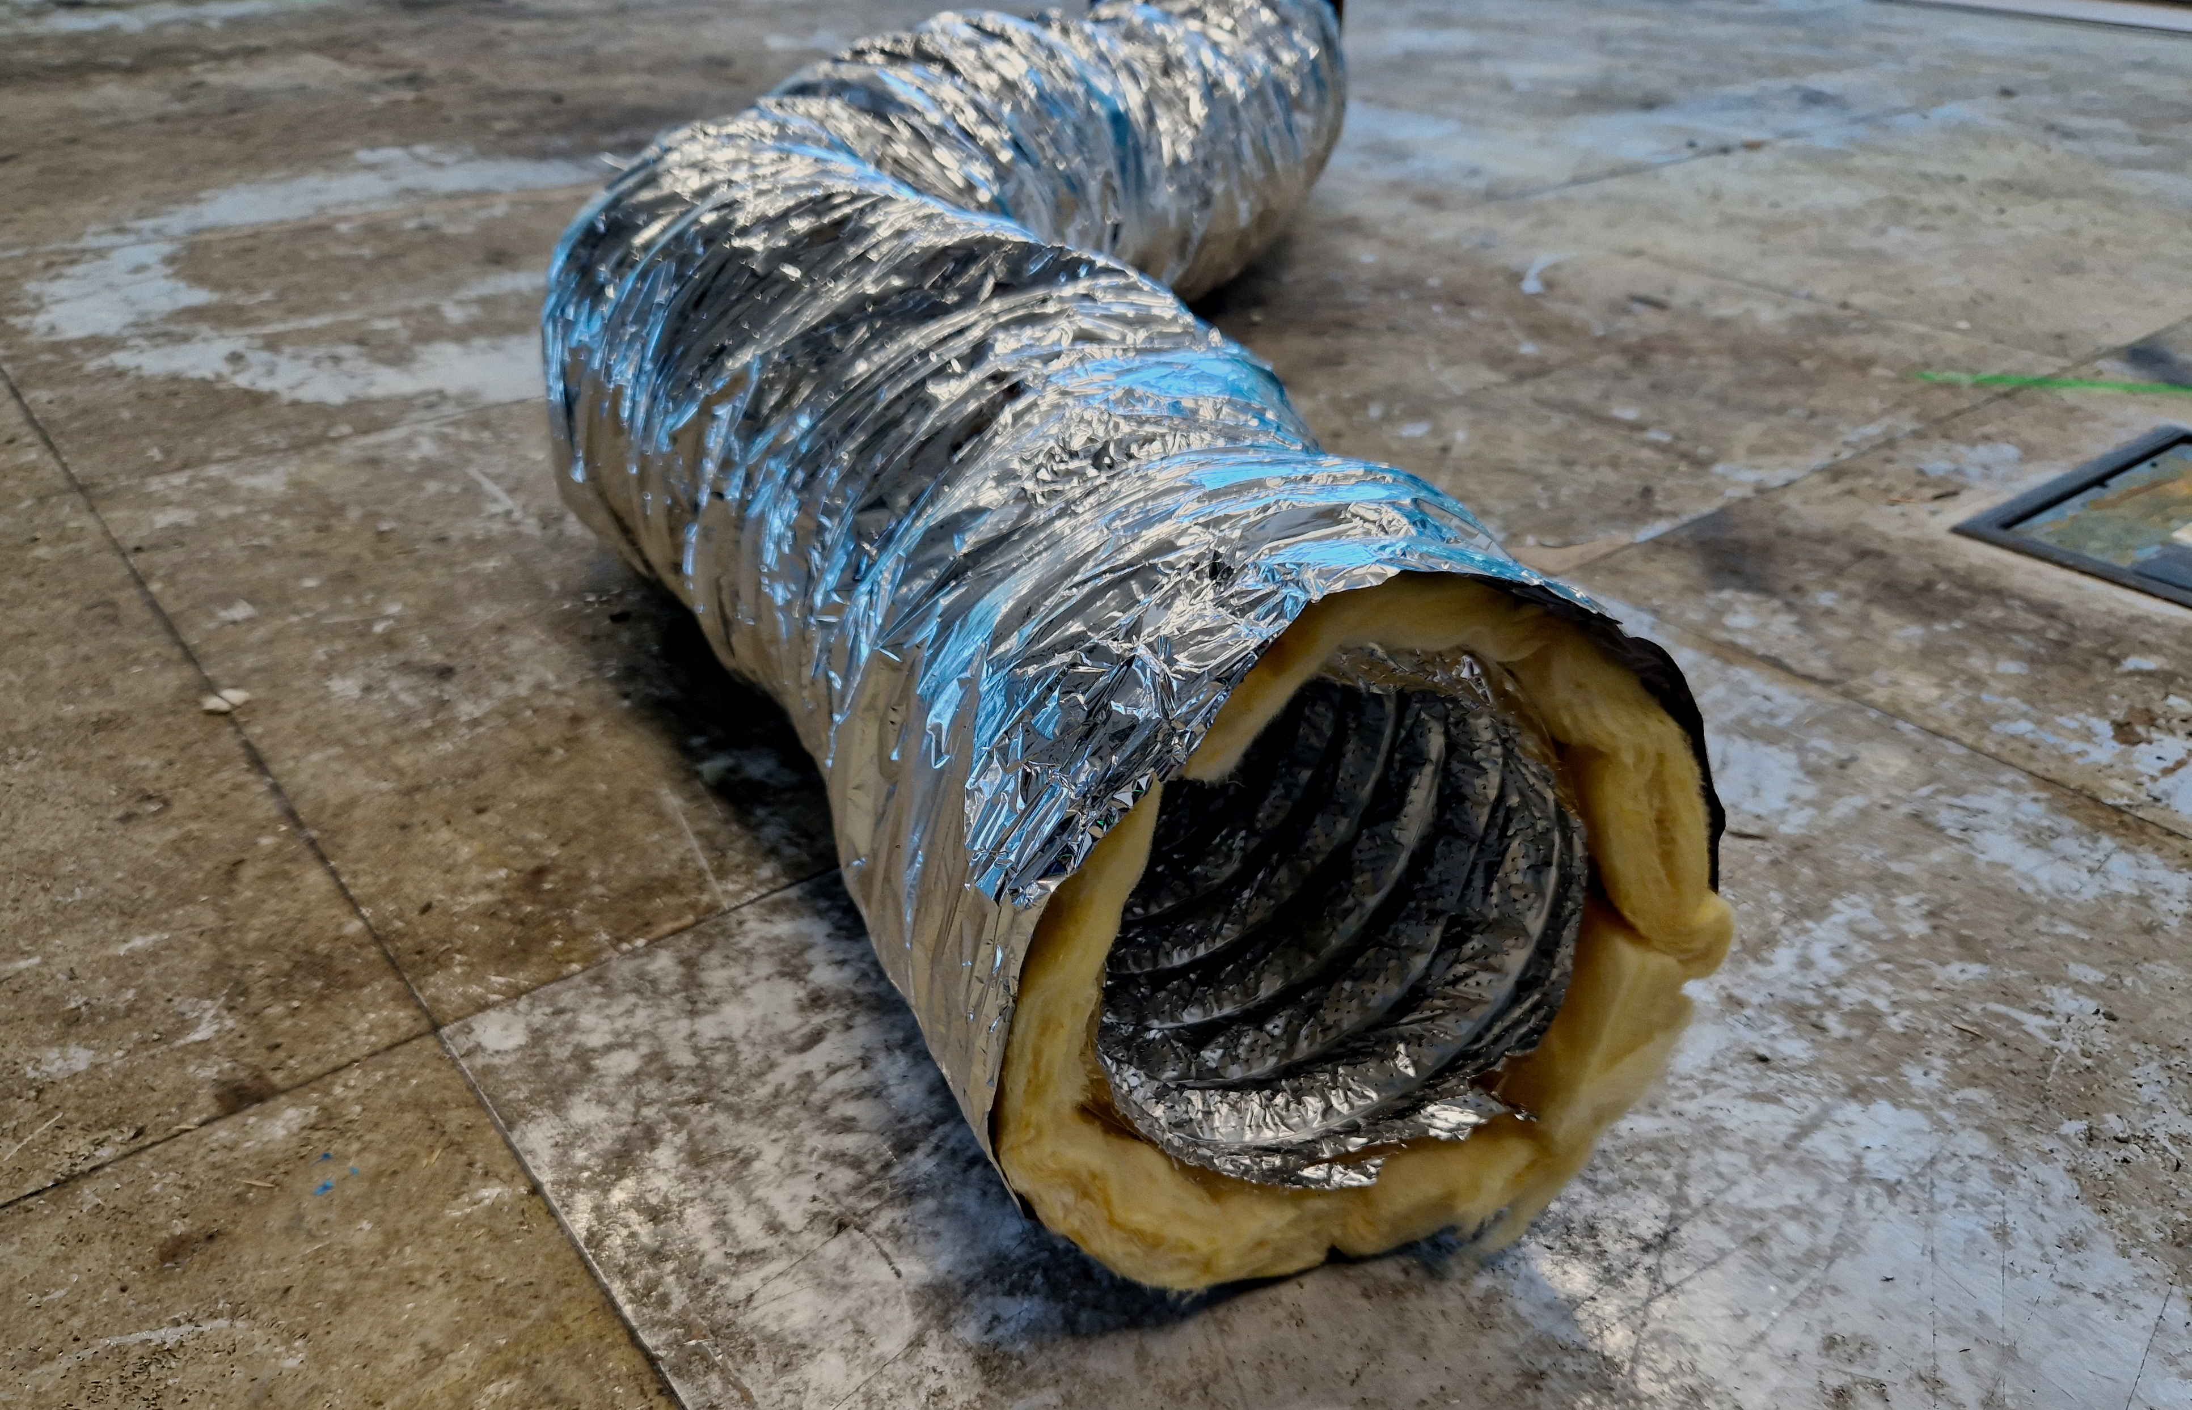
Insulated flexible ducting
Insulated ducting is particularly useful in situations where heat loss or heat gain may influence the integrity of an air conditioning (AC) or ventilation system.

Slide 9
Cardboard ductwork
Cardboard ducting is scored before delivery, making assembly very easy.
Installation is easy and site assembly and modifications are straightforward.
Cardboard ducting is strong and durable and will not damage easily.
It is lightweight, so it is easy to move around the site.
It is is sustainable, has a long life (the life of the building) and will not corrode.

Slide 10
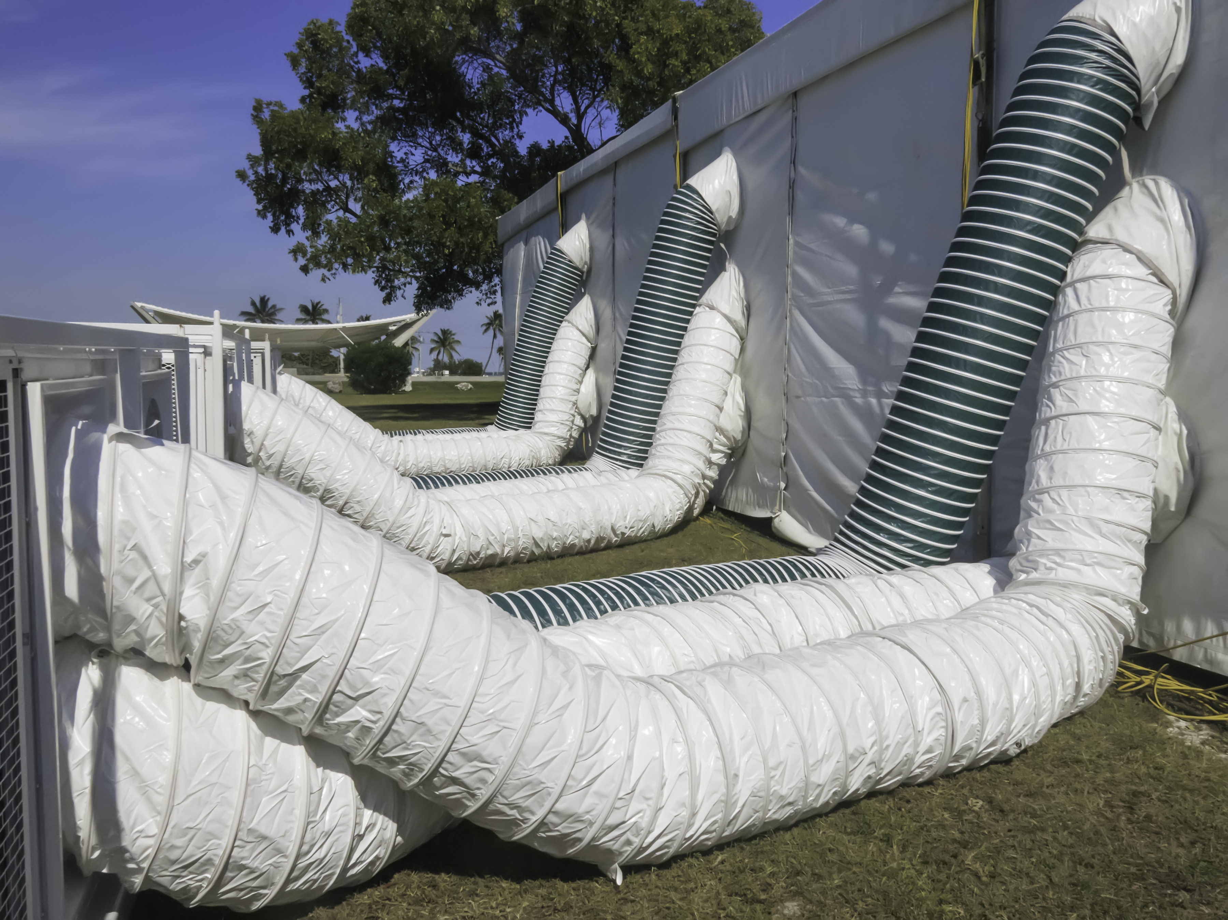
Fabric ductwork: air positive pressure supply
Fabric ductwork is used in some AC systems and provides more energy efficiency and thermal comfort than steel ducting. It takes less time to install and gives more uniform air distribution, so creating a better indoor climate.

Slide 11
Ductwork components
Heating and cooling coils are a system of small-bore copper tubes passing through stainless steel plates.
The flow and return pipes connect to headers which have the small-bore pipes brazed into them.
Either heating or chilled water can be connected depending on the intended function.

Slide 12
Ductwork components
Large buildings have fire compartments intended to prevent fire from spreading to other parts of the building.
Where ductwork passes through a fire compartment a duct fire damper is installed.
If fire is travelling through a ductwork system, when it reaches a damper, the damper will automatically close, preventing the fire from spreading.

Slide 13
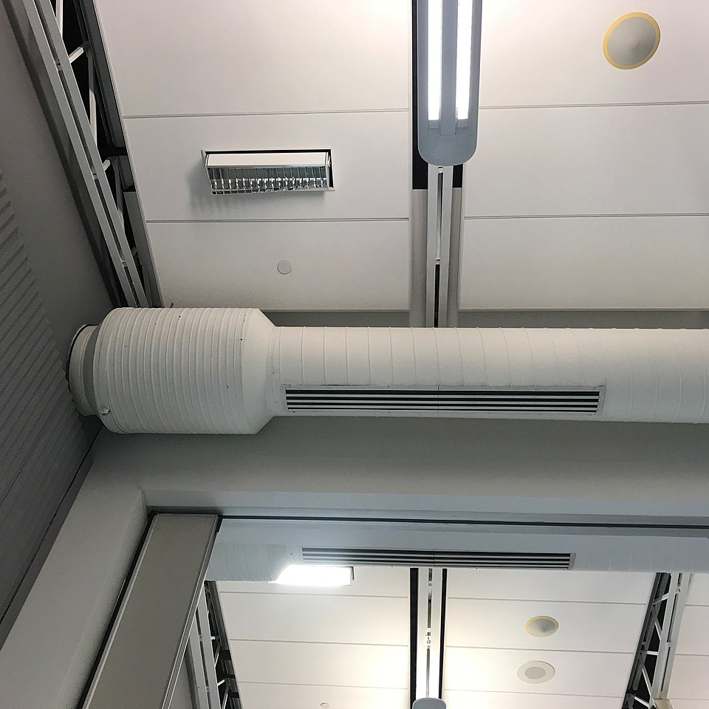
Ductwork components
A ductwork attenuator is an in-line silencer for ductwork. It prevents fan noise from being transmitted throughout the system.

Slide 14
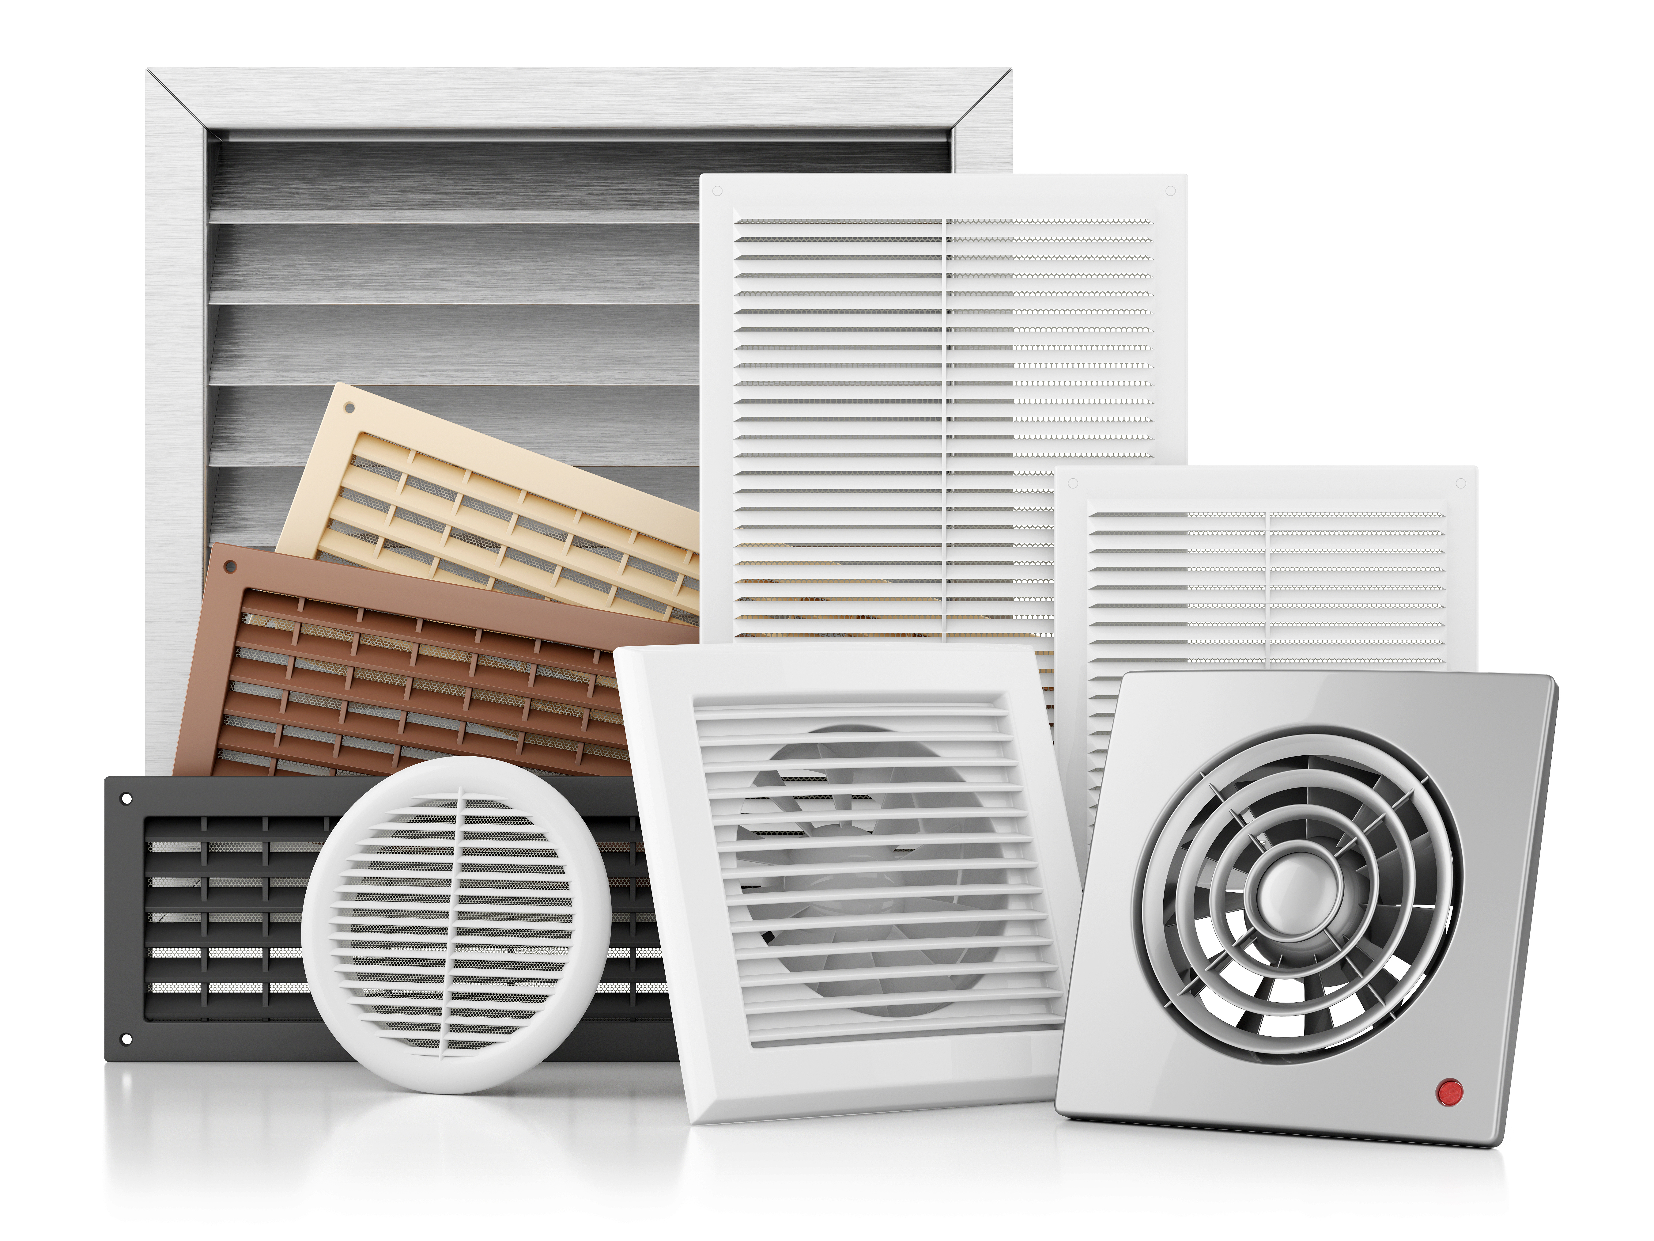
Ductwork components
At the exit points of a ductwork system, you will find duct grilles or registers mounted on the wall.
Grilles sometimes have adjustable louvres to enable outflowing air to be directed for maximum comfort.

Slide 15
Pipework and pipework skills
All hydronic and gaseous systems incorporate the pipework skills of manual dexterity, numerical skills, jointing, fixing, suspending, cutting, soldering and problem-solving.
Common pipe materials in use include low carbon steel (LCS), stainless steel, copper and plastic.
Systems utilising pipework include heating, cooling hot and cold water, natural gas and compressed air.
Different trades share generic pipefitting skills to enable competent installation.

Slide 16
Pipework
LCS tubing/pipe normally comes with a male thread on both ends of the tube with a socket on one end.
The pipe is supplied in 6m lengths in a variety of diameters.
LCS is traditionally used in heating, chilled water, compressed air, steam and gas systems.
It is very strong and can take high pressures and temperatures.

Slide 17
Pipework components
Malleable iron fittings for LCS pipe are supplied with either a tapered or parallel thread.
The male thread on the pipe requires a jointing medium of paste and hemp or polytetrafluoroethylene (PTFE) tape wound into the thread.

Slide 18
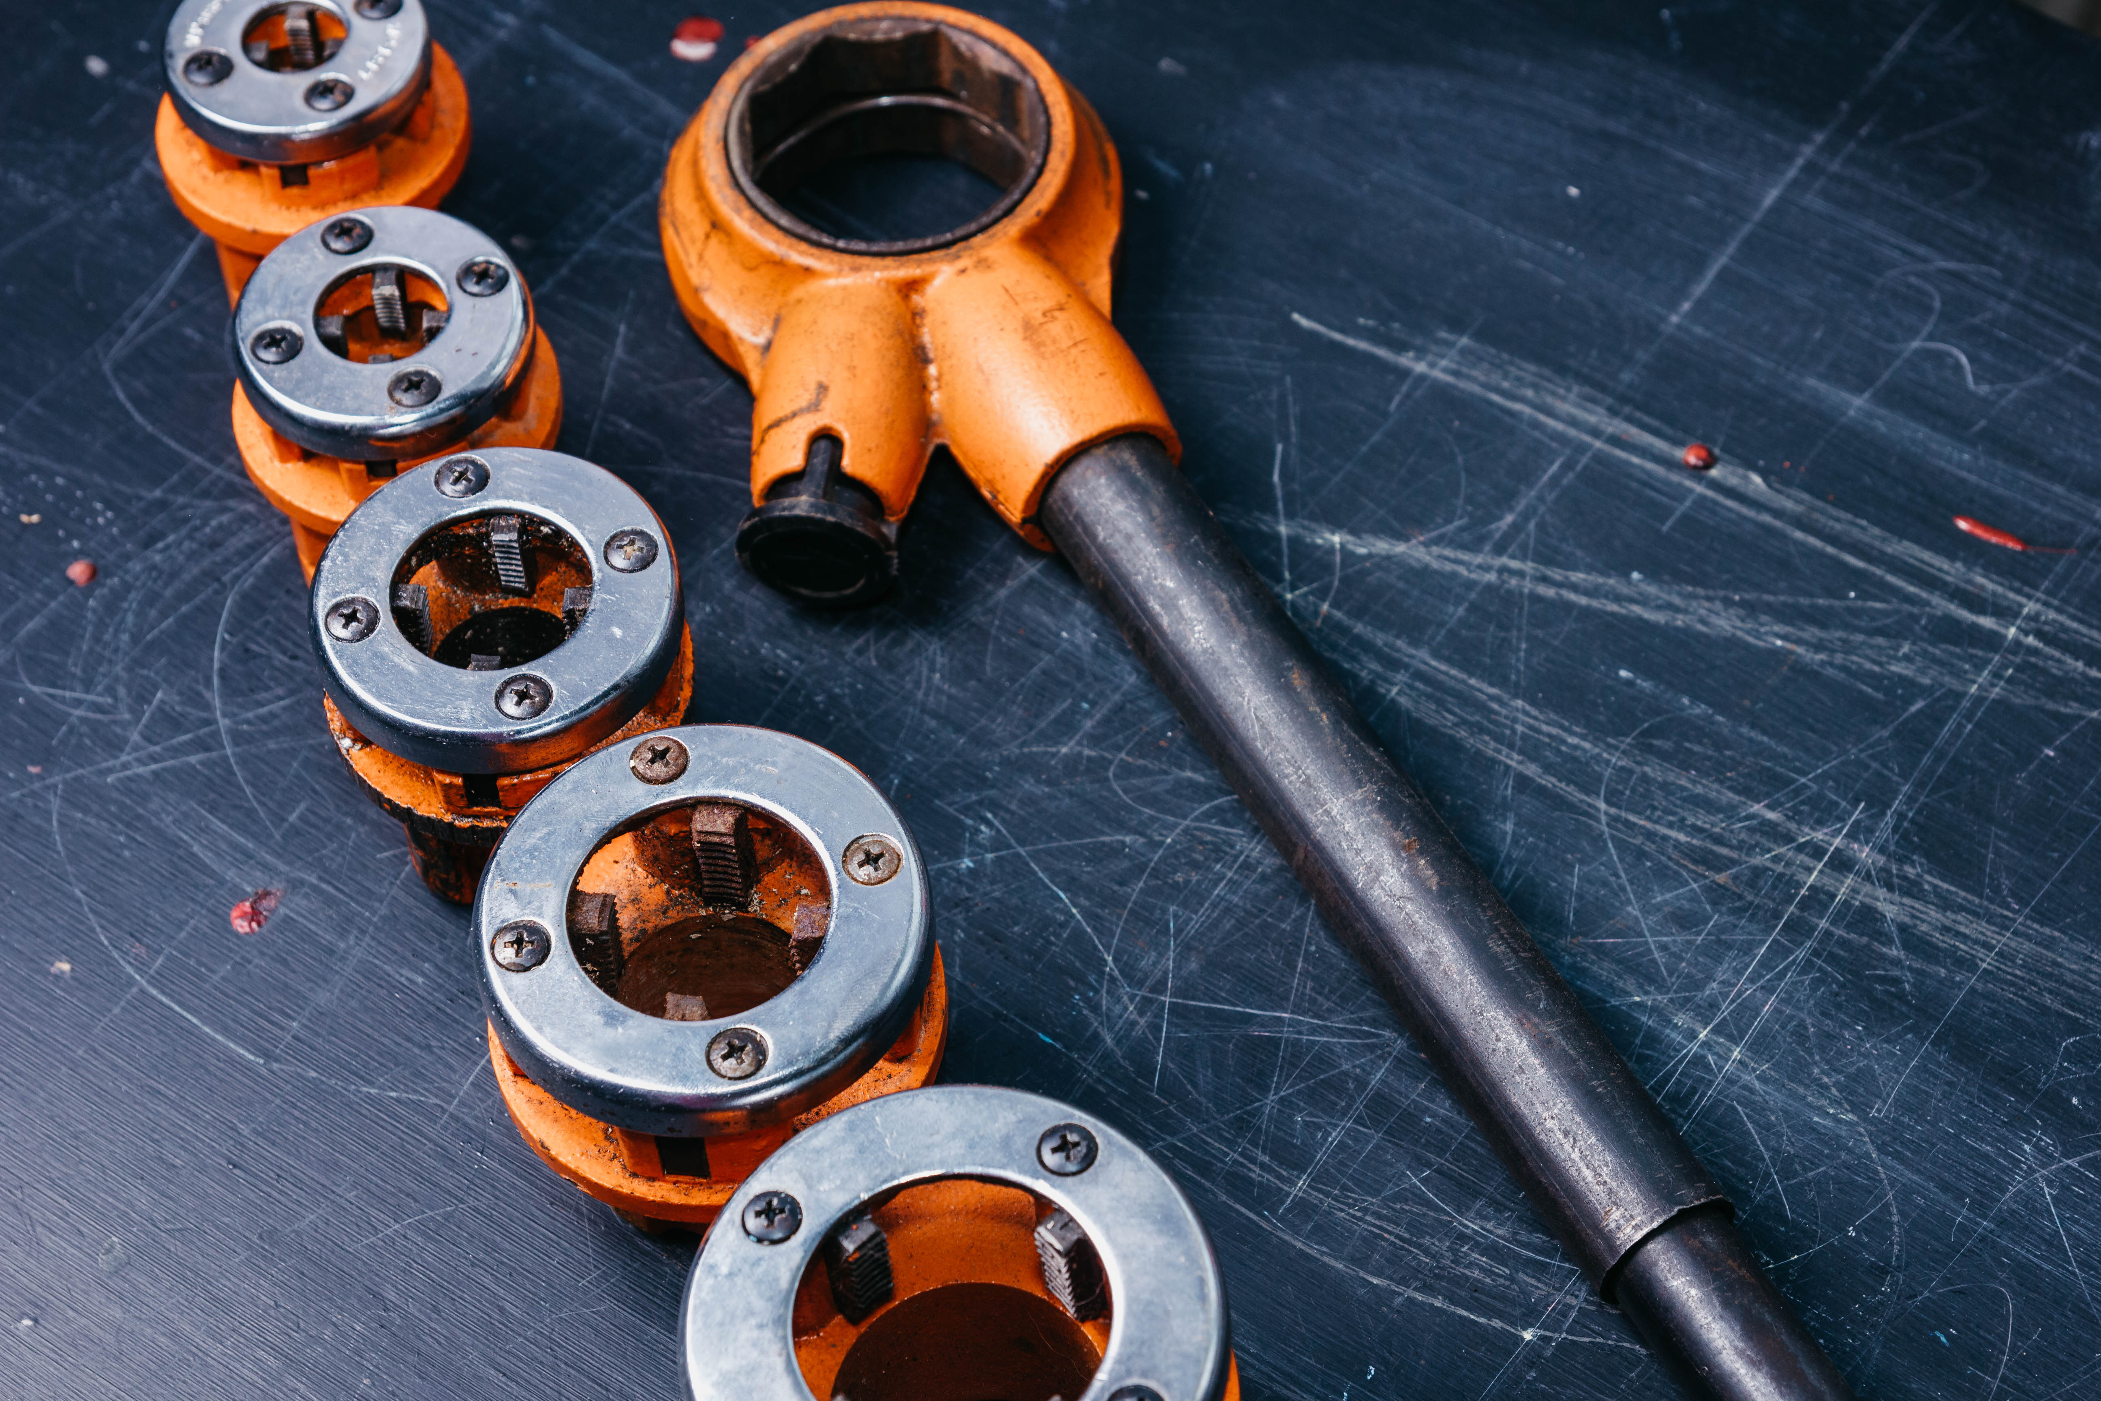
Pipework skills
These tools impose a male thread on the end of LCS piping in preparation for jointing using pipe fittings. The threader has a ratchet device for easy use by the pipe fitter and is also reversible to enable the die head to be turned off the tube.

Slide 19
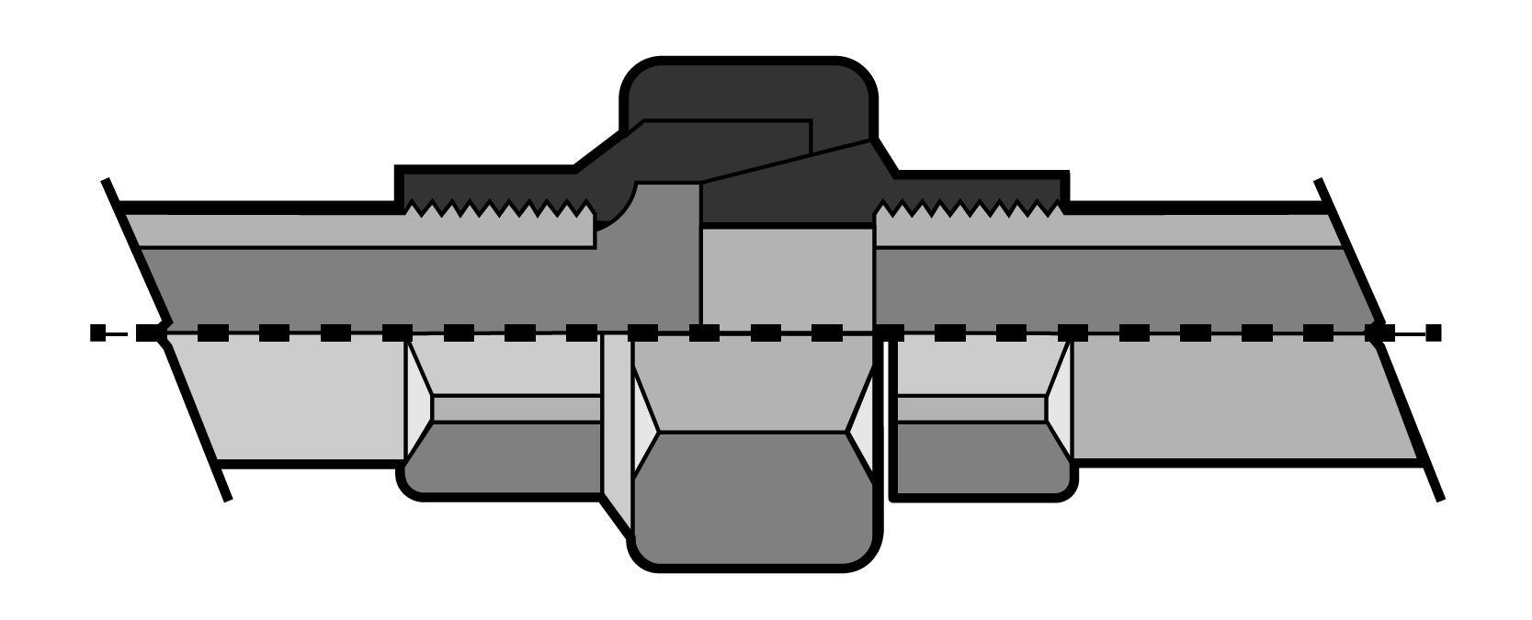
Pipework components
Here you can see the different types of LCS pipework joint:
flanged, unthreaded
groove: lock joints
threaded joints.

Slide 20
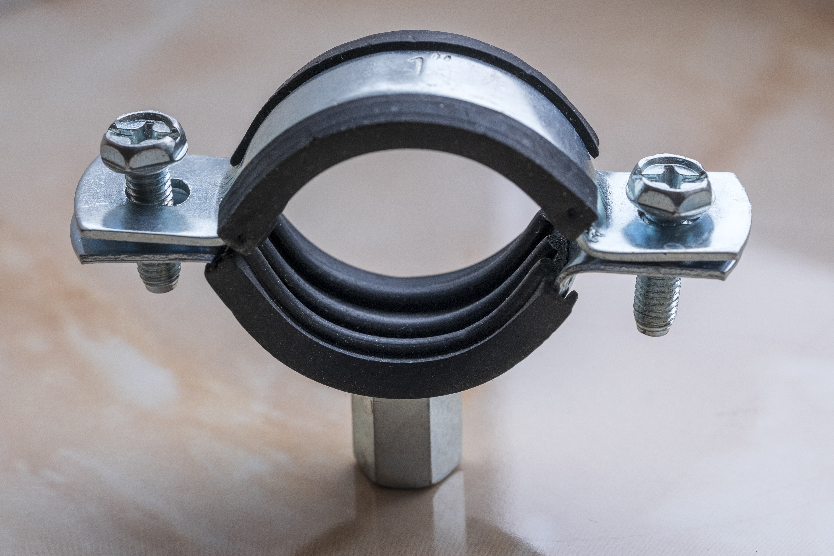
Pipework components
There is a wide variety of bracket supports for LCS pipes.
Girder hangers are clamped to beams with screwed rod dropped through them and nuts to adjust and tighten the pipe level.
The pipe rings are also screwed onto the screwed rod to support the pipe before fitting and joined together.

Slide 21
Pipework
Copper tube comes in diameters ranging from 6mm to 150mm.
Jointing methods include brazing, bronze welding, capillary soldering and compression.
Copper tube has a very smooth internal surface which makes it ideal for hydronic systems.
It is very resistant to corrosion from acidic or alkaline water.
It is available as soft, half hard or hard depending on the intended application.
Special soft copper tubes are available for refrigeration systems.

Slide 22
Pipework
Press fit copper tube has a rubber ‘O’ ring just inside the fitting opening which makes a watertight joint when it is compressed.
A specially designed power tool is used to compress the fitting.
The tool has interchangeable jaws for the different diameters of pipe.
Special attention is required when preparing to joint before pressing: the pipe end must be free from burrs and be fully in the fitting, or the joint may fail.
Notes:
For a comparison of push fit, press fit and solder see: https://www.youtube.com/watch?v=q7V9fN_5u30

Slide 23
Pipework components
Copper tube is connected using ‘Tectite’ push-fit connectors. On the inside of each connector is a rubber ‘O’ ring which makes the seal, and a stainless-steel grab ring which prevents the copper tube from being pushed out when pressurised.
These fittings can be dismounted using an extraction tool which opens the grab ring.

Slide 24
Pipework components
In a type A non-manipulating compression fitting, the compression ring is the seal itself when compressed by the back nut and the body of the fitting. Over-tightening can result in leakages and may cause the pipe to deform.

Slide 25
Pipework components
Type B compression fittings are generally used with soft copper tube. The tube needs to be flared (attached through a clamp designed to work with copper tubing of various diameters) before it can be assembled. The underground joints of gas supply pipes must be made using compression type B fittings to guard against the possibility of ground movement.

Slide 26
Pipework skills
To prevent horizontally and vertically mounted pipework from sagging or deforming when pipes expand and contract, it is important that pipework is fully supported by bracketry set to the correct spacing. The table shows recommended maximum bracket distances under BS6700.
Pipe size |  | Copper pipe |  | Steel size |  | Plastic pipe
(mm) | (in) | horizontal | vertical | horizontal | vertical | horizontal | vertical
15 | ½ | 1.2 | 1.8 | 1.8 | 2.4 | 0.6 | 1.2
22 | ¾ | 1.8 | 2.4 | 2.4 | 3.0 | 0,7 | 1.4
28 | 1 | 1.8 | 2.4 | 2.4 | 3.0 | 0.8 | 1.5
35 | 1 ¼ | 2.4 | 3.0 | 2.7 | 3.0 | 0.8 | 1.7
42 | 1 ½ | 2.4 | 3.0 | 3.0 | 3.6 | 0.9 | 1.8
54 | 2 | 2.7 | 3.0 | 3.0 | 3.6 | 1.0 | 2.1

Slide 27
Pipework skills
Press-fit installation is a favoured onsite technique because there is no flame associated with this type of pipe fitting.
There is also a stainless-steel version of pipe and press-fit fittings for heating and chilled water systems.

Slide 28
Pipework components
Push-fit plastic fittings are being used increasingly as an alternative to traditional fittings, because no specialist tools are necessary and in general, they are much quicker to fit.

Slide 29
Pipework skills
Types of plastic | Mechanical joints | Solvent welding | Fusion welding | Push fit ‘O’ ring Discharge pipes/overflows only
Polythene | X | X |  | X
Polyethylene |  | X | X | X
Polypropylene |  | X |  | 
PVC-U |  |  | X | 
ABS |  |  | X | 
Plastic pipe jointing methods

Slide 30
Valves for pipework
Float operated valves (BS1212) are automatic discharge valves that open and close when the water level within a cistern falls. The float attached to the lever arm will rise as the water is replenished through the valve. It closes the flow when the water level reaches a preset level. The lever arm moves the piston washer onto the orifice, overcoming the water pressure.

Slide 31
Valves for pipework
A type 2 valve operates on the same principles as a type 1; however, the piston has been replaced with a diaphragm washer and the water outlet spout is on the top. The air gap means there is less chance of back siphonage of contaminated water.

Slide 32
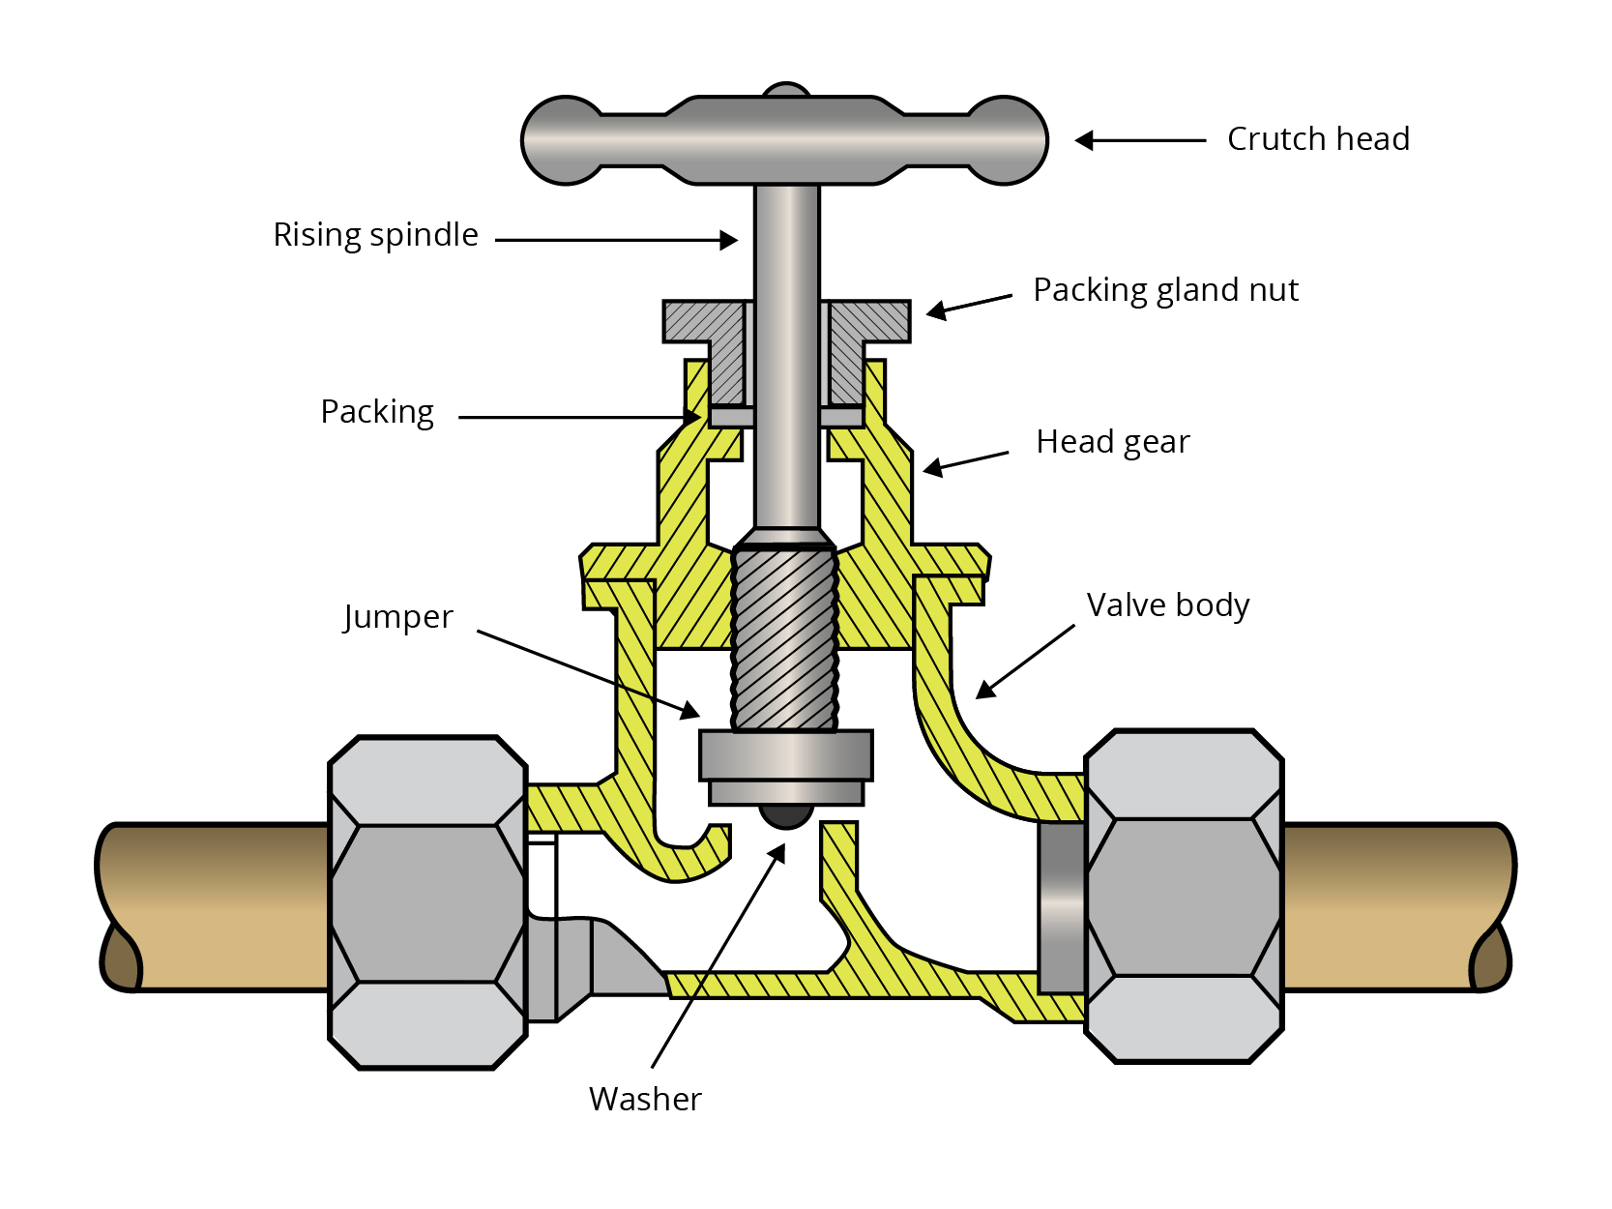
Valves for pipework
This is a brass stop valve (BS1010), used for supplying and controlling domestic mains water, because it is easily shut off when required.

Slide 33
Valves for pipework
Isolation service valves are fitted before float-operated valves. The valve itself is drilled out to suit the pipe diameter and turned using a screwdriver.

Slide 34
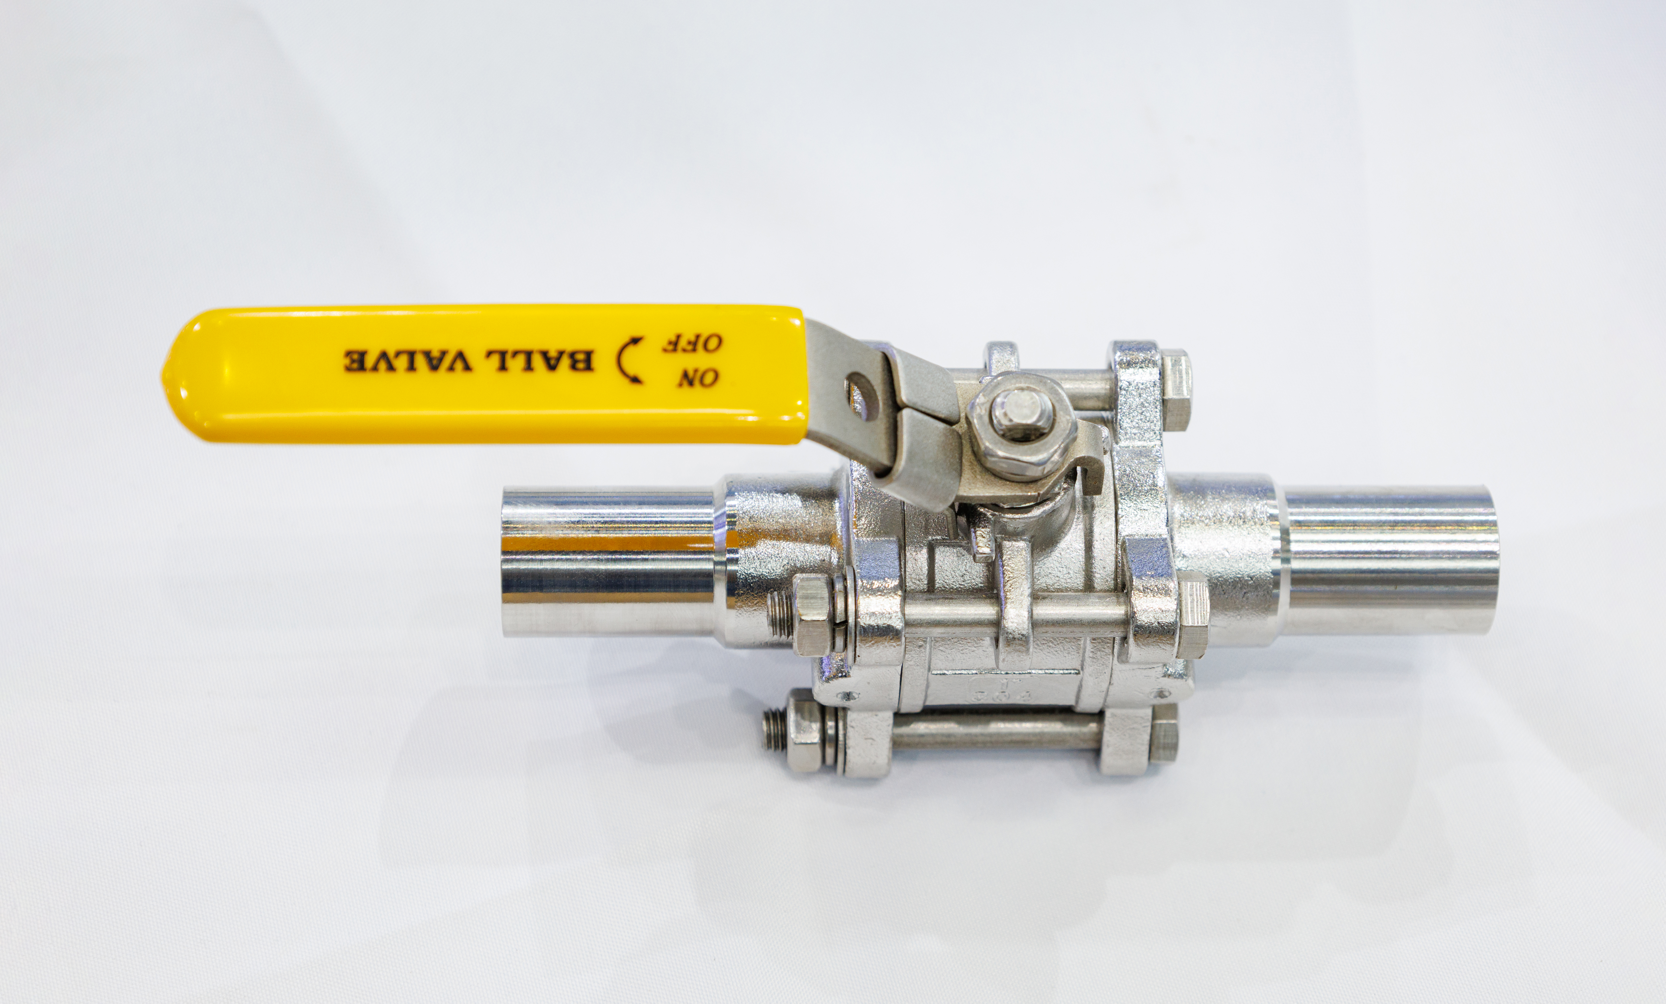
Valves for pipework
Ball valves are rapid-closing control valves operated with a lever that moves through 90º.
The image shows a gas valve (indicated by the yellow-coloured handle). It must be mounted so that the handle, when turned at 90º (valve closed), will not be impeded (eg by other pipework).
When the handle is in line with the pipe, the valve is open.

Slide 35
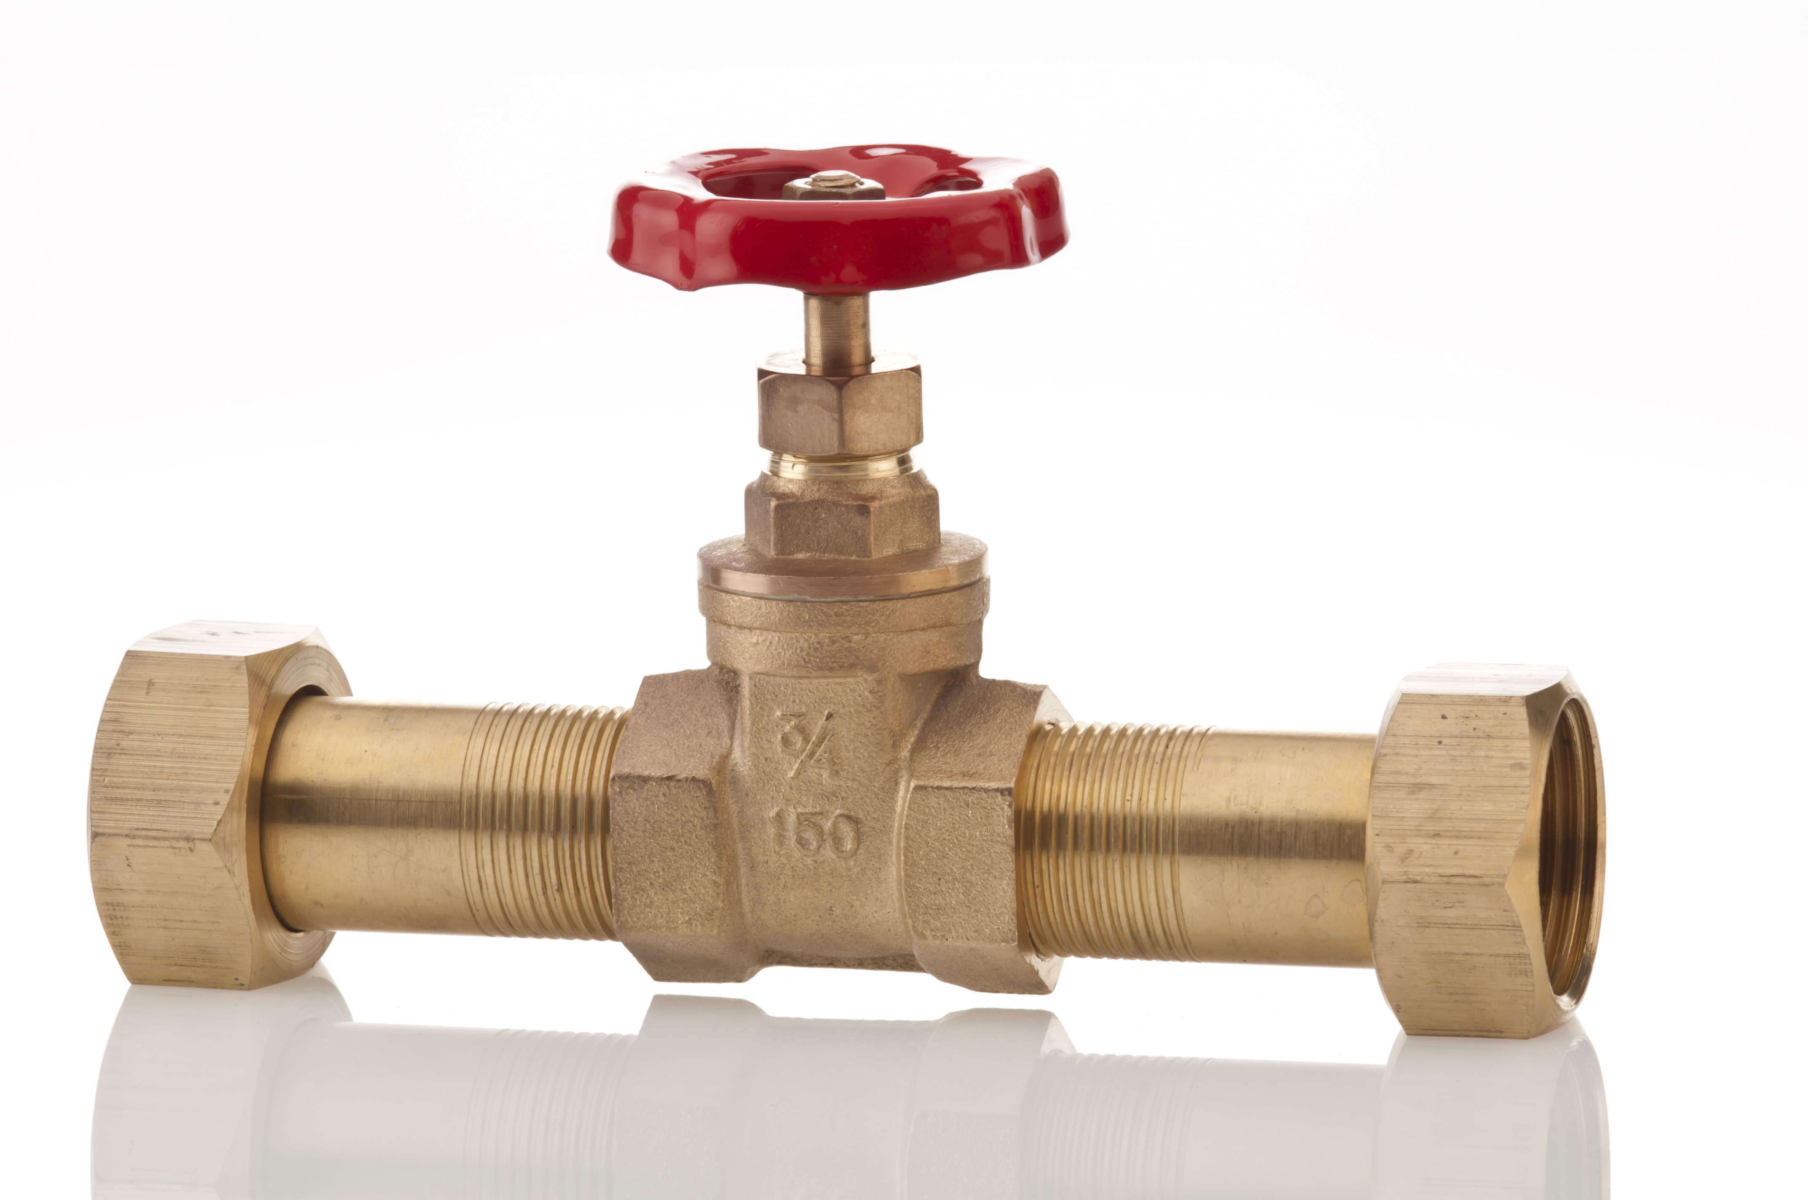
Valves for pipework
Brass or gunmetal gate valves are in-line control valves for low pressure systems.
They have low frictional resistances to fluid flow.
Gunmetal valves are used when the liquid in the system is likely to cause ‘de-zincification’ corrosion to brass fittings.
These valves should not be used in gas systems.

Slide 36
Valves for pipework
Three-port mid-positional valves (diverter valves) are motorised valves used in fully pumped domestic heating systems and are designed to comply with building regulations Part L, which relates to conservation of fuel and power.
The valve will allow water to flow to the heating system or the hot water storage cylinder.
When the thermostats call for heat, the valve moves the control plug which switches the boiler and pump on.
When there is no call for heat, the valve closes and shuts down the boiler and pump.

Slide 37
Any questions?

