Slide 1
PowerPoint 10: Mechanical principles of components
PowerPoint presentation
12. Building services engineering (BSE) systems
12.3 Mechanical principles of components

Slide 2
Objectives
By the end of this session learners should be able to:
describe how fans and pumps function within a BSE system
explain the operational principles of gas and oil burners
describe how heat pumps extract low-grade heat from the ground and air
understand the logic of domestic heating controls.

Slide 3
Centrifugal fans
Centrifugal fans are components that assist in the movement of air through ducting, in both domestic and industrial settings. They are expensive to purchase and run but extremely effective (therefore they have high operational efficiency and low energy efficiency).
When the fan impeller is rotated by the fan motor, air is induced because the impeller creates low negative pressure in the chamber.
The air is slightly compressed and forced through the outlet into the ductwork at a much higher pressure due to the centrifugal action.
The pressure generated has to be sufficient to overcome the total frictional resistance of the ductwork to deliver the desired quantities of air. If the fan fails, the system stops working.

Slide 4
Centrifugal fans
The impellers in centrifugal fans have a cylindrical structure creating small, negative suction pressure at the inlet, which is multiplied as a positive pressure at the outlet.
The motor is coupled directly to the fan with a flexible coupling and can be removed and replaced without affecting the fan.
The drive pulleys and belts can be changed to increase or decrease the pressure and volumetric flow rates of the fan.

Slide 5
Advantages and disadvantages of centrifugal fans
Advantages
highly efficient
very durable
can withstand overload if capacity exceeded
easily cleaned (some are self-cleaning)
multipurpose applications
multiple sizes.
Disadvantages
noisy
expensive to buy and run.

Slide 6
Axial fans
Axial fans have a high volume of airflow, created at a low pressure, which means they are suitable for cooling confined spaces, from computer casings to entire rooms. To avoid a turbulent and noisy flow they use two impellers, which creates a laminar (streamlined) flow, which is much quieter.
Axial fans are sized by the manufacturers to overcome the total frictional resistances of the ductwork and deliver the correct volume of air at the outlets.

Slide 7
Bifurcated axial fan
A bifurcated fan has the motor outside the fan duct.
These fans are used mainly for extraction systems (eg the extraction of corrosive fumes).
Being on the outside, the motor is naturally cooled by ambient air and not corroded by fumes.

Slide 8
Centrifugal pumps
Centrifugal pumps are used for pumping water, solvents, oils and other ‘thin’ liquids in industrial, agricultural and domestic settings.
Single-stage centrifugal pumps have one impeller and follow the same laws as fans: low suction/negative pressure with high pressure on the outlet.
Pumps are sized to generate sufficient pressure in the liquid to overcome the total resistance of the pipework.
They are often fitted with a standby pump in parallel in the event of the duty pump failing.

Slide 9
Multi-stage centrifugal pumps
These pumps are identifiable by the stainless-steel vertical cylinder beneath the motor.
They generate very high pressures and are used to lift water in high-rise buildings to supply break tanks etc.
The water pressure is increased as it passes from stage to stage until it is discharged.

Slide 10
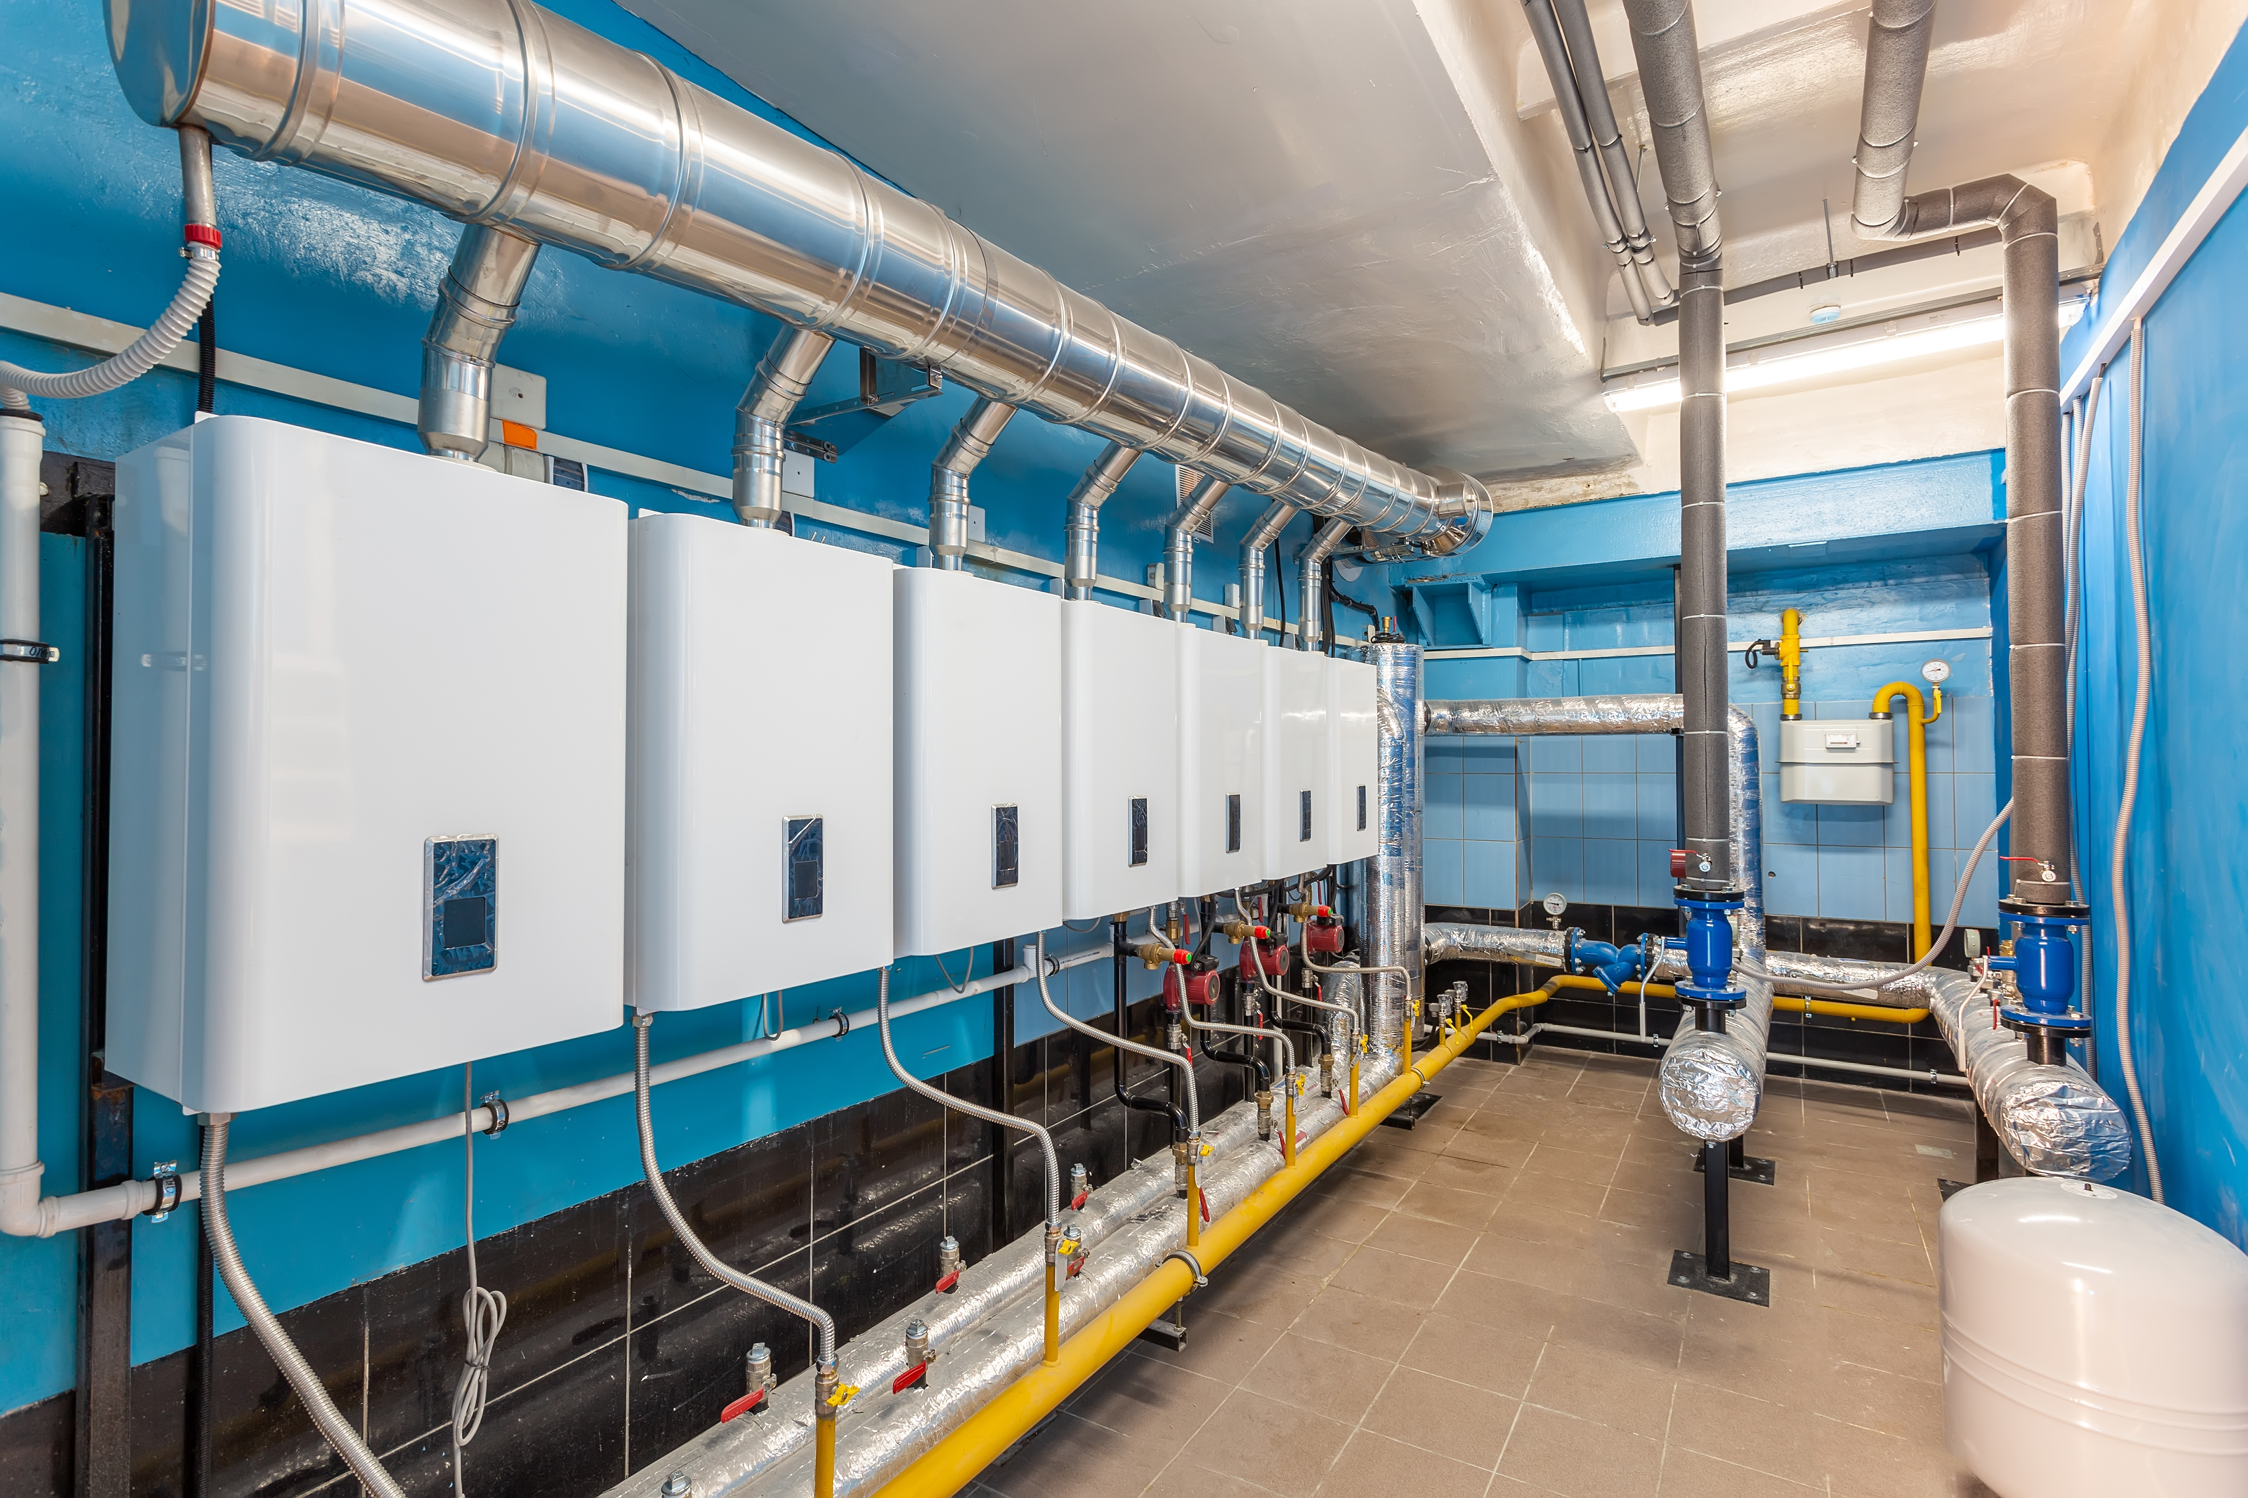
Industrial gas boilers
Shown here is a modern multiple gas boiler installation in a heating, ventilation and air conditioning (HVAC) plantroom.
Installing multiple boilers to meet heat requirements is common practice and has the advantage of having one boiler on standby when the load increases. In addition, alternating the duty boiler improves boiler life.
Blown gas burners (shown here) are very efficient. They use a fan to induce combustion air into the burner mixing chamber, where air and gas are mixed to achieve complete combustion.
The pipework painted yellow is the gas inlets to the burners.

Slide 11
Blown gas burners
Blown gas burners are designed for large and small boilers.
Gas is mixed with combustion air and then blown through electrode igniters.
The flame is retained on a flame ring.
The multifunctional valve arrangement controls the pressure and flow rate of the gas to the burner.
A flame failure device will shut the burner down in the event of the burner flame extinguishing.

Slide 12
Wall mounted domestic gas boiler
Condensing boilers use the products of combustion to preheat the return water from the system before it enters the heat exchanger.
The water vapour in the flue gas condenses, giving up its latent heat.
The condensate is then fed to an external drain.

Slide 13
Atmospheric gas burner
In these devices gas is injected into the mixing chamber where combustion air is drawn in by a Venturi effect.
The mixed gas and air is ignited at the bar burner ports.
Secondary combustion air is taken from around the burner to complete the combustion process.
The burner is ignited by an automatic spark electrode or a permanent pilot flame.
The pilot flame is protected by a thermo-couple flame failure device.

Slide 14
Oil fired pressure jet burner
Pressure jet burners provide the ignition of heating oil or biodiesel fuel which is used to heat air or water by means of a heat exchanger. Oil is forced through a fine nozzle at very high pressure by a pump connected to the fan motor shaft.
The oil leaves the nozzle as atomised vapour which is mixed with air and then ignited by an arc across two electrodes strategically placed at the nozzle.
A photoelectric cell monitors the flame and in the event of flame failure a solenoid valve cuts off the oil supply to the nozzle.

Slide 15
Vapour compression refrigerant plant
These items of plant are installed in a chilled water system. They are refrigerant vapour compression systems using the vapour compression cycle. They consist of an evaporator, a compressor, a condenser and an expansion valve.
Notes:
Tutor can elaborate on the vapour compression cycle if deemed appropriate:
1 The evaporator is a shell and tube bundle heat exchanger (sometimes referred to as a non-storage calorifier) where the tube bundle has refrigerant low pressure liquid within it returning warmed cooled water in the shell. As the water flows through the shell it surrenders its sensible heat (chilling effect) to the refrigerate which causes it to boil to a low pressure gas.
2 This gas is then sucked into the compressor which convers it into a very high pressure gas. Across the compressor the thermodynamics of the gas increases the heat content as rejected heat.
3 The condenser is also a shell and tube heat exchanger with the hot gas flowing through the tube bundle whereby its high level of latent heat is given up to the cold water within the shell converting the gas to a high pressure liquid. The heated water is then pumped to a cooling tower of hot water calorifier for recycling.
4 The hot liquid refrigerant is the passed through an expansion valve where its thermodynamics are altered as the liquid looses its heat and is converted to a low pressure vapour/liquid to re-enter the evaporator to complete the cycle.

Slide 16
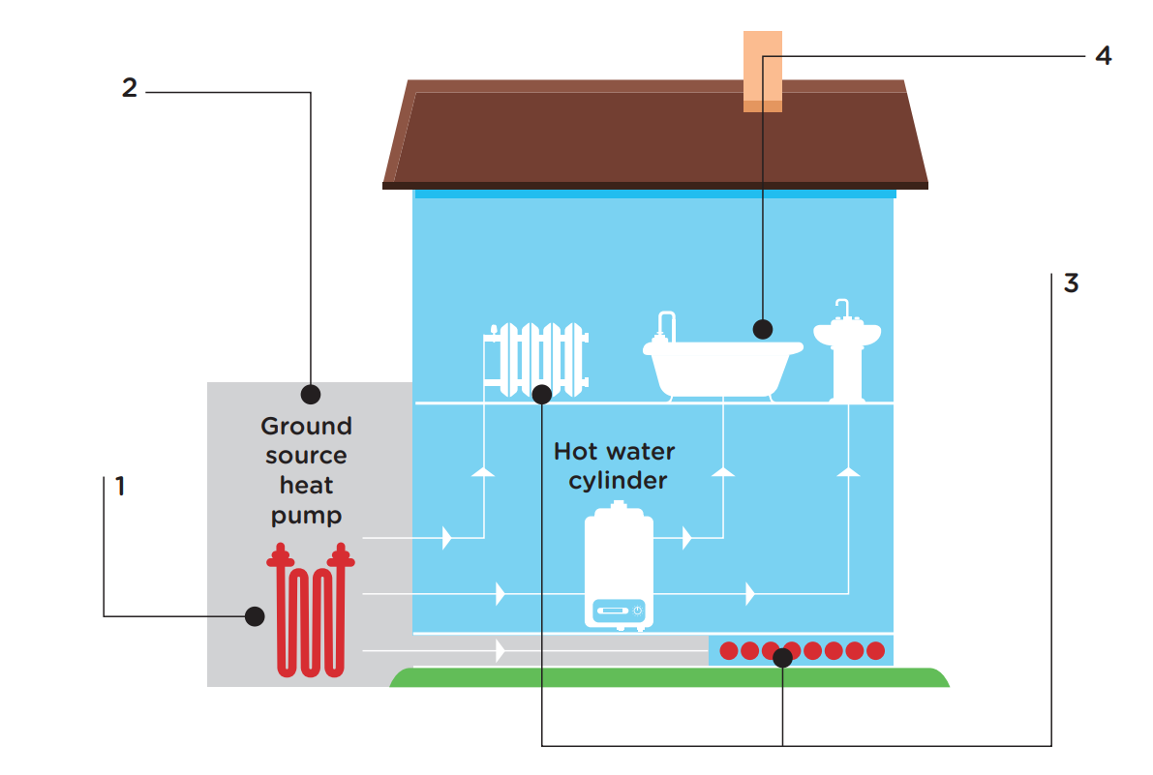
Ground source heat pumps
The ground beneath our feet absorbs and retains heat and beyond a certain depth this remains fairly constant throughout the year. Ground source heat pumps have boreholes up to 100m deep or slinky tube arrays buried 2m below ground. Water in the tubes is pumped into a heat exchange unit which uses the vapour compression cycle.
The connected internal pipework which warms or cools the building is of the underfloor type because such systems have a low circulating temperature.

Slide 17
Ground source heat pumps
When heating the building, the water from the ground source goes through the evaporator and the internal system water passes through the condenser.
In the summer, the heat pump is reversed using a series of four-way valves. This cooling effect uses the ground as a heat dump, preheating it for the winter months.

Slide 18
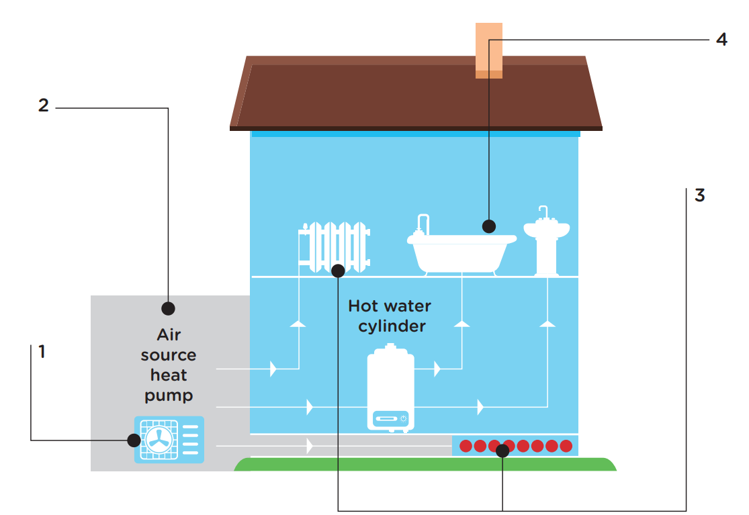
Air source heat pumps
An air source heat pump acts like a fridge in reverse. It is the least expensive of heat pump installations, being simply mounted outside the building. It extracts low grade energy from the ambient air.
It is a vapour compression cycle system with the evaporator outside. The condenser acts to provide the heat. A buffer tank is normally installed to prevent the heat pump cycling and so improve efficiency.

Slide 19
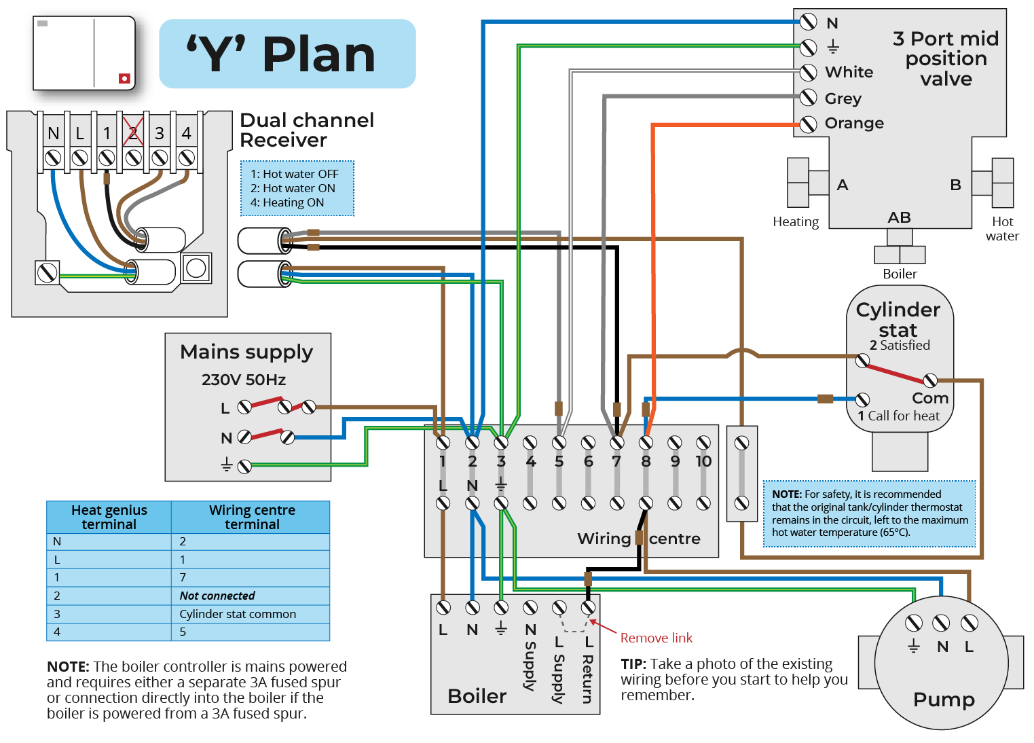
Heating controls: ‘Y’ plan
The diagram shows how a pumped domestic heating system (in this case a ‘Y’ system) is controlled. A two-channel programmer allows for the provision of hot water and/or heating by means of a mid-positional motorised valve. The current which energises the boiler and pump is fed through the motorised head of the mid-positional valve. This in turn is energised through the cylinder and room thermostats indicating the need for heat.
All the wiring for the control system, including the main electricity fused spur, is connected to a 10-terminal connector block.

Slide 20
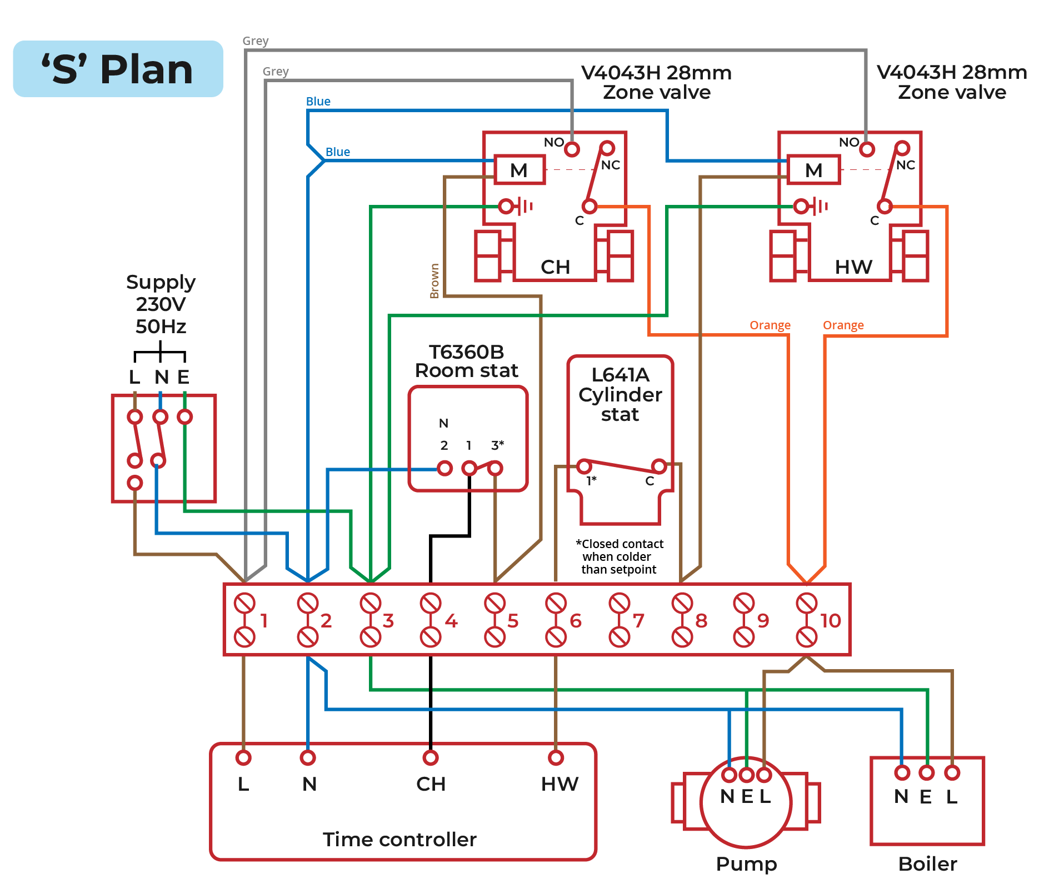
Heating controls: ‘S’ plan
While the ‘S’ plan has a different configuration its basic operational control is the same as the ‘Y’ plan described on the previous slide.

Slide 21
Safeguards against component failure
Safeguards are built in to a fully pumped domestic heating system. For example:
if the pilot light goes out, the boiler’s thermocouple will shut off the gas valve
in addition, flame rectification is used in modern boilers to prevent unburnt gas building up.
Notes:
The range of components can be broken down as
Wiring Centre (hub which houses electrical connections)
Programmer (the brains of the outfit)
Room thermostat (senses air temperature to call or negate heat)
Cylinder stat - designed to sense the water temperature in storage cylinders
3 positioned valve (electromagnetic device which regulates the passage of water)
A deep understanding is required when fault finding, because faults may be mechanically biased, such as 3 port valve failing to motor or thermistors (temperature sensitive resistors)

Slide 22
Any questions?

