Slide 1
PowerPoint 1: Air conditioning systems
PowerPoint presentation
12. Building services engineering (BSE) systems
12.1 Building services engineering systems

Slide 2
Objectives
By the end of this session learners should be able to:
list the reasons why air conditioning (AC) is provided in buildings
list the various types of AC system in buildings
draw the layout of a central plant AC system
describe the operation of two types of AC system
explain the advantages and disadvantages of various AC systems.

Slide 3
What is air conditioning?
Air conditioning (AC) is a system that is capable of heating and cooling a building as well as controlling the humidity of the air.
AC is provided in buildings to maintain an environment conducive to the health and wellbeing of the inhabitants. Air is ‘conditioned’ to supply adequate oxygen, be a comfortable temperature and have CO₂ and odours removed.

Slide 4
Central plant AC systems
In central plant AC systems, the air is conditioned before being distributed via ducting. Therefore, the effect will be identical throughout the building and can only be changed by reducing the off-coil temperature.

Slide 5
Description of central plant components
Preheater battery – in the winter cycle, fresh air is heated to 7ºC, which prevents the filters from freezing.
Recirculation duct – up to 25% of room air can be mixed with fresh air, utilising already conditioned air.
Supply fan – the ‘duty’ of a fan is the air volume and static pressure at which it operates. In other words, it is the pressure required to overcome system resistances. The supply fan has a duty slightly greater than that of the return air fan which creates positive air pressure in the room.
Cooling coil – air is cooled using chilled water or a refrigerant gas. Moisture is removed from the air by dehumidification.
Reheater battery – the air is then heated to the supply air temperature (34ºC) for comfort and to compensate for heat loss throughout the building.

Slide 6
CAV and VAV systems
Whereas CAV (constant air volume) systems supply regular air flow, albeit at varying temperatures, in a variable air volume (VAV) system a supply duct feeds each room, and air is then returned through lines/grills which reconnect with the air handling unit (AHU), which ‘dumps’ dirty air or recycles clean air.
The main advantage of a VAV system is that it can meet the comfort requirements of different zones in a building without heating and cooling at the same time.

Slide 7
VAV systems
With a VAV system the air is conditioned to one supply condition, but at the terminal unit the supply volume can be reduced or increased to condition a room by adjusting the amount of air entering the space.

Slide 8
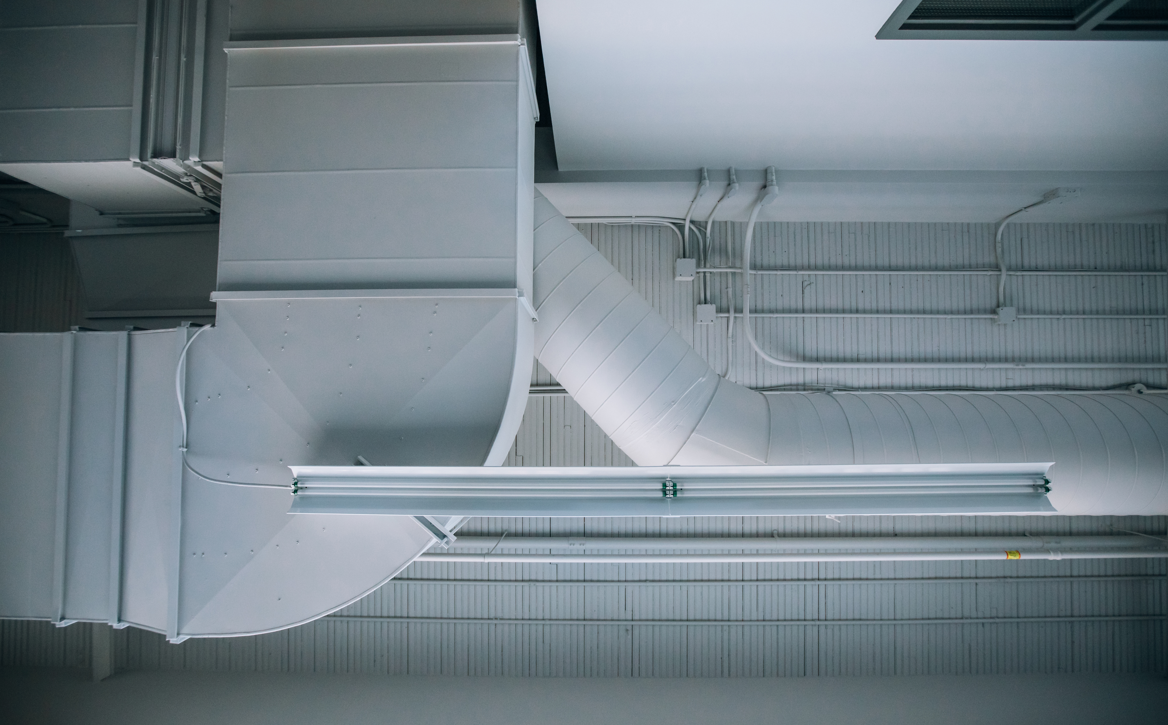
VAV terminal unit
On entry to the terminal unit there is a velocity sensor and volume control damper to adjust the volume of air entering the space.
An attenuator eliminates the velocity noise of the air flow, and its casing will also reduce the velocity of air entering the space. An optional reheater battery can be incorporated if necessary.

Slide 9
VAV terminal box
VAV systems vary the airflow at a constant air temperature, typically 13ºC, which is fed to each room via a diffuser.
Each room, or zone, will have its own VAV terminal, electrically linked to a thermostat. The terminal has an actuator and a damper which regulate the system, as well as a reheater, to boost the temperature if necessary. Pressure sensors link to variable speed drives/variable frequency drives which regulate the speeds of the induction motor blower fans.

Slide 10
Induction systems
AC induction systems condition the air to a single condition which is then circulated into the building at high velocity to feed room induction units. These units are
box-like casings with ports through which high velocity air passes, allowing room air to be induced and mixed with fresh, conditioned air.
There is no return air ductwork for recirculation, so all recirculation takes place within the casing. Heating water can be used to reheat the mixed air, but this significantly increases the capital cost of the system.

Slide 11
The Venturi effect
Induction systems makes use of the Venturi effect. Pipework is deliberately constricted to reduce fluid pressure and increase velocity.
This creates a vacuum, which recirculates the air from the room.

Slide 12
Dual duct systems
A dual duct system distributes air via two ducts: one for chilled air and one for heated air. Incoming fresh air is preconditioned before entering the fan suction chamber and being split into hot and cold. The two ducts are insulated to prevent the chilled air from absorbing warmer ambient temperatures and the heater air from losing heat to the surrounding air.

Slide 13
Dual duct terminal boxes
In a dual duct system, terminal boxes mix the chilled and heated air before discharging it into the room, where it is controlled by a thermostat.

Slide 14
Cooling systems
Compression cycle refrigeration circuits are known as variable refrigerant volume (VRV) systems. VRV systems are used where ductwork is not possible or needed.
The main refrigeration unit is normally sized to feed a single storey of a building, confining any problems to a single floor.
VRV systems have a three-pipe distribution system: a main refrigerant flow and two return pipes.
Individual room units are capable of reversing the flow of refrigerant to heat or cool the room using the same refrigerant.
Room units have a drainage system to remove condensate when cooling.
Notes:
https://www.youtube.com/watch?v=evOYz8xATrw

Slide 15
Schematic of a VRV system
A single outdoor condensing unit connects to one or more air handlers.
Refrigerant is cycled through the outdoor unit, which then distributes heat or cooled air accordingly. Each room/zone will have a thermostat, which means heating and cooling can occur at the same time in different rooms.
VRV systems incur mininal energy loss compared with forced air systems, and no back-up heat source is required.

Slide 16
Split system air conditioners
Split system units operate in a similar way to refrigerators or freezers. They are designed to condition individual rooms as stand-alone units.
The internal unit is the evaporator. An internal centrifugal impeller draws room air across the heat exchanger which in turn evaporates the refrigerant liquid, removing heat from the room air. The external unit is the condenser. The heat exchanger has a propeller fan which draws the outside air across the heat exchanger, removing heat from the refrigerant gas.
The two units are piped with copper tubing to enable the refrigerant to flow between them. The compressor and expansion valve are located within the external unit.

Slide 17
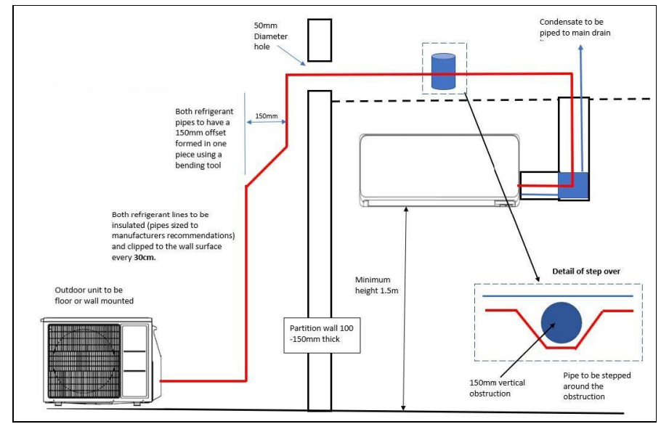
Air Conditioning System

Slide 18
Any questions?

