Slide 1



Virtual Modelling
WJEC GCE Built Environment
Notes:
Virtual Modelling
Virtual modelling is described in section 2.2.5 of the specification. The section is in three parts; part(a) refers to understanding the use of virtual modelling to produce project information, part (b) refers to an awareness of the importance of common methodologies with reference to collaboration and part (c) refers to the ability to produce and render 2D and 3D models.

Slide 2
Understand virtual modelling :
2D virtual modelling:
Representation of elements including:
• architectural form and spatial arrangements
• outline structural and services designs
• outline site and landscape design.
3D virtual modelling:
Virtualisation developed from the 2D model to include:
objects with specifications and method statements attached.
• all information necessary to allow the objects in the model to be manufactured and installed or constructed.
Notes:
This slide outlines the content for part (a) and describes the scope and level of understanding of virtual modelling expected, moving from the 2D representation of elements, traditionally in the form of plans and elevations, to a comprehensive 3D virtualization complete with object attributes and construction specifications.

Slide 3
Use Virtual Modelling :
Produce virtual models
Use of CAD software for the input and processing of building design information to output 2D and 3D images of the proposed building.
Render virtual models
Generating photorealistic digital images from a model. The model will contain objects in a strictly defined data structure; with details on geometry, viewpoint, textures, lighting, and shading.
Notes:
This confirms the scope of modelling skills expected, moving from 2D CAD work to the development of 3D images and creation of photorealistic outputs by rendering.

Slide 4
Virtual Modelling for the NEA
The task requirement:
To use virtual modelling design to produce 2D and 3D virtual modelling outputs for the (specified building) including rendering.
The assessment descriptor:
Setting up virtual modelling projects using common methodologies and using virtual modelling design to produce 2D and 3D outputs including virtual models and rendering.
Notes:
The task requirement describes the virtual modelling skills that are to be demonstrated in part (d) of the NEA. The assessment descriptor refers to modelling projects, common methodologies and virtual models. The actual assessment will need to be sensitive to the context of a single project carried out by an individual without scope for collaboration.

Slide 5
Virtual Modelling for the NEA
21-24 marks
Strong evidence of thorough and effective application of knowledge and understanding in the:
• setting up of virtual modelling projects
• use of common methodologies.
Excellent application of knowledge and understanding to produce high quality 2D and 3D virtual modelling outputs, which include:
• a range of sophisticated and convincing models of proposals
• highly effective use of rendering.
Notes:
The top band of the levels mark scheme for the modelling work indicates a maximum mark of 24 out of 80 or 30% of the unit. The band descriptions also refer to modelling projects, common methodologies and a range of models. The assessment will need to reflect that there will be only one project, that the range of models will be restricted by time constraints and that the scope of the project is likely to involve one 3D model developed from one 2D model.

Slide 6
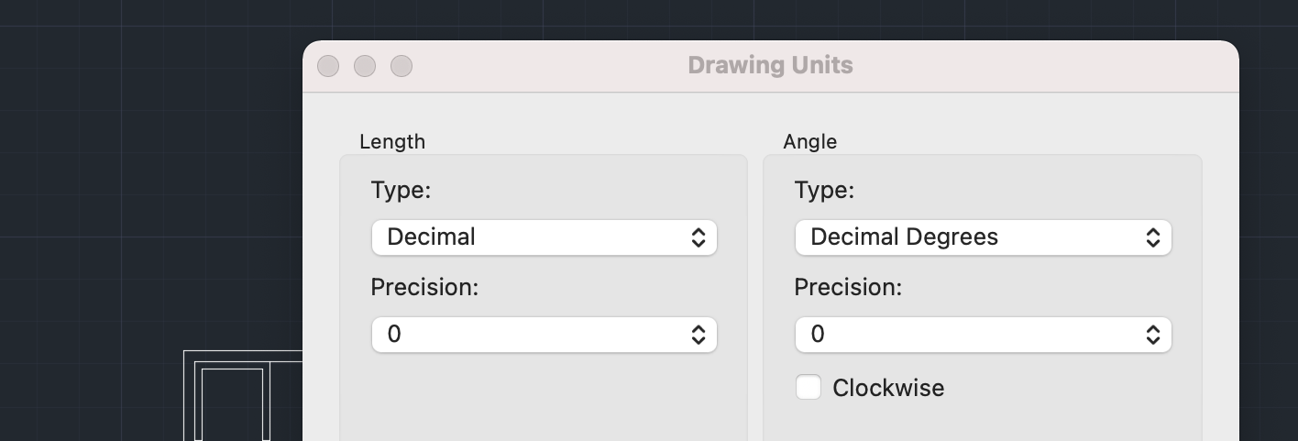
Producing the 2D Model
Basic rules
Work at 1 : 1 not to scale
Set the units required (mm)
Notes:
The modelling work will begin once the design work for part (c) of the NEA, which requires the production of a range of 2D and 3D sketches and drawings has been completed. The modelling work will need to start with the use of CAD software to produce floor plans. The screen shots in the following slides have been taken from AutoCad and have been used to illustrate a few basic rules to follow when producing a 2D model of this type. The slide states that the work should be carried at full size and be in millimeters.

Slide 7
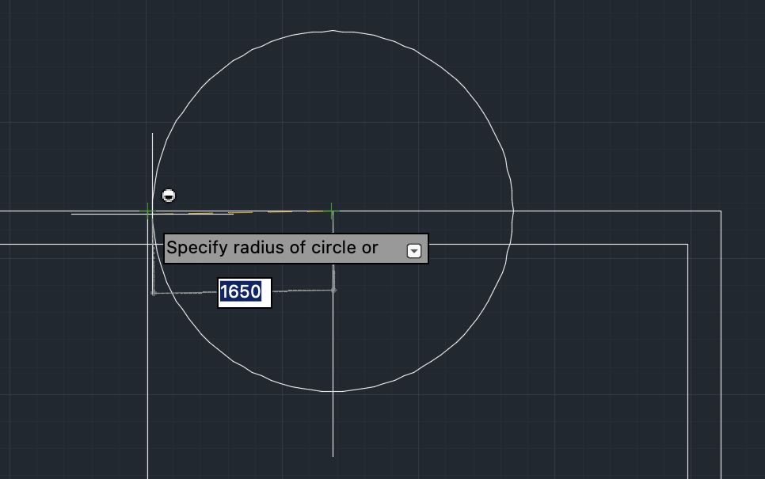
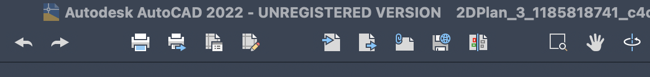
Producing the 2D Model :
Basic rules
Work accurately.
Select circle / Locate centre point / Enter / Type radius / Enter.
Use Undo / Redo
Notes:
Working accurately
Using this type of software, it easier and quicker to work accurately than to approximate. The software will allow precise placement of objects and enable dimensions to be input with zero tolerance. In AutoCad the undo/redo buttons are at the top of the screen.

Slide 8
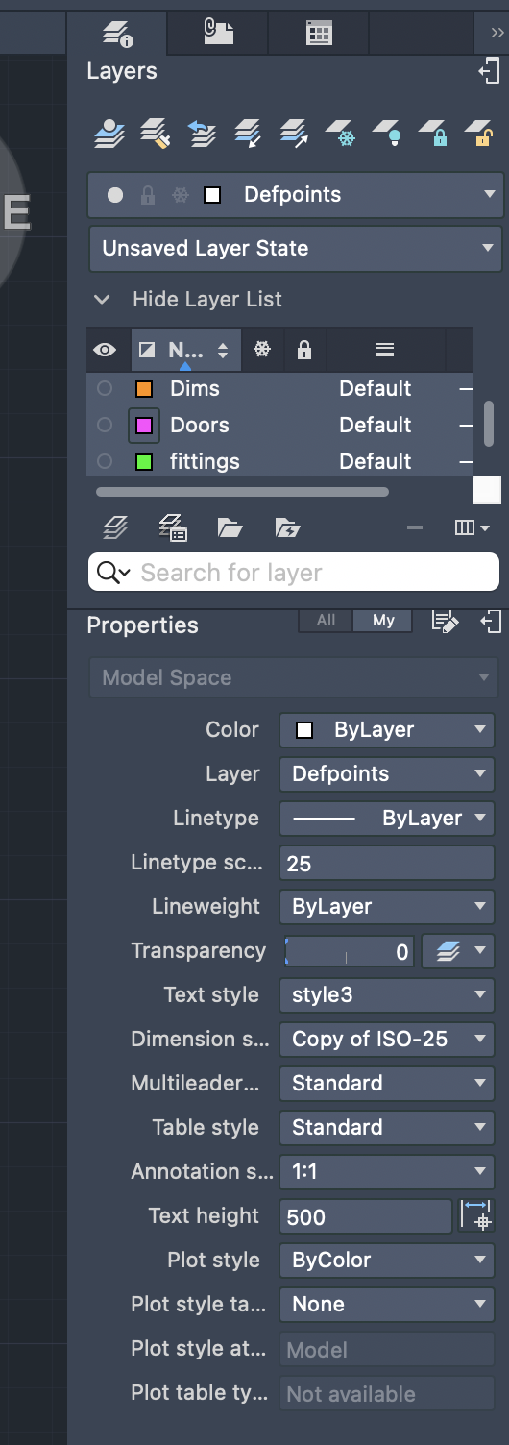
Producing the 2D Model :
Use layers
Notes:
Layers must be used to group common objects and their properties. Layers for a model of this type will include walls, windows, doors, fixtures and fittings, text and dimensions as a minimum. Each layer should be designated a colour. The objects grouped in a layer can be displayed or hidden and be active or locked. Common properties will include line type and thickness, level of transparency, text and dimension styles.

Slide 9
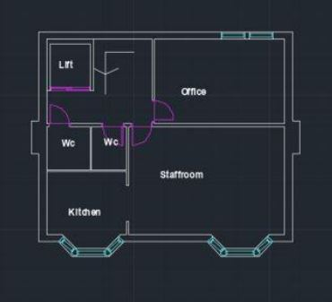
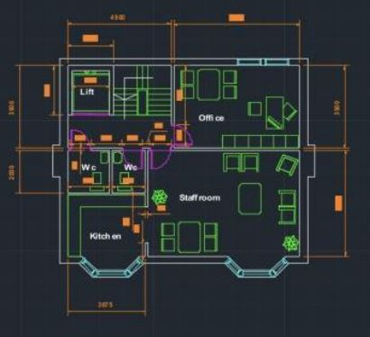
Producing the 2D Model :
Use of layers
1. 2.
Notes:
This slide shows tow images of the same model. Image 1 with wall, door, window, and text layers only. Image 2 with layers for fittings and dimensions also displayed.

Slide 10
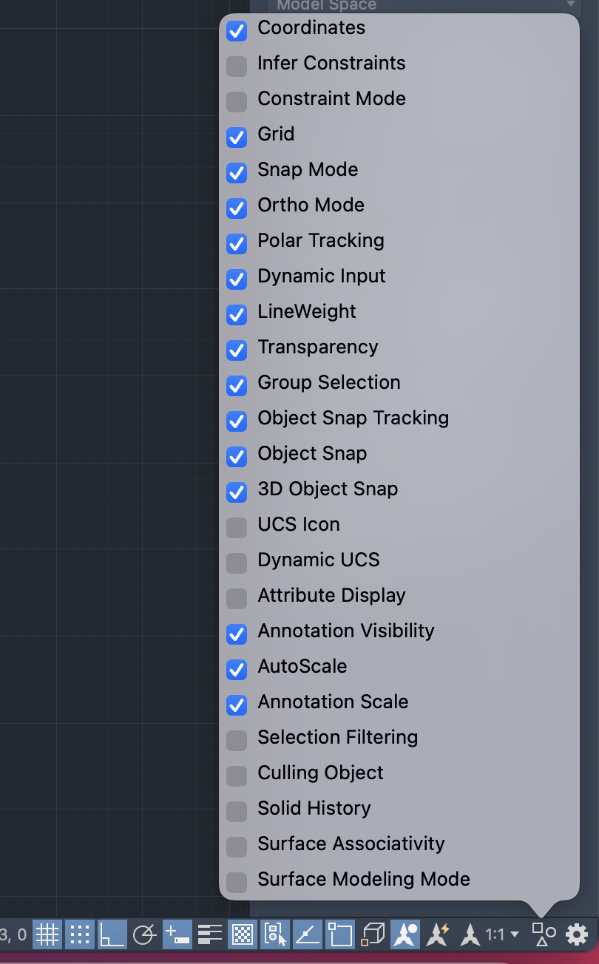
Producing the
2D Model :
Basic rules.
Work with ortho on
Use object snap
Remember the 3D
model to follow
Notes:
Working with Ortho on will limit the model to 90-degree angles, which will be required most of the time. Object snap will help when combining or objects. Remember that the model is to be used to create a second 3D model – the wall layer is critical and needs to be completed without errors so that they can be developed as solid 3D objects with the required thickness and not as isolated surfaces.

Slide 11
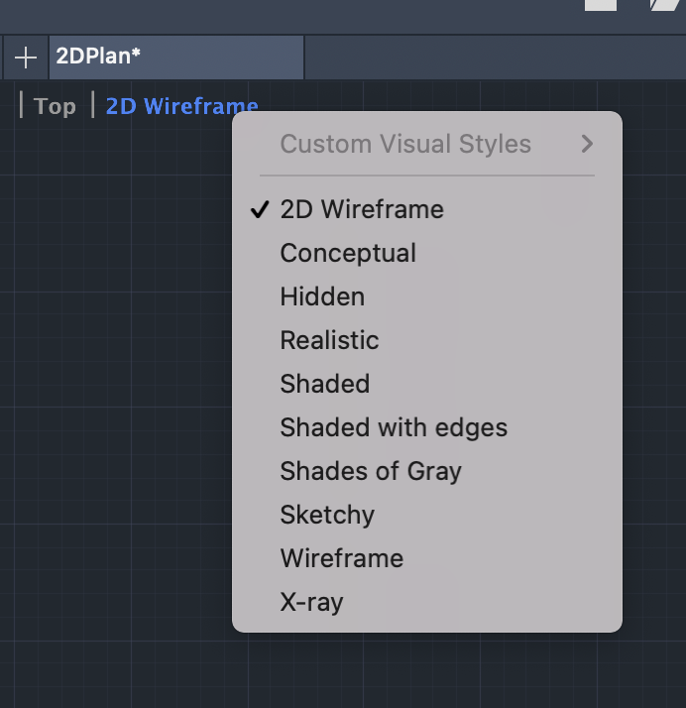
Viewing the 2D Model :
Set to top and
2D wireframe.
Zoom with scroll wheel
or use select window
Tool.
Move by dragging
using pan tool
Notes:
The floor plans will be developed as a 2D wireframe with the view set to top. Most of the time zoom provided by the scroll wheel on the mouse will be adequate, although window zooms of a selected area are also useful and the pan control can be used to move the model within the viewing area.

Slide 12
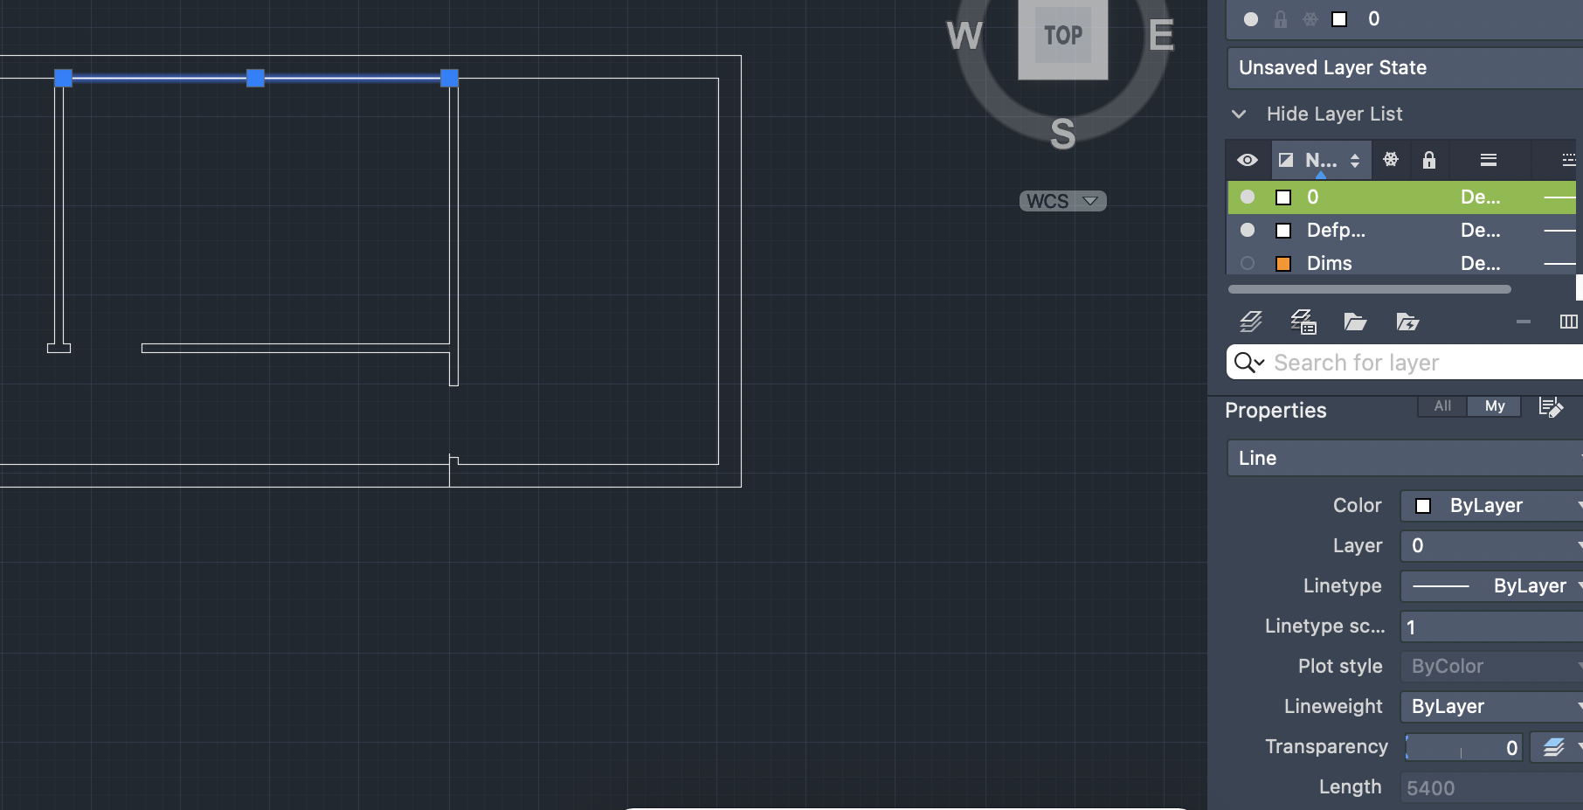
Components of the 2D Model :
The model will be made up of Objects - lines, rectangles and other geometric shapes.
End points and mid point
Length
Notes:
The 2D model will be made up of objects, which will have reference points and properties. The slide illustrates a single line with end and mid points that can be used when placing the line and other objects in relation to the line. The properties of the line including length are also shown.

Slide 13
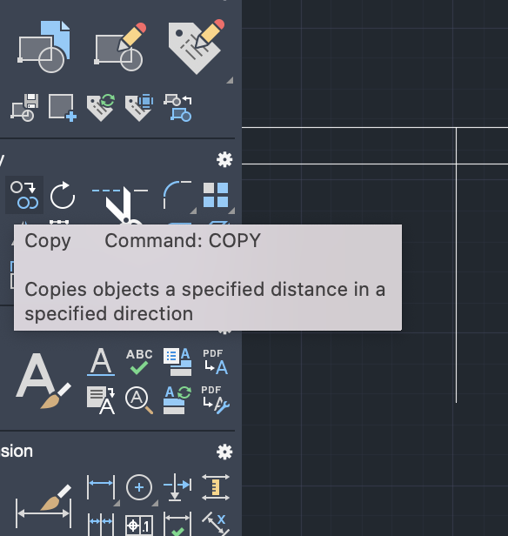
Selecting Existing Objects :
Click to select single
Objects.
OR for multiple objects
Select tool / click / ‘w’ /
Enter / Draw window /
Enter
Notes:
Selecting existing objects is achieved with a simple mouse click. Groups of objects can be selected by specifying a window selection, as shown.

Slide 14
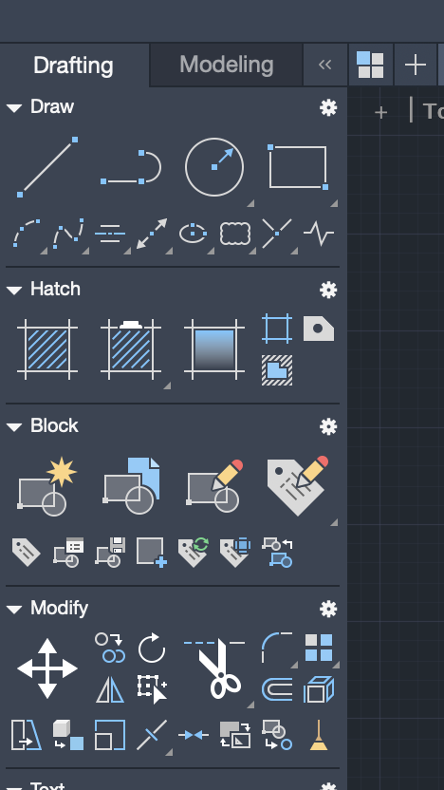
Creating and Editing Objects
Objects can be
Created
Hatched
Blocked
Modified
Notes:
This is a view of AutoCads drafting tools, which are grouped into four sections so that objects can be created, hatched, blocked or grouped and modified. Most CAD packages will provide similar facilities.

Slide 15
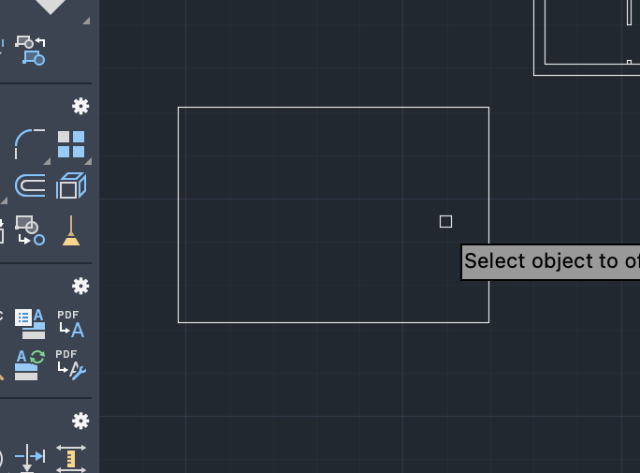
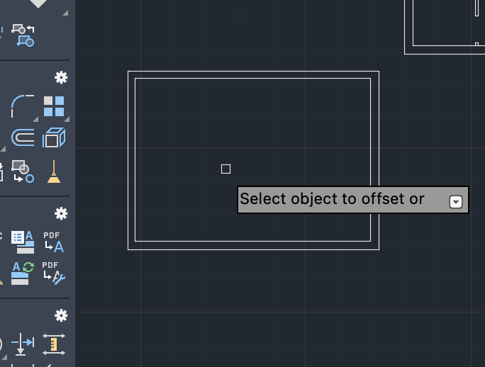
Modify Tools :
Modify tools include:
Move / Copy / Rotate / Scale / Mirror / Trim / Extend / Fillet / Explode / Erase / Offset -
Notes:
The software will provide a range of powerful tools for modifying objects. The slide illustrates the use of the offset tool to offset a rectangle by 300mm to create and enclosed space.

Slide 16
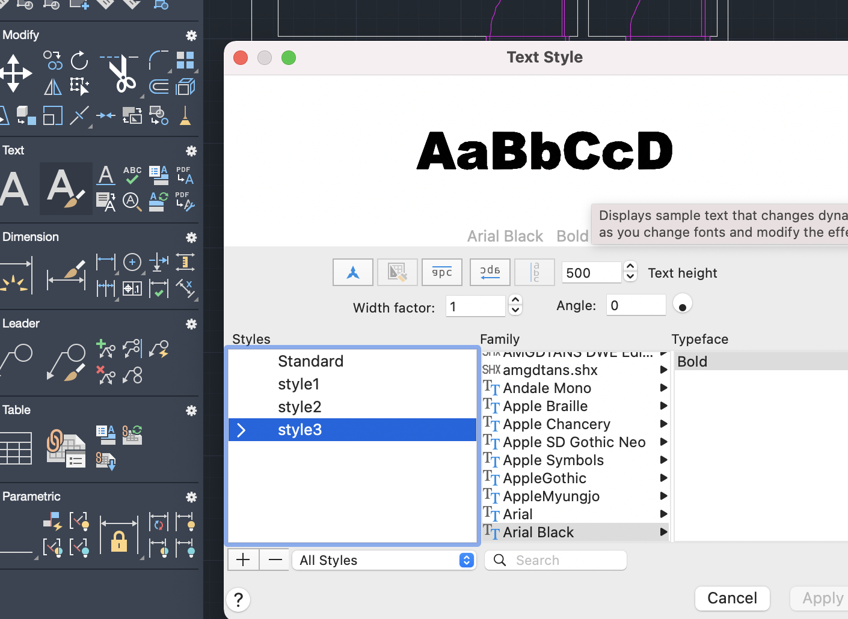
Text :
Use styles
Notes:
The model is likely to use a range of text styles, which can be set up and saved as shown.

Slide 17
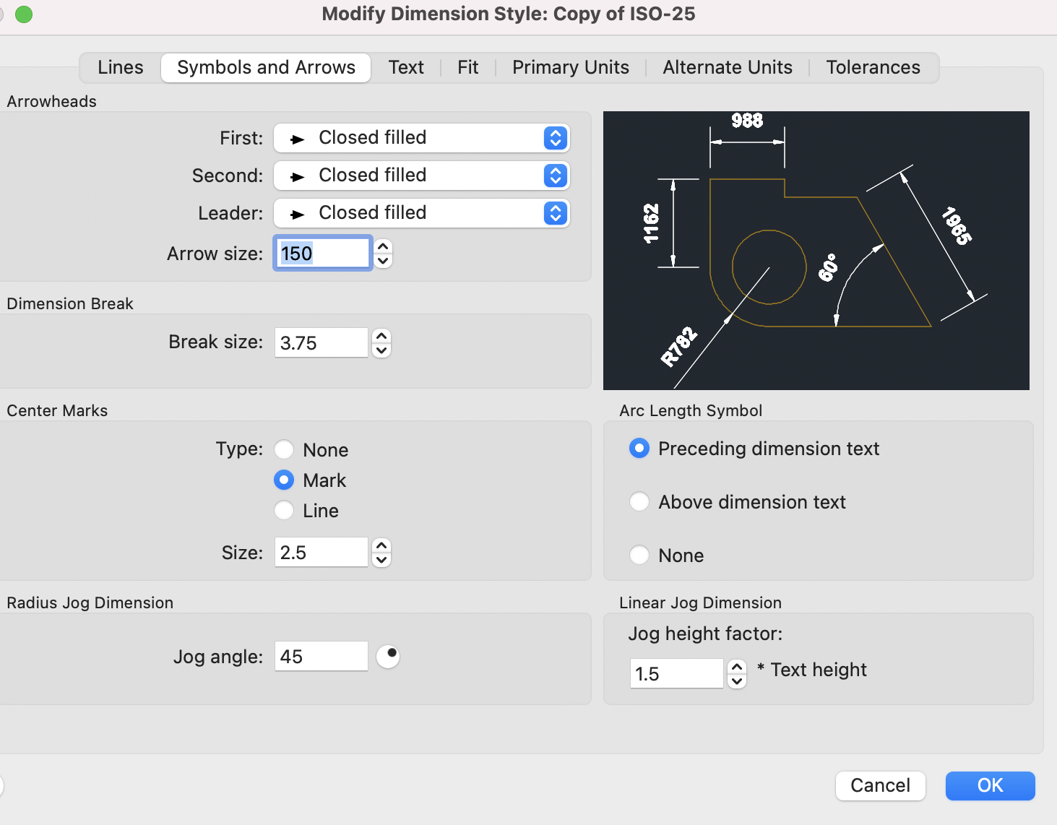
Dimensions:
Set up
Notes:
And dimensions will also need to be set up in terms of lines, arrows, text size, position, fit etc. Once a dimension is inserted other dimensions in the same run can be added using a follow-on command.

Slide 18
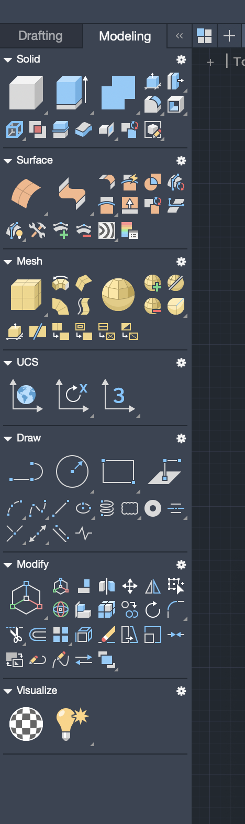
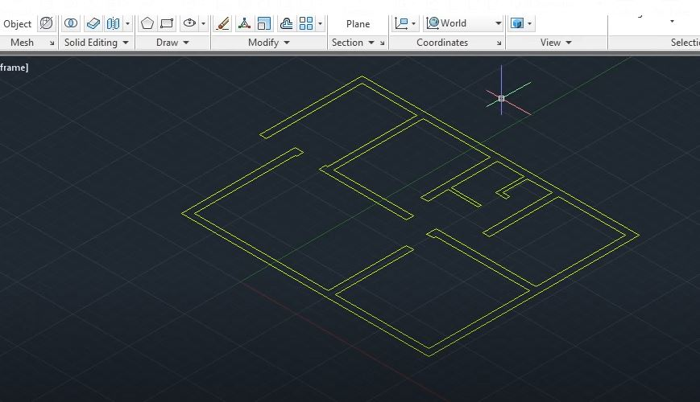
Producing the 3D Model 1
Swap tools from drafting to modelling
Turn off all layers except walls.
Change to isometric view
Notes:
When complete, save the 2D model and use one version as a base for the 3D model. Open the modelling toolbar, view the walls only and select an isometric view according to the required orientation.

Slide 19
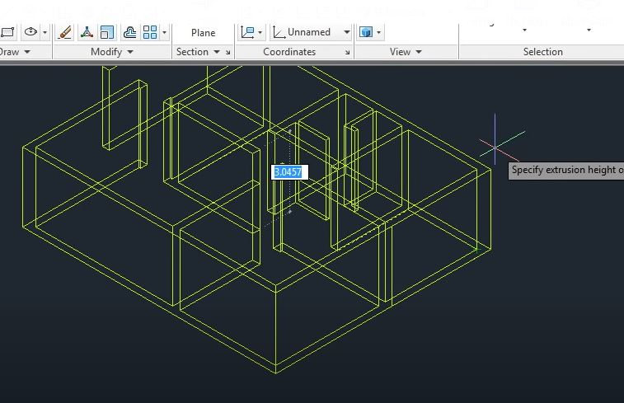
Producing the 3D Model 2
Extrude : Command press/pull / Enter ‘m’ for multiple selection / Select all walls / Enter height / Enter
Notes:
Select and extrude the walls having specified the required storey height.

Slide 20
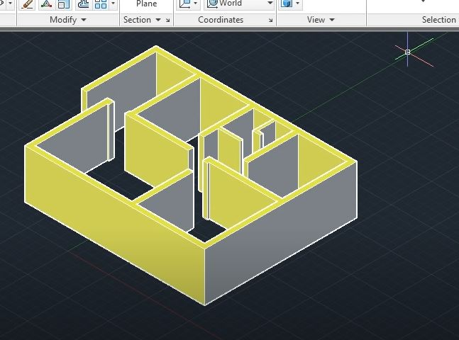
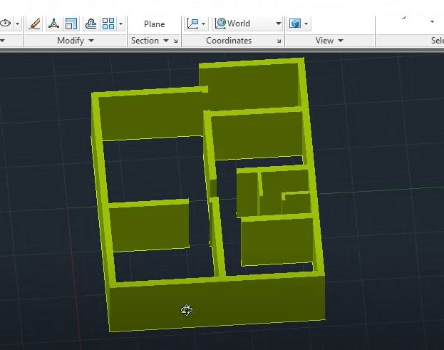
Producing the 3D Model 4
Select shading mode
Orbit to select perspective view
Notes:
Add shading to aid viewing. It is easier to work with solid shapes than with the outlines of a wireframe. The orbit tool can be used to rotate the shaded model at any time.

Slide 21
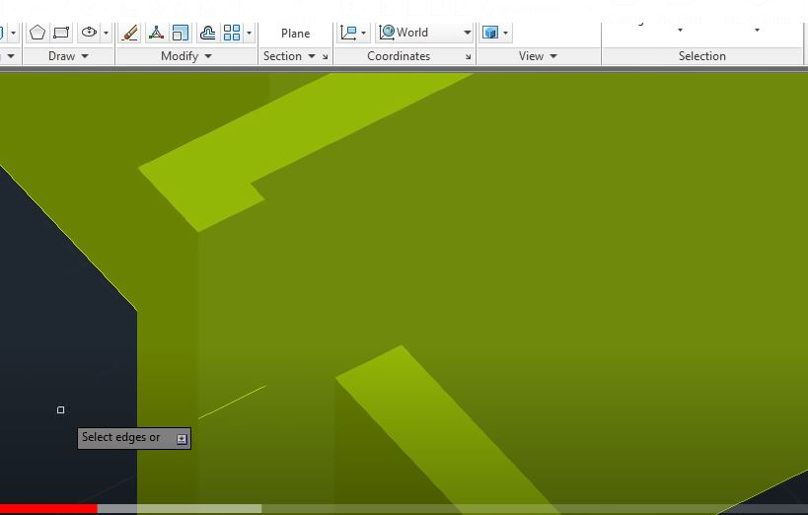
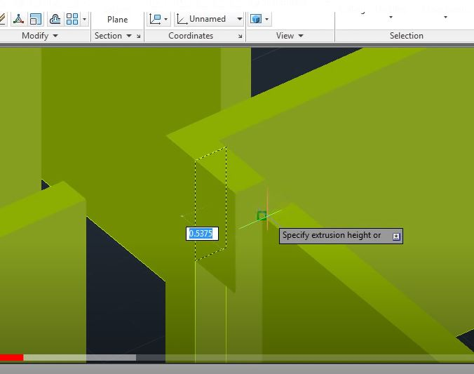
Producing the 3D Model 5
Complete above doors
Copy and move down upper edge
Extrude (pull) wall above door.
Notes:
Complete the walls above doorway openings, as shown.

Slide 22
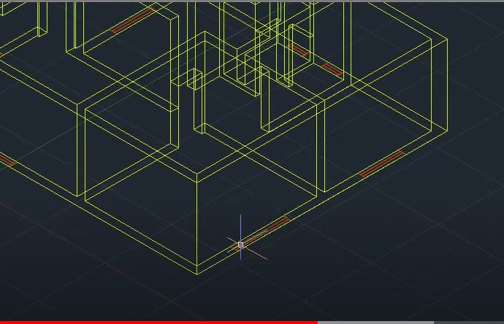
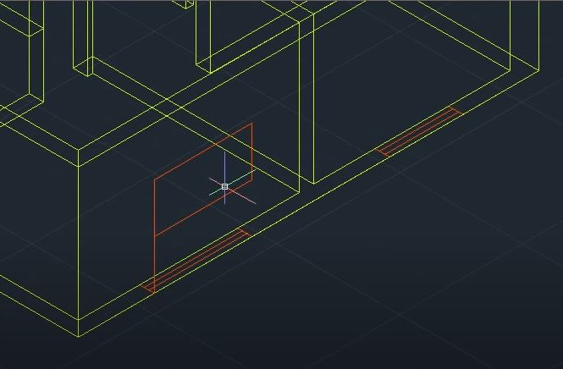
Producing the 3D Model 6
Wireframe view.
Turn on window layer.
Set sill height
Add rectangle to outline window.
Notes:
Return to the wireframe and turn on the window layer to position window openings. Specify the sill heights and draw rectangles to create window openings..

Slide 23
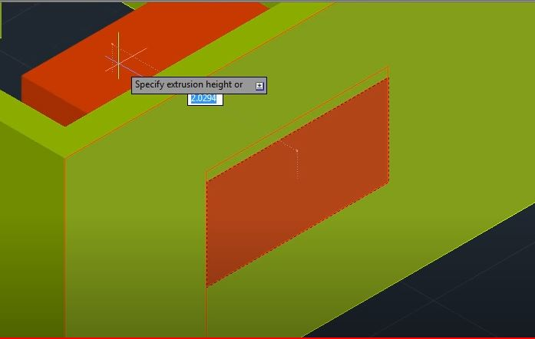
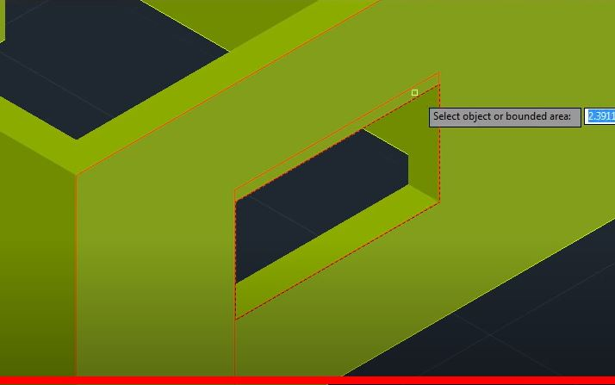
Producing the 3D Model 7
Select window outline.
Extrude (press) inwards
/ Enter
To form opening
Notes:
Extrude or press the window rectangles inwards to create openings in the walls.

Slide 24
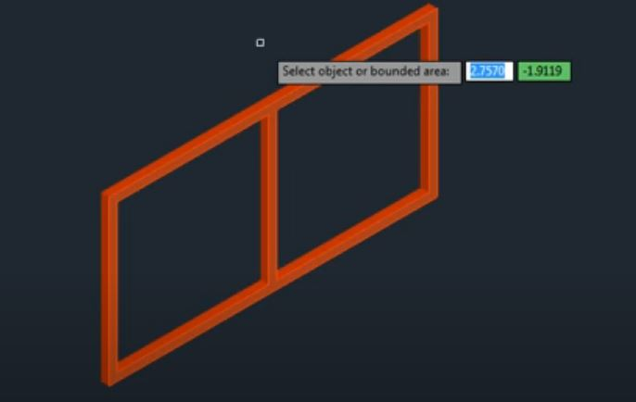
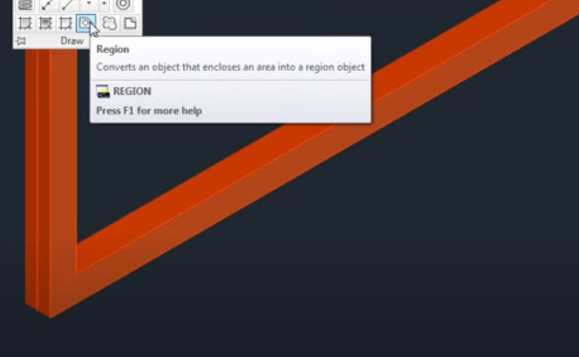
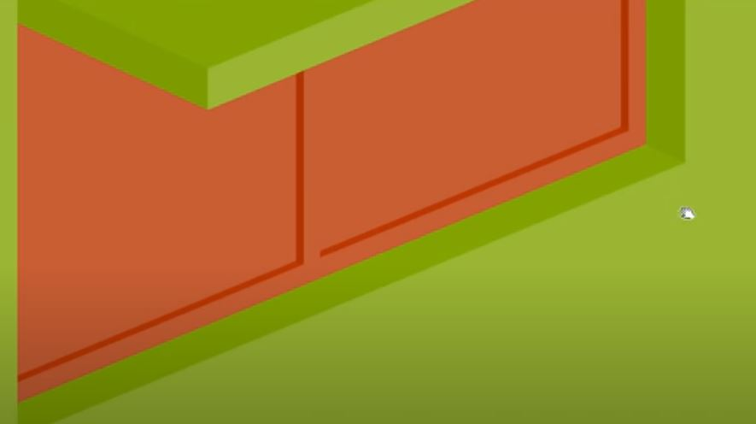
Producing the 3D Model 8
Use drafting tools to produce frame.
Add glazing plane at midpoint of frame
Set reference point. Copy window into wall
Notes:
…continue by creating and positioning 3D window and door frames. There are several internet libraries where elements such as door sets can be downloaded and then imported into the model.

Slide 25
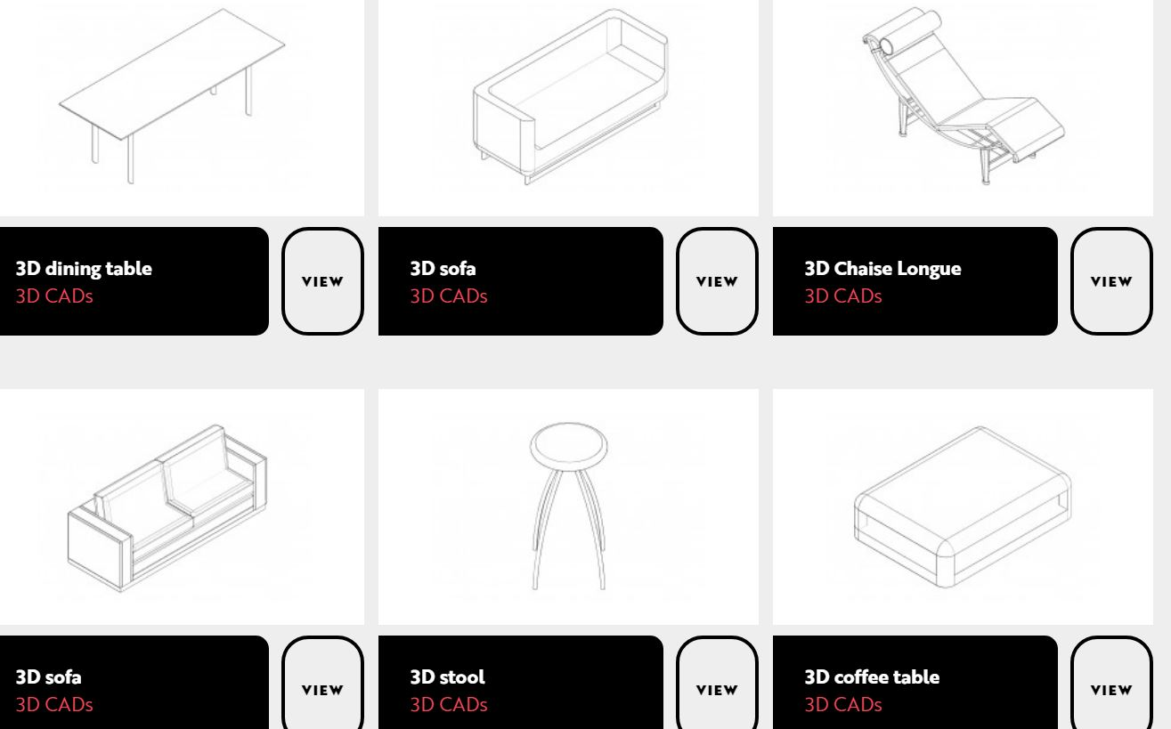
Producing the 3D Model 9
Repeat processes for all windows and doors.
Add fixtures and fittings to suit. There are many libraries of CAD blocks available.
There are many libraries of CAD blocks available.
Notes:
Similarly, many 3D libraries of furniture and sanitary goods are available.

Slide 26
Presenting the 3D Model
3D Rendering.
The use of 3D software to help create images that better explain concepts and designs. CAD software is used to create 3D models. Lights, textures and cameras are added to the base model and the model is then rendered which involves the 3D software computing all inputs to create a photorealistic image.
The rendered image can be rotated and viewed from various angles and the rendering will adapt accordingly with textures, lighting and shadows following the view angle.
Notes:
This slide explains what is meant by rendering. The ‘highly effective use of rendering’ is a requirement of the top band of the levels-based mark scheme for this unit. Decisions regarding the extent of the model to be rendered will be necessary. Will it be necessary to render all elevations? Are any internal views required?. When working on the model the rotate, zoom and pan facilities can be used. When presenting the model for assessment it is likely that only pre-selected views can be submitted.

Slide 27
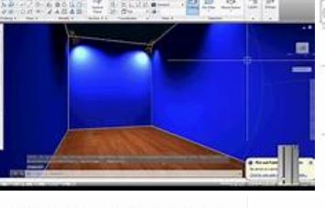
Presenting the 3D Model 1
For an internal view.
Adding a ceiling – from the modelling toolbar.
Add surface / draw / enter / thicken / input value.
Add spotlights on ceiling (see software tutorial).
Lights are used to add depth when rendering
Notes:
A ceiling will be required for an internal view and lighting will need to be added to generate highlights and shadows. The type and use of lighting will vary according to the software being used.

Slide 28
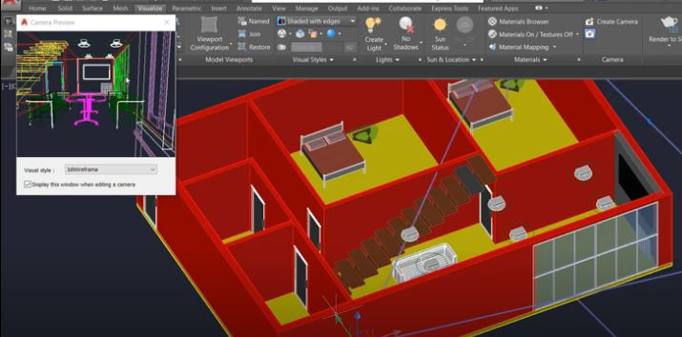
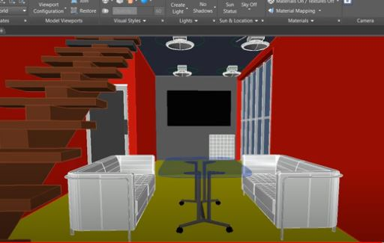
Presenting the 3D Model 2
Hide the ceiling.
Add a camera from the render panel.
Use camera controls (zoom and pan) to select view and save
Notes:
AutoCad uses cameras to preview and fix perspective views.

Slide 29
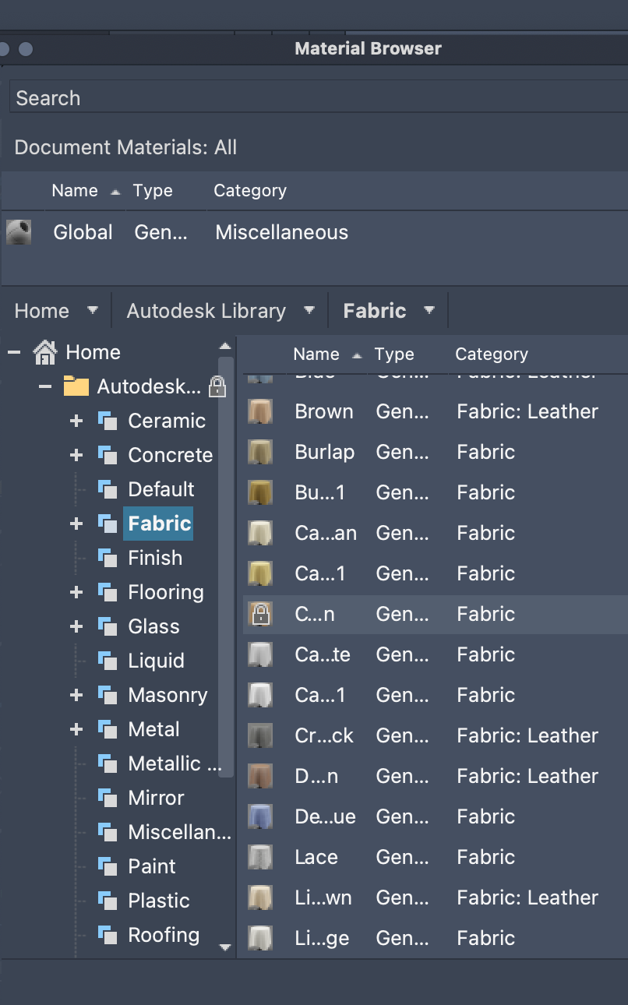
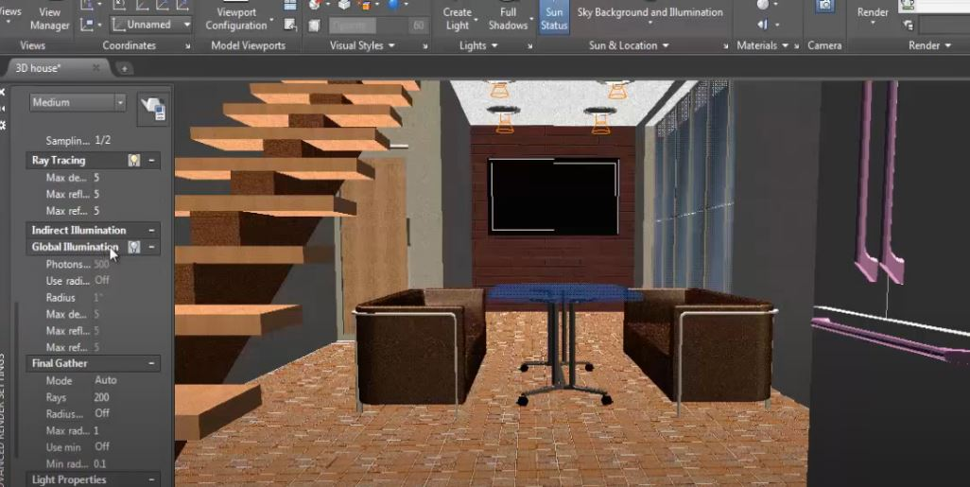
Presenting 3
Add finishes
modelling / visualize / material browser.
Use camera controls (zoom and pan) to select view and save
Notes:
Before rendering add surface finishes and textures. AutoCad provides an extensive library of surface finishes in the material browser available from the modelling toolbar.

Slide 30
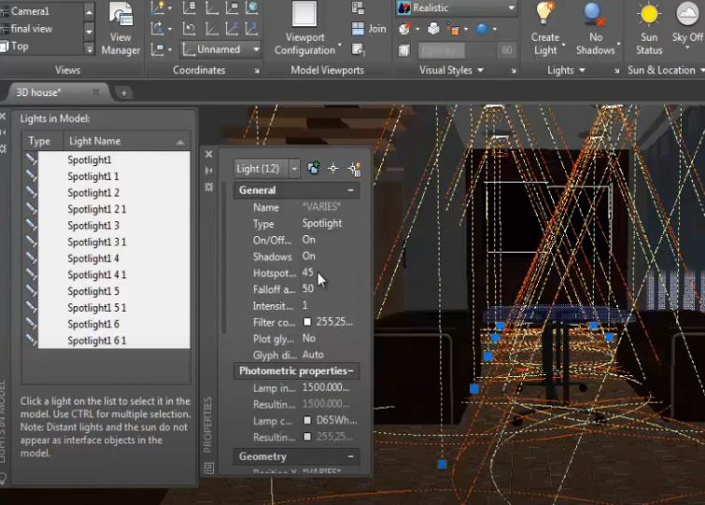
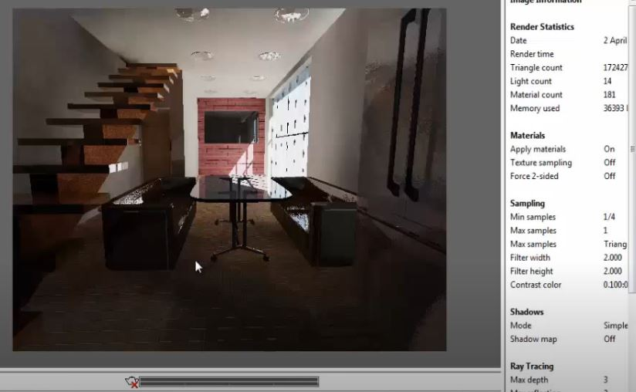
Presenting the 3D Model 4
Set lighting directions and intensities.
Render and save
Notes:
Set lighting properties according to the facilities of the software being used and render. The final image may take some time to appear on the screen. Save the image and export it specifying a portable file type.

Slide 31
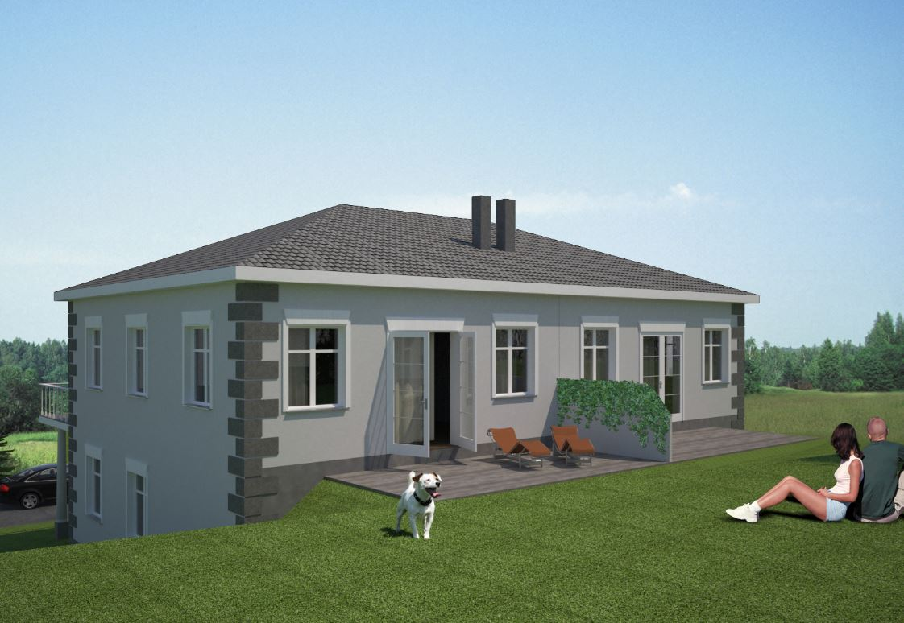
Presenting the 3D Model 5
See separate tutorials for :-
Use of tapered extrusion for roof geometry.
Adding materials and adjusting daylight angle.
Importing assets (people, cars etc.)
Importing of background and foreground
Notes:
External views require a similar process and will benefit from the import of a realistic background, foreground and assets such as people and cars. Again, several online libraries are available for download of suitable assets.

Slide 32


Any Questions?
Subject Officer
Allan Perry
construction@wjec.co.uk
Subject Support Officer
Andrew O’Regan
construction@wjec.co.uk
@wjec_cbac | @cbac_wjec
cbac.co.uk | wjec.co.uk
Notes:
Time to deal with any questions arising at his stage.

