Slide 1
GCE AS/A Level Built Environment
Online Professional Learning
Preparing to teach and assess Unit 1
March 2021

Slide 2
Agenda
Introductions and outline for workshop (10 minutes)
Overview of Unit 1 (45 minutes)
Marking exercise – (60 minutes)
Sample Assessment Materials
Completed exam paper – marking exercise
Review of marked paper
Introduction to WJEC resources (30 minutes)
Teachers
Students
Exam Walk Through (20 minutes)
Question and Answer session (10 minutes)
Contacts and the next workshop (5 minutes)

Slide 3
What Unit 1 includes
Unit 1 – Our built environment
Is designed to build knowledge and understanding of:
Buildings and structures
Careers, roles and organisations
Designing and constructing buildings
Change of use
External works
Notes:
AS Unit 1 contributes 50% to the AS qualification and 20% to the A level qualification.

Slide 4
The content of Unit 1
2.1.1 The life cycle of buildings and structures
2.1.2 Low-rise and high-rise structures in the built environment
2.1.3 Professional and technical careers and roles in the built environment
2.1.4 Organisations in the built environment
2.1.5 Structures of low-rise domestic and commercial buildings
2.1.6 Designing and constructing substructures
2.1.7 Designing and constructing superstructures
2.1.8 Designing the services requirements for buildings
2.1.9 Change of use
2.1.10 External works

Slide 5
Assessment
The following knowledge, understanding and skills will be assessed in Unit 1:
Recall of knowledge relating to the contents of Unit 1
Application of knowledge relating to Unit 1
Ability to analyse and evaluate tools, techniques and strategies relating to creating the built environment for the content of Unit 1
The ability to sketch construction components.

Slide 6
Life cycle of buildings and structures
The life cycle of a building covers the whole of its life:
Design
Construction
Operation
Demolition / repurposing

Slide 7
Life cycle of a building - design
The design phase covers:
Strategic definition
Preparation and brief
Concept design
Developed design
Technical design
Notes:
Design – The application of architectural, engineering, and technical skills to create a building to meet agreed requirements.
Building design is a collaborative process involving a Client and a design team usually led by an Architect. A Client will identify building requirements. The design team will work with the Client to define a brief and develop a solution, in terms of function, performance, aesthetics and budget, to meet the requirements.

Slide 8
Life cycle of a building - design
RIBA Plan Stages 0 - 4
Stage 0 | Strategic definition of the client’s business case.
Stage 1 | Establish project objectives, outcomes, and budget.
Stage 2 | Develop architectural concept design including outline structural and services designs.
Stage 3 | Developed design leading to application for planning permission.
Stage 4 | Detailed technical design with material and performance specifications and application for Building Regulation approval.

Slide 9
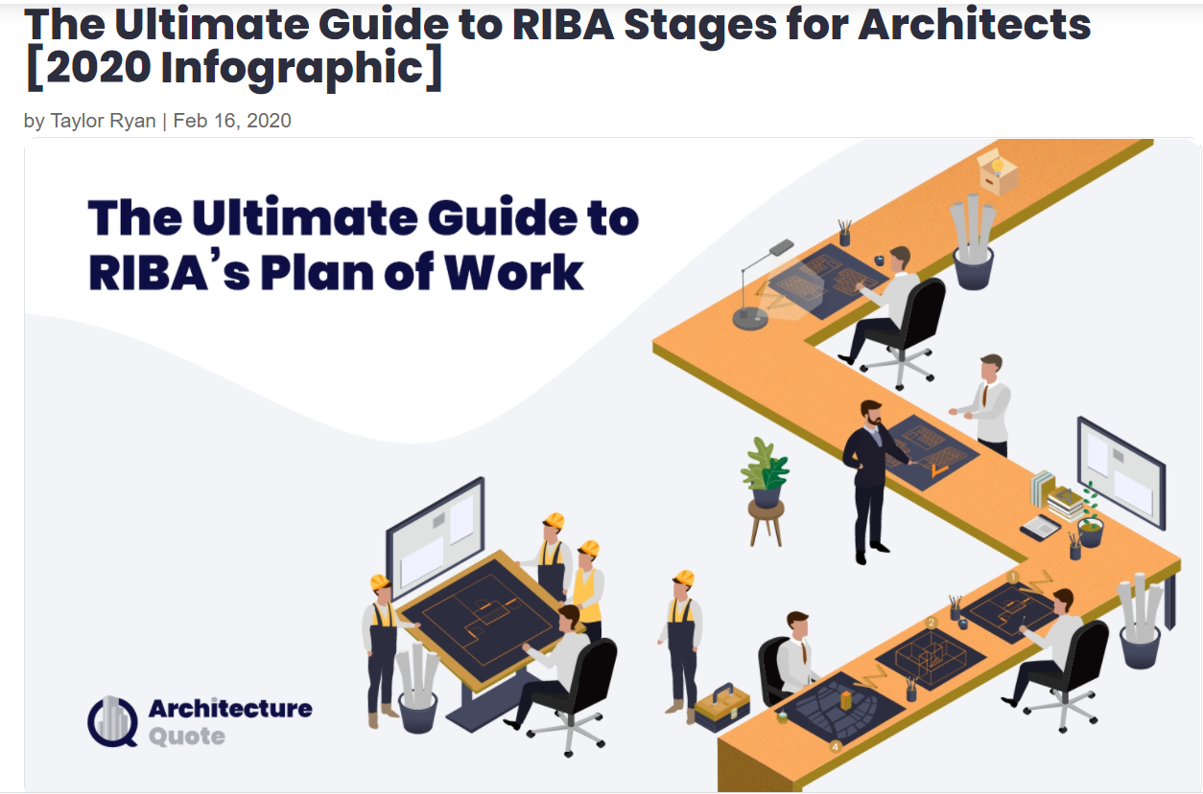
Teaching and Learning Resources
Resources
http://www.architecturequote.com/guide-riba-architects/
A guide to the RIBA Plan of Work that contains useful info graphics, clear descriptions and concise summaries covering Stages 0 -4 of the plan.
http://www.architecture.com/education-cpd-and-careers/learning/young-people
Learning resources from the RIBA.

Slide 10
Life cycle of a building - construction
The construction phase covers:
Appointment of contractors
Supply of raw materials
Manufacture of component parts
Building of structure / assembly of prefabricated parts
Installation and commissioning of services
Handover to client
Notes:
The construction industry is made up of Clients, developers, consultants, manufacturers, suppliers, and contractors.
The construction stage of the life cycle will begin with the appointment of a main contractor and end with the handover of the finished building to the Client.

Slide 11
Teaching and Learning resources
Information on the appointment of contractors
https://www.thebs.com/knowledge/which-procurement -method
Supply of raw materials
https://www.designingbuildings.co.uk/wiki/Supply-chain-management-in-construction
Installation of services
https://www.designingbuildings.co.uk/wiki/Building_sevices

Slide 12
Life cycle of a building - operation
The operation phase covers:
Occupation of the building
Use of the building
Maintenance and repair of the building
Notes:
Operation refers to the management of a built environment in use. It can involve:
controlling and monitoring of heating, cooling, and lighting systems
provision of security, cleaning, and other services, including testing and evacuation procedures.
Maintenance is the repair / prevention of decay, and damage caused by weather, aging and general use. Maintenance will be either:
Planned maintenance i.e. carried out on a regular basis, in order to keep something in working order or extend its life
OR
Corrective maintenance, which involves repairing something that has broken.
Building Operation and Maintenance Manual:
A document given to the client on completion of the construction stage. It contains detailed information regarding the operation, maintenance, and subsequent demolition of a building.

Slide 13
Life cycle of a building – demolition/ repurposing
The demolition / repurposing phase covers:
Securing permissions
Refurbishment / extension / alteration
Removal of structure, product or waste resulting from demolition of a structure
Reuse, recovery and recycling of materials
Brownfield development site opportunity and design of a new project.
Notes:
Demolition is a hazardous activity that requires efficient risk control, environmental and site management, and careful planning. It involves the taking down of a structure and the disposal of the resulting waste materials. It may involve the use of explosives, machine demolition or taking down by hand.
Vacant buildings are prone to vandalism and natural degradation and have often been demolished, as this was thought to be more profitable than repair.
As an alternative, repurposing of disused buildings can play an important role in the regeneration of the built environment, getting empty properties back into use to meet changing needs. Repurposing will extend a building’s lifecycle and is a sustainable way of construction.
Repurposing can be described as the alteration of a building to suit new conditions, such as a change in use or size or performance requirements, and may include
Conversion: a change in function or use, such as converting an office block to residential use.
Extension: increase in size, which can be horizontal or vertical expansion.
Refurbishment: work related to a change in performance.
In the UK approximately 40% of all construction work is involved in the refurbishment and maintenance of existing buildings.

Slide 14
Teaching and Learning resources
Securing permissions
https://www.planningportal.co.uk/info/200130/common_projects/13/demolition/
Demolition of a building
https://www.downwell.co.uk/the-demolition-process/
Reuse, recovery and recycling of materials
https://www.metropolismag.com/architecture/recycling-demolition-building-materials/

Slide 15
Professional and technical careers and roles
Professional and technical careers and roles in the built environment include:
Architecture
Civil and structural engineering
Surveying
Site and project management
Quantity surveying
Town planning
Building services engineering
Notes:
Role of the Architect. Designing buildings (layout and aesthetics) and development the technical aspects of their designs for construction, including residential, industrial, and commercial developments, and work on restoration and renovation projects.
Role of the Civil Engineer. The design and management of infrastructure projects such as roads, bridges, and sports stadiums.
Role of the Structural Engineer. The design and detailing of the structural elements of buildings and civil engineering projects.
Role of a Building/Land Surveyor. Measurement and assessment of the condition of a built asset/land intended for development.
Role of the Site Manager. To organise work on site, making sure that it is completed safely, to standard, on time and to budget.
Role of the Project Manager. To oversee all aspects of a building project, including work programmes and the procurement of labour and materials.
Role of the Quantity Surveyor. Management of the cost and budget of a building project from inception to completion.
Role of the Town Planner. To balance and advise politicians on the demands on land by housing, business, transport, and leisure with the needs of people and society.
Role of the building services engineer. The design and specification of service installations.

Slide 16
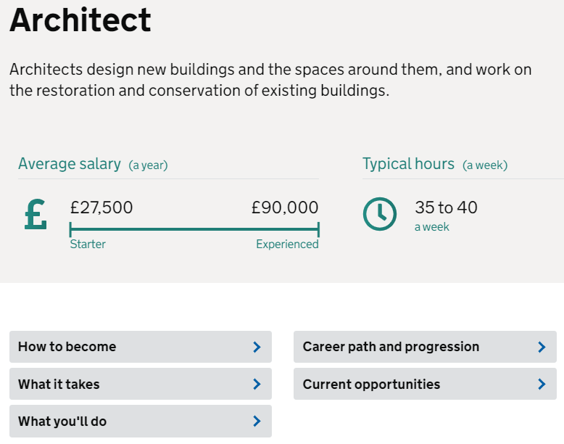
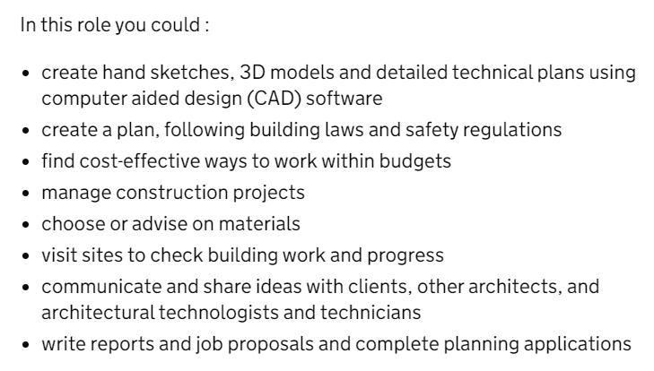
Professional and technical careers and roles
Teaching and Learning opportunities
The government careers service website that covers all careers in the design and construction industry. A good starting point for research the professional and technical careers and roles.
https://nationalcareers.service.gov.uk/explore-careers/
Learners could use this website and other industry sites to gather information of the careers and roles to produce a report, presentation of series of fact sheets on the roles involved in the construction industry.

Slide 17
Low-rise and high-rise structures
This section of the specification covers low-rise and high-rise structures in the built environment concentrating on:
Portal frame
Skeleton frame
Cavity wall construction
Structural insulated panels
Materials used within the built environment including:
Structural grade timber
Precast concrete
Insitu concrete
Brickwork and blockwork
Notes:
Portal frames - Typically, a single storey, clear span frame with double, shallow, pitched rafters supported by columns, on base plates on pad foundations.
Skeleton frames - A system of columns and connecting beams that support the internal floors and external walls and carries all loads to the foundations.
Cavity wall construction - A wall formed with an inner structural skin and an outer skin, or leaf, both in masonry, separated by a cavity.
Structural insulated panels - Prefabricated composite panels with insulation sandwiched between structural facings.

Slide 18
Low-rise and high-rise structures
Portal frame
https://www.youtube.com/watch?v=Z-7qaTDwkx4
Cavity wall construction
https://www.youtube.com/watch?v=EE-Ik-SvkAw
Modern methods of construction (MMC)
www.cewales.org.uk/files/4614/4369/9241/BRE_modern_methods_of_construction.pdf

Slide 19
Organisations in the built environment
Organisations in the construction and built environment sector include:
Small and medium sized enterprises (SME)
Nationwide and global companies
Contractors and sub-contractors
Tendering processes and procurement exercises including relevant legislation such as the Modern Slavery Act 2015
Local authority planning departments
Trade and industry training bodies
Trade registration and development schemes
Notes:
Small and medium sized enterprises - Enterprises with fewer than 250 employees, which covers over 90% of UK businesses, including most UK construction contractors and consultants.
Nationwide companies - Contractors and consultants with local offices able to serve the whole of the UK.
Global companies - Contractors and consultants with organisations that enable them to operate across several continents.
Contractors and sub-contractors – Main contractors are the organisations appointed (awarded contracts) by Clients to carry out the construction work they require. Sub-contractors. Usually trade businesses appointed by main contractors to carry out work that they cannot complete using their own employees.
Tendering processes - A competitive bidding process, where contractors submit proposals and a price for carrying out work.
Local authority planning department - The local authority will employ professional planning officers to consider planning applications and make recommendations to the ‘Planning Committee’ of elected councillors regarding decisions to grant or refuse permission to build.
Trade and industry training bodies - Construction Industry Training Board (CITB).
The CITB is a public body and charity funded by the construction industry intended to ensure that there is an adequate supply of trained and qualified people at all levels within the industry, with a main focus on apprenticeships and careers development.
Trade registration and development schemes - International Organisation for Standardisation (ISO).
Publish international standards (‘the best way of doing something’), including ISO standards for Quality Environmental and Energy Management and Health and Safety.

Slide 20
Teaching and Learning resources
Tendering
Information on the tendering process from Future Learn (Coventry University) that includes information and tasks involving additional research
https://www.futurelearn.com/info/courses/contract-management-and-procurement/0/steps/75150#:~:text=In%20construction%2C%20tendering%20is%20a,documents%20issued%20by%20the%20client
Modern Slavery Act 2015
Resources from the Guardian for teachers – includes a very good article on the issues of modern slavery in the construction of World Cup facilities in Qatar.
https://www.theguardian.com/teacher-network/teacher-blog/2013/dec/01/modern-day-slavery-news-teaching-resources

Slide 21
Structures of low-rise domestic and commercial buildings
The features and characteristics of structures of low-rise domestic and commercial buildings including:
The structural forms created both on-site and off-site
The advantages and disadvantages of different structure types including:
Precast concrete
Engineered timber
Insitu concrete structural forms
Notes:
Structural forms
Prefabrication techniques for primary structures using secondary components off-site:
Structural steel
Precast concrete
Engineered timber.
On-site structural forms of insitu concrete:
Formwork and falsework
Reinforcement
Concrete

Slide 22
Teaching and Learning resources
Precast concrete – this site provides useful information about the nature of precast concrete components and details to the advantages of its use for the construction team including the client, architect, contractor and engineer.
https://www.wellsconcrete.com/benefits-of-precast/
Engineered timber – this site provides a comprehensive introduction to timber structural systems.
http://www.structuraltimber.co.uk/assets/InformationCentre/timberframeeb2.pdf
Notes:
The construction industry is made up of Clients, developers, consultants, manufacturers, suppliers, and contractors.
The construction stage of the life cycle will begin with the appointment of a main contractor and end with the handover of the finished building to the Client.

Slide 23
Designing and constructing substructures
Designing and constructing substructures in contemporary practice including:
Methods for investigating subsoil
Producing information for foundation design
Methods for improving subsoil
The types of building foundations
Principles for designing foundations
Basement excavation, retaining walls and damp-proof courses.
Notes:
Methods for investigating subsoil – trial pits, borehole drilling, sampling, Insitu testing/
The site survey needs to include ground investigations to help determine:
Water table level and water flows.
Nature of underground faults or voids.
Subsoil layer thicknesses and depths.
Properties, including bearing capacity, of subsoil.
Soil classification. Soil types are classified according to particle or grain size and shape:
Soil density. Density test results will help determine the level of compaction and bearing capabilities of the subsoil.
Ground water conditions and level. Identification of contaminations to be considered in relation to material specifications and health and safety of site operatives. The level and seasonal variations in the water table need to be established for consideration in the detailing of substructures, basements, and other below ground elements, such as lift pits.
Moisture content analysis to establish natural water content and its effect on shear strength of the subsoil.
Chemical analysis. As with ground water the pH value and levels of contamination need to be established to inform material specifications and health and safety issues for site operatives and future occupants.
TYPES OF BUILDING FOUNDATION
Strip foundations (or strip footings). Shallow foundations used to provide a continuous, level support to a load bearing wall.
Trench fill foundations. Shallow foundations often used when soil is loose or in areas with a high-water table. It involves filling the trench excavation with concrete, typically, to within 150 mm of the surface ground level.
Raft foundations. Reinforced concrete ground slabs, typically between 150 mm to 300 mm thick that spread the imposed load over a wide area, often the entire footprint of a building.
Pad foundations. Generally formed by rectangular, reinforced concrete ‘pads’ that support localised single-point loads such as from the structural columns of a steel frame.
Pile foundations. Deep foundations formed by long, columnar elements, made from steel or reinforced concrete, used to transfer loads from superstructures, through unsuitable subsoil onto stronger soil or rock at depth.

Slide 24
Teaching and Learning resources
Soil investigations and soil core sampling – lesson plan, theory and activity.
https://www.teachengineering.org/lessons/view/cub_rock_lesson05
https://www.teachengineering.org/activities/view/cub_rock_lesson05_activity1
Types of building foundations – useful theory guide to the topic.
https://www.designingbuildings.co.uk/wiki/Building_foundations
Notes:
The construction industry is made up of Clients, developers, consultants, manufacturers, suppliers, and contractors.
The construction stage of the life cycle will begin with the appointment of a main contractor and end with the handover of the finished building to the Client.

Slide 25
Designing and constructing superstructures
Designing and constructing superstructures in contemporary practice includes:
Types of ground floor construction
Types of intermediate floor construction
Designing stairs and open spaces
Types of internal wall and partitioning
External walls and cladding
Notes:
Types of ground floor construction.
Solid floors - Often constructed as ground bearing concrete slabs on a DPM lapped / joined to wall DPCs.
Suspended insitu concrete floors. As per solid floors, with additional steel reinforcement designed to span between supporting walls / ground beams.
Suspended timber floors.
Timber joists supported at DPC level on load bearing external walls and internal sleeper walls. The joists are laid across the shortest spam with insulation between.
Beam and block floors.
Benefit from off-site manufacture of the reinforced concrete beams, availability of concrete infill blocks, fast assembly and little requirement for specialist labour or equipment.
Intermediate floor construction
Timber joist - Joists may be built into walls or supported on steel hangers and will require intermittent herringbone strutting to prevent distortion and to help distribute imposed loads.
Engineered timber joists - Engineered products designed to overcome the span limitations of solid timber. Variations include:
Precast concrete planks - Precast and prestressed reinforced concrete slabs, typically 1200mm wide x 150 / 200 mm deep, used to construct floors in multistorey buildings.
Stairs and open spaces
Timber staircases - generally used in dwellings, usually single flight or with a half landing. Designs with tapered treads are also used to save space by forming turns in flights.
Metal staircases - durable, can withstand heavy loads, are weather resistant and are sustainable due to their potential for recycling. Metal spiral staircases can also be used as a feature or where space is restricted, including as external escape stairs.
Concrete staircases -Can be precast or formed insitu and be designed to add structural stability and are inherently fire resistant.
External walls and cladding
Brick cladding.
Cladding using brick slips, intended to match the appearance of conventional brickwork, but typically only 20 mm thick with ‘specials’ made for corners etc. to replicate the appearance of full brick walls.
Timber cladding - Cladding using softwood boards fixed on battens to run horizontally or vertically to suit a design. The boards can be stained or painted and machined to create a range of profiles.
Composite cladding - Composite cladding panels, or sandwich panels, consist of an insulated core sandwiched between two metal or plastic facings.
Metal sheet cladding - Metal profiled sheets, widely used for wall and roof cladding on agricultural, commercial, and industrial buildings.
Curtain walling - Non-structural cladding systems generally associated with multi-storey buildings, comprising a lightweight aluminium frame with glazed or composite infill panels.

Slide 26
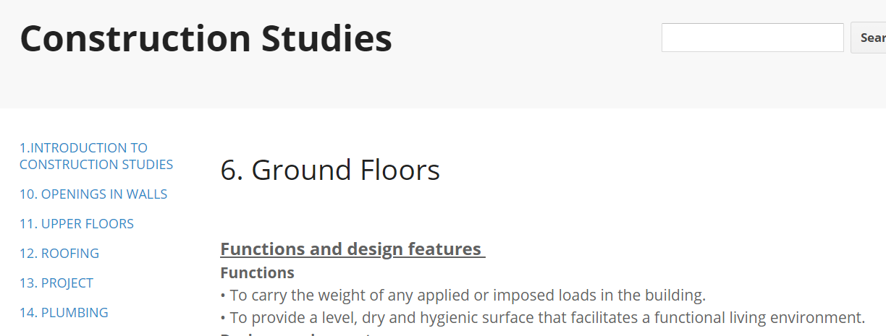
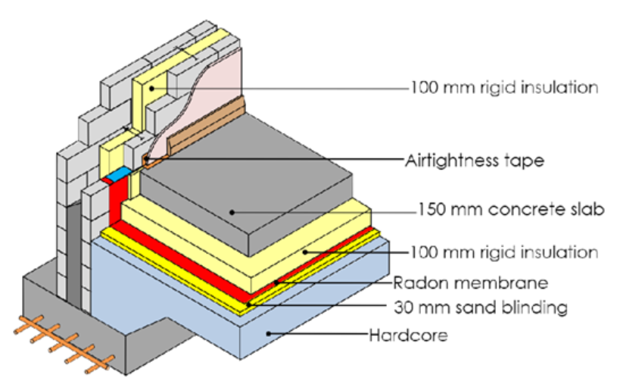
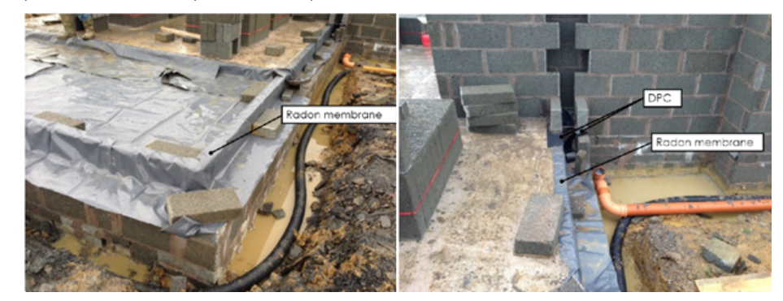
Teaching and Learning resources
A useful site for the content of Unit 1
https://sites.google.com/site/constructionstudies2/6-ground-floors

Slide 27
Designing the services for buildings
Designing the services requirements for buildings including:
services requirements for different types of buildings:
Residential buildings
Commercial buildings
Industrial buildings
The design of services at different points in the construction process including:
Temporary supplies required for construction
Retaining existing supplies
Construction of permanent supply plantroom
Notes:
Residential buildings
Electrical supplies - This will comprise a mains supply connected to an electricity meter with connections from the meter to the consumer unit.
Gas supplies - Metered supplies, similar to electrical supplies with internal pipework connected to appliances such as cookers and central heating boilers.
Water supplies - Increasingly a metered supply to a stop valve to enable whole house isolation, with pipework to direct feed points such as the kitchen sink and to storage facilities connected to the hot and cold-water system.
Communications - Cable or satellite broadband connections for media and internet services used to provide television, telephone and private wi-fi networks.
Commercial buildings
Lifts. There are two main categories of lift:
Traction lifts - operate with steel ropes running over a wheel attached to an electric motor located above the lift shaft, with a counterweight to balance the load on the motor. Suitable for use in high rise buildings.
Hydraulic lifts - use an electric pump and hydraulic piston to push up the car, and a release valve to lower the hydraulic pressure in the piston. Hydraulic lifts require a lift pit below the lift shaft and are used at relatively slow speeds in 2 – 8 story buildings.
Escalators - Used in buildings where the movement of a large number of people is required, such as shopping centres and airports, etc. Similar space requirements as stairs but allow a greater flow of people.
Electrical and communication services - A modern commercial building is likely to include a computer-based ‘Building management System’ (BMS), which will monitor and control a range of electrical services.
Gas supplies - Used for boiler based heating systems and in commercial kitchens.
Water supply - will be used for drinking and cooking, cleaning, and sanitation, and possibly fire-fighting.
Industrial buildings (in addition to commercial building services)
3 phase 400v electrical supplies - The availability of a high voltage power supply may be fundamental in decisions regarding the siting of an industrial building.

Slide 28
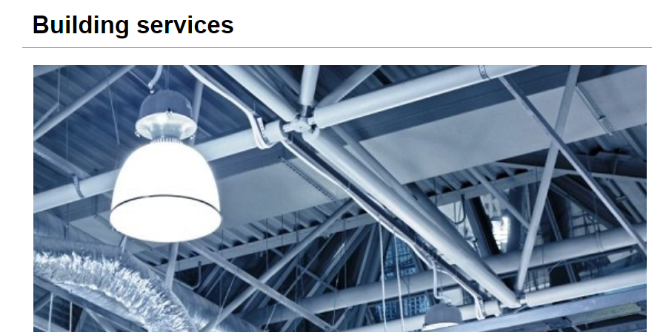
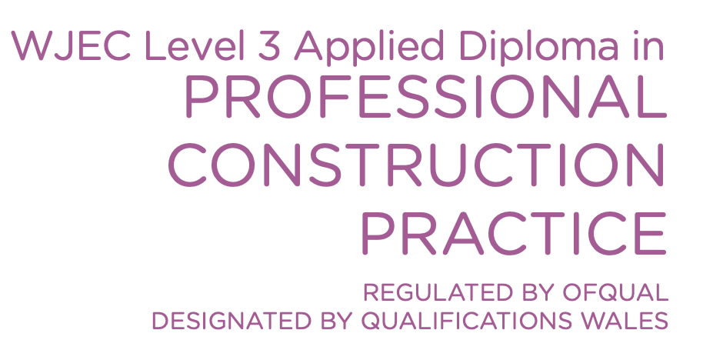
Teaching and Learning resources
Useful links:
Designing Buildings Wiki:
https://www.designingbuildings.co.uk/wiki/Building_services
WJEC PCP Guidance
https://www.wjec.co.uk/umbraco/surface/blobstorage/download?nodeId=4538
Chartered Institution of Building Services engineering:
https://www.cibse.org/building-services/what-s-so-special-about-building-services-engineer
Notes:
The construction industry is made up of Clients, developers, consultants, manufacturers, suppliers, and contractors.
The construction stage of the life cycle will begin with the appointment of a main contractor and end with the handover of the finished building to the Client.

Slide 29
Change of use
Change of use incorporating:
Altering, refurbishing and extending existing buildings
Issues of compatibility and using consistent materials
Pre-1919 buildings and structures
Notes:
The Town and Country Planning (Use Classes) Order categorises uses of land and buildings. Developments may not be used for purposes that are not within the use class for which they received planning permission.
The main use classes are:
A: Shops and other retail.
B: Commercial and Industrial
C: Residential
D: Assembly and leisure
Planning permission is generally not needed to change the use of a development when the existing and proposed use are within the same class, such as from a DIY store to a charity shop. Changing the use of a building from one class to another may be considered as permitted development, otherwise the change will require planning permission.

Slide 30
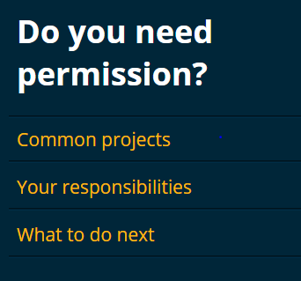
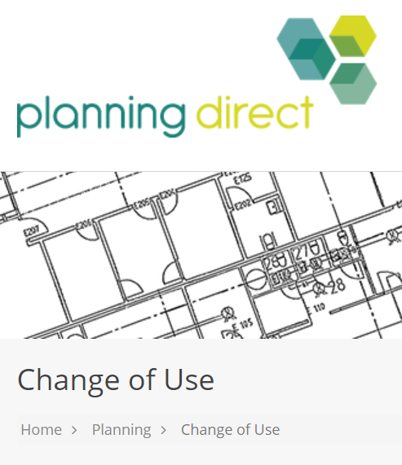
Teaching and Learning resources
https://www.planningportal.co.uk/
https://www.planningdirect.co.uk/planning/change-of-use/

Slide 31
External works
External works include:
Foul and surface water drainage
Sustainable urban drainage systems
Installation / distribution of utility services
Methods for creating footpaths and roads.
Notes:
Foul and surface water drainage
Combined mains drainage systems -The first drains or sewers were built to combat diseases caused by poor sanitation by removing foul drainage and wastewater from residential areas.
Separate mains drainage systems - As urban populations grew the amount of wastewater could not be accommodated by the combined system and separate sewers were developed with two drains, one for wastewater from toilets, sinks, industrial wastes, etc (that go to the sewage works for treatment before being discharged into rivers), and one for clean surface water from roofs and roads that discharge directly into rivers.
Sustainable urban drainage systems - are systems dealing with surface water run-off locally, through collection, storage, and cleaning before allowing it to be released slowly into the environment.

Slide 32
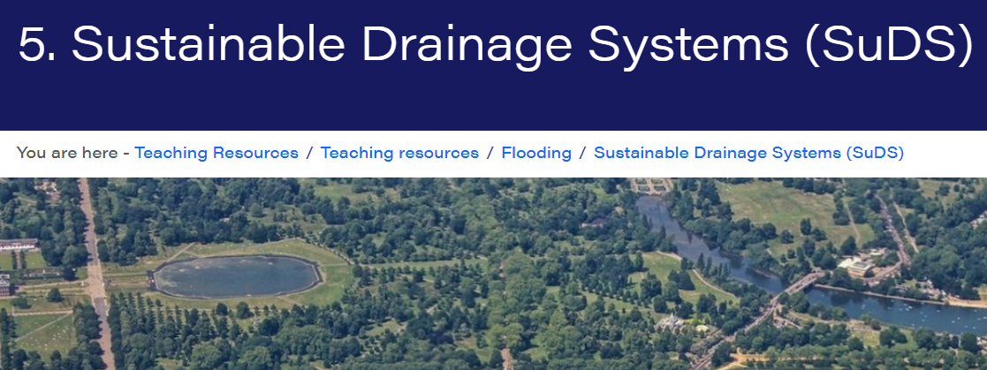
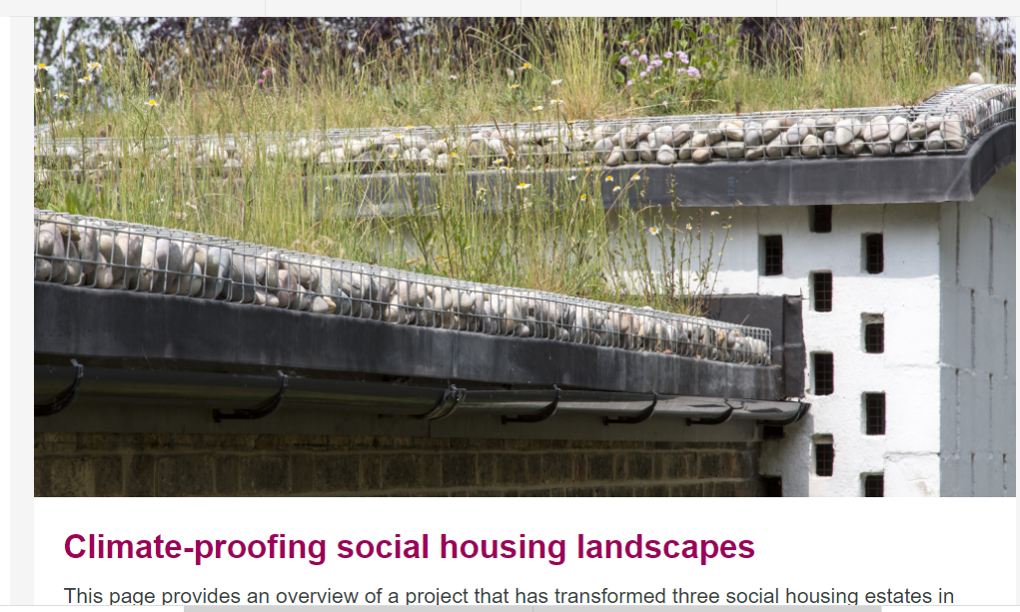
Teaching and Learning resources
https://www.geography.org.uk/teaching-resources/flooding/sustainable-drainage-systems
https://www.london.gov.uk/what-we-do/environment/climate-change/surface-water/climate-proofing-social
Notes:
The construction industry is made up of Clients, developers, consultants, manufacturers, suppliers, and contractors.
The construction stage of the life cycle will begin with the appointment of a main contractor and end with the handover of the finished building to the Client.

Slide 33
General resources
Construction UK Magazine – free school resources for teachers. “The Construction Youth Trust bringing construction and the built environment into the classroom”.
https://constructionmaguk.co.uk/free-school-resources-for-industry-professionals-and-teachers-construction-youth-trust-are-bringing-construction-and-the-built-environment-into-the-classroom/
Stem Learning – information and activities relating construction and mathematics
https://www.stem.org.uk/resources/community/collection/24330/construction-and-built-environment/
CADW – understanding traditional (pre-1919) and historic buildings for Construction and Built Environment courses.
https://cadw.gov.wales/learn/education/teaching-resources/understanding-traditional-pre-1919-and-historic-buildings
Construction Industry Training Board – a useful list of guidance and resources available from industry and professional bodies
https://www.citb.co.uk/documents/qualifications/professional-bodies-support-materials.pdf

Slide 34
WJEC Resources
There are a wide range of resources available for teachers and students on the WJEC website. Currently resources are available for Unit 1. resources for the other units will be provided to coincide with future workshops.
https://resources.wjec.co.uk/Pages/ResourceSingle.aspx?rIid=3979

Slide 35
Cwestiynau? | Any Questions?
Subject Officer
Allan Perry
construction@wjec.co.uk
Subject Support Officer
Andrew O’Regan
construction@wjec.co.uk
@wjec_cbac | @cbac_wjec
cbac.co.uk | wjec.co.uk

