Slide 1
Exam Walk-Through
GCE Built Environment
Unit 3
Notes:
Exam Walk-Through
GCE Built Environment
Unit 3

Slide 2
What you should have in front of you:
A copy of the exam paper
Some lined paper
A pen, pencil, ruler
A highlighter
Post-it notes
Notes:
You need to make sure that you have all the materials you need to work through the walk-through.
This includes a copy of the exam paper which has spaces for you to write your answers.
Some lined paper for rough work
A black pen, pencil and a ruler
A highlighter
Post-it notes to record any issues you want to raise with your teacher later.

Slide 3
What this exam paper is all about:
This paper is A2 Unit 3 – Materials, technologies and techniques.
It is testing your knowledge and understanding of:
Properties of and degradation of materials
Structural analysis and building comfort
Standards for measurements
Thermal, acoustic and lighting considerations
Building services systems
The paper is made up of 7 questions.
The exam lasts 2 hours and 30 minutes.
Notes:
A Level Unit 3 is a 2 hours and 30 minutes written examination. It contributes 30% to the A level qualification.
The paper is made up of 7 questions and is awarded out of 100 marks.
The exam tests your knowledge and understanding of: properties of and degradation of materials, structural analysis and building comfort, standards for measurements, thermal acoustic and lighting considerations and building services systems.

Slide 4
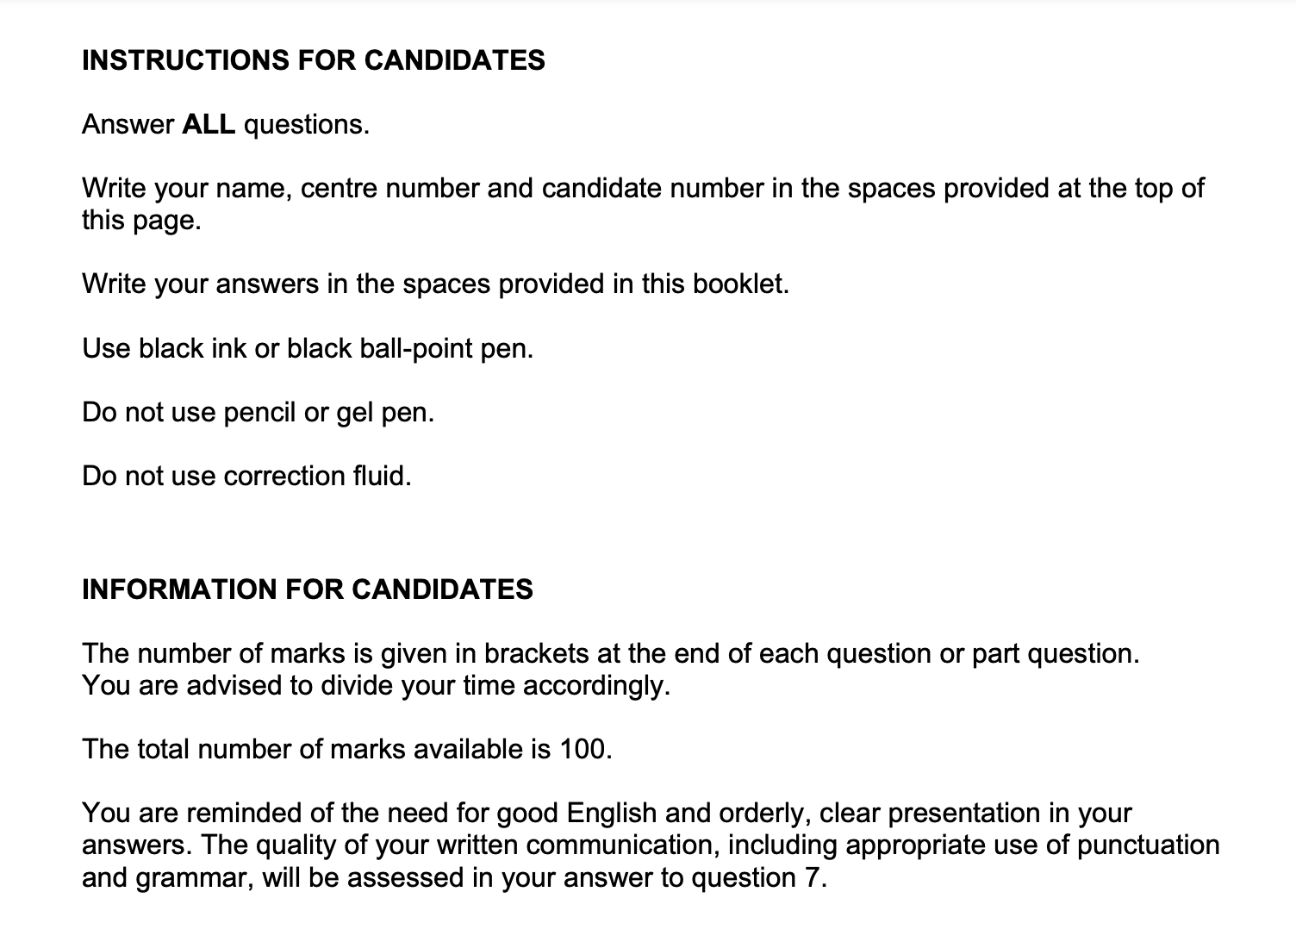
What should I do first?
Read the front cover of the exam paper.
Notes:
The first thing you will need to do is to read the front cover of the paper to make sure that you know exactly what you need to do to answer the paper.
In this paper you have to answer all the questions, there are no optional questions.
It is very important that you enter your name, centre number and candidate number on the front of the paper. These must be correct so that your marks can be recorded accurately.
The paper has lined spaces after each question that you must use to present your answer.
You must use a black ink or ball point pen – this is because your paper will be scanned before it can be marked by the examiner. Black pen produces the clearest scans.
The paper is marked out of 100 marks. Each question or part question has a mark at the end of the question. You should use the mark to give you a guide as to how long you can spend on each answer and how much detail you should include in your answer. The paper is timed for two hours 30 minutes – that means that you should spend roughly I minute 30 seconds on each mark.
It is important that you write as clearly as possible make sure that you write in full, coherent sentences.

Slide 5
What should I do first?
Make sure you know what the command words used in the questions are asking you to do.
State / Give / Identify – you should provide brief facts or examples. There is no requirement to write in detail for this command word.
An example of a question is Question 1.
Describe – you should provide characteristics of a topic or a series of linked facts. The description should be as complete as possible to show the main features of the topic you have been asked to describe.
An example of this type of question is Question 2
Outline - you should provide a description of the main characteristics of, for example, a theory or concept.
An example of this type of question is Question 4a
Notes:
All questions have a command word that is used to tell you what to do. The word indicates the depth of the answer required in addition to the number of marks indicated at the end of the question.
State / Give / Identify indicates as short answer with no requirement to write in detail.
Describe indicates that a a more detailed response is required. You should consider the main characteristics of a topic. The description should be as complete as possible. The first question part b on the paper is an example of this.
Outline is used on the paper, in Question 1. This is a six mark question where you have to provide a description of the main characteristics of a theory or concept.

Slide 6
What should I do first?
Make sure you know what the command words used in the questions are asking you to do.
Explain – if you are asked to explain a topic, you should include a clear definition of what you have been asked to explain in sufficient details so that any cause or effect is communicated clearly in your answer. In short, this command word requires an explanation with informed reasoning.
An example of this type of question is Question 3
Evaluate – if you are asked to evaluate something then you should make a judgement based on weighing up points for and against what you have been asked to evaluate. You should provide a verdict as to what extent you agree with a statement, presenting evidence and examples.
Notes:
The command word explain requires more detail than describe. You need to include a clear definition of what you have been asked to explain. This must be in sufficient detail so that any cause and effect can be communicated clearly in your response to the question.
Evaluate is the highest order command word to be used in this paper. In an evaluate question you will need to make a judgement on the topic you have been asked to evaluate. You must weigh up points for and against the topic and provide a conclusion of your evaluation.

Slide 7
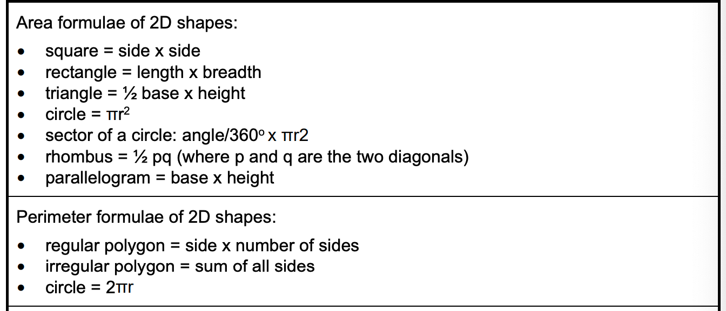
What should I do first?
Make sure you know what formulae are included on the exam paper:
Notes:
The exam paper includes a list of the formulae you may need to use to answer the questions on the paper.
It is important to make sure that you are familiar with the formulae and know how to apply them to produce the required outcomes for the questions.
The first set of formulae relate to the areas of two dimensional shapes such as rectangles, triangles, circles and other quadrilaterals.
The second set of formulae relate to the perimeters of two dimensional shapes – for any regular polygon the length of one side multiplied by the number of sides.

Slide 8
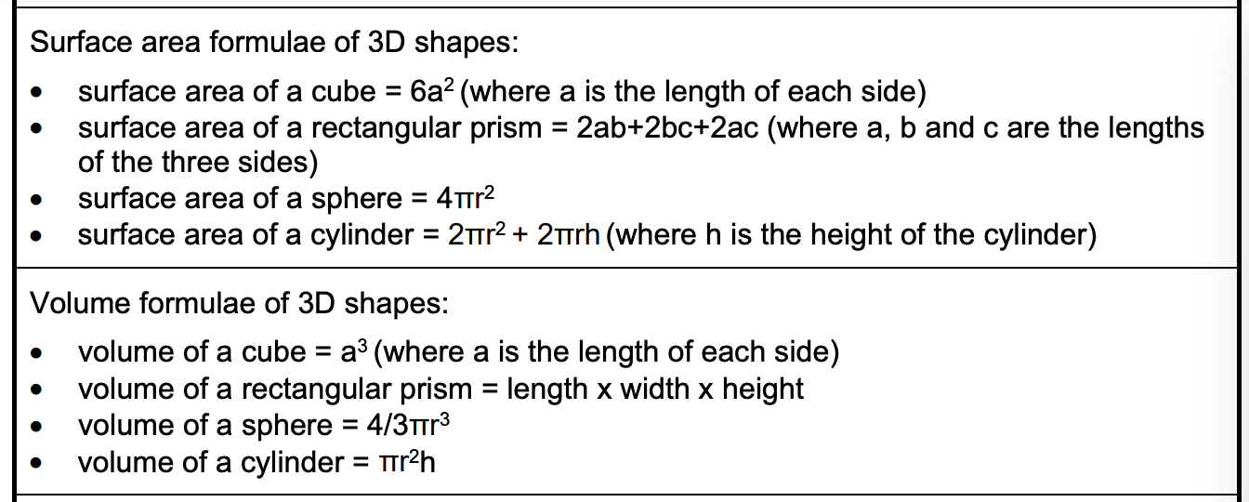
What should I do first?
Make sure you know what formulae are included on the exam paper:
Notes:
Similarly, it is important to make sure that you are familiar with the formulae for calculating the surface area and volume of three dimensional shapes and know how to apply them to produce the required outcomes for the questions.
These formulae are more complex so make sure you can use them before you are ready to sit the examination.

Slide 9
What should I do first?
Make sure your name and candidate number are on your answer booklet.
Question 1.
Command word used in question 1:
Outline - you should provide a description of the main characteristics of the three properties named in the question.
Notes:
What should you do first? Let’s consider Question 1.
The command word is Outline, you are asked to describe three properties of building construction materials: brittleness, malleability and ductility.
The question is marked out of 6. This means that two marks are available for each property.

Slide 10
How do I tackle Question 1a?
Question 1: Content being tested – properties of building construction materials
Time for answering: 9 MINUTES
How do I get full marks: [two marks per correct answer]
Approach:
Step 1 Read the question and and note the command word
Step 2 Identify and highlight the key words in the question
Step 3 Be clear on the knowledge being tested
Step 4 Consider what you know about the content
Step 5 identify the two advantages you want to use and the two disadvantages to be used.
Step 6 Remember that one mark is awarded for each separate point that you make in this type of question
TOP TIPS - make sure that you are answering the question that was asked and that you have made enough separate points to gain full marks.
Notes:
The content being test is properties of construction materials– in particular, brittleness, malleability and ductility.
It is a six-mark question meaning you have nine minutes to answer the question.
To get full marks you must provide accurate and technical descriptions of the three properties, each containing two correct facts, one per mark.
Step 1 – you must read the question carefully. It is important to identify the command word to give you guidance on the way in which you will need to formulate your answer.
Step 2 - What are the key words in the question – it is a good idea to highlight the keywords to make sure that you answer the question correctly.
Step 3 - Make sure that you know what knowledge you are expected to demonstrate in your answer – in this case you are looking at the properties of materials.
Step 4 – you are required to outline what you know about the properties of building construction materials.
Step 5 – identify the two facts about each of the named properties and formulate your answers before you write it down in the exam paper.
Step 6 – make sure that although your answer is likely to be brief it must be sufficient to gain the mark.

Slide 11
Steps 1-3
Step 1 Read the question and highlight the command words
Step 2 Identify and highlight the key words in the question
Step 3 Be clear on the knowledge being tested
The command word is Outline
1a. Outline the following properties of building construction materials: (i) brittleness; (ii) malleability: (iii) ductility. 3 X[2]
The question asks for an outline of three properties.
Note available marks and allocate time accordingly
Notes:
Following our six step process the first thing to do is to identify and highlight the command word – ‘Outline’.
At step 2 identify the keywords in the question, the fact that you need to write a description of the properties of building construction materials. The three properties required are given in the question.
Step 3 – make sure you know which part of the specification is being examined. In this case it is ‘Properties of building construction materials’. The answer should ensure that the properties described relate to this part of the specification.

Slide 12
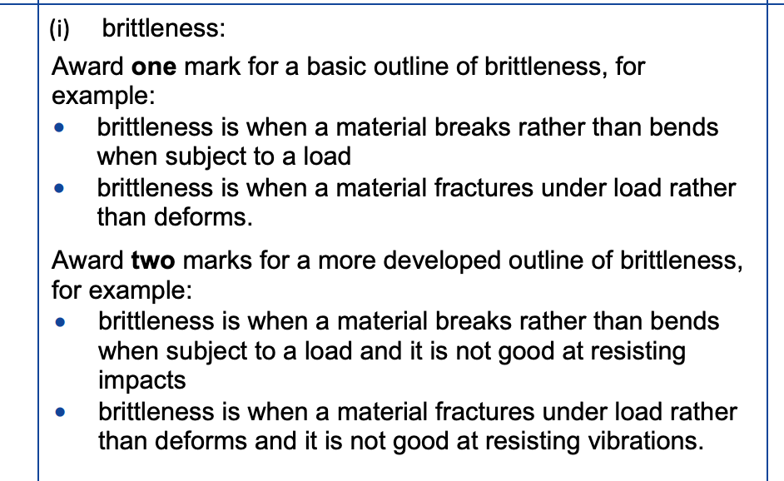
Steps 4 - 6
Step 4 Consider what you know about the content
Step 5 identify the required properties of the construction material
Step 6 Remember that one mark is awarded for each separate point that you make in this type of question
Notes:
Step 4 – reflect on what you know about the content included in the question.
Step 5 – identify the features of the properties you want to describe in your responses.
Step 6 – make sure that you give two relevant features for each of the three properties..
The mark scheme shown identifies the descriptions of brittleness and illustrates the difference between a one mark response and a two marks response.
Spend some time reading through the responses to make sure you understand how to access both marks for this outline..

Slide 13
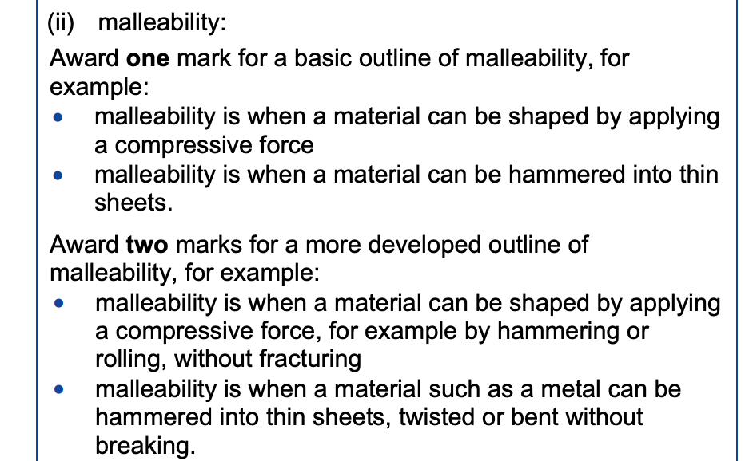
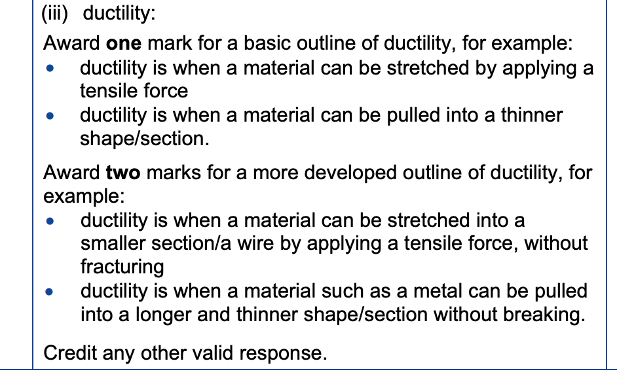
Steps 4 - 6
Step 4 Consider what you know about the content
Step 5 identify the required properties of the construction material
Step 6 Remember that one mark is awarded for each separate point that you make in this type of question
Notes:
The mark scheme shown identifies the outlines the descriptions of malleability and ductility and illustrates the difference between a one mark response and a two marks response.
Spend some time reading through the responses to make sure you understand how to access both marks for these outlines.

Slide 14
How do I tackle Question 1b?
Question1b: Content being tested – properties of building construction materials
Time for answering: 9 MINUTES
How do I get full marks: [this question is band marked]
Approach:
Step 1 Read the question and and note the command word
Step 2 Identify and highlight the key words in the question
Step 3 Be clear on the knowledge being tested
Step 4 Consider what you know about the content
Step 5 Identify the effects of humidity on building construction materials over a period of time.
Step 6 Remember that one mark is awarded for each separate point that you make in this type of question
Notes:
The content being tested is properties of construction materials– in particular, how materials may respond to high levels of humidity.
It is a six-mark question meaning you have nine minutes to answer the question.
To get full marks you must provide accurate and technical descriptions how materials respond to exposure to humidity.
Step 1 – you must read the question carefully. It is important to identify the command word to give you guidance on the way in which you will need to formulate your answer.
Step 2 - What are the key words in the question – it is a good idea to highlight the keywords to make sure that you answer the question correctly.
Step 3 - Make sure that you know what knowledge you are expected to demonstrate in your answer – in this case you are looking at the effects of humidity on construction materials.
Step 4 – you are required to identify what you know about the effect of prolonged exposure to humidity on building construction materials.
Step 5 – identify the effects of different causes of humidity on construction materials and formulate your answer before you write it down in the exam paper.
Step 6 – make sure that although your answer is in sufficient detail to gain the marks for this question which is band marked.

Slide 15
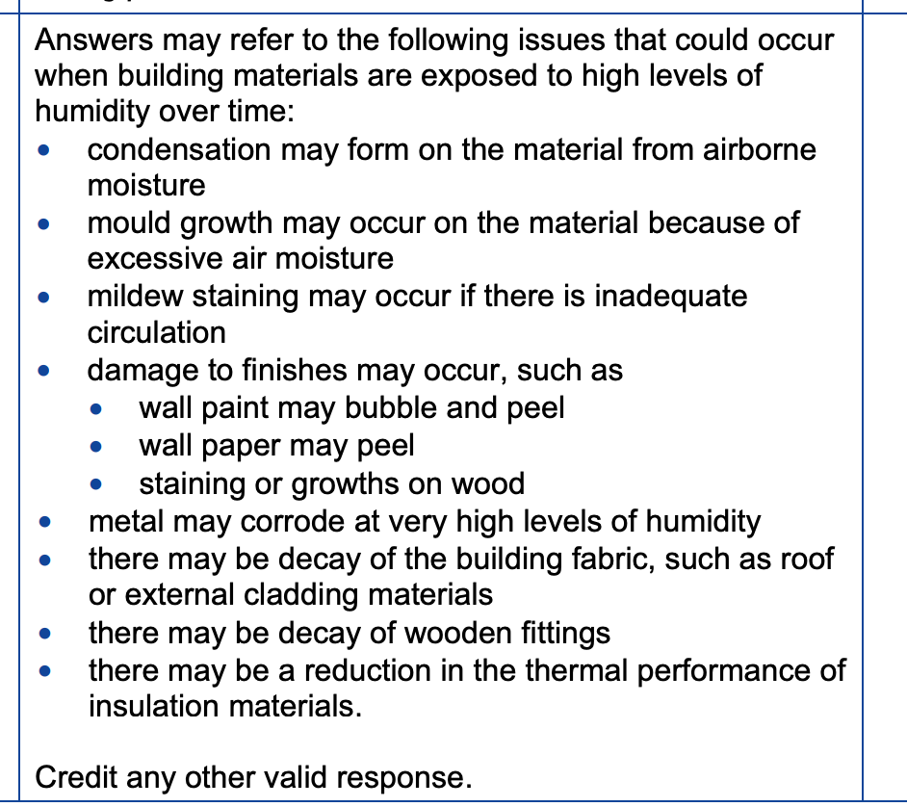
How do I tackle Question 1b?
Indicative content
Full mark answers may not contain all the indicative content but in that case should go into technical details about the points covered to show the depth of knowledge required to access the higher mark bands.
Notes:
The mark scheme shown outlines the descriptions of the effects of humidity on building materials over a long period of time.
The bullet points show what is known as the indicative content that should be included in a response to this question. Full mark answers may not contain all the indicative content but in that case the response should go into technical details about the points covered to shown depth of knowledge and understanding.
Spend some time reading through the responses to make sure you understand how to access the marks for this question.

Slide 16
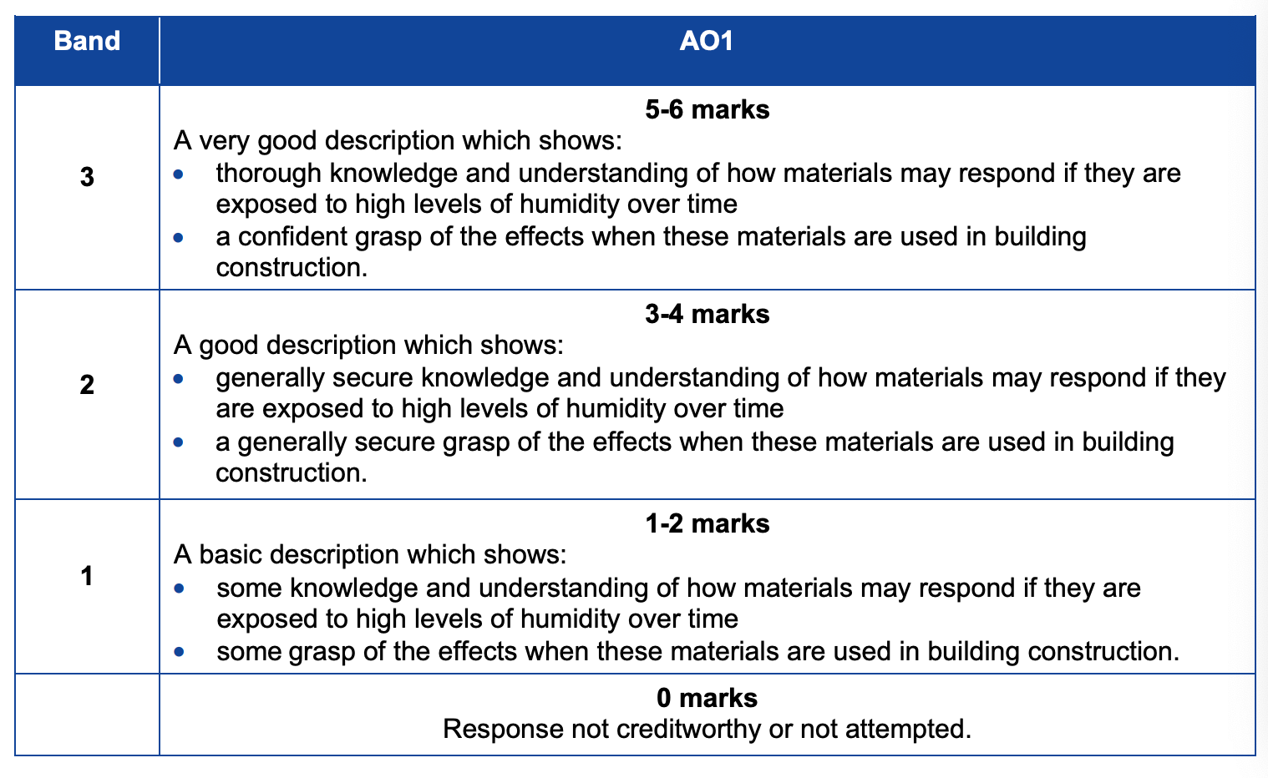
How do I tackle Question 1b?
Notes:
The mark bands describe candidate performance in terms of knowledge and understanding of the topic of the question – effects of humidity.
When an examiner is marking this type of question they will consider the coverage of the indicative content and then compare the quality of the response to the descriptions in the mark bands.
Spend some time reading through the responses to make sure you understand how to access the marks for this question.

Slide 17
How do I tackle Question 2a?
Question 2a: Content being tested – Properties of construction materials – properties of brick as a construction material
Time for answering: 6 MINUTES
How do I get full marks: [this is a band marked question]
Approach:
Step 1 Read the question and highlight command words
Step 2 Identify and highlight the key words in the question
Step 3 Be clear on the knowledge being tested
Step 4 Consider what you know about the content
Step 5 Identify the relevant properties of brickwork that make it suitable for use to build these types of buildings..
Step 6 There are six marks available for this part of the question which will be band marked. You need to make sure that you include sufficient information and technical detail to access the top mark band.
Notes:
Question 2a – the content being tested is the the properties of construction materials with a focus on the use of bricks.
The question is worth six marks meaning that you have 9 minutes to answer this question.
For each question you should work through the six steps:
Identify the command word for this question – in this case describe
Identify the key words in the question – you need to consider the properties of brick that makes it suitable for use as a construction materials.
You need to identify the relevant content of the question, the construction stage of the building life cycle.
Formulate your responses to justify the properties of brickwork that make it a suitable material for the construction of a house and garage (Domestic constructions)
Make sure you identify a series of properties and explain why each makes brick a suitable material for this construction work.

Slide 18
How do I tackle Question 2a?
Relate your answer to the stem of the question – the buildings are a house and garage.
The outer walls of a house and garage are to be constructed in brick.
Describe the properties of brick which make it suitable as a construction material [6]
The question refers to the construction stage
Note available marks and allocate time accordingly
Describe – you should provide characteristics of a topic or a series of linked facts. The description should be as complete as possible to show the main features of the topic you have been asked to describe.
Notes:
The command word describe means that you should provide a series of linked facts that cover the characteristics of the topic of the question.
You must relate your answer to the stem of the question – the construction of a house and garage.

Slide 19
How do I tackle Question 2a?
Indicative content for Question 2a.
Notes:
The mark scheme covers a series of properties that would gain marks. Your response should include most if not all of these properties to gain good marks.
Read through the answers and try to identify the points that have gained the marks in each one.

Slide 20
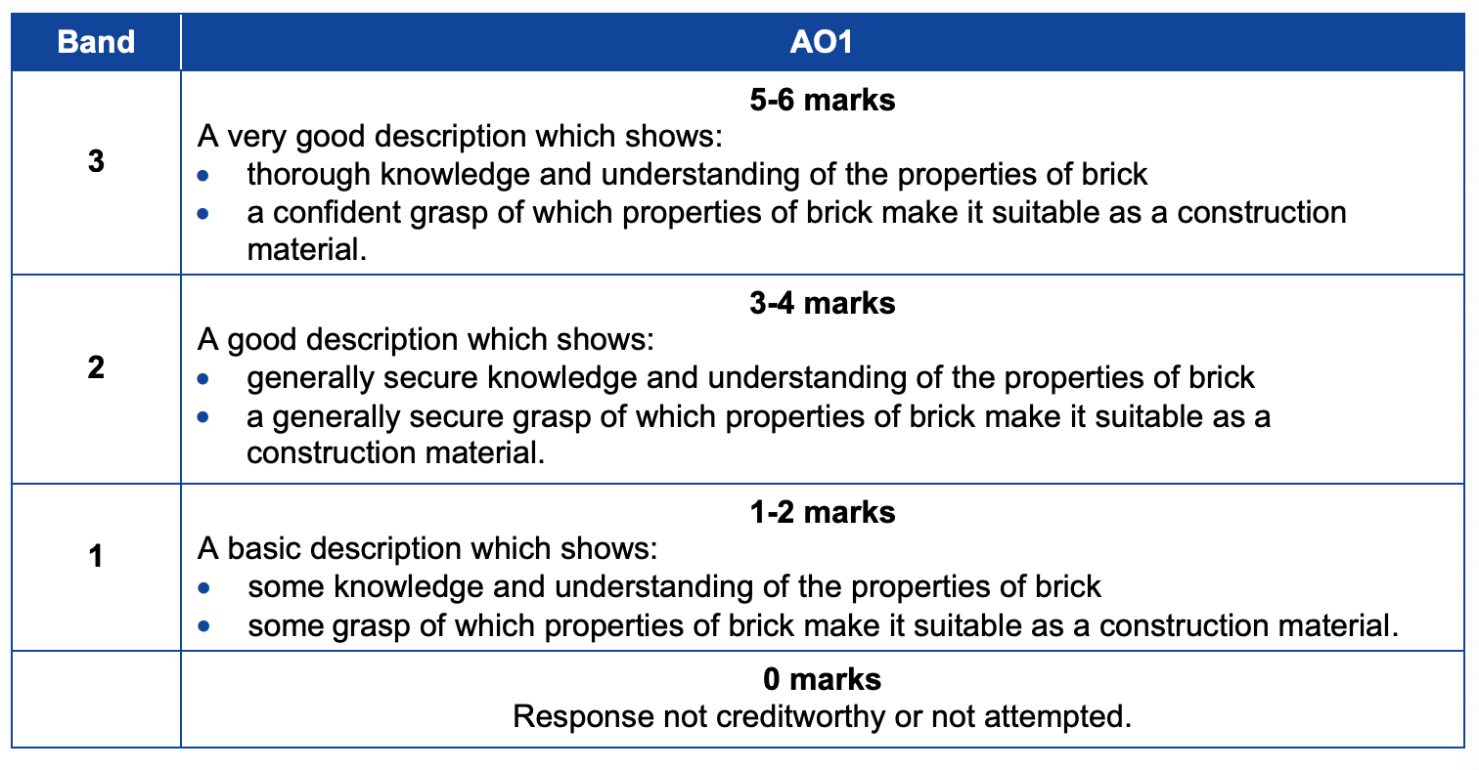
How do I tackle Question 2a?
Notes:
The mark bands describe candidate performance in terms of knowledge and understanding of the topic of the question – the properties of brick. However it is important that you relate the properties to the type of building that is being discussed as some properties would not be beneficial in other constructions.
Read through the mark bands to make sure you understand how different levels of performance are being marked.

Slide 21
How do I tackle Question 2a?
From the Knowledge Organiser for this topic:
Main properties of Bricks Hardness. Bricks are formed of a hard material and therefore do not deform easily in a construction. Compressive strength. Bricks have a high compressive strength and are well suited to use for load bearing walls. Flexural strength of brick makes it suitable for use in situations where bending loads may be imposed on the structure. Durability. Bricks are durable and have a long service life the durability of bricks is directly related to the material hardness. Frost resistance. Bricks can resist water percolation which leads to good levels of frost resistance.
Notes:
There are Knowledge Organisers available on the WJEC website covering the content of Unit 3. This is an extract from the Knowledge Organiser on the properties of using bricks in the construction of a building.
Read through the knowledge organiser – would the information help you answer questions on this topic?

Slide 22
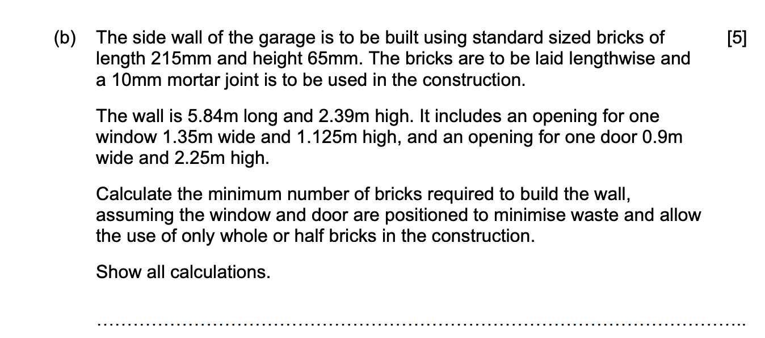
How do I tackle Question 2b?
Question 2b: Content being tested –Standards for Measurement – Producing quantities for superstructures
Time for answering: 7.5 MINUTES
How do I get full marks: [1 mark per stage of the calculation]
Approach:
Carry out steps 1 – 4 as in previous questions.
Step 5 identify the context for the calculation and the numeric information in the question..
Step 6 There are five marks available for this part of the question, so you must ensure you carry out each stage of the calculation correctly to gain full marks.
Notes:
The content being tested in this question is the calculation of quantities for the construction of a brick wall.
There are five marks available here giving you seven and a half minutes to answer the question.
For each question you should work through the six steps:
Identify the command word for this question – in this case calculate
Identify the key words in the question – in this case the dimensions of the wall.
Each stage of the calculation will be awarded one mark if correct.
You need to identify the relevant numerical information in the question and make relevant assumptions such as the positioning of the window and door will allow bricks to be cut in half.
Set out your calculation clearly and ensure that you check your answers.

Slide 23
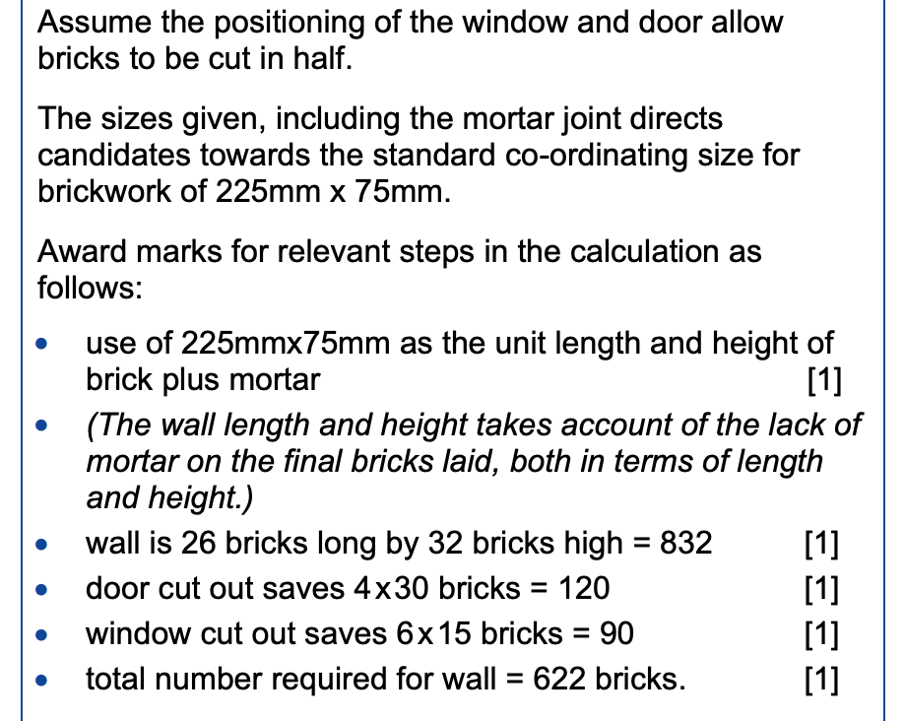
How do I tackle Question 2b?
Notes:
This question asks you to calculate the number of bricks required to build a wall of given dimensions that includes openings for a door and a window.
The calculation allows for mortar surrounding a brick and therefore the brick size is taken as 225 x 75 mm rather than the size given in the question of 215 x 65 mm. If you had not made this allowance you would have lost 1 of the five marks available.

Slide 24
How do I tackle Question 3a?
Question : Content being tested – Thermal comfort – the environmental factors.
Time for answering: 9 MINUTES
How do I get full marks: [Band Marked Question]
Approach:
Carry out steps 1 – 4 as previously.
Step 5 Make sure that you plan your drawing carefully to make sure that it fits in the space provided and has room for you to label the drawing.
Step 6 There are six marks available for this part of the question which will be band marked. However, you will need to make six relevant points in your answer to be eligible for a mark in the top band.
Notes:
This question concerns the topic of thermal comfort and focuses on the environmental factors that may affect thermal comfort in a building..
There are six marks available for this question which means you should spend up to nine minutes answering it.
Your answer should focus on issues such as air temperature, radiant temperature, air velocity and relative humidity. Each should be linked to its affect on the comfort of the building for its occupants.

Slide 25
Answering the question –
Timed practice – Nine minutes.
Click on the timer to start.
Now we have looked at the key words in the question and the skills/knowledge you need to show, you have nine minutes to write your answer as you would do in the exam.
Notes:
Now you have the chance to attempt to answer a question in the time that is allowed in the examination. There are 100 marks available in the paper and you have 2½ hours to do the paper. This works out as 1½ minutes per mark.
Answer this question in your copy of the question paper.
When you are ready to answer the question, click on the timer that will count down the nine minutes.

Slide 26
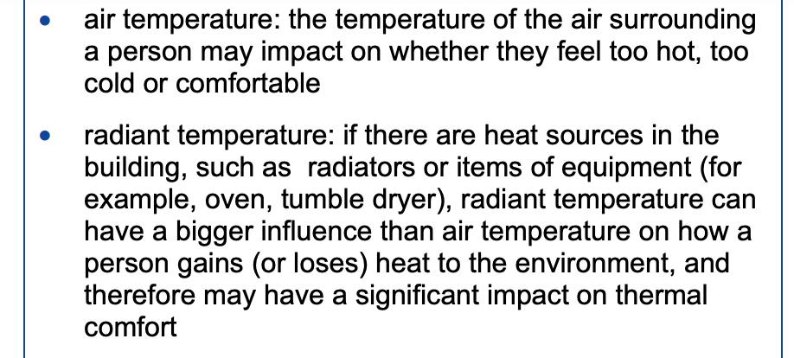
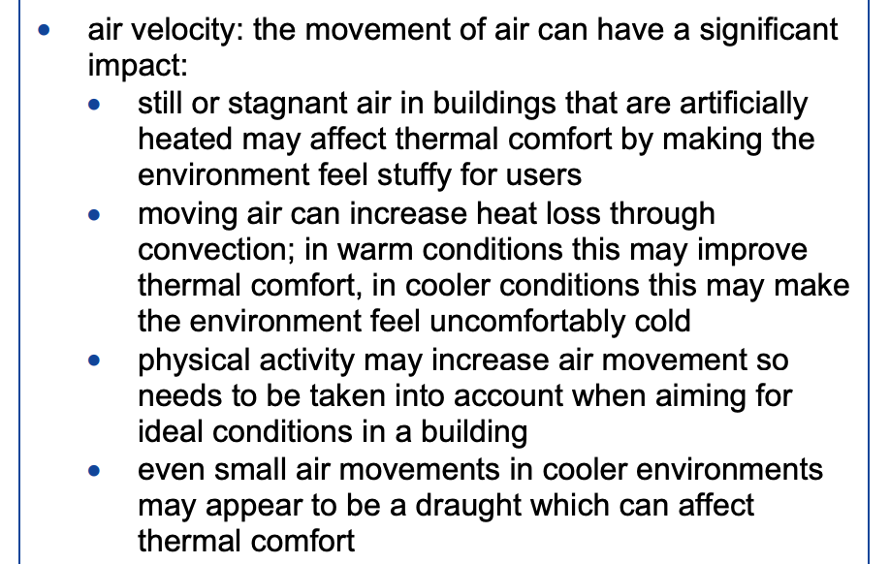
How do I tackle Question 3a?
Notes:
This is the indicative content for Question 3a. Read through the content and compare it to your response to the question. How many of the points contained in the indicative content were included in your answer?.
Look carefully at the answers to make sure that you understand the content that was required.

Slide 27
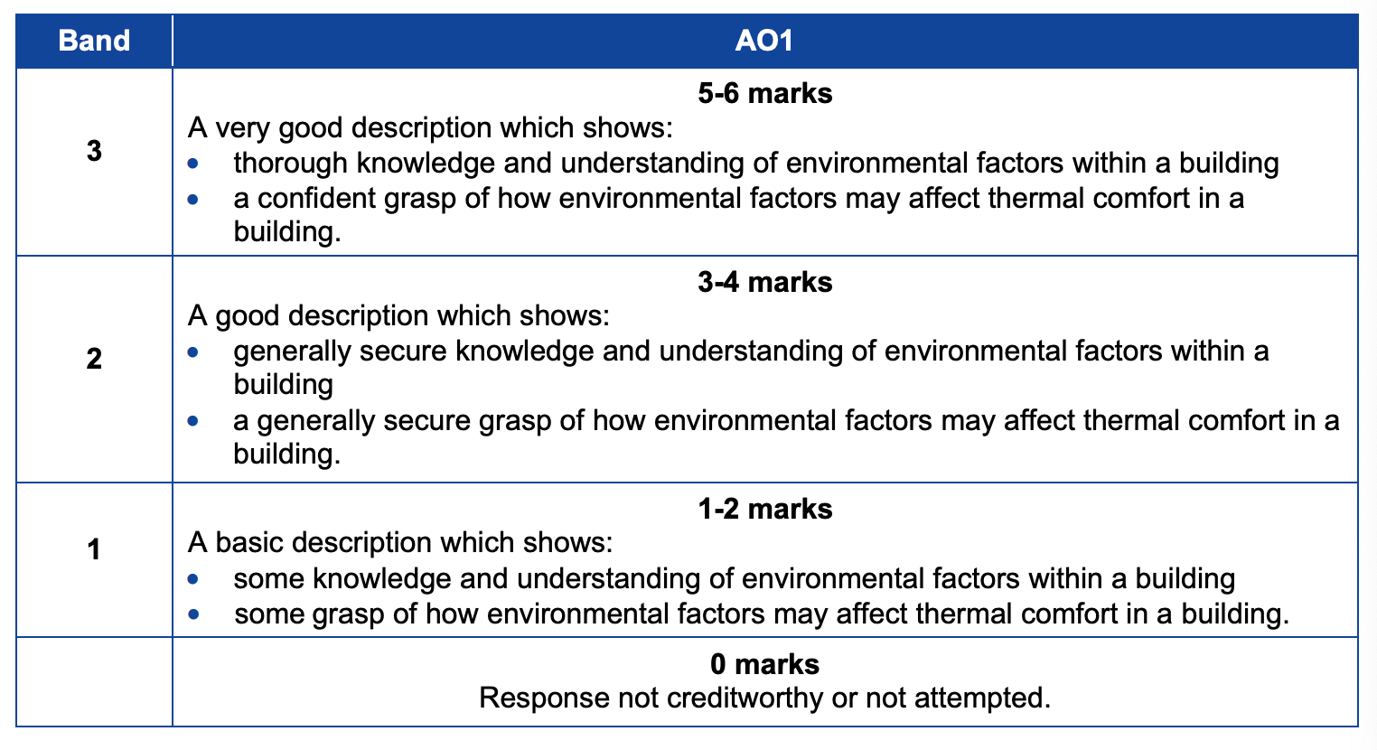
How do I tackle Question 3a?
Notes:
Look carefully at the Mark bands to make sure that you understand how the marks were awarded. Which mark band would be most appropriate for your response. How could you improve your response to gain full marks?

Slide 28
How do I tackle Question 3a?
Environmental factors that affect thermal comfort. Air temperature. In most circumstances a room temperature in the region of 20⁰C will feel comfortable. Radiant temperature. Radiant heat may be present if there are heat sources in an environment and this will has a greater influence than air temperature on how occupants loose or gain heat to the environment. Air velocity. Stagnant air in indoor environments that are artificially heated may cause people to feel ‘stuffy’ and lead to a build-up in odour. Moving air in warm conditions can increase heat loss through convection and therefore produce a cooling effect without any change in air temperature. A small air movement in a cooler environment may be perceived as a draught and detract from perceived comfort levels. Relative humidity is the ratio between the actual level of water vapour in the air and the maximum level of water vapour that the air can hold at that air temperature. Relative humidity between 40% and 70% does not have a major impact on thermal comfort. High humidity environments have a lot of vapour in the air, which prevents the cooling caused by evaporation of sweat.
From the Knowledge Organiser for this topic:
Notes:
There are Knowledge Organisers available on the WJEC website covering the content of Unit 3. This is an extract from the Knowledge Organiser on the need to ensure thermal comfort in a building.
Read through the knowledge organiser – would the information help you answer questions on this topic?

Slide 29
How do I tackle Question 3b?
Question : Content being tested – Controlling and managing heat.
Time for answering: 9 MINUTES
How do I get full marks: [Mark Band Question]
Approach:
Carry out steps 1 – 4 as previously.
Step 5 Identify what you know about the factors that should be considered when controlling the heat flow in buildings.
Step 6 There are six marks available for this part of the question therefore you need to make six valid points about heat control to measures that can be taken in a building.
Notes:
This question also concentrates on controlling and managing heat flow in a building.
You have nine minutes to answer this question.
This part of the question has the command word ‘Describe’.
To remind you:
Describe – you should provide characteristics of a topic or a series of linked facts. The description should be as complete as possible to show the main features of the topic you have been asked to describe.
When you are considering what you know about the heating of a building, think how you can relate your knowledge to the question..
Your response must use the context of the question in order to gain marks. This means that you must form your response carefully to apply your knowledge to the context.

Slide 30
Answering the question –
Timed practice – Nine minutes.
Click on the timer to start.
Now we have looked at the key words in the question and the skills/knowledge you need to show, you have nine minutes to describe the factors to be taken into account when controlling the heat flow in a building.
Notes:
Time for you to do some work. Look back at the six steps for this question and plan your response.
You have nine minutes to answer this question. To start the timer click on ‘9.00’.
Once the time is up or you have finished your response you can move onto the next slide to see the mark scheme and mark your work.
Remember the examiner is expecting you to need around the nine minutes to write in sufficient detail to gain full marks.

Slide 31
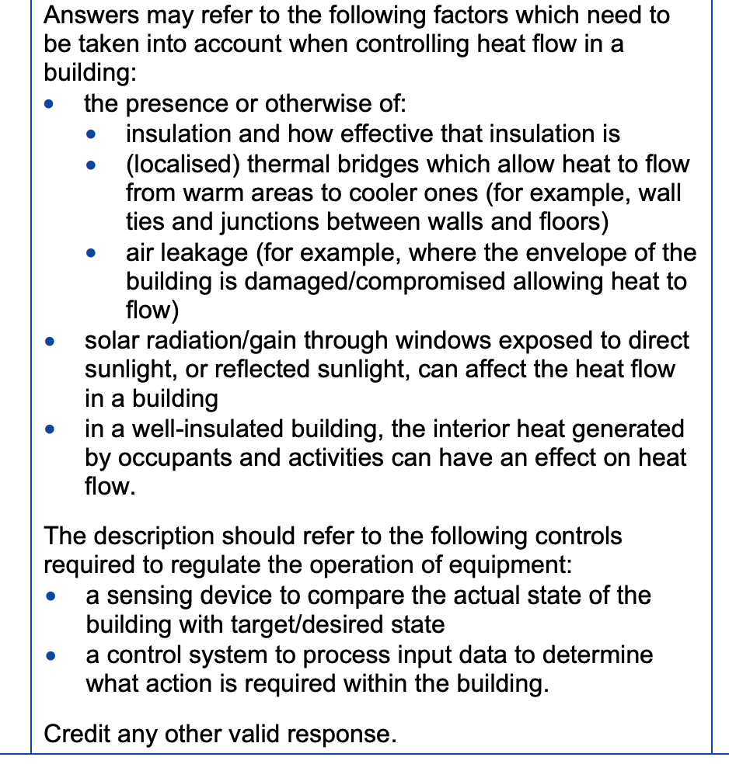
How do I tackle Question 3b(i)?
Notes:
Use this extract from the mark scheme to check the content in your response. Obviously you will not have written exactly what is here but you need to identify the points made in the indicative content and match them to your response.
How could you improve your answer to gain full marks?

Slide 32
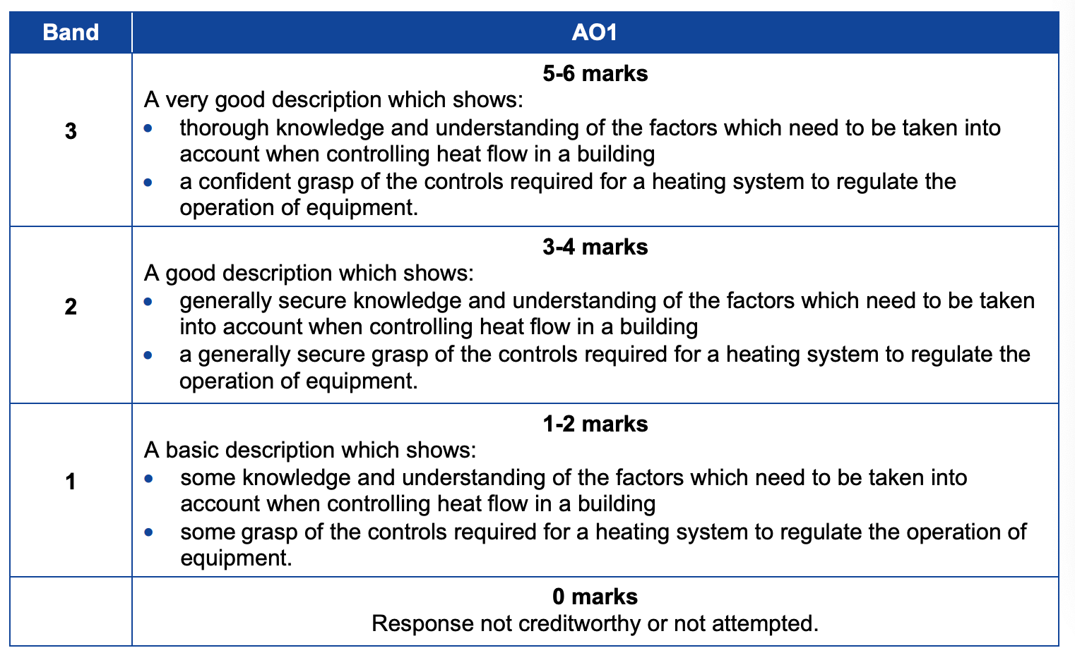
How do I tackle Question 3b(i)?
Notes:
Look carefully at the Mark bands to make sure that you understand how the marks were awarded. Which mark band would be most appropriate for your response. How could you improve your response to gain full marks?

Slide 33
How do I tackle Question 3c?
Question : Content being tested – Impact of temperature changes on building users..
Time for answering: 9 MINUTES
How do I get full marks: [Mark Band Question]
Approach:
Carry out steps 1 – 4 as in previous questions.
Step 5 Identify what you know about the impact of temperature changes on building users with an emphasis on residential buildings
Step 6 There are six marks available for this part of the question therefore you need to identify specific impacts that you explain in detail to gain high marks.
Notes:
This question covers the impact of temperature change on users of residential buildings..
You have nine minutes to answer this question.
We have looked a range of questions so far. I am assuming that you are able to remember how to carry out steps 1 – 4 for this question. If you cannot remember steps 1 – 4 revisit one of the previous slide to remind yourself.
This part of the question is considering the impact of temperature changes on the users of a residential building depending on the type of construction used to build the structure. You should consider factors such as insulation, the age of the building, the nature of the building and siting of the building.

Slide 34
Answering the question –
Timed practice – Nine minutes.
Click on the timer to start.
Now we have looked at the key words in the question and the skills/knowledge you need to show, you have nine minutes to describe the factors to be taken into account when controlling the heat flow in a building.
Notes:
Time for you to do some work. Look back at the six steps for this question and plan your response.
You have nine minutes to answer this question. To start the timer click on ‘9.00’.
Once the time is up or you have finished your response you can move onto the next slide to see the mark scheme and mark your work.
Remember the examiner is expecting you to need around the nine minutes to write in sufficient detail to gain full marks.

Slide 35
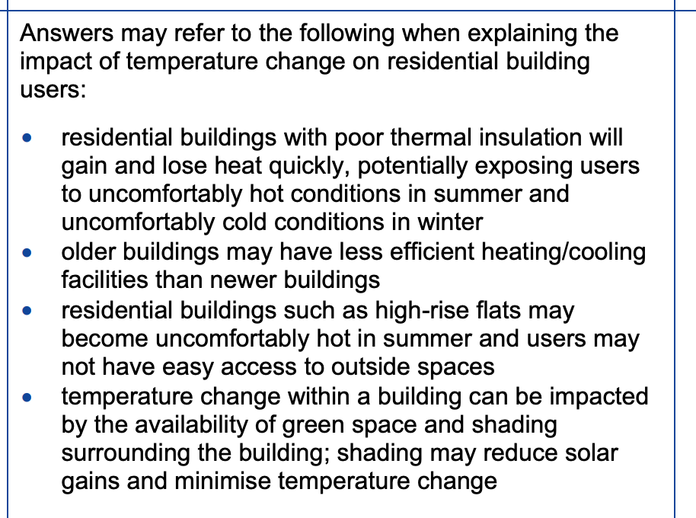
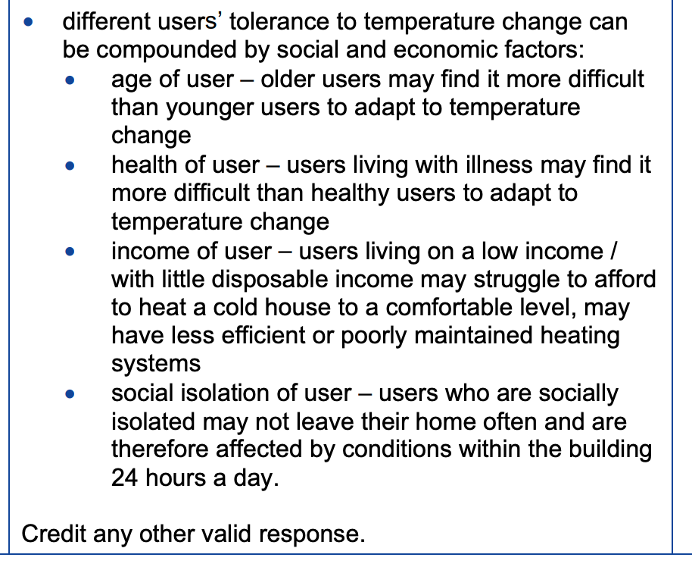
How do I tackle Question 3c?
Notes:
The mark scheme for this question includes the indicative content the examiner will want to see in your answer. As before you may not have covered all the indicative content but your response will be judged against the band mark descriptors which will take into account the depth and technical detail included in your answer.

Slide 36
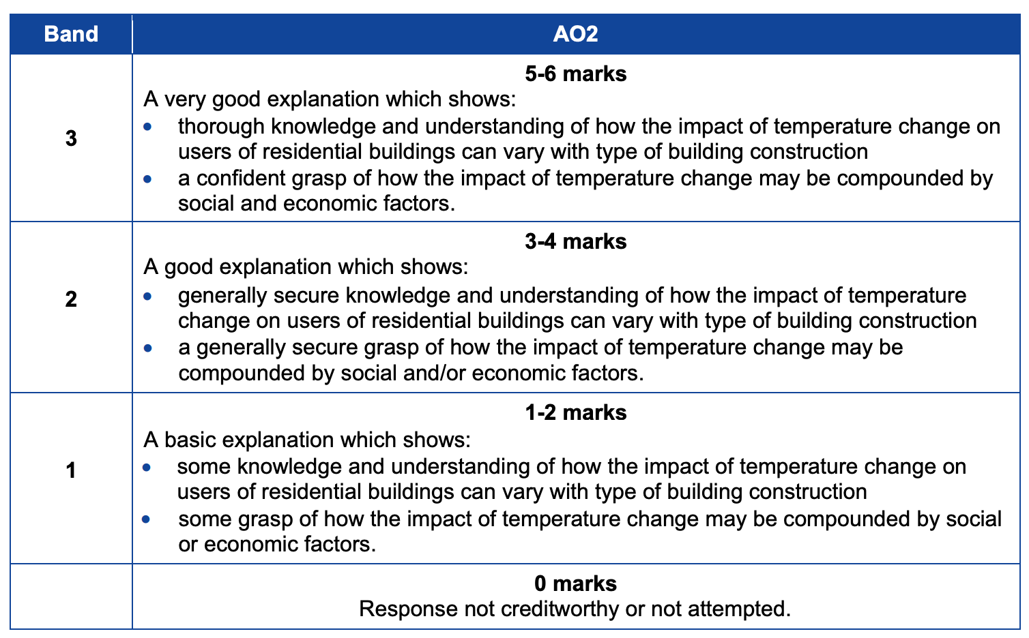
How do I tackle Question 3c?
Notes:
Look carefully at the Mark bands to make sure that you understand how the marks were awarded. Which mark band would be most appropriate for your response. How could you improve your response to gain full marks?

Slide 37
How do I tackle Question 4(a)?
Question : Content being tested – Structural analysis – live and dead loads
Time for answering: 9 MINUTES
How do I get full marks: [Band Marked Question]
Approach:
Carry out steps 1 – 4 as in previous questions.
Step 5 Identify what you know about structural analysis and in particular, live and dead loads and the differences between them.
Step 6 This question will be band marked. The mark scheme will include a list of points that you should make but the final mark will be awarded using the banded mark scheme.
TOP TIPS This question is focused on differences between the two types of load, but you will need to define each type before you start to compare them.
Notes:
This question on the topic of structural analysis, and in particular live and dead loads.
This is a six mark question so you have nine minutes to answer this question.
Question 4a is set to test your knowledge and understanding of the differences between the two classifications of load.
Work through steps 1 – 4 for this question to make sure you are on the right track to form your answer.
The command word here is ‘Describe’ to remind you:
Describe – you should provide characteristics of a topic or a series of linked facts. The description should be as complete as possible to show the main features of the topic you have been asked to describe.
Your response to the question should include a definition of each type of load and examples of live and dead loads.

Slide 38
Answering the question –
Timed practice – Nine minutes.
Click on the timer to start.
Now we have looked at the key words in the question and the skills/knowledge you need to show, you have nine minutes to describe the differences between live and dead loads as you would in an exam.
Notes:
This is a higher mark question, in fact six marks. This means that you would have up to 9 minutes to answer this question. This shows that you are going to need to include a lot of detail.
Spend some time considering how you will answer this question – you may want to rough an answer out in terms of bullet points before you start to answer the question in your copy of the exam paper.
Click the timer (9.00) when you are ready to write your answer.

Slide 39
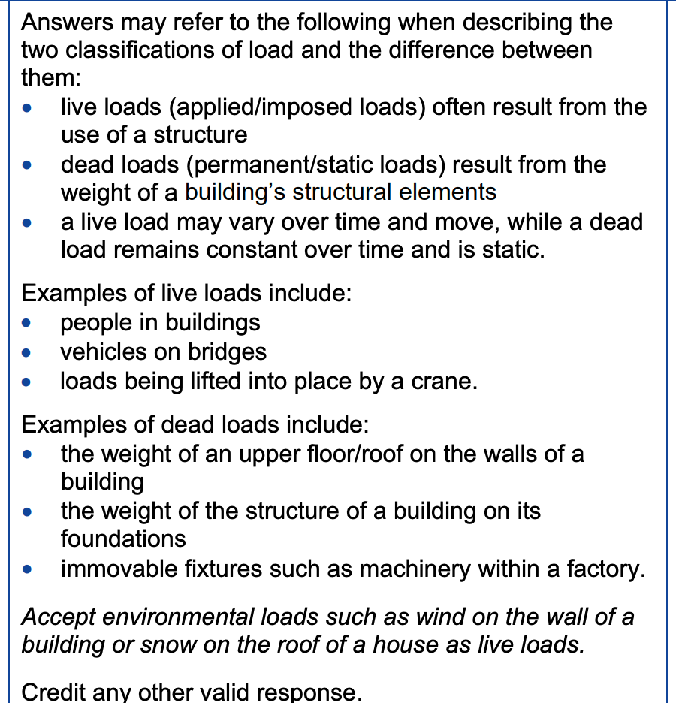
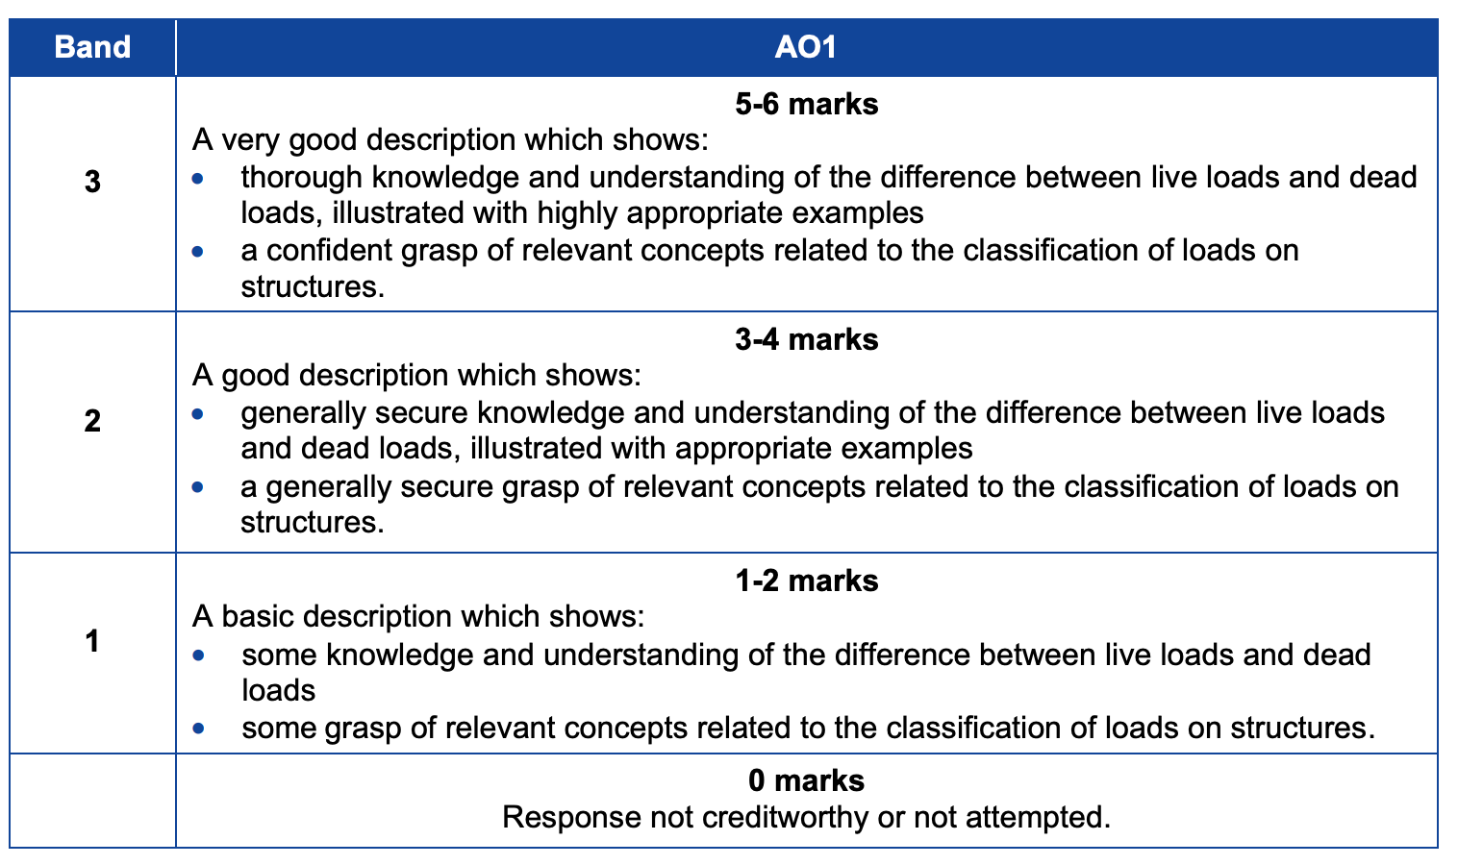
How do I tackle Question 4(a)?
Notes:
This question is band marked. That means that although the mark scheme will include a series of points (indicative content) that should be included in a good response the marks are awarded using a description of candidate performance taking into account the number of points from the indicative answer covered in the mark scheme.
Read through the points made in the indicative answer and compare your answer against the list.
Then read the mark band descriptors to see where you think your answer would lie.
How could you improve your answer to this type of question?

Slide 40
How do I tackle Question 4(b)?
Question : Content being tested – Structural analysis– calculations
Time for answering: 7.5 MINUTES
How do I get full marks: [Band Marked Question]
Approach:
Carry out steps 1 – 4 as in previous questions.
Step 5 Identify the formulae that you will need to use from the list at the start of the paper.
Step 6 This question is requiring you to carry out calculations. The marks will be awarded for use of the correct formulae, correct methods of calculation and the correct answers.
Notes:
This question tests your knowledge and understanding of the formulae required to calculate bending moments.
Work through the steps 1 to 4. The command word is calculate.
You need to identify the formulae that you will need to use, substitute the numbers from the question into the formula and carry out the required arithmetic calculations.

Slide 41
Answering the question –
Timed practice – Seven and a half minutes.
Click on the timer to start.
Now we have looked at the key words in the question and the skills/knowledge you need to show, you have nine minutes to describe the differences between live and dead loads as you would in an exam.
Notes:
This is a 5 mark question. This means that you would have up to 7.5 minutes to answer this question. The question reminds you that you must ‘Show all calculations’.
Spend some time identifying the formula that you will need to use and the relevant information from the question required for the calculations.– you may want to rough out an answer before you start to answer the question in your copy of the exam paper.
Click the timer (7.30) when you are ready to write your answer.

Slide 42
How do I tackle Question 4(b)?
Notes:
The mark scheme shows the correct calculation and the steps that will be awarded marks.
Check your answer against the mark scheme.

Slide 43
How do I tackle Question 5?
Question : Content being tested – Building services systems – integrated passive design.
Time for answering: 21 MINUTES
How do I get full marks: [this question is band marked]
Approach:
Carry out steps 1 – 4 as in previous questions.
Step 5 Identify what you know integrated passive design, the barriers to and the drivers for the widespread use of passive house design.
Step 6 This is a higher mark question so it will be band marked. The mark scheme will include a list of points that you should make but the final mark will be awarded using the banded mark scheme.
TOP TIPS This question is focused on integrated passive design, but the question puts the emphasis on houses in Wales, so you need to make sure that you answer in the context of the question.
Notes:
This question tests your knowledge of integrated passive design with a particular emphasis on the barriers to and drivers for the use of passive house design in Wales.
The question is worth fourteen marks meaning that you would have twenty one minutes to answer this.
Carry out steps 1 – 4 as usual.
There are two command words in the question, firstly describe which will require you should provide characteristics of a topic or a series of linked facts. The description should be as complete as possible to show the main features of the topic you have been asked to describe.
The second command word is discuss which will require you to examine an issue closely, taking account of different points of view. In this case the view points are the barriers and drivers to the widespread use of passive house design in Wales.

Slide 44
Answering the question –
Timed practice – Twenty one minutes.
Click on the timer to start.
Now we have looked at the key words in the question and the skills/knowledge you need to show, you have twenty one minutes to describe and discuss the use of passive house design in Wales as you would in the exam.
Notes:
This question initially uses the command word describe so you will have to provide a series of facts that cover the main elements of integrated passive design.
However there is another command word used further through the question – discuss. You are asked to discuss the barriers to and the drivers for the widespread use of passive design in houses in Wales.
Identify the main points you will want to make in your answer before you click on the timer and start to write your response in the examination paper. You may wish to rough out an answer before you start to answer the question.

Slide 45
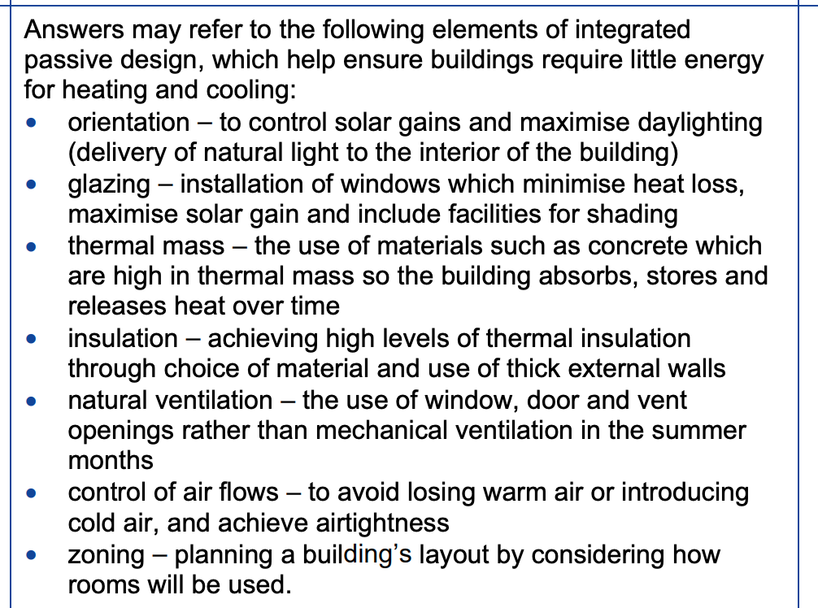
How do I tackle Question 5?
Notes:
The mark scheme provides the indicative content for a good quality response. However the question is band marked with the top band (5 – 6 marks) for the description requiring a very good description that demonstrates thorough knowledge and understanding of the main elements of integrated passive design.
Consider the indicative content – the bullet points on this slide – and compare them with your response. How many of these points did you cover?
.

Slide 46
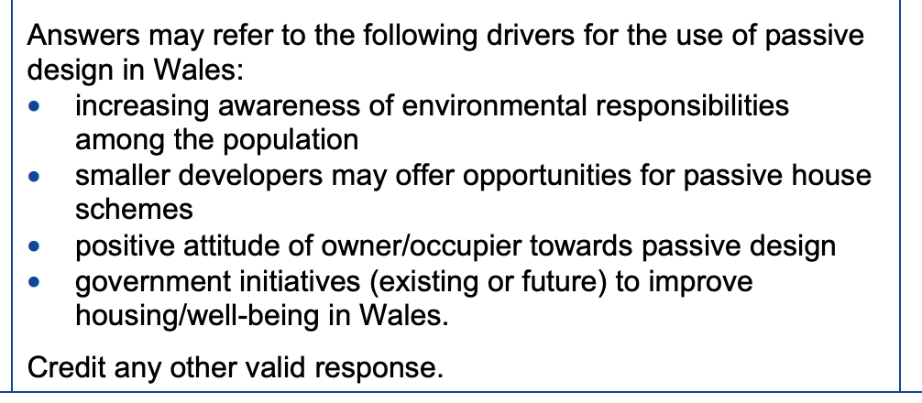
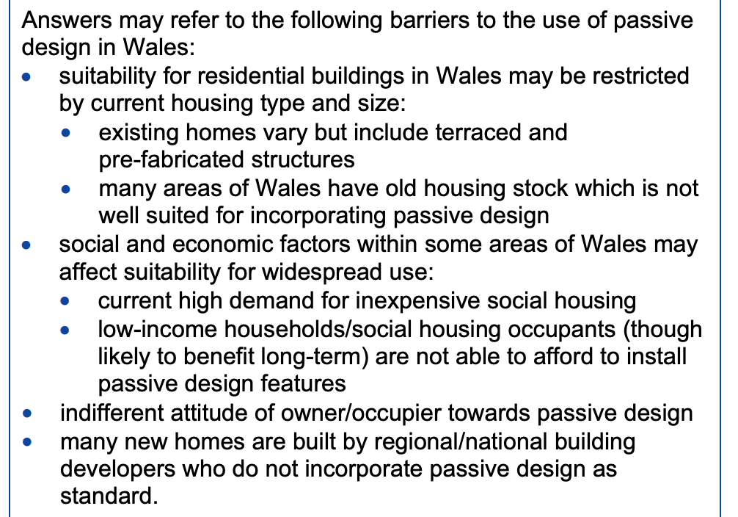
How do I tackle Question 5?
Notes:
The mark scheme provides the indicative content for a good quality response. The top band for the discuss of the barriers and drivers is 7 to 8 marks. To achieve these marks you would have to present an excellent discussion that demonstrates perceptive and informed judgements about the barriers to and drivers for the widespread use of passive deign in Wales.
The indicative content puts forward the points for drivers and barriers separately. Spend some time reading through the two sets of content and compare them with your response.
The top band also requires the candidate to present a confident and detailed consideration of the relevant factors, fully exploring their potential influence on the use of passive house design in Wales .

Slide 47
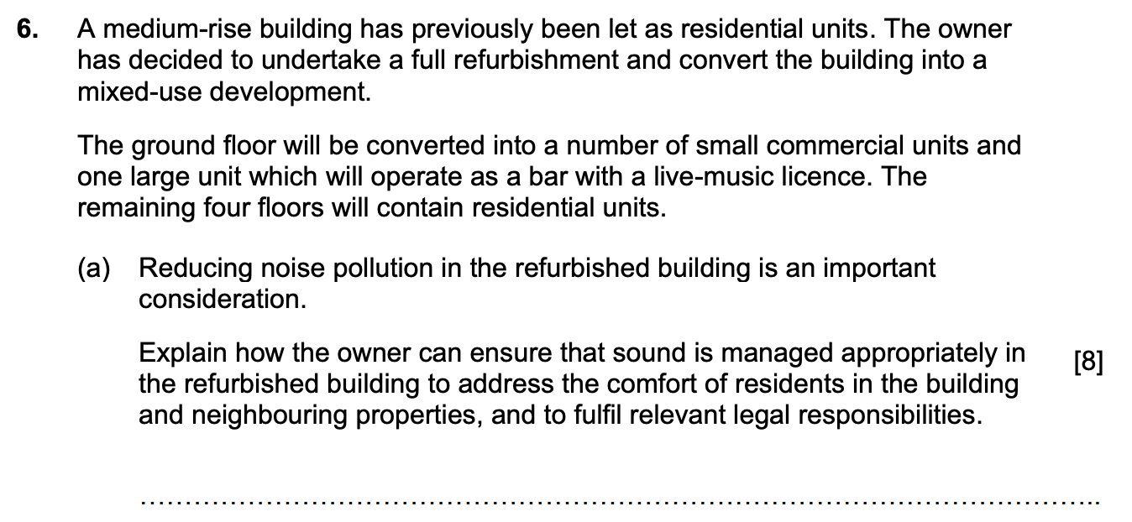
How do I tackle Question 6 (a)?
Notes:
The background for question 6 is the refurbishment of a medium rise building from residential units to a mixed-use development.

Slide 48
How do I tackle Question 6 (a)?
Question : Content being tested – Structural analysis and building comfort – noise pollution
Time for answering: 12 MINUTES
How do I get full marks: [this question is band marked]
Approach:
Carry out steps 1 – 4 as in previous questions.
Step 5 Identify what you know about reduction of noise pollution. You should concentrate on the construction techniques that can be used to ensure that the refurbished building is as soundproof as possible.
Step 6 This is a higher mark question so it will be band marked. The mark scheme will include a list of points that you should make but the final mark will be awarded using the banded mark scheme.
Notes:
This question is testing your understanding of the measures that can be taken to reduce noise pollution in a refurbished building.
Carry out steps 1 – 4 as usual.
The content being tested is ‘structural analysis and building comfort – in this case the control of noise pollution..
The command word is explain - – if you are asked to explain a topic, you should include a clear definition of what you have been asked to explain in sufficient details so that any cause or effect is communicated clearly in your answer. In short, this command word requires an explanation with informed reasoning.

Slide 49
Answering the question –
Timed practice – Twelve minutes.
Click on the timer to start.
Now we have looked at the key words in the question and the skills/knowledge you need to show, you have 12 minutes to describe the issues to be considered when in the soundproofing of a building.
Notes:
The command word here is explain so we need a definition of noise pollution and the construction methods that can be taken to soundproof a building.
When you are ready to write your answer click on the timer to check that you can produce a detailed enough answer in the given time.

Slide 50
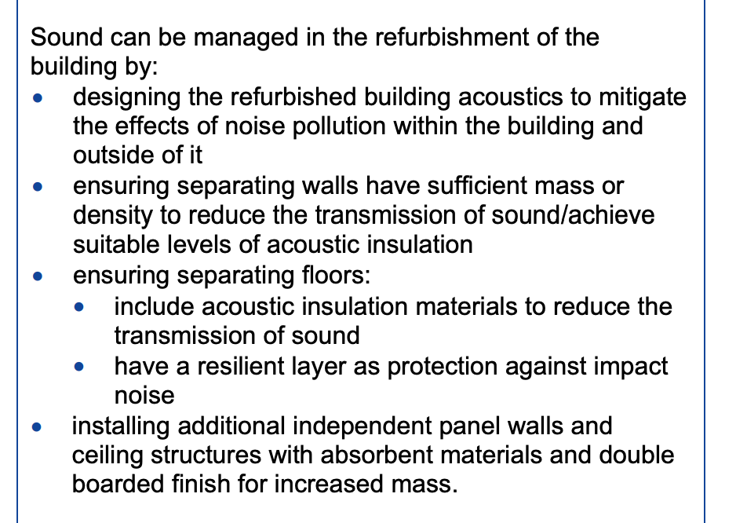
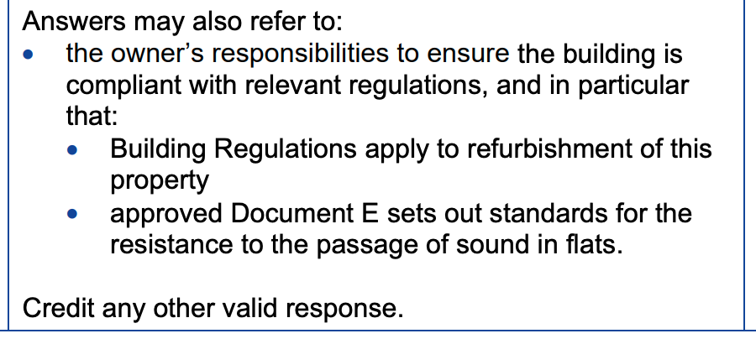
How do I tackle Question 6 (a)?
Notes:
The mark scheme gives the indicative content of a good quality response to this question. Compare you response to the indicative content, how much of the content did you include in your answer?
Once you have read the indicative content, consider how you could improve your response?

Slide 51
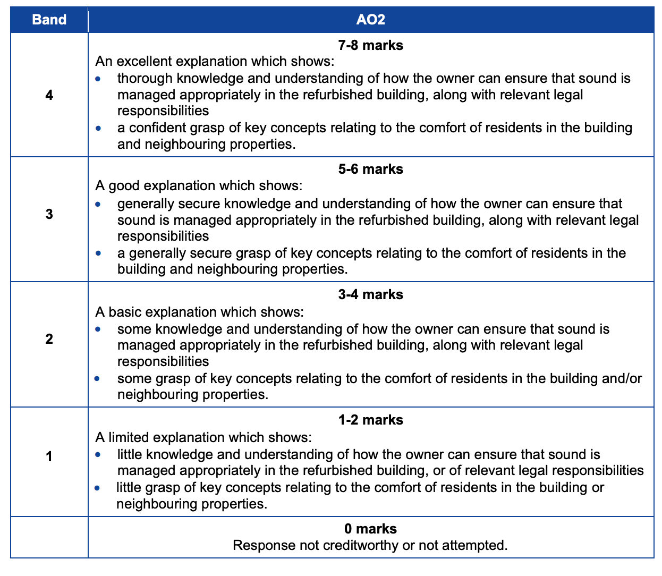
How do I tackle Question 6 (a)?
Notes:
Having considered the indicative content, read through the mark bands and decide in which mark band your answer would be.
How could you improve your response? Spend some time working on your response to take it into the top mark band.

Slide 52
Knowledge organiser:
Noise nuisance Noise nuisance is noise disturbance that may have a negative effect on health or the quality of life. The degree of disturbance depends on properties such as: volume, duration, repetition, frequency (pitch), ‘normal’ background noise levels and time of day. Sources of potential disturbance include: Environmental noise, including noise from transportation. Neighbour noise, including noise from adjacent buildings. Neighbourhood noise, including noise arising from industry, entertainment, and construction sites. Noise nuisance may produce economic impacts such as decreasing property value and loss of productivity, and social impacts such as sickness or absenteeism. The noise profile of an area should be considered when designing buildings to minimise the potential impact of noise disturbance, either on or caused by the development. Planning permissions may include conditions intended to reduce noise nuisance, and projects that require environmental impact assessments may require specific noise studies. Construction noise assessments may be carried out, and noise should be monitored on site and. If necessary be reduced by restricting working hours and changing construction practices.
Notes:
Here is some additional information about noise pollution.
Read through this information carefully and consider what you could use from it the improve your response to question 6.

Slide 53
How do I tackle Question 6b?
Question : Content being tested – Lighting in buildings and of assets – artificial lighting
Time for answering: 9 MINUTES
How do I get full marks: [Band marked question]
Approach:
Carry out steps 1 – 4 as in previous questions.
Step 5 Identify what you know about the different types of artificial lighting that can be used to light areas of a building. In this case you should concentrate on lighting of communal areas.
Step 6 This is a 6-mark question. As the question asks for different types of lighting you should provide enough examples and explanations to merit the award of six marks.
Notes:
The content being tested in this question is lighting in buildings and of assets, in particular the use of artificial light.
This is another question using the command word ‘explain’. If you are asked to explain a topic, you should include a clear definition of what you have been asked to explain in sufficient details so that any cause or effect is communicated clearly in your answer. In short, this command word requires an explanation with informed reasoning.
As this is a six-mark question it is band marked and you will need to ensure that you include enough technical detail to be able to gain marks in the top band.

Slide 54
Answering the question –
Timed practice – nine minutes.
Click on the timer to start.
Now we have looked at the key words in the question and the skills/knowledge you need to show, you have nine minutes to describe different types of provision for artificial lighting, as you would in the exam.
Notes:
The command word is explain - – if you are asked to explain a topic, you should include a clear definition of what you have been asked to explain in sufficient details so that any cause or effect is communicated clearly in your answer. In short, this command word requires an explanation with informed reasoning.
When you are ready to write your answer click on the timer to check that you can produce a detailed enough answer in the given time.

Slide 55
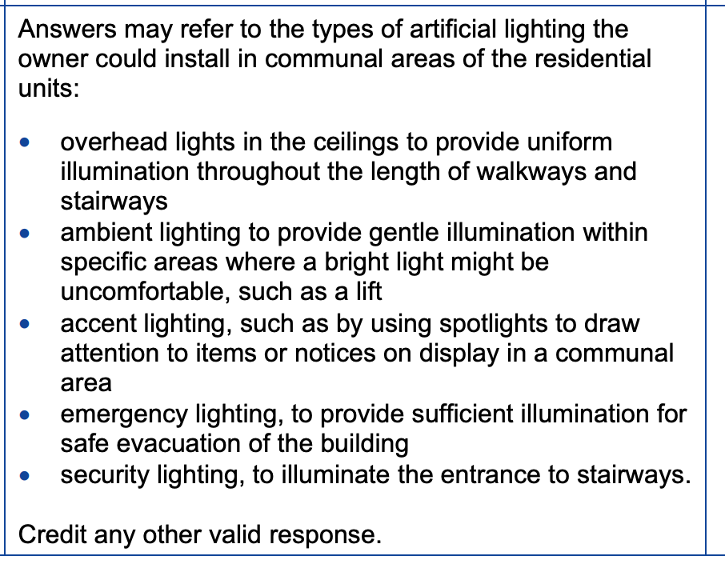
How do I tackle Question 6b?
Notes:
This is a band marked question. The slide shows the indicative content that should be included in your answer to the question.
Read through the mark scheme carefully. How you could amend your answer to gain full marks.

Slide 56
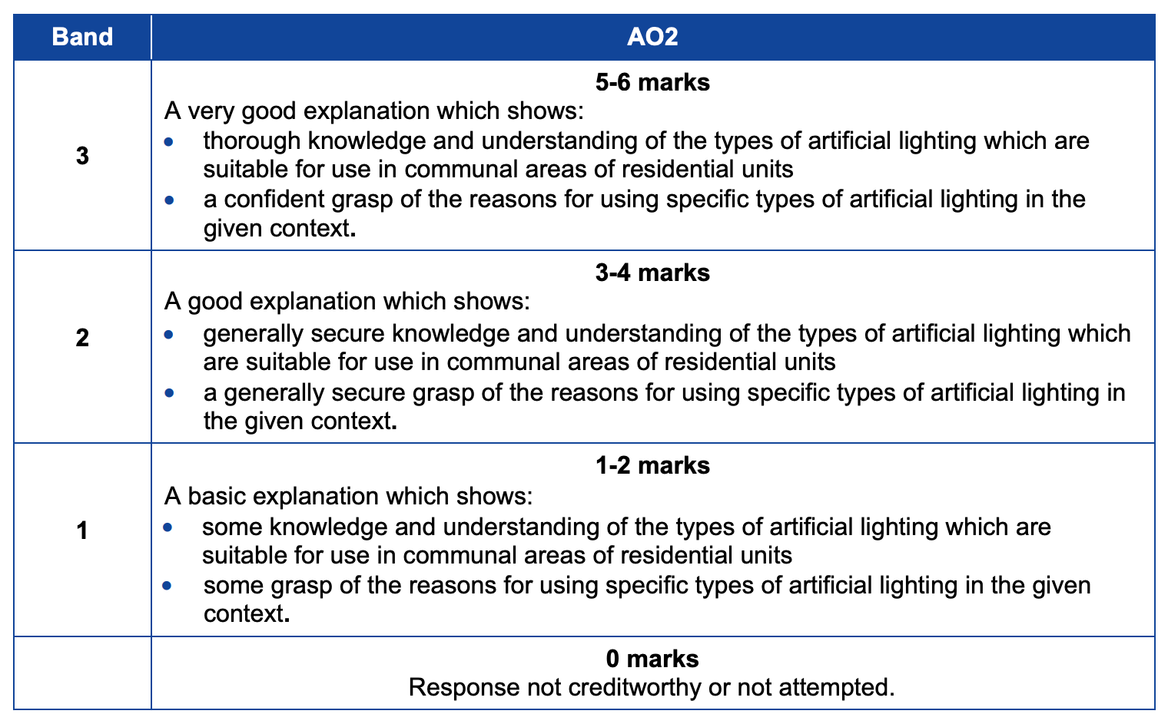
How do I tackle Question 6b?
Notes:
Having considered the indicative content, read through the mark bands and decide in which mark band your answer would be.
How could you improve your response? Spend some time working on your response to take it into the top mark band.

Slide 57
How do I tackle Question 7?
Question : Content being tested – degradation of materials.
Time for answering: 30 MINUTES
How do I get full marks: [this question is band marked]
Approach:
Carry out steps 1 – 4 as in previous questions.
Step 5 Identify what you know about the degradation of a range of materials including steel, timber and brick. You will need to describe measures that could be taken to solve problems associated with this degradation.
Step 6 This is a 20-mark question. The question asks for a description, so you need to consider the ways in which materials degrade and measures that can be taken to prevent or reduce degradation.
Notes:
This question focuses on the causes of degradation in materials such as steel, timber and brick.
It is a twenty mark question so you can allow 30 minutes of exam time to plan and write your answer.
The command word here is describe so you will need to present an informed set of linked facts related to the degradation of materials. Remember to concentrate on measures that can be taken to prevent or reduce the issue of degradation.
This question will be band marked.

Slide 58
Answering the question –
Timed practice – 30 minutes.
Click on the timer to start.
Now we have looked at the key words in the question and the skills/knowledge you need to show, you have thirty minutes to describe the degradation of materials and measures that can be taken to prevent or reduce the process.
Notes:
The command word in the question is describe which will require you should provide characteristics of a topic or a series of linked facts. The description should be as complete as possible to show the main features of the topic you have been asked to describe.
When you are ready to write your answer click on the timer to check that you can produce a detailed enough response in the given time.

Slide 59
How do I tackle Question 7?
Notes:
The boxes show indicative content for the possible causes of degradation in steel, timber and wood plus some measures that can be taken to solve the material degradation.
How many of the points did you make in your answer?
It is possible to achieve a high mark in this question of you did not cover all the points in the indicative content providing that you have demonstrated thorough knowledge and understanding of the topic.
More indicative content is shown on the next slide for this high mark question.

Slide 60
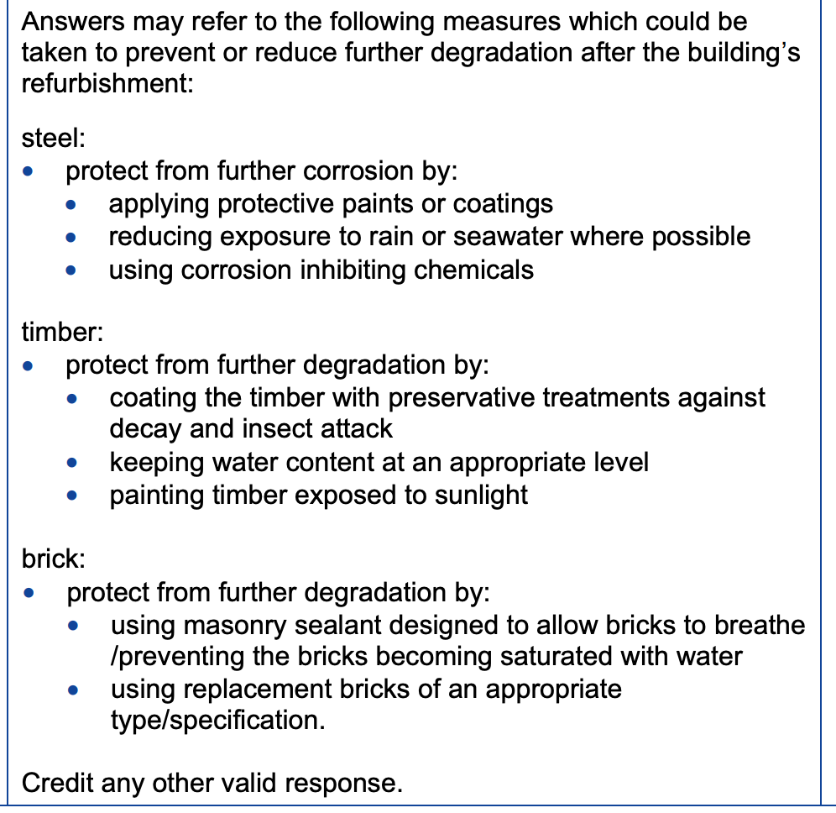
How do I tackle Question 7?
Notes:
The final section of the indicative content covers additional measures that can be taken to reduce further degradation after a building’s refurbishment.
How much of the indicative content did you include in your response?

Slide 61
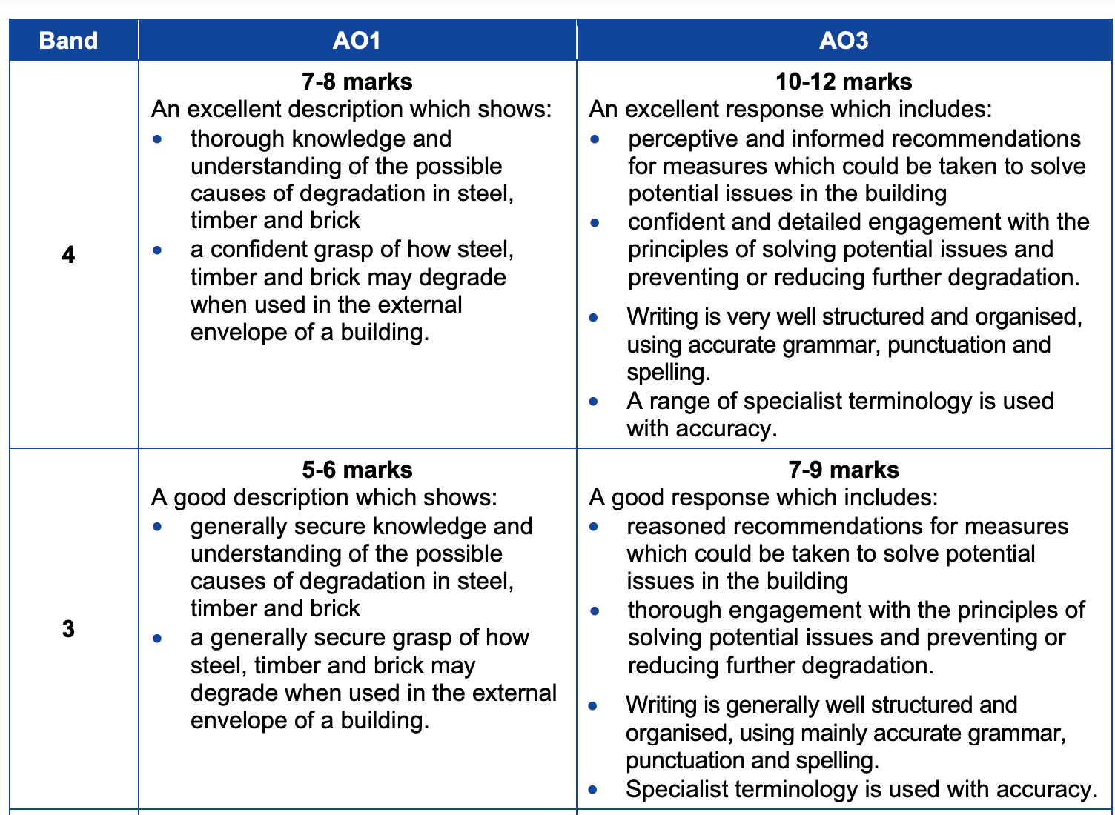
How do I tackle Question 7?
Notes:
Read through the mark bands and decide which is most appropriate for your response.

Slide 62
Cwestiynau? | Any Questions?
Do you have any further questions about this exam?
If so, write them on a post-it note and stick it to the front of your paper to give to your teacher.

