Slide 1


GCE AS/A Level Built Environment
Pre-recorded Online Professional Learning
Preparing to teach and assess Unit 3
Notes:
Welcome to this workshop for Unit 3 of GCE Built Environment

Slide 2
WJEC GCE Built Environment
Introduction to the new specification
The WJEC GCE AS and A level qualification in Built Environment advances learners’ understanding of the built environment, including the professional and technical roles within it and the range of buildings, assets and structures that comprise it.
Notes:
The WJEC GCE AS and A level qualification in Built Environment advances learners’ understanding of the built environment, including the professional and technical roles within it and the range of buildings, assets and structures that comprise it.

Slide 3
WJEC GCE Built Environment
Introduction to the new specification
The specification will enable learners to develop knowledge and understanding of:
• the stages and processes involved in the built environment life cycle
• the professional and technical roles involved in the built environment
• the built environment needs of clients and stakeholders
• Building Information Modelling (BIM) practices and the role of BIM software in all stages of the built environment life cycle
• sustainability issues and sustainable practices in the built environment life cycle
• the changing nature of practice in the built environment sector over time and during different periods.
Notes:
The specification will enable learners to develop knowledge and understanding of:
• the stages and processes involved in the built environment life cycle
• the professional and technical roles involved in the built environment
• the built environment needs of clients and stakeholders
• Building Information Modelling (BIM) practices and the role of BIM software in all stages of the built environment life cycle
• sustainability issues and sustainable practices in the built environment life cycle
• the changing nature of practice in the built environment sector over time and during different periods.

Slide 4
WJEC GCE Built Environment
Content and Assessment: Overview
Presented in four units
Sub-divided into topic areas
Amplification is provided for clarity of breadth and depth
Assessment by examination and non-exam assessment (NEA)
Requirement for the application of mathematical knowledge, skills and understanding
Notes:
The specification is presented in four units
Sub-divided into topic areas.
Amplification is provided for clarity of breadth and depth
Assessment is by examination and non-exam assessment (NEA)
There is a requirement for the application of mathematical knowledge, skills and understanding

Slide 5
WJEC GCE Built Environment
Assessment Structure
AS |  | Unit assessment
Unit 1 | Our built environment | Examination
Unit 2 | Design and planning practices | NEA
A Level |  | Unit assessment
Unit 3 | Materials, technologies and techniques | Examination
Unit 4 | Construction practices (choice of pathway) | NEA
Notes:
This table outlines the focus of all 4 Units for AS and A Level and how they are assessed.

Slide 6
Unit 3
Notes:
This presentation will now focus on preparing to teach Unit 3 of the specification, offering an overview of the content, assessment structure and resources available to support you.

Slide 7
Agenda
Overview of Unit 3
Sample Assessment Materials
  Exemplar review
WJEC resources
  Teachers
  Students
Useful Contacts
Notes:
In this presentation we will give an overview of Unit 3, look at the SAM for this Unit where there is an exemplar that you can review in your own time. We will go on to highlight free WJEC resources available to support teaching and learning of this Unit and useful contact should you need further support or need to ask questions.

Slide 8
Overview of Unit 3
Unit 3 – Materials, technologies and techniques
This unit is designed to build knowledge and understanding of:
  Properties of and degradation of materials
  Structural analysis and building comfort
  Standards for measurements
  Thermal, acoustic and lighting considerations
  Building services systems
Notes:
A2 Unit 3 contributes 50% to the A2 qualification and 30% to the A level qualification.

Slide 9
The content of Unit 3
2.3.1 Properties of materials
2.3.2 Properties of construction materials
2.3.3 Degradation of construction materials
2.3.4 Structural analysis and building comfort
2.3.5 Standards for measurements
2.3.6 Thermal comfort
2.3.7 Acoustic design of buildings and assets
2.3.8 Lighting in buildings and of assets
2.3.9 Building services systems
Notes:
The contents of Unit 3 are divided into nine topics as shown on the slide. Examination papers written for this unit will cover some of the topics in each examination series and over a period of time all topics will have been covered. A rule of thumb would suggest that all topics would be covered in a three year cycle.

Slide 10
Assessment
The following knowledge, understanding and skills will be assessed in Unit3:
Recall of knowledge relating to the contents of Unit 3
Application of knowledge relating to Unit 3
Ability to analyse and evaluate tools, techniques and strategies relating to creating the built environment for the content of Unit 3.
Notes:
The assessments are designed to cover candidates’ ability to:
Recall knowledge and understanding of the topics covered in Unit 3
Apply knowledge and understanding of these topics in given contexts
Analyse and evaluate tools, techniques and strategies relating to creating the built environment

Slide 11
2.3.1 – Properties of materials
The properties of materials cover:
The properties that define the uses and purposes of materials
The ways that materials may respond to changing conditions and situations
The factors that cause material degradation.
Notes:
The first topic in the specification for Unit 3 covers the properties of materials.

Slide 12
Properties that define the uses of materials
These properties cover:
Strength
Toughness
Hardness
Brittleness
Malleability
Ductility
:
Resilience
Resistance to creep and slip
Resistance to fatigue
Notes:
Properties that define the uses and purposes of materials
Learners need to be able to understand and be able to explain the properties of building construction materials listed.
For example:
Strength as the ability to withstand an applied load without failure
Brittleness as materials such as glass that will fail when subjected to stress with little or no plastic deformation
Resilience as the ability of a material to return to its original shape following compression.

Slide 13
How materials respond to changes
Learners need to understand how materials react the changes in conditions including:
Air temperature causing expansion or contraction
Humidity causing condensation, mould growth, staining, corrosion and decay of the building fabric
Precipitation causing reduction in concrete compressive strength, strength in timber and corrosion in steel.
Notes:
Changes in air temperature can cause materials to expand and contract. These variations can introduce stress and strain resulting in cracking and deformation.
Changes in levels of humidity include condensation which occurs when air that has reached its dew point meets cooler surfaces.
Precipitation, rain, causes damage to many types of materials including the warping and rotting of timber and corrosion of steel.

Slide 14
Material degradation
The factors that cause material degradation include:
Corrosion
Salt crystalisation
Frost damage
Water damage
Pollution
Solar radiation
vandalism
Notes:
Learners need to understand that material degradation is cause by natural weathering processes that result from exposure to outdoor conditions.
Degradation can result from a range of causes including:
Salt crystallisation – which is damage resulting from stresses produced when natural or absorbed salt within a porous material crystallises.
Frost damage – arises when moisture in the pores of a material freezes and expands causing damage to the material.
Pollution – such as damage to stone and metals arising from contact with atmospheric pollutants such as oxides of nitrogen and sulphur which then react with rainwater to produce acid rain.

Slide 15
2.3.2 Properties of construction materials
The properties of construction materials includes:
Properties of concrete and their influence on durability
Properties of steel as a construction material
Properties of stainless steel as compared with steel
Properties of timber as a construction material
Properties of bricks as a construction material
Notes:
The properties of concrete include considerations such as compressive strength, shrinkage, porosity and density and fire resistance. This section also covers the properties of reinforced and prestressed concrete.
The properties of steel include considerations such as compressive strength, tensile strength, ductility, durability and thermal conductivity.
The properties of stainless steel compared with steel including higher corrosion resistance, higher compressive and tensile strength and higher ductility.
The properties of timber include considerations such as aesthetics, hardness, weight as compared with other construction materials, durability, shrinkage and swelling.
The properties of bricks including considerations such as hardness, high compressive strength and durability.

Slide 16
2.3.2 Properties of construction materials
The ways in which common materials are manufactured including:
Cement – raw materials such as limestone are crushed to produce a fine material for blending
Steel – iron ore is mined, smelted and carbon is added
Timber – felled logs are cut into boards and then seasoned
Brick – natural clay minerals are crushed, shaped, dried and fired.
Notes:
The manufacturing of cement covers mortar, concrete, reinforced concrete and prestressed concrete.
The manufacturing of steel includes structural steel, lightweight mild steel and profile sheeting.
The manufacturing of timber covers engineered wood products designed to overcome limitations on the size and length of sawn timber.

Slide 17
2.3.2 Properties of construction materials
Learners should know about the load bearing properties of construction materials including:
Concrete – high compressive strength which increases over time.
Steel – high strength capacity in both tension and compression
Timber – potential for good strength capacity in both tension and compression.
Brick – high compressive strength of the bricks or blocks used and mortar.
Notes:
This section of the specification also covers how changing temperatures will affect this range of construction materials.

Slide 18
2.3.3 Degradation of construction materials
This section of the specification covers:
The causes of material degradation
Measures involved in preventing and reducing degradation
Solving issues caused by material degradation
Impact on the environment
Notes:
The causes of material degradation include corrosion, frost damage, water damage, pollution and solar radiation.
The measures involved in preventing and reducing degradation include:
Reinforced concrete – ensuring adequate concrete cover to the bars, use of impermeable concrete mix and use of corrosion inhibiting coatings and sealers
Steel – use of paint or powder coating, reduced exposure to rain or seawater, use of corrosion inhibiting chemicals
Timber – use of preservative treatments and pressure treating timber and forcing preservatives into the timber.

Slide 19
2.3.3 Degradation of construction materials
Learners should understand how to minimise the impact of material degradation to the following materials:
Reinforced concrete
Steel
Timber
Brick
Notes:
Minimising the impact of material degradation involves:
Reinforced concrete – treating exposed steel reinforcement
Steel – chemically removing corrosion, protecting from further corrosion by galvanizing, applying protective paints or coatings, replacing defective and/or loose fixings
Timber with dry rot: treating timber with a fungicide or replacing affected timbers Timber with wet rot: reducing moisture content down to sufficiently low levels
Brick – replacing broken or spalled bricks, repairing mortar joints, installing a DPC (Damp Proof Course), installing additional wall ties where existing anchors have failed.

Slide 20
2.3.4 Structural analysis and building comfort
In this section learners will gain knowledge and understanding of the application of the following techniques:
Structural analysis of buildings/assets
Impacts of material properties on building users
Impacts of material properties on building acoustics and sounds
Determining the designs required for lighting in buildings/assets
Notes:
This section of the specification covers the topic of the structural analysis of the built environment. It also covers the impact of the built environment on the building users.

Slide 21
2.3.4 Structural analysis of building/assets
Learners need to understand that:
Structural loads are forces that cause stress and deformation
There are three categories of loads, concentrated (point) loads, line loads, distributed (distributed loads)
The maximum bending moment will occur at different points depending on how the beam is supported and the type of load applied to the beam.
Notes:
Structural loads – loads that act upon a structure will vary according to the design, use, location and materials being used. Loads are classified as either dead loads which will be the structure’s self weight or live loads which are imposed loads which are temporary or moving loads such as traffic on a bridge.
The learners should be able to apply formulae to calculate maximum bending moments for simply supported beams and cantilever beams. In the examination the paper will include a list of the appropriate formulae for all mathematical calculations required by the specification.

Slide 22
2.3.4 Impact of temperature changes, material properties on building acoustics and designs for lighting.
Learners need to understand:
The impact of temperature change on building users and how it varies depending on building type, building construction and how buildings are used.
That building acoustics is the controlling of noise in a building
The requirements of lighting design, enabling users to see clearly and that consideration should be given to appropriate design and equipment, control systems and uses of daylight.
Notes:
Learners need to understand that buildings should provide thermal comfort for users but that temperature changes can be impacted upon by social and economic factors, as well as the availability of green space and shading surrounding the building.
Controlling the noise in a building includes minimising the transmission of noise form one space to another and the control of the characteristics of sound within spaces themselves.
Learners should also understand how building acoustics are influenced by the geometry and volume of a space, sound absorption, transmission and reflection of the surfaces within a space and airborne sound transmission.
The learners need to know that the design process for lighting takes account of the kind of activity for which the lighting is being provided, the amount of light required, the colour of the light and the distribution of light throughout the space.

Slide 23
2.3.5 Standards for measurements
This section covers:
The rules of measurement affecting the planning of construction, installation and maintenance projects
The rules of measurement for civil engineering projects
Producing quantities for substructures and superstructures
Producing quantities for civil engineering projects
Producing bills of quantities for building/asset projects.
Notes:
Learners should be aware of the New Rules of Measurement and understand that they provide a standard set of measurement rules for estimating, cost planning, procurement and whole-life costing for construction projects.
Learners should also be aware of the Civil Engineering Standard Method of Measurement for civil engineering projects including the procedures to which a bill of quantities should be prepared and priced.
To produce quantities for substructures and superstructures will require learners to apply a variety of mathematical techniques including calculation of areas, perimeters, volume and surface areas. These calculations will also include centre line calculations for construction of substructures such as foundations. The areas to be considered include reinforced concrete, steelwork, block/brickwork, floors, roofs, finishing, windows, doors and electrical and plumbing installation.
Learners should understand that preparing a bill of quantities has to be done in line with the rules for standard measurement of quantities once a design has been completed and a specification prepared.

Slide 24
2.3.6 Thermal comfort
In this section learners need an understanding of the principles and risks affecting thermal comfort including:
The scientific principles required to understand the factors affecting the thermal comfort of buildings
Controlling and managing heat
Moisture risks to buildings, including condensation and approaches to moisture management.
Notes:
Learners should understand that the mode of heat transfer can change – solar radiation can be absorbed by a brick wall, the heat is then transferred by conduction though the brickwork, to the indoor air by convection and to indoor surfaces by radiation.
Environmental factors that affect thermal comfort include air temperature, radiant temperature, air velocity and relative humidity.
Learners need to understand measures that can be taken to control the heat flow in buildings such as insulation, thermal bridges, solar radiation and interior heat gains.
Heating and cooling systems use controls to regulate their operation including sensing devices to compare actual states with target states and a control system to process data to determine what action in necessary.
Learners should also be aware of building management systems, (BMS), which can control a buildings mechanical and electrical equipment.
Learners need to know that a building is at risk of being affected by moisture which may result in damp patches, damage to surface finishes, corrosion and decay to the building’s fabric and frost damage.
Learners need to know that moisture can be managed by limiting sources of moisture, dehumidification, natural ventilation and vapour barriers.

Slide 25
2.3.7 Acoustic design of buildings and assets.
This section covers:
The scientific/mathematical principles required to understand the way in which sound is measured
How sound is managed throughout the life cycle of buildings/assets
The implications of sound design on building users and others.
Notes:
Learners should understand how to measure the following methods of measurement for sound: frequency, wavelength, amplitude and loudness.
Learners need to be aware that Building Regulations govern that emission of sound as set out in Document E. These standards apply to new buildings, alterations to pre-existing buildings and to buildings being converted into flats.
Learners need to understand that:
Separating walls rely on mass or density to achieve suitable levels of acoustic insulation.
Separating floors typically include acoustic insulation
Conversion projects may require additional independent panel walls and celling structures with absorbent materials.
Learners need to understand that noise pollution is an important consideration in the location, design and construction of new developments. Noise pollution includes environmental noise, neighbourhood noise and noise arising from industrial, entertainment and business premises.
The design of building acoustics can help mitigate the effects of noise pollution and is also significant in spaces such as concert halls where the quality of sound is important.

Slide 26
2.3.8 Lighting in buildings and of assets.
This section covers:
The types of light, both natural and artificial, which affect building/asset users.
The methods of measuring light in buildings and of assets.
Notes:
Learners need to understand the different types of light including natural light, artificial lighting and lamps.
Artificial light includes overhead lights to provide uniform illumination throughout a space, accent lighting provided by spotlights to draw attention to items, emergency lighting to provide illumination for safe evacuation and security lighting.
Lamps can be filament lamps, discharge lamps and light-emitting diodes (LED).
Learners need to know how to measure the following:
Daylight factor – the percentage of daylight available in a room
Lux – the SI unit of illuminance
Illuminance – the amount of light received on a surface
Luminance – the amount of light reflected or emitted from a surface
Candela – the SI unit of luminous intensity.

Slide 27
2.3.9 Building service systems
This section covers:
The nature of energy and its use in building services systems
The energy forms used in electrical, air conditioning, refrigeration and heating systems
The units, calculations and methods of calculating energy use and requirements
The links between structural design and energy consumption
Active and passive building services engineering design
The benefits of collaborative use of Building Information Modelling (BIM) when designing structures and building services systems.
Notes:
Learners need to understand the nature of energy as the capacity to do work. Energy is converted from one form into another, it is neither created or destroyed. The use of energy in building services includes the conversion of energy from sources into outputs.
Learners need to know the difference between renewable and non-renewable forms of energy.
Learners need to be able to calculate the energy consumption of an appliance or item of plant using the formula:
power in watts = 1000 x Energy in kilowatt hours / consumption time period in hours.
The energy consumption of a building varies according to the structural design of the building.
Learners need to understand that the design of a building can include either active or passive services systems. Active services include items such as boilers and chillers, mechanical ventilation and electric lighting. Passive services include the use of methods such as solar radiation, cool night sir and air pressure differences.
Learners should know the main benefits of using BIM in a collaborative approach to produce facilities management to provide a building that meets the end user’s needs including handover documents that are accurate and fully detail the operation of the building.

Slide 28
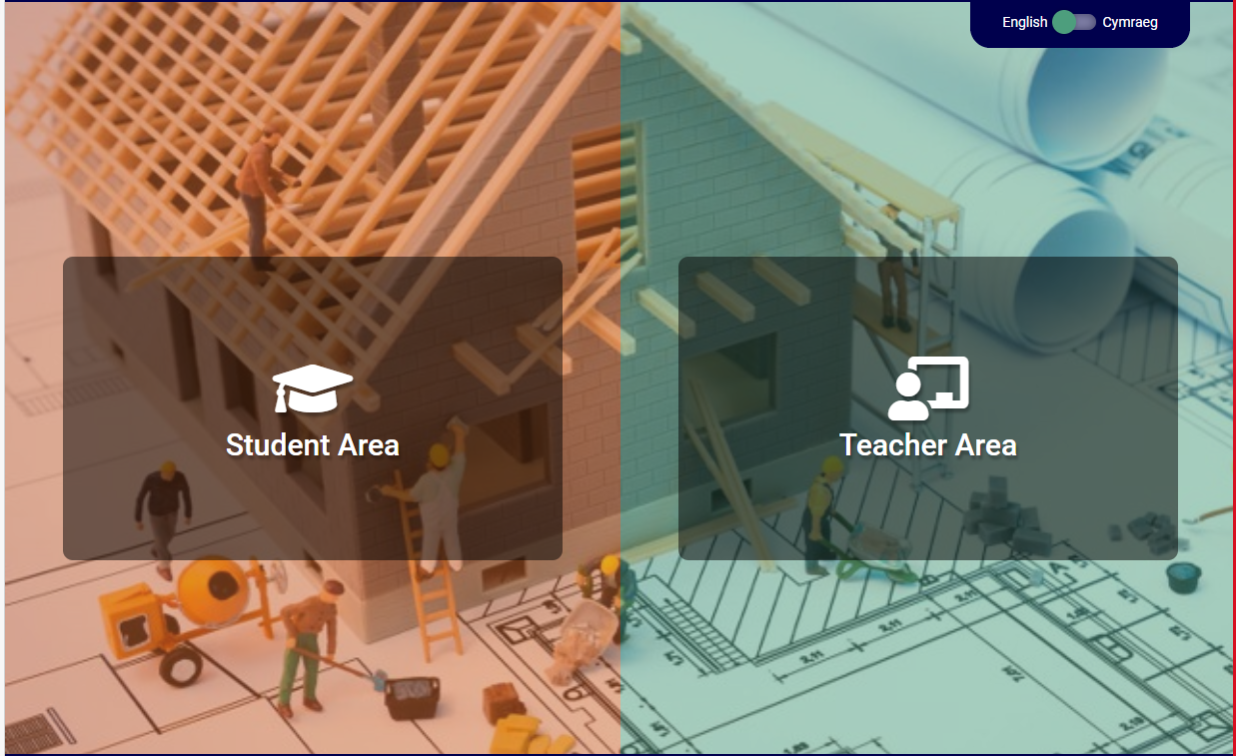
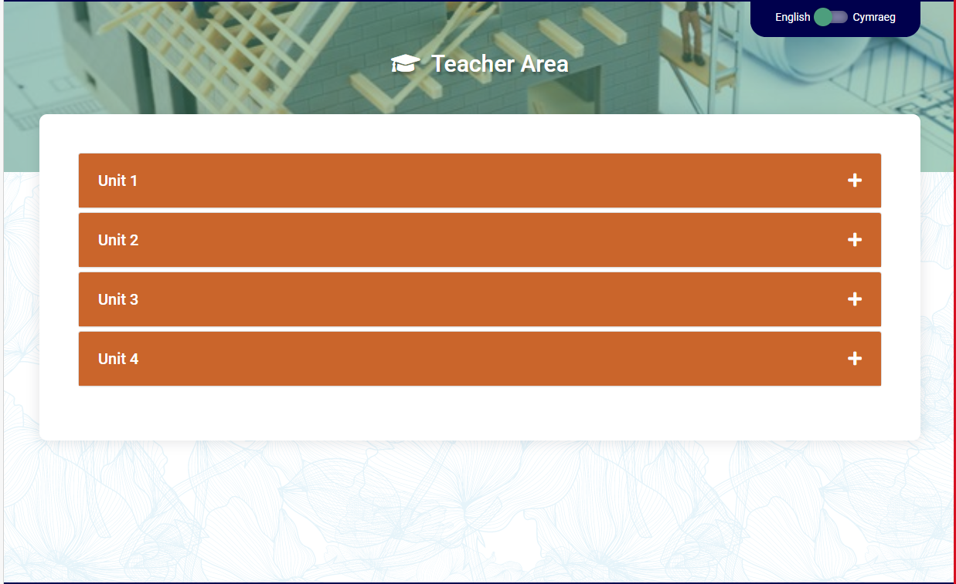

WJEC Resources
There are a wide range of resources available for teachers and students on the WJEC website.
Notes:
This slide contains a link to WJEC resources for this qualification.
There are a wide range of resources available for teachers and students on the WJEC website. Currently resources are available for Unit 1 and 2. Resources for the other units will be provided to coincide with future workshops.

Slide 29


Cwestiynau? | Any Questions?
Subject Officer
Allan Perry
construction@wjec.co.uk
Subject Support
construction@wjec.co.uk
@wjec_cbac | @cbac_wjec
cbac.co.uk | wjec.co.uk

