Slide 1
NEA Walk-Through
WJEC GCE Built Environment
Sample Assessment Material – Unit 2
Notes:
This is the NEA walkthrough for the GCE Built Environment Unit 2 – sample assessment materials.

Slide 2
What you should have in front of you:
A copy of the Sample Non Examination Assessment (NEA) brief for Unit 2
A copy of the Specification for Unit 2
Materials for making notes and sketches
Notes:
During this session you will need to have access to the Sample NEA brief for Unit2 and the specification for Unit 2.
You will also need to be able to make notes and perhaps sketch out ideas as we go through the requirements for the NEA.

Slide 3
What this NEA is all about:
You will have approximately 30 hours to complete this brief.
It is testing the content of the specification for Unit 2.
The brief describes a scenario for the extension of an existing building.
The brief identifies a series of factors to be considered and tasks to be carried out.
Notes:
The brief will be issued in December of each year for submission the following summer.
This walk through will consider the brief from the specification which is part of the sample assessment materials for the qualification.
The brief covers the content of unit 2 of the specification.
The brief describes a scenario covering the extension of an existing building to provide a new medical centre. It includes factors you should take into account and tasks to be carried out to complete the brief.

Slide 4
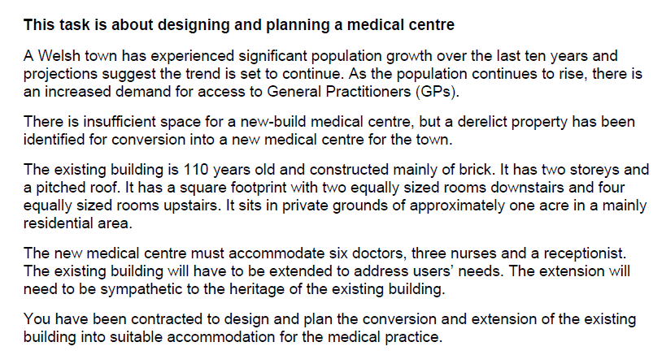
What should I do first?
Read the scenario
Notes:
Before you can consider starting work on the brief you will need to make sure you fully understand the scenario.
The scenario will have been written by a senior examiner and it is important to break down the information so that you make sure that you know what the requirements for the task involve.
Spend some time reading the scenario and make your own notes summarising the facts about the site, the existing building and the client’s requirements for the new building.

Slide 5
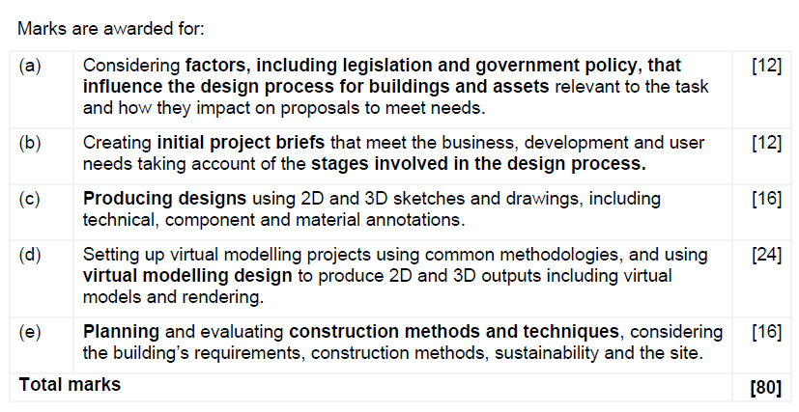
How will I be assessed?
Notes:
The task is divided into five sections:
Considering factors that influence the design process for buildings and assets relevant to the task – 12 marks available
Creating initial project briefs that meet the business, development and user needs taking account of the stages involved in the design process (RIBA Plan of Work, Stages 0 – 4). – 12 marks.
Producing designs using 2D and 3D sketches and drawings – 16 marks.
Setting up virtual modelling projects using common methodologies and using virtual modelling design to produce 2D and 3D outputs – 24 marks..
Planning and evaluating construction methods and techniques, considering the building’s requirements, construction methods, sustainability and the nature of the site – 16 marks.

Slide 6
How do I tackle part (a)?
The brief states that you need to consider the following bullet points in terms of their impact on the design of the conversion and extension.
Notes:
For each section, consider the requirements of the brief, including:
The nature of the site
Planning regulations
Statutory regulations
Environmental issues and concerns
Social impacts
Budgetary and economic constraints
Construction (design and management regulations – known as CDM
The nature of the existing building and its age/heritage features and issues.

Slide 7
How will I be marked on Part (a)?
This is the mark scheme for the top band for Part (a)
Notes:
For each section we will consider the allocation of marks by discussing the top mark band from the specification.
To achieve high marks here you will need to have covered the bullet points listed on the previous slide and to have considered the requirements and constraints from the brief that may influence the design process.
You will need to provide evidence of critical and objective analysis of how these parameters, requirements and constraints may impact on proposals to meet business, development and user needs with the context of the new medical centre.

Slide 8
What evidence should I include for Part (a)?
Consideration of the site.
You will need to identify a site for the conversion and extension taking into account the information in the scenario.
It is important that you can provide as much information as possible about your chosen site and the production of a site plan to illustrate your considerations would be important.
You need to describe:
Location relative to areas such as the town centre.
The orientation of the site
Ground conditions at the site
The availability of mains services and utilities
Notes:
The brief describes a site of approximately one acre in area in a mainly residential area. On the site is an existing building, approximately 110 years old, constructed from brick.
You will need to provide evidence of your consideration of the information in the brief, the location of the site relative to areas such as the town centre, transport links and other access routes.
In addition, you should consider the orientation of the site, the ground conditions at the site and the availability of mains services and utilities.

Slide 9
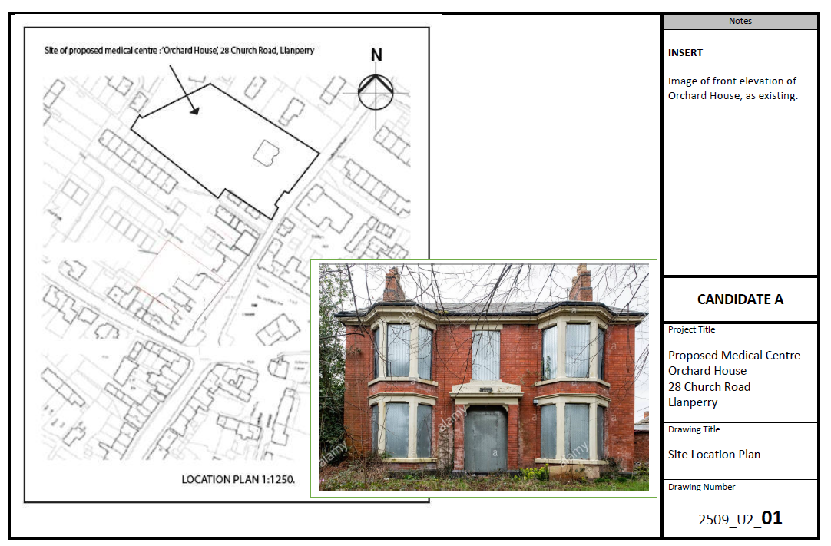
What evidence should I include for Part (a)?
Notes:
This presentation will consider work produced for the NEA brief as an example.
This drawing provides information about the location of the site, the orientation of the site and includes an image of the existing building that is to be converted as part of the new medical centre.

Slide 10
What evidence should I include for Part (a)?
Consideration of the planning.
You will need to identify issues related to planning including any related to:
Compliance with the Local Plan and other government policies
Impact on the local area
Effect on trees and wildlife and the impact on any Site of Special Scientific Interest (SSSI) or Area of Outstanding Natural Beauty (AONB)
Highway matters, traffic access, visibility and parking scope of existing local facilities and local housing stock
Potential loss of light or privacy to neighbouring properties
Suitability for the local area, issues of conservation and listed buildings
Over development
Provision or retention of employment
Issues concerning drainage and surface water runoff.
Notes:
You need to consider the parameters of the planning process including:
Compliance with the Local Plan and other government policies
Impact on the local area
Effect on trees and wildlife and the impact on any Site of Special Scientific Interest (SSSI) or Area of Outstanding Natural Beauty (AONB)
Highway matters, traffic access, visibility and parking scope of existing local facilities and local housing stock
Potential loss of light or privacy to neighbouring properties
Suitability for the local area, issues of conservation and listed buildings
Over development
Provision or retention of employment
Issues concerning drainage and surface water runoff.
All these parameters need to be discussed in relation to your chosen site for the new medical centre. The nature of the site and access to the site will govern which of the parameters are relevant to your situation.

Slide 11
What evidence should I include for Part (a)?
Consideration of the planning (Continued).
You will need to identify any constraints that information from the planning process may have on your design for the new medical centre including:
Flood risk
Contaminated land
Tree Preservation Orders
Conservation areas
Listed building consent.
Notes:
You need to consider the constraints that may have been identified during the information gathering with regard to planning including:
The risk of flooding at the site
The nature of the ground that could be contaminated with chemical or industrial waste
Whether any trees on the site have preservation orders that would prevent them being felled to make way for the extension to the existing building
Whether the existing building is listed, restricting the changes that can be made to its appearance and use.

Slide 12
What evidence should I include for Part (a)?
Consideration of other statutory requirements.
You will need to identify the statutory requirements that will affect the design and construction of the new medical centre including:
National Building Regulations and Building Standards
What qualifies as building work
The notification procedures that must be followed
The requirements for building design and construction (Approved documents A – R).
In particular Approved Document M that sets ‘Access to and use of buildings’ to ensure that any design complies with the Disability Discrimination Act.
Notes:
You need to consider and discuss in detail the statutory requirements that you must comply with including Building Regulations.
Your conversion and extension will have to be designed to comply with the requirements set out in the National Building Regulations and Building standards.
To find out the requirements that will affect your design decisions go to ‘https://gov.wales/building-regulations-approved-documents’ where you will find a full set of guidance on these requirements.

Slide 13
What evidence should I include for Part (a)?
Notes:
This drawing considers the statutory regulations, sustainability and building regulations that will inform your design.

Slide 14
What evidence should I include for Part (a)?
Consideration of other statutory requirements.
You will need to be aware of other requirements arising from public bodies:
Police – concerning security arrangements and lighting of public spaces
Fire service – regarding means of escape, access and water supplies for fire fighting
Highway authority – regarding road layouts and access
Notes:
You will also need to take account of statutory requirements related to other public services such as the police, fire service and highway authority.
The police are concerned with security arrangements which will be relevant to the new medical centre is terms of the storage of medicines and drugs.
The fire service will want to ensure that there are sufficient means of escape for staff and patients and that the design allows for access to the building and water supplies.
The highway authority will be concerned with access to the site, any increase in traffic volume and any alterations that may be need to the road layout in the vicinity of the medical centre.

Slide 15
What evidence should I include for Part (a)?
Consideration of the environmental issues
You will need to identify a environmental parameters that could constrain the design process including:
Use of sustainable or hazardous materials
Energy consumption and carbon emissions
Air, water or ground pollution
Waste and water management
Noise, vibration and dust
Traffic and transport
Preservation of ecology
Resilience to climate change
Design for deconstruction and disposal
Notes:
You will need to consider the environmental parameters that could constrain your design of the conversion of the existing building and the proposed extension.
The nature of your site will dictate which environmental issues will affect your design. Which of these parameters are likely to be of importance for your site and design?

Slide 16
What evidence should I include for Part (a)?
Consideration of social issues.
You will need to identify social requirements that may constrain the design process:
Consultations with stakeholders, including the local community regarding development proposals
The range of services that may be included as community care:
GPs and practice nurses
Health visitors, social workers and home care advisors
Community midwives
Pharmacists
Mental health professionals
Notes:
You will need to consider any social issues that may constrain the design process.
It is important that the views of stakeholders are taken into account. This includes the local community who may become patients at the new medical centre, but may also have concerns about increased traffic, car parking and footfall generated by the health centre.
It is also important to consider the range of services that will be offered by the new medical centre and the needs of the wide range of staff who will be working there.

Slide 17
What evidence should I include for Part (a)?
Consideration of economic issues
You will need to identify possible impacts of economic constraints on the project budget and the allocation of resources in terms of:
Quality
Safety
Functionality
Performance
Notes:
The project budget will constrain the development and issues relating to funding need to be considered. You will need to research how the National Health Service fund this type of project or whether the medical practice will need to self fund the work.

Slide 18
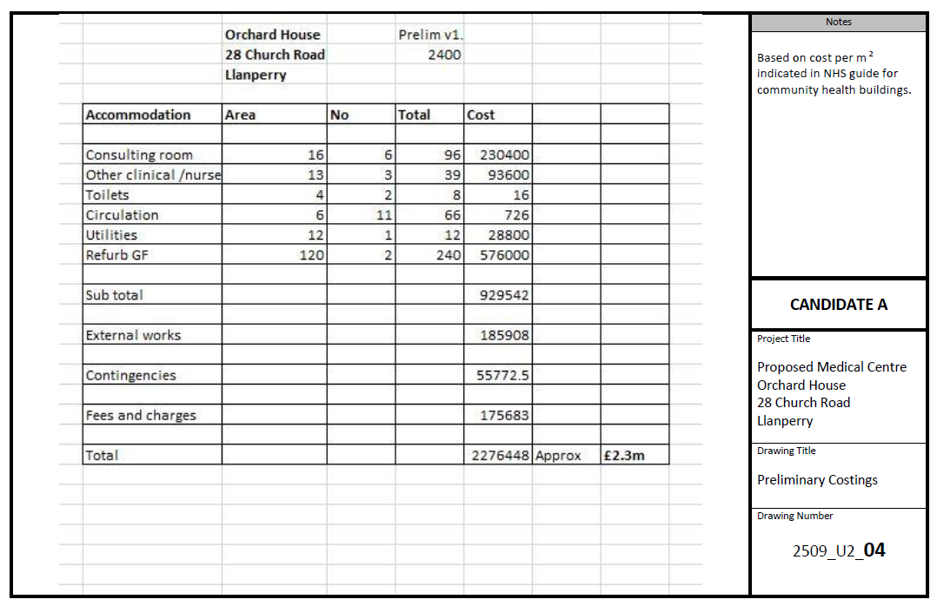
What evidence should I include for Part (a)?
Notes:
This slide provides evidence of the consideration of the costs for the conversion of the existing building and construction of the extension for the new medical centre.

Slide 19
What evidence should I include for Part (a)?
Consideration of Construction (Design and Management) Regulations (CDM) which are the main set of rules for managing health, safety and welfare of construction projects.
You will need to identify issues arising from CDM Regulations that apply to:
All building and construction work
The design work
The regulations require the identification, elimination, or control of foreseeable risks and places responsibility for planning and managing health and safety in the pre-construction phase on the duty holders, the Client and the principal designer.
Notes:
Complying with the Construction (Design and Management) Regulations, known as CMD, is essential.
You will need to carry out a risk analysis of the works as part of the design process and include the work required in mitigation of identified risks in the project budget.

Slide 20
How do I tackle Part (b)?
The brief states that you need to create initial project briefs for the client which:
Set parameters
Set project outcomes
Outline possible design ideas and specifications
Take account of the activities which are required in the pre-construction stage of the plan to convert and extend the existing building.
Notes:
The second set of tasks for the NEA requires you to create an initial project brief for the client.
This should include setting parameters, project objectives, outlines of possible design ideas and planning constraints.

Slide 21
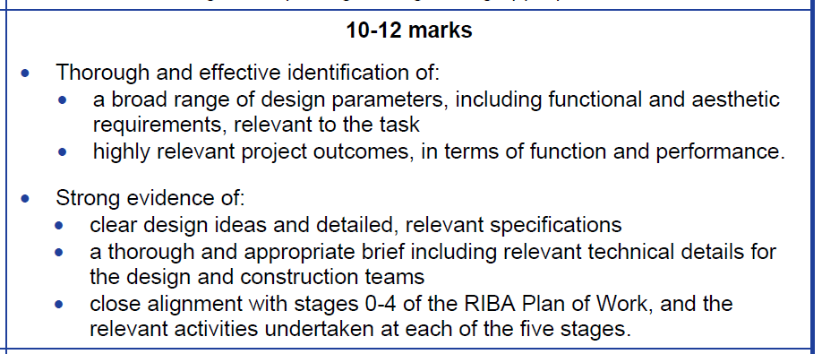
How do I tackle Part (b)?
Notes:
The second set of tasks for the NEA requires you to create an initial project brief for the client.
The top band of the mark scheme sets out the requirements for Part (b). To achieve top marks, you will need to:
Provide evidence of a thorough and effective identification of:
A broad range of design parameters including functional and aesthetic requirements relevant to the conversion of the existing building and the building of the extension to provide a new medical centre.
Highly relevant project outcomes in terms of function and performance of the new medical centre.
Provide strong evidence of:
Clear design ideas and relevant detailed specifications for the project
A thorough and appropriate brief for the project including details for the design and construction teams
A close alignment with stages 0 – 4 of the RIBA Plan of Work and the relevant activities undertaken at each of the five stages.

Slide 22
How do I tackle Part (b)
Setting parameters.
The project parameters should be based on the following factors that influence building design:
Owner or end user functional requirements
Aesthetic requirements
Implications arising from the physical environment
Planning constraints and building regulations
Resources.
Notes:
For the new medical centre, there has to be detailed consideration of the end users’ functional requirements.
The doctors will require clinical accommodation with sufficient space to carry out patient examinations in private, these requirements will have to be based on NHS guidance.
The nurses will require similar accommodation to the doctors whereas other staff will require safe and comfortable working conditions with a reception area and waiting room for patients and staff accommodation for rest periods plus toilet and washing facilities.
As the project involves the conversion and extension of an existing building the deign must reflect the nature of the existing building in terms of the materials used in construction.
The implications arising from the physical environment will depend on your choice of site for the new medical centre.
Standard planning constraints will apply, again some depending on the area in which your medical centre is to be situated, for example if it is in a conservation area.

Slide 23
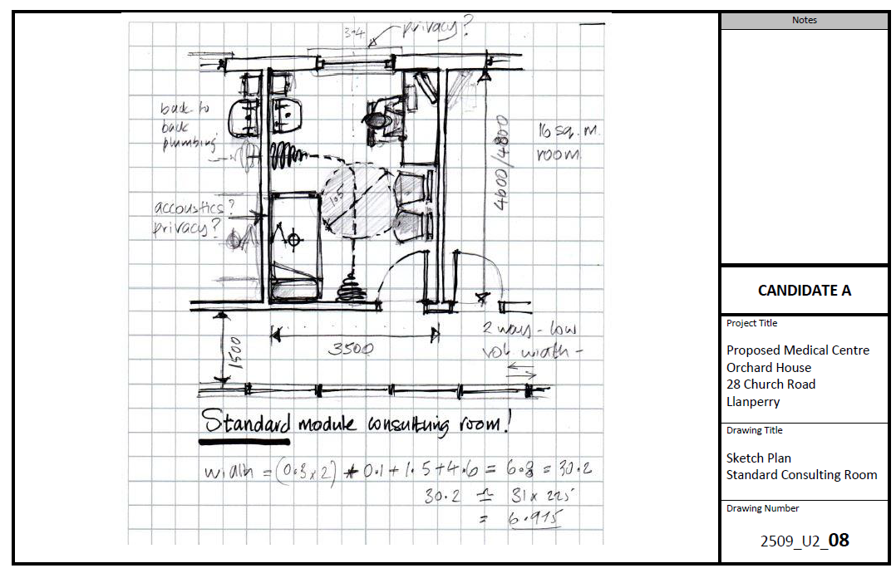
How do I tackle Part (b)
Notes:
This sketch provides details of the requirements for a standard consulting room to be used by the GPs in the new medical centre.

Slide 24
How do I tackle Part (b)
Project outcomes
Setting outcomes for function will involve defining the process to be carried out in the new medical centre and the nature of the accommodation required for those processes.
Setting outcomes to include end user satisfaction should cover:
The internal environment
Energy consumption and operational cost targets
Construction cost and sustainability targets
Project programme.
Notes:
The project outcomes are always going to depend on the nature of the building required.
In this case the outcomes will relate to the nature of the activities that will take place in a medical centre including the work of doctors, nurses, support and administration staff. The need for privacy will be essential both in consultations and the maintenance of confidential records.

Slide 25
How do I tackle Part (b)
Possible design ideas and specifications
Design ideas and specifications can be presented using drawings, plans, specifications and models
Design process is an iterative process of inputs, refinements and outputs
Models are representations of a concept/design for client in consultation with stakeholders
Specifications describe the materials and workmanship required.
Notes:
Design ideas can be represented using a variety of methods including sketches, drawings, plans, specifications and models.
The designs for the medical centre will need to cover both the conversion of the existing building and the proposed extension. All stakeholders should be consulted about the initial ideas for the building.

Slide 26
How do I tackle Part (b)
The project brief is the key document upon which the design for the building will be based. The project brief may include:
A description of the client
Site information
Spatial requirements, including schedules of accommodation and adjacencies
Technical requirements and performance standards
Component requirements including lead in times
Other issues, including planning requirements, budget and programme.
Notes:
The project brief is the key document upon which the design for the building will be based, including technical details intended for the professional design team and specialist contractors.
The project brief will include:
A description of the client
Site information
Spatial requirements, including schedules of accommodation and adjacencies
Technical requirements and performance standards
Component requirements including lead in times
Other issues, including planning requirements, budget and programme.

Slide 27
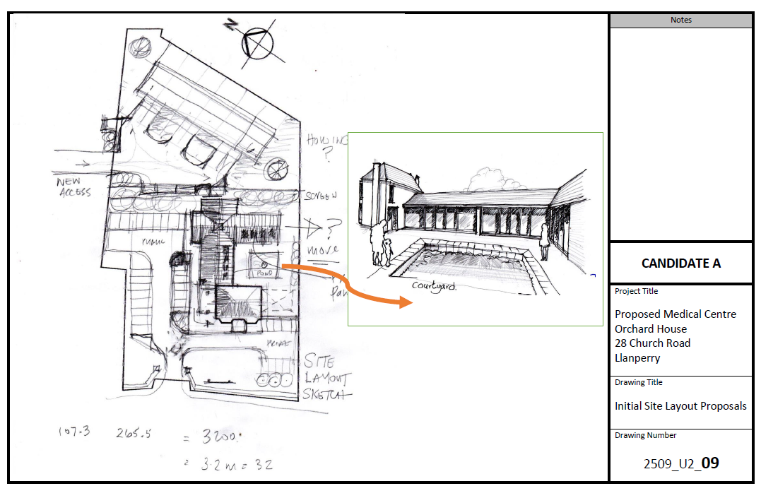
How do I tackle Part (b)
Notes:
This drawing provides details of the initial site layout design for the new medical centre.

Slide 28
How do I tackle Part (c)
Original ideas are usually represented using:
2D sketches that are freehand design drawings of spatial relationships, floor plans, elevations and site arrangements.
3D sketches that are freehand design drawings often prepared on isometric grids or using approximate two pint perspective.
Notes:
Part (c) of the task asks you to provide evidence of designs for the medical centre including 2D and 3D sketches and drawings with technical, component and material annotations.

Slide 29
How do I tackle Part (c)
Notes:
Part (c) covers assessment objective 2 – application of knowledge and understanding of the built environment and the processes, stages, roles and materials involved in its design, construction, use and maintenance.
To gain high marks in this part of the NEA you need to demonstrate:
Excellent application of knowledge and understanding and sophisticated and highly effective use of techniques, principles and conventions to produce:
A comprehensive range of high quality 2D and 3D sketches and drawings which are relevant to the design and potential users of the new medical centre.
Clear and detailed technical component and material annotations.

Slide 30
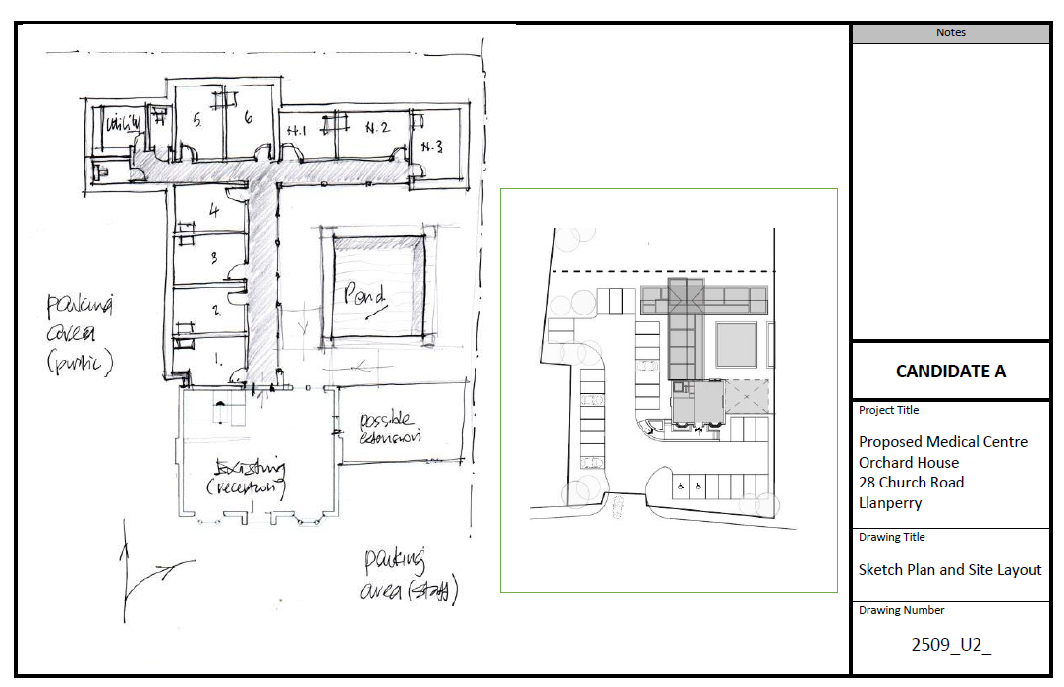
How do I tackle Part (c)
Notes:
This drawing includes a sketch plan and site layout for the new medical centre.
The site layout plan includes details such as provision for parking and access to the medical centre.

Slide 31
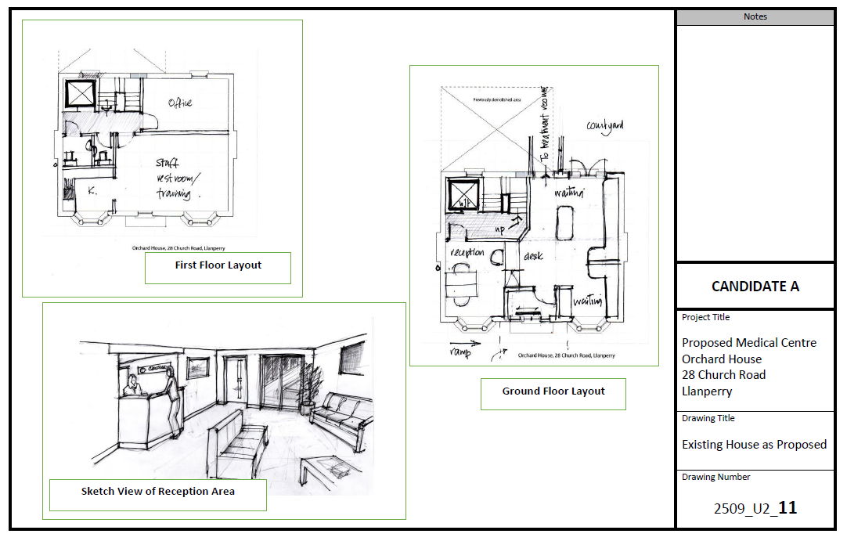
How do I tackle Part (c)
Notes:
This sketch provides details for the proposed conversion of the existing building to form the reception and waiting areas for patients and accommodation for support staff.

Slide 32
How do I tackle Part (c)
Design drawings are usually represented in the following formats:
2D drawings that are orthographic drawings accurately prepared to scale including location plans, site plans, floor plans, construction details, elevations and sections.
3D drawings that are isographic drawings, prepared to scale, including site layouts , construction details and perspectives.
Notes:
Design drawings are accurately prepared to scale and should include location plans, site plans, floor plans, construction details, elevations and sections.

Slide 33
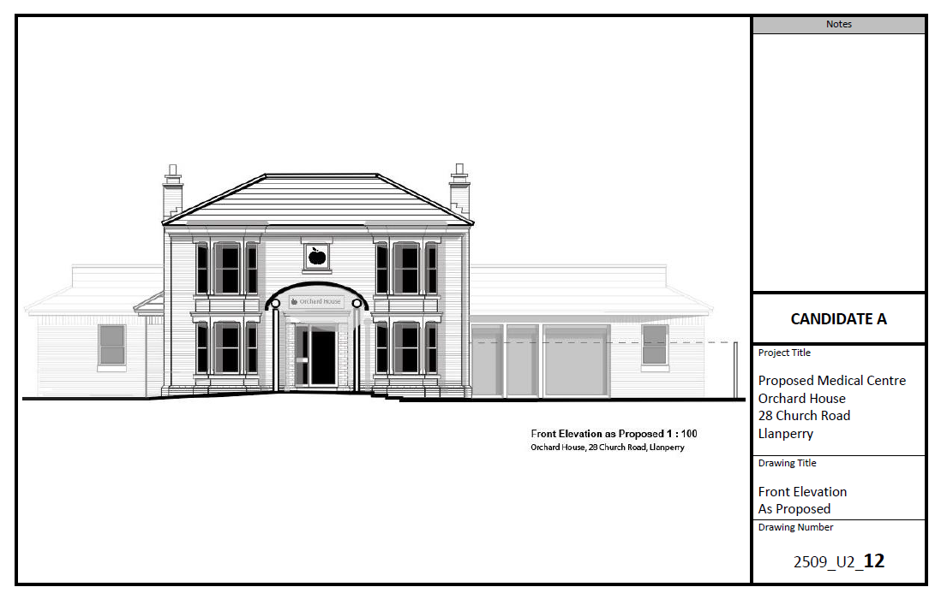
How do I tackle Part (c)
Notes:
This drawing shows the front elevation of the new medical centre with the converted existing building and the proposed extension.

Slide 34
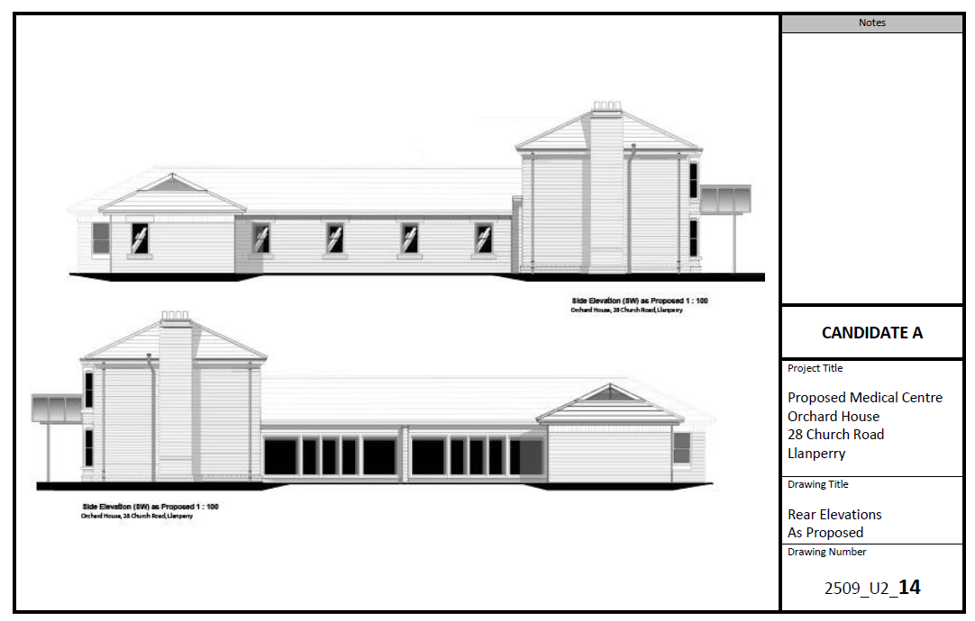
How do I tackle Part (c)
Notes:
This drawing shows the rear elevations of the conversion and proposed extension to the new medical centre.

Slide 35
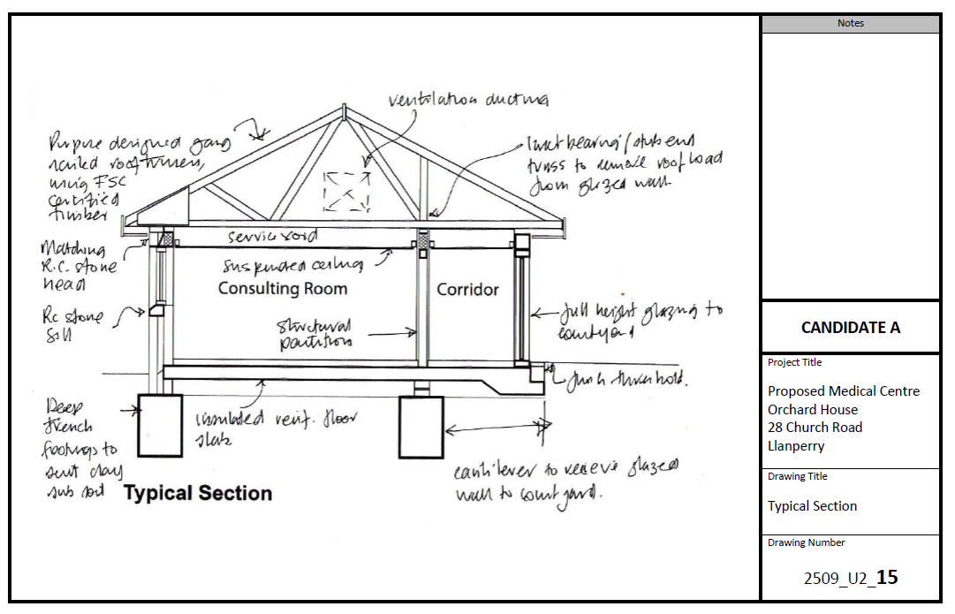
How do I tackle Part (c)
Notes:
This sketch shows a typical section through the proposed single storey extension.

Slide 36
How do I tackle Part (c)
Techniques, principles and conventions of manual drawing including:
Sheet layout, title block and recording of revisions
Dimensioning
Line thickness, weight and line types
Indication of elevational and sectional views
Types of annotation including:
Technical annotations
Component annotations
Material annotations
Notes:
You will need to understand the principles and conventions of manual drawing including:
Dimensioning
Line thickness, weight and line types
Indication of elevational and sectional views
Technical component and material annotations include:
Technical annotations – recommended minimum text sizes for notes and dimensions, headings and titles.
Component annotations – architectural symbols for doors, windows and associated motion. Symbols for electrical and security fittings, heating equipment and sanitary ware.
Material annotations – cross referencing to schedules. Material hatching, covering concrete, masonry, timber, insulation and groundworks.

Slide 37
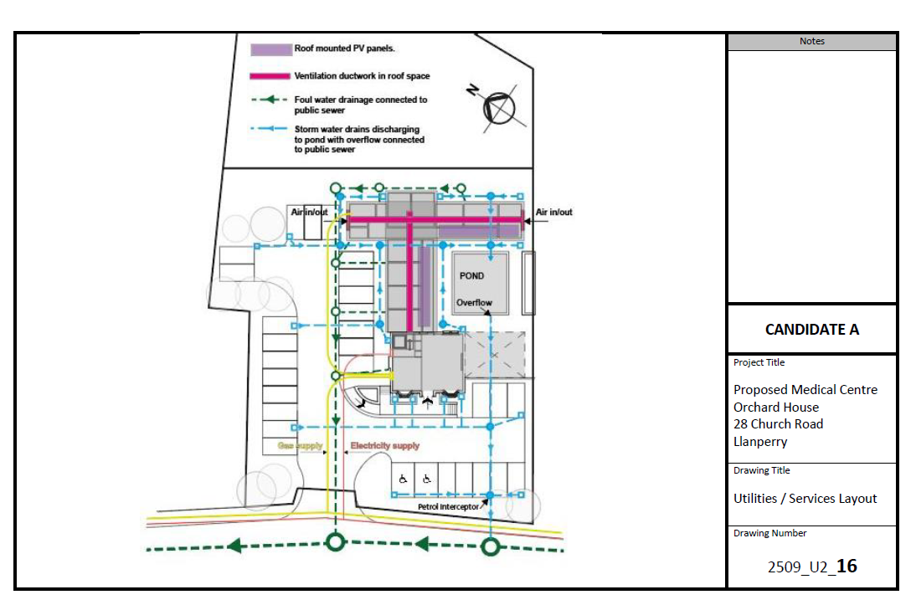
How do I tackle Part (c)
Notes:
This detailed site plan shows the utilities and services layout for the new medical centre.

Slide 38
How do I tackle Part (d)
2D and 3D virtual models are used to represent project information.
2D virtual modelling:
The initial model is likely to include diagrams and symbols to represent elements of the design including:
Architectural form and spatial arrangements
Outline structural and services design
Outline site and landscape design
3D virtual modelling
A complete 3D virtualisation developed from the 2D model to include objects with specifications and method statements attached
Notes:
Part (d) requires you to create 2D and 3D virtual models of your design.
For 2D virtual modelling your model is likely to include diagrams and symbols to represent elements of your design.
Your 3D model should be a visualisation developed from the 2D model to give a clear representation of the design for the medical centre.

Slide 39
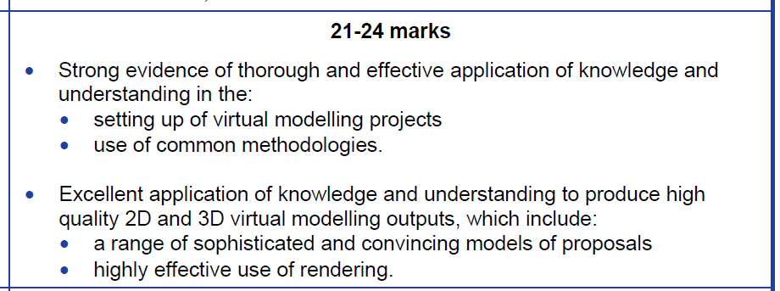
How do I tackle Part (d)
Notes:
To achieve high marks for Part (d) you will need to provide:
Strong evidence of thorough and effective application of knowledge and understanding in the:
Setting up of virtual modelling projects
Use of common methodologies
You need to demonstrate an excellent application of knowledge and understanding to produce high quality 2D and 3D virtual modelling outputs which will include:
A range of sophisticated and convincing models of proposals
Highly effective use of rendering

Slide 40
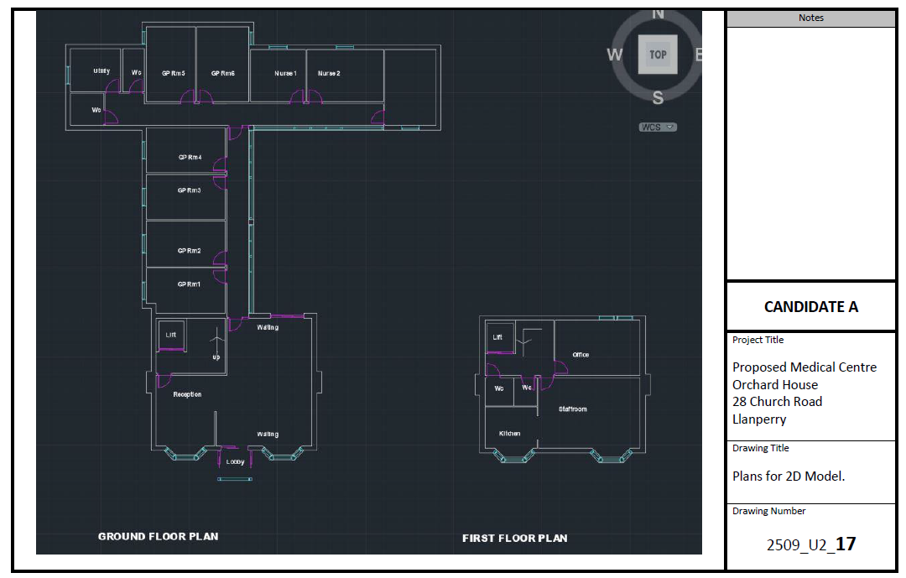
How do I tackle Part (d)
Notes:
The building plan has been developed as a 2D model.
It has separate layers for walls, windows and doors. Room labels have been added using text tools.
Note the orientation of the building as shown by the compass points in the top right hand corner of the drawing.
The plan shows the ground floor plan on the left with the single storey extension and the first floor of the house conversion on the right.

Slide 41
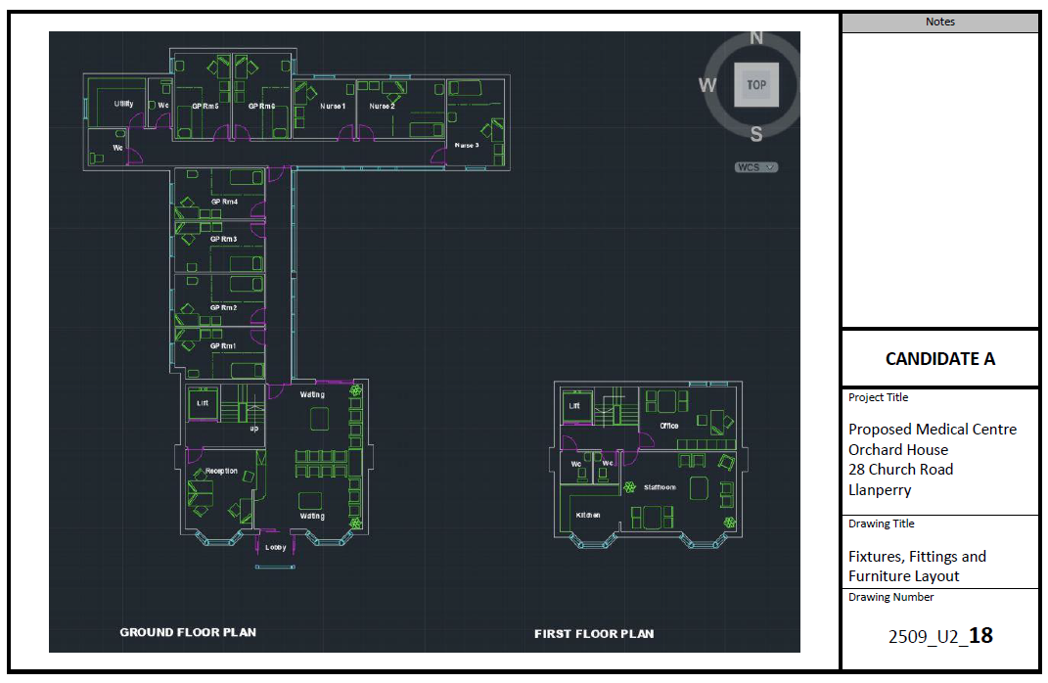
How do I tackle Part (d)
Notes:
An additional layer has been added to the drawing to show fixtures, fittings and furniture.

Slide 42
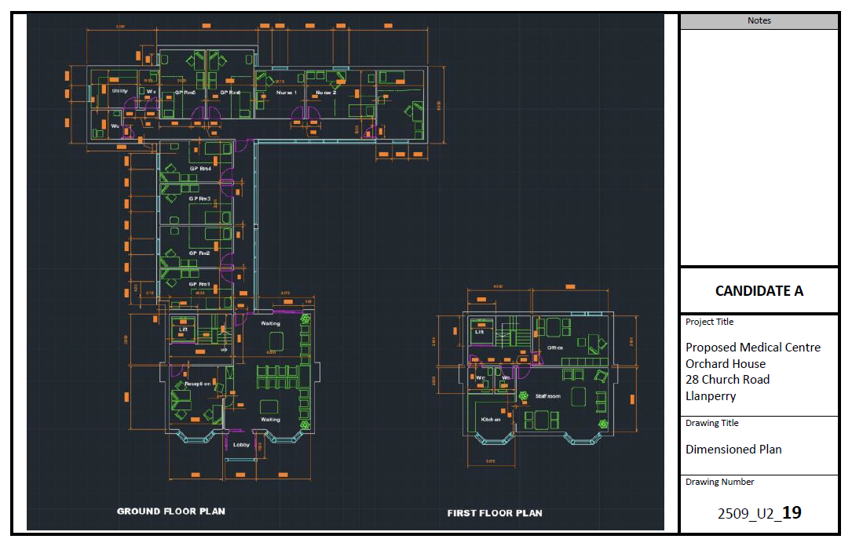
How do I tackle Part (d)
Notes:
A final layer has been added to the drawing to shown all necessary dimensions.

Slide 43
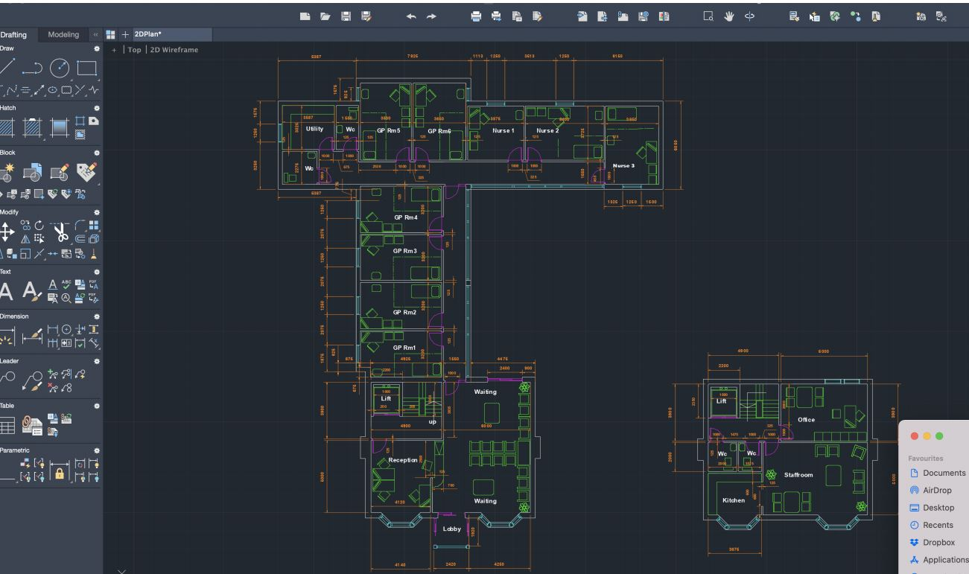
How do I tackle Part (d)
Notes:
The drawings were prepared using CAD software.

Slide 44
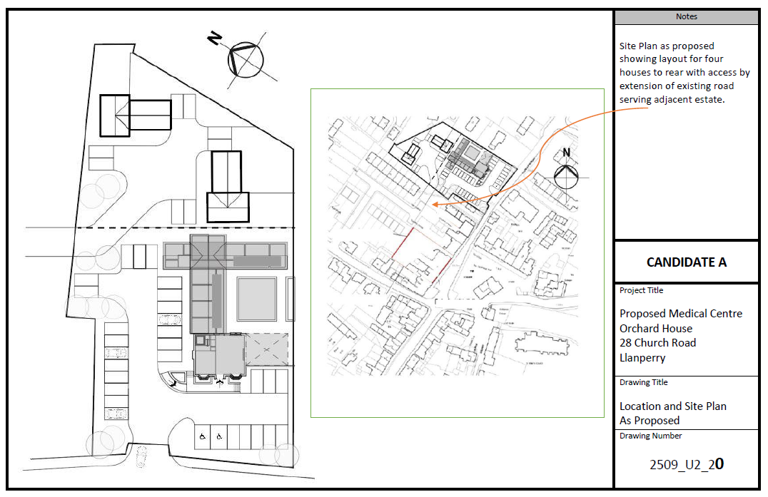
How do I tackle Part (d)
Notes:
The site plan has been developed using graphics software with a second layer to illustrate a proposal to develop the area of the site to the rear, which is not needed at this stage, as housing.
This limits the potential for the future extension of the medical centre and may not be thought appropriate at this stage but including the houses as part of the planning application for the medical centre allows the option to be considered, particularly if it helps with funding.

Slide 45
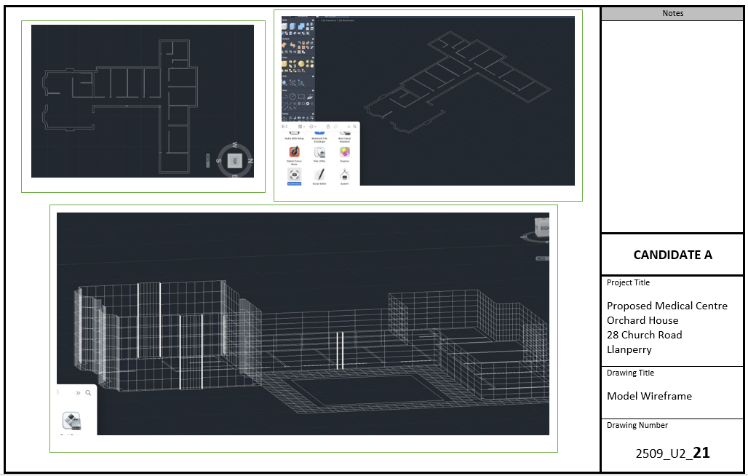
How do I tackle Part (d)
Notes:
A 3D version of the model was created by turning the basic 2D model (with all layers off, except the wall layout) into an isometric view and then extruding the walls vertically by the ground floor storey height to form a wire frame.

Slide 46
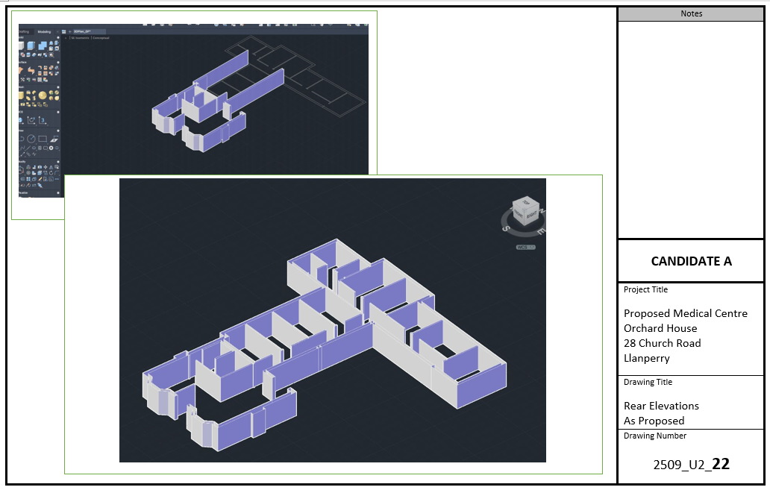
How do I tackle Part (d)
Notes:
The wire frame was then extended by raising the walls to form the first floor of the existing house, adding the outline geometry of the roof slopes and outlies of the external windows. The wire frame was then shaded and rotated 360⁰ to select a view for presentation. Note the compass in the lower drawing indicating the direction of the view.

Slide 47
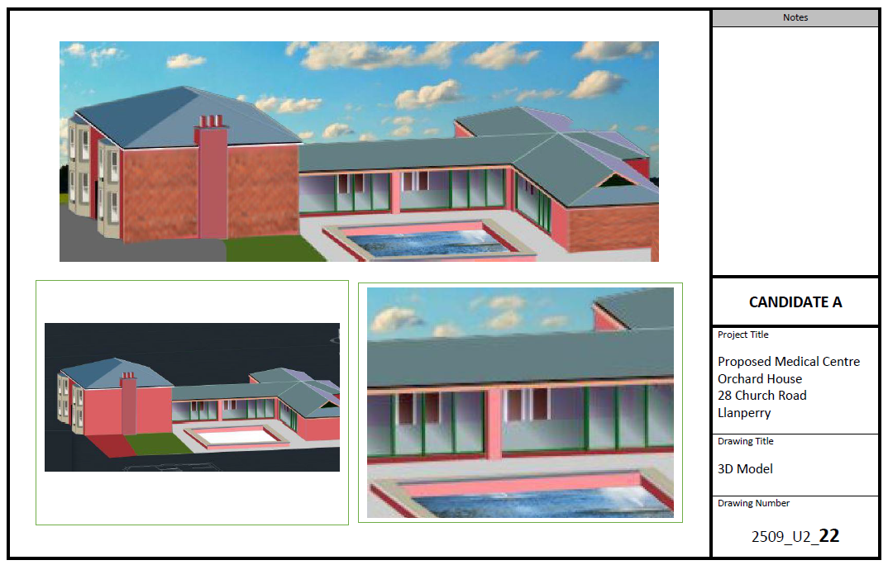
How do I tackle Part (d)
Notes:
The perspective view of the model was then imported into an image to provide a realistic setting.

Slide 48
How do I tackle Part (e)
Part (e) requires you to plan and evaluate construction methods and techniques, considering the building’s requirements, construction methods, sustainability and the site.
Notes:
You need to consider your work for Parts a, b, c and d, and explain your decisions against the bullet points on the slide.
The marking grid for this section of the work asks for:
Thorough and effective planning of the construction methods and techniques that you have chosen to use in the conversion of the existing building and the construction of the extension.
The next series of slides provide additional information that you should consider for each of the bullet points.

Slide 49
How do I tackle Part (e)
Notes:
Part (e) requires you to reflect on your work for the previous parts of the project and to justify choices you made in the planning of construction methods and techniques needed to produce the new medical centre.
To gain high marks you will need to provide strong evidence for at least five of the following points:
The primary and secondary requirements of the building
How the existing building is to be conserved and how the design of the extension reflects the heritage of the existing building
Contemporary construction methods for substructures and superstructures
Sustainable construction methods, techniques and considerations
Wate and waste water systems
Landscape and site design
You will need to provide strong evidence of perceptive and informed judgements about how the proposed construction methods and techniques could be further developed or improved to better meet the needs of the intended users of the new medical centre.

Slide 50
How do I tackle Part (e)
The primary and secondary requirements of the building.
You need to consider:
The primary requirements of this low rise building and the components to be used in the superstructure of the building.
The secondary requirements of the building: that common construction methods are to be used for the doors, windows, internal walls, staircases and internal finishes.
Notes:
The primary requirement for the new medical centre was to provide the level and type of accommodation required by the GPs and nurses.
The secondary requirements were to provide a welcoming entrance and relaxing waiting area for patients plus a suitable and safe working area for support staff.
You will need to consider how well your design satisfies that primary and secondary requirements for the new medical centre.

Slide 51
How do I tackle Part (e)
The requirements for working with buildings from different periods.
You need to consider how the existing building will be conserved and how the design of the extension reflects the heritage of the existing building.
In this case study the process involves the renovation – the process of improving or modernising an old, damaged or defective building.
Conservation skills and workmanship may involve working with materials such as wood, masonry, plasterwork, brickwork, ferrous and non-ferrous metals.
Notes:
You will need to consider how your design has met the importance of the existing house, placing it centrally both in terms of functionality and aesthetics.
Have the features of the main house been replicated in the extension?
Have materials been specified to match those used in the existing building?
What skills will be needed to achieve to conserve the main house and create the new extension in terms of the use of:
wood – use of traditional methods, craft skills, carving and materials to conserve, repair, or replace timbers that have decayed or been damaged.
masonry – refurbishment and repair, including fixing, carving, pointing, grouting, cleaning, stone sourcing and matching.
plasterwork – plaster matching and repair carried out in the correct material, including pure lime plasters and renders, solid run and fibrous work, free hand modelling, pattern and mould making, pargetting and other specialist finishes
brickwork – matching existing building materials, such as reproduction bricks and terracotta, and carrying out works including structural repair, anchoring, tying, pointing and grouting to ensure the integrity and aesthetic of the building is maintained.
ferrous and non-ferrous metals – including specialist leadwork in sheeting and flashings and replacement of cast iron, wrought iron and brass features.

Slide 52
How do I tackle Part (e)
Contemporary construction methods for substructures.
You will need to consider:
Structural foundations
Retaining walls
Basements
Ground bearing floors
Notes:
You will need to consider measures that will be needed to limit differential settlement of the existing building and the extension in the methods used to create substructures to support the extension and changes that may be required in the existing house such as the replacement of timber floors with new concrete slabs.
You may also need to consider the following, depending on your design and methods of construction:
structural foundations, designed to suit ground conditions and to transfer building loads to the supporting ground foundation:
strip footings and trench fill concrete foundations
raft and pad foundations
load bearing piles, friction piles and ground compactor piles.
ground beams and foundation walls
retaining walls, designed to resist pressure from retained ground and hydrostatic forces, including sheet piles, reinforced masonry/concrete walls, and gabions.
basements, below ground level accommodation constructed using tanked floor slab and retaining walls.
ground bearing floors – reinforced concrete slabs, with power float or screed finish and incorporating insulation and damp-proof membrane.

Slide 53
How do I tackle Part (d)
Contemporary construction methods for superstructures.
You will need to consider:
Structural walls
Frames
Traditional external cladding
Contemporary external cladding
Intermediate floors
Vertical circulation
roofs
Notes:
You will need to consider some of the following depending on your design and methods of construction:
structural walls – solid masonry and cavity constructions, dense concrete blocks, insulating blocks and reinforced concrete cast in situ
frames – skeleton frames and portal frames constructed in standard or laminated timber, steel and reinforced concrete, both precast and in situ
traditional external cladding – brick, stone, rendered blockwork, tile hanging, brick slips, timber boarding and profiled steel sheeting on secondary steel rails
contemporary external cladding – including structural insulated panels (SIPs), glazed curtain walling systems and composite cladding panels
intermediate floors – timber joist, beam and block, reinforced concrete both precast and in situ
vertical circulation – timber and concrete staircases, trimming of stairwells, construction of shafts for lifts, escalators and services within primary structures
roofs – traditional flat and pitched roof constructions, including roof joists, rafter and purlin, trussed rafter, secondary structures between frames, insulations and finishes
roofs – alternative structures, vaults, domes, shell constructions and green roofs.

Slide 54
How do I tackle Part (e)
Sustainable construction methods, techniques and considerations.
You will need to consider the main components of sustainable construction methods:
Reuse of materials or components in situ
Use of reclaimed materials or components
Use of materials manufactured with recycled content
Use of natural materials.
Use of materials less damaging to the environment.
Other sustainable considerations include:
Sourcing materials locally
Improving energy efficiency
Reduction of water usage
Notes:
It is important that the character and heritage features of the existing house are retained and that the design of the extension is in keeping with the existing building. Both to achieve this and to ensure that sustainable construction methods and techniques are used you will need to consider:
Reuse of materials or components in situ
Use of reclaimed materials or components
Use of materials manufactured with recycled content
Use of natural materials.
Use of materials less damaging to the environment.
Other sustainable considerations include:
Sourcing materials locally
Improving energy efficiency
Reduction of water usage

Slide 55
How do I tackle Part (e)
Water and waste water systems design and construction.
You need to consider different water and waste water systems:
Rainwater and waste water removal
Rainwater harvesting
Sustainable drainage systems (SuDS)
Landscape design – involves the composition, layout and specification of trees, other planting and hard landscaping feature.
Site design – involves the layout and specification of vehicular and pedestrian access routes.
Notes:
For the proposed new medical centre, the required water systems are not likely to extensive as they would be in, for example, a large factory. However the use of a SuDS approach to harvest rain water should reduce water use and avoid peak flows from entering the public system.

Slide 56
Any Questions?
Do you have any further questions about this NEA?
If so, write them on a post-it note to give to your teacher.

