Slide 1



GCE AS/A Level Built Environment
Pre-recorded Online Professional Learning
Preparing to teach and assess Unit 4
Notes:
Welcome to the GCE Built Environment Unit 4 Construction Practices

Slide 2
WJEC GCE Built Environment
Introduction to the new specification
The WJEC GCE AS and A level qualification in Built Environment advances learners’ understanding of the built environment, including the professional and technical roles within it and the range of buildings, assets and structures that comprise it.
Notes:
The WJEC GCE AS and A level qualification in Built Environment advances learners’ understanding of the built environment, including the professional and technical roles within it and the range of buildings, assets and structures that comprise it.

Slide 3
WJEC GCE Built Environment
Introduction to the new specification
The specification will enable learners to develop knowledge and understanding of:
• the stages and processes involved in the built environment life cycle
• the professional and technical roles involved in the built environment
• the built environment needs of clients and stakeholders
• Building Information Modelling (BIM) practices and the role of BIM software in all stages of the built environment life cycle
• sustainability issues and sustainable practices in the built environment life cycle
• the changing nature of practice in the built environment sector over time and during different periods.
Notes:
The specification will enable learners to develop knowledge and understanding of:
• the stages and processes involved in the built environment life cycle
• the professional and technical roles involved in the built environment
• the built environment needs of clients and stakeholders
• Building Information Modelling (BIM) practices and the role of BIM software in all stages of the built environment life cycle
• sustainability issues and sustainable practices in the built environment life cycle
• the changing nature of practice in the built environment sector over time and during different periods.

Slide 4
WJEC GCE Built Environment
Content and Assessment: Overview
Presented in four units
Sub-divided into topic areas
Amplification is provided for clarity of breadth and depth
Assessment by examination and non-exam assessment (NEA)
Requirement for the application of mathematical knowledge, skills and understanding
Notes:
The specification is presented in four units
Sub-divided into topic areas.
Amplification is provided for clarity of breadth and depth
Assessment is by examination and non-exam assessment (NEA)
There is a requirement for the application of mathematical knowledge, skills and understanding

Slide 5
WJEC GCE Built Environment
Assessment Structure
AS |  | Unit assessment
Unit 1 | Our built environment | Examination
Unit 2 | Design and planning practices | NEA
A Level |  | Unit assessment
Unit 3 | Materials, technologies and techniques | Examination
Unit 4 | Construction practices (choice of pathway) | NEA
Notes:
This table outlines the focus of all 4 Units for AS and A Level and how they are assessed.

Slide 6
Unit 4
Notes:
This presentation will now focus on preparing to teach Unit 4 of the specification, offering an overview of the content, assessment structure and resources available to support you.

Slide 7
Agenda
Introductions and Agenda
Overview of Unit 4
NEA Overview
  Pathway A – Building Survey
  Pathway B – Land Survey
  Common Content
Assessment Criteria Guidance
Exemplar Scenarios
WJEC resources
  Teachers
  Students
FAQs
Contacts
Notes:
The agenda for this presentation is shown here. We will begin with an overview of the unit 4 content and then spend some time looking at the requirements of the NEA. The NEA aspect to this presentation will include sources of key teaching and learning resources, suggested approaches to the NEA and the assessment criteria. We will also discuss the range of exemplar scenarios available that can be used with the programme of activities section of the NEA. The session will finish with where to find our resources, and a look at frequently asked questions

Slide 8
Unit 4 Overview
Unit 4 – Construction practices
Designed to build knowledge and understanding of, and skills in:
  Surveying (properties or land)
  Development concepts
  Management of construction, purchasing and finance
  Programmes of activities
Notes:
Unit 4 contributes 30% to the A Level qualification. It is designed so that candidates or centres can select the type of surveying practice that is more suited to them, this can either be through a building survey or a land survey. After the survey has been completed then all learners will develop design concepts and plan construction practices around the building or land surveyed.

Slide 9
Unit 4 Overview
Non-Exam Assessment (NEA)
Approximately 40 hours
Marks: 80 UMS: 150
To assess knowledge, understanding and skills in relation to surveying, concept designs and construction practices.
NEA task to remain the same for the lifetime of the specification
Notes:
The unit is to be assessed via an 80 mark NEA project intended to represent approximately 40 hours work.
The NEA task itself will remain the same for the lifetime of specification to allow for candidates to focus on an area of particular interest to them and the built environment in their locality

Slide 10
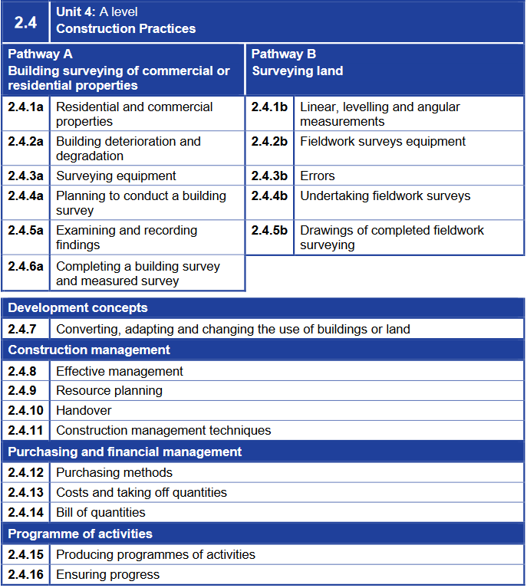
Unit 4 Overview
Pathway Options
Notes:
The two pathway options are shown on this slide with the subheadings. The first pathway is the building survey of a residential or a commercial property which will include planning, conducting and reporting on a survey that is carried out. The second pathway is a land survey which includes calculating levels and contours as well as reporting on the fieldwork conducted.

Slide 11
Unit 4 Overview
Common content to both pathways
Notes:
After completing one of the two pathways students will study additional unit 4 content which is common to both methods of survey. These are grouped in 4 sections as shown on the slide with a total of 10 sub-sections. These involve utilising the survey results to design a concept for the building or land surveyed and plan the construction activities involved as well as providing costings for budgets.

Slide 12
NEA Overview
Overview of Both NEA Briefs
A – Building OR Land Survey 25 Marks
B – Development Concepts 15 Marks
C – Construction Management 15 Marks
D – Purchasing and Financial Management 10 Marks
E – Programme of Activities 15 Marks
Notes:
The NEA Brief for both pathways is broken down into 5 tasks.
Task A is worth 25 marks and is the survey part of the NEA, this is the one that enables the differentiation between land and building surveys.
Task B is worth 15 marks, this is the development concepts part of the brief which enables students to utilise their knowledge and skills learnt in previous units to create designs based on either their land or building survey.
Task C is worth 15 marks and is about the management of construction project details, such as resource planning and handover.
Task D is work 10 marks, it covers the financial aspect of the project, including bill of quantities
Task E is worth 15 marks, it covers the construction programme and sequence of work

Slide 13
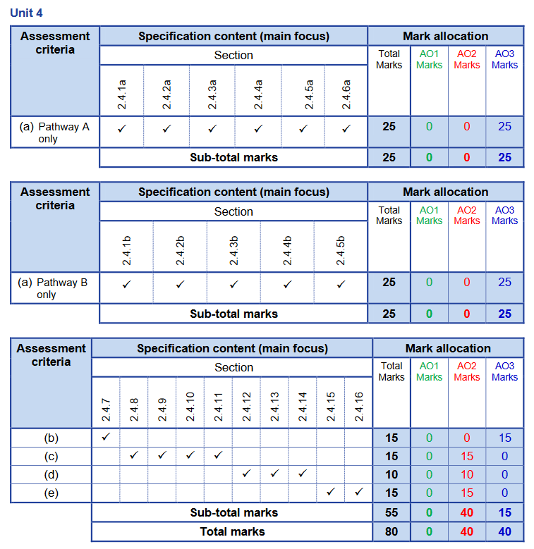
Pathway A – Task A
Plan and carry out a building survey and produce a report which shows evidence of your planning, including consideration of relevant health and safety issues, understanding of equipment and principles involved in inspecting a property, and reporting findings in an appropriate way. The survey must include:
  Details of the type and style of property and the associated maintenance implications
  Identification of external and internal defects, along with suitable means of repair or renewal
Notes:
Pathway A, Task a) is for candidates to plan and carry out the building survey which will enable them to produce a report evidencing their work. The report generated will cover all specification connect for 2.4.1a to 2.4.6a as shown in the graphic on this slide.

Slide 14
Pathway A – Building Selection
The building should, as a minimum, be:
  A low-rise building with a footprint area of at least 75m²
  Able to offer opportunities for identifying maintenance implications for internal and external defects
  Located in Wales
Potential Opportunities
  A small school building
  A local office building
  A residential property
  A community hall
Notes:
Selecting the building for pathway A needs to be carefully considered so that students are able to demonstrate all key skills within the specification and mark scheme. The building should have a minimum foot print of 75m” and be located in Wales. The type of building selected needs to offer opportunities for candidates to comment and report on internal and external defects as well as the ongoing maintenance impact of these.
Potential opportunities could be a small school building on the school site, a local office building, a residential property or a community hall.

Slide 15
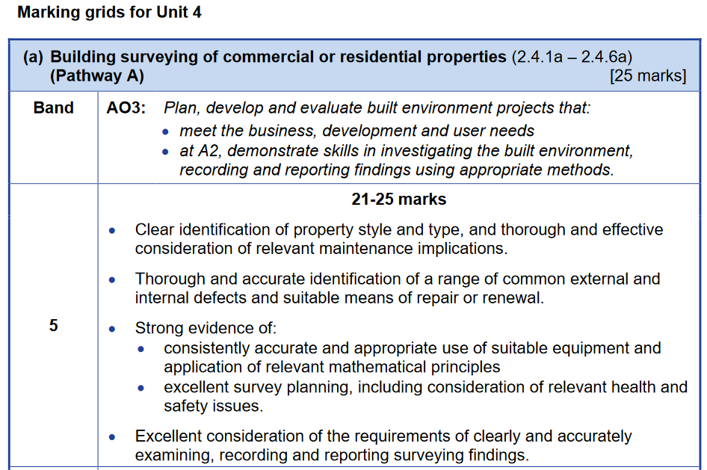
Pathway A – Assessment Grid
Notes:
Task A, Pathway A, covers 6 areas of the specification and these should be evidenced through a report generated following the survey. The report should be a professionally written document aimed at the owner of the building or the potential client looking to acquire the building. The marking grid shown here for the top band demonstrates the expectations of the survey report. A good teaching and student resource is the RICS website and their survey guides, there are templates available and information on how to conduct a survey and how to write a professional report. The RICS is a professional body that have set standards for surveys, it is recommended that students follow these, where possible, as they are based on experience and are industry standard recommendations.

Slide 16
Pathway A – 2.4.1a
In this section learners will gain knowledge and understanding of:
  The different types of residential and commercial properties in the built environment
  The architectural styles (and periods) in which commercial and residential properties are/have been built
  The impact of style and type on future maintenance
NEA Learner Expectation
  Candidates fully explain the building type surveyed, its history with architectural style/period it was built
  Candidates identify materials used and potential impact on maintenance required
Notes:
In specification area 2.4.1a, the learners are expected to differentiate between building types within the residential and commercial categories, for example a retail space is a commercial property. Also, architectural styles and periods are covered as they have an impact on a building and its potential maintenance implications, and the impact those may have on the building. The age and type of property impact the materials used with each material having its own lifespan and maintenance considerations.
It is expected that learners demonstrate this knowledge through the “About the property” section of the report. Material information may also be presented in the “outside” and “inside” sections of the report

Slide 17
Pathway A – 2.4.2a
In this section learners will gain knowledge and understanding of building degradation with respect to:
  Common defects to external envelopes of residential properties and suitable means of repair and renewal
  Common internal defects of residential properties and suitable means of repair or renewal
NEA Learner Expectation
  Each element of the building is photographed
  Ratings are given to each element following RICS guidance
  A description of each element along with an opinion on the condition of that element
  Remedial work advice is provided where required
Notes:
In specification area 2.4.2a, the learners are expected to identify common defects to both the external and internal areas of the property. Defects that have been identified and explained through the report should also have a suggestion for remedial work to correct the defect.
It is expected that learners demonstrate this knowledge through the “Outside the property” and “Inside the property” section of the report.

Slide 18
Pathway A – 2.4.3a
In this section learners will gain knowledge and understanding of surveying equipment with respect to:
  Manual and electronic equipment
  Relevant mathematical principles involved in using this equipment
NEA Learner Expectation
  The survey is conducted using equipment from the list
    It is not expected that learners will have access to all the equipment on the list but they are required to be aware of it
  The report includes a section on what equipment was used and how it was used to accurately record data
  Drawings of the property are included in the report which demonstrate room area and volume calculation.
Notes:
In specification area 2.4.3a, the learners are expected to be aware of the different types of surveying equipment that is used and the purpose of each one. The list of equipment is included in the specification.
It is expected that learners use the equipment list as a guide to the items they may use in their survey, the report should contain a section on what equipment was used during survey providing candidates further opportunity to justify their use. They are not expected to have access to all of the equipment and marks will not be limited if specialist equipment is not used, such as a moisture meter. Learners can demonstrate their awareness of this through the not inspected part of the report and comment on the need for using further equipment to complete additional investigative works.
The importance of using equipment is accurate dimensions and getting the floor plans and elevations correct, this will enable students to demonstrate their use of survey equipment and the mathematical skills required for 2.4.3a (b). This will be evidenced through the floor plans which are generally in the appendices of a survey report.

Slide 19
Pathway A – 2.4.4a
In this section learners will gain knowledge and understanding of the following aspects of planning a building survey:
  Sequence of surveying activities
  Health and safety planning
  Arranging access to relevant areas
NEA Learner Expectation
  Candidates explain the survey activity to their clients through the report
  Risks are assessed with mitigation steps in place, including the limitations identified
  Survey report will demonstrate the access arrangements
Notes:
In specification area 2.4.4a, the learners are expected to follow surveying convention when planning and conducting the survey. This includes communicating with the property owner and occupier and an awareness of health and safety with risks identified clearly.
Candidate will be able to demonstrate their sequencing of survey activities and health and safety planning in the “About the Inspection” and the “Description of Survey” part of the report. This is the explanation to the client about the level of detail the inspection will go in to and any identified health and safety concerns. There will be limitations to what students can inspect for both practicality reasons and health and safety, it is expected that candidates recognise this in their reports, this can either be through the “description of survey” section or through the limitation headings under the “outside the property” and “inside the property” headings.

Slide 20
Pathway A – 2.4.5a
In this section learners will gain knowledge and understanding of the following aspects relating to examining and recording findings of a building survey:
  State of repair of building elements and features
  Measuring the relevant dimensions related to findings
  Capturing the appropriate and relevant evidence
NEA Learner Expectation
  Condition ratings used for each building element
  Evidence captured and included in the report to support findings
  Measurements used to draw floor plans, elevations and cross sections
Notes:
In specification area 2.4.5a, the learners are expected to conduct the survey. This includes taking measurements of each room, including floor to ceiling height, taking photos of each element, particularly if a defect is found and recording the state of repair of each building element
Candidate will be able to demonstrate their inspection notes through their report and their use of the condition rating system used by the RICS. This will be evidenced in the overall assessment section as well as the outside, inside and services sections, these sections will also include the capturing of findings, for example the use of photos. The measurements of the building will be used by the candidate to draw the floor plans, elevations and cross sections.

Slide 21
Pathway A – 2.4.6a
In this section learners will gain knowledge and understanding of the following aspects of completing a building survey and measured survey:
  The requirement of building survey and measured survey reports
  Producing scaled survey drawings
NEA Learner Expectation
  A survey report
  Scaled drawings
Notes:
In specification area 2.4.6a, the learners are expected to write the survey report and draw the plans of the property that was inspected. The specification lists the requirements for the contents of the report as well as the scaled drawing requirements.

Slide 22
Pathway B – Task A
Carry out a land survey and produce a report which shows evidence of your understanding of survey frameworks, the use of fieldwork surveys equipment, relevant mathematical principles, identifying and rectifying errors and reporting findings in an appropriate way. The survey must include:
  Linear, levelling and angular measurements from the fieldwork surveys
  Drawings of the completed fieldwork surveys, using appropriate conventions and notation
Notes:
Pathway B, Task a) is for candidates to carry out a land survey which will enable them to produce a report evidencing their work. The report generated will cover all specification connect for 2.4.1b to 2.4.5b as shown in the graphic on this slide.

Slide 23
Pathway B
The land should, as a minimum, be:
  Around 2500m², although features is more important than size
  Able to offer opportunities for measurement of linear, levelling and angular data
  Located in Wales
Potential Opportunities
  School field/playing area
  Local sports grounds
  Woodlands
  An area of park land
Notes:
Selecting the land for pathway B needs to be carefully considered so that students are able to demonstrate all key skills within the specification and mark scheme. The land should be around 2500m2, however features such as a sloping site or uneven ground are of more importance that strict size measurements. The land should enable the candidate to access all mark bands available and it needs to be located in Wales.
Potential opportunities could be school fields or playing areas within the school site, local sports grounds, woodland areas or an area of park land. It is recommended that the land be part of an existing property or adjacent a road for access as this will make it easier for NEA Tasks B to E to be completed

Slide 24
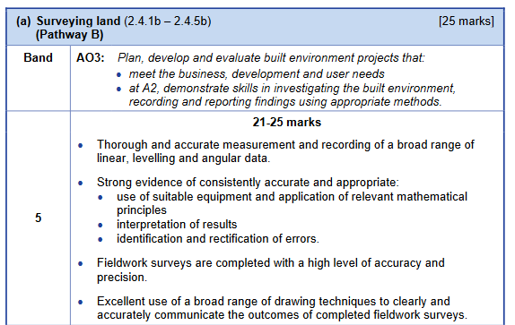
Pathway B – Assessment Grid
Notes:
Task A, Pathway B, covers 5 areas of the specification and these should be evidenced through a report generated following the survey and the associated drawings. The report should a professionally written document aimed at the owner of the land or the potential client looking to acquire the land. The marking grid shown here for the top band demonstrates the expectations of the survey outcomes. A good teaching and student resource is the RICS website and their measured and land survey guides, there are templates available and information on how to conduct a survey and how to write a professional report.

Slide 25
Pathway B – 2.4.1b
In this section learners will gain knowledge and understanding of the following:
  Purpose and development of survey frameworks
  Measuring horizontal and sloped distances
  Traverse types in surveying
  The purposes, principles and methods of levelling
  The mathematical principles used in conducting the critical content above
NEA Learner Expectation
  Candidates conduct a land survey and create a report with key decisions and factors explained
  Candidates create drawing based on the survey results
Notes:
In specification area 2.4.1b, the learners are expected to understand the land surveying theories and apply them through a detailed survey of a piece of land. This element includes the mathematics involved in calculating height differences.
It is expected that learners demonstrate this knowledge through the report and the drawings produced

Slide 26
Pathway B – 2.4.2b
In this section learners will gain knowledge and understanding of the use of fieldwork surveys equipment:
  Manual, electronic and technological equipment
  Interpreting the results of fieldwork surveys
  The mathematical principles required when using the above equipment
NEA Learner Expectation
  Candidates use equipment in their survey
  Candidates create table of collated results
  Candidates create drawings demonstrating the levels on site
Notes:
In specification area 2.4.2b, the learners are expected to understand elements of fieldwork that include using equipment to collect data, interpretation of their results and mathematic principles that allow for accurate results of changes in levels to be reported on
It is expected that learners demonstrate this knowledge through the results of their survey and the drawings that are produced from those results

Slide 27
Pathway B – 2.4.3b
In this section learners will gain knowledge and understanding of identifying, understanding and rectifying:
  Human/gross errors
  Systematic equipment errors
  Random errors
NEA Learner Expectation
  Candidates should be able to identify errors and make corrections as part of their survey and the report
Notes:
In specification area 2.4.3b, the learners are expected to understand the different types of errors and how to account for them in the report and drawings that result from the survey.
It is expected that learners demonstrate this knowledge through the explanation of any anomalies on their results within their survey

Slide 28
Pathway B – 2.4.4b
In this section learners will gain knowledge and understanding of aspects of fieldwork surveys:
  Linear Surveys
  Levelling Surveys
  Reading and recording angles on closed traverse
  The mathematical principles required when carrying out the above tasks
NEA Learner Expectation
  Candidates should be able to explain survey procedures in the report
  The recorded data and resulting calculations should be presented in the report
Notes:
In specification area 2.4.4b, the learners are expected to understand the different aspects of fieldwork surveys and the mathematical principles which underpin land surveys.
It is expected that learners demonstrate this knowledge through the report and mathematical calculations should be included either through the main body of the report or the appendices

Slide 29
Pathway B – 2.4.5b
In this section learners will gain knowledge and understanding of the conventions of drawings of fieldwork surveys:
  The conventions and notation required in developing drawings
  Plotting survey lines accurately
  Cross sections and long sections
NEA Learner Expectation
  Candidates should use their results to produce drawings as listed in the specification
Notes:
In specification area 2.4.5b, the learners are expected to understand how to use the fieldwork survey results to create drawings representing the land surveyed

Slide 30
NEA Task B to E – Both Pathways
Overview of Task B to E
B – Development Concepts
C – Construction Management
D – Purchasing and Financial Management
E – Programme of Activities
Notes:
On both NEA pathways, tasks B to E are the same and are based on the results and report from task A. The following slides breakdown the tasks with the links to the specification areas as shown here.

Slide 31
NEA – Task B
Produce development concepts for how the building or land could be converted, adapted or its use changed, taking into account:
  Alternative uses for the building or land
  Factors, including feasibility, influencing the conversion, adaption or change of use
  Relevant processes and legislative requirements
  Suitable materials to meet development aims and user needs
Notes:
Task B) is for candidates to develop concept drawings and a feasibility report based on a number of alternative use suggestions.

Slide 32
NEA Task B – 2.4.7
In this section learners will gain knowledge and understanding of the processes involved in the conversion of buildings and land:
  Investigating and evaluating alternative uses for buildings or development of land
  The factors influencing the conversion, adaptation or change of use of building or development of land
  The processes and legislative requirements involved
  Feasibility reporting
  Working drawing for proposed ideas
  Planning the use of materials that will meet development aims and user needs including building safety requirements
NEA Learner Expectation
  Feasibility Survey with alternative use suggestions
Notes:
In specification area 2.4.7, the learners are expected to evaluate the current use of the building and land and suggest alternatives through a feasibility report. 2 or 3 alternatives should be critically analysed with working drawings produced and relevant legislation, such as the building regulations and planning consent considered. The concepts should also discuss material use in relation to aesthetics and sustainability linking a knowledge or BREEAM and the standards required for an excellent rating. It is expected that the feasibility survey include a conclusion as to whether the existing use, or an alternative would be the most beneficial to the client. The decision at the end of the feasibility study would enable the student to continue with the suggested use for the next task of the NEA

Slide 33
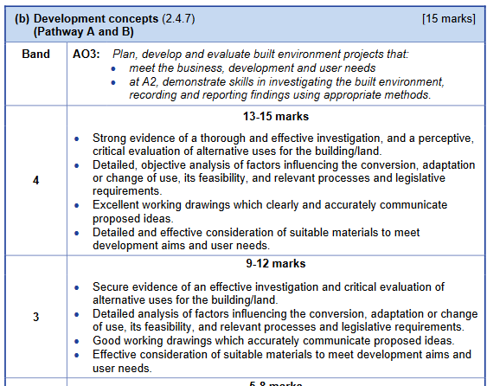
NEA Task B – Mark Scheme
Notes:
The mark scheme for task B has 4 bands, the top two bands are shown here. To access the top mark bands it is suggested that candidates not only focus on the designs they create but the business purpose behind it as well as whether it's likely to get permission to be built.

Slide 34
NEA – Task C
Provide appropriate details related to construction management, including:
  How the project could be managed effectively
  Resource planning
  Handover
  Construction management techniques
Notes:
Task C) requires candidates to provide details of the construction and project management of the project to be reported on, this develops candidates knowledge on how to take a concept design and put in place procedures that will enable delivery of the completed project effectively. This task covers 4 areas of the specification and is worth 15 marks

Slide 35
NEA Task C – 2.4.8
In this section learners will gain knowledge and understanding of :
  Management and leadership styles
  Project management teams; roles, responsibilities, interdependencies and decision making roles
  Uses of Building Information Management (BIM) technologies
  Contingency planning
NEA Learner Expectation
  Report including project management section
Notes:
In specification area 2.4.8, the learners are expected to explain how the project will be managed, including management styles used and the different roles of the project management team, including their responsibilities. This also includes areas of BIM and contingency planning at the project management level.

Slide 36
NEA Task C – 2.4.9
In this section learners will gain knowledge and understanding of :
  Cash flow
  Ordering and scheduling material deliveries
  Human resource requirements, including health and safety needs
  Plant resource needs
  Site storage
  Supervision of workforce and quality assurance of output
NEA Learner Expectation
  Report including resource planning
Notes:
In specification area 2.4.9, the learners are expected to explain how the project will be resourced. This includes cashflow, human resourcing and materials sourcing.

Slide 37
NEA Task C – 2.4.10
In this section learners will gain knowledge and understanding of :
  RIBA Plan of Work Stages 6 to 7
  Commissioning building services installations
  Health and safety files
  Handover period
  The completion period and client feedback
NEA Learner Expectation
  Health and safety file exert
  Handover strategy
Notes:
In specification area 2.4.10, the learners are expected to explain how the project will be handed over on completion and the other crucial end of project factors. These are generally pre-planned for before construction begins so that the communication is kept open between the project team and the client. A good teaching resource for this is the RIBA Plan of Work and the guide that is available, it explains each section and the responsibility of each person involved at hand over.
Candidates should prepare information for the handover file based on their prior survey and designs for the project. They should also develop a handover strategy which is included in the construction management report

Slide 38
NEA Task C – 2.4.11
In this section learners will gain knowledge and understanding of :
  Master programmes such as lines of balance, Gantt charts and critical path analyses
  Risk assessments and method statements
  Quality assurance systems and testing methods
  Management of human resources and subcontractors
NEA Learner Expectation
  Programme(s) for construction work
  Exemplar RAMS applicable to the project
  Quality assurance strategy
Notes:
In specification area 2.4.11, the learners focus on construction management techniques which involve the planning of certain aspects of site work, including programmes of activities. There are a range of methods by which candidates can produced evidence for this. Different program tools could be used to support candidates developing this element along with viewing parts of the CDM regulations for support on risk assessments and method statements.

Slide 39
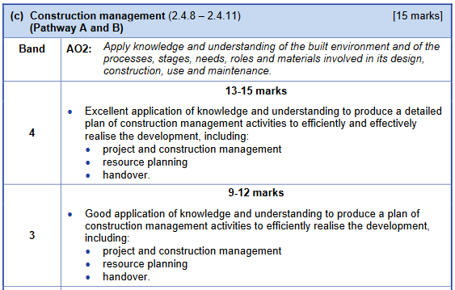
NEA Task C – Mark Scheme
Notes:
The mark scheme for task C has 4 bands, the top two bands are shown here. To access the top mark bands it is suggested that candidates write a construction management plan for the context as written in task A and B. As this is a real-life place, the candidates will be more likely able to visualise how the project they designed in task B could be built. The plan itself will demonstrate students knowledge and understanding as well as their ability to apply it to a given situation, in this case a building or piece of land they have selected and would have good knowledge of prior to the assignment.

Slide 40
NEA – Task D
Provide appropriate details related to purchasing and financial management, including:
  Purchasing methods
  Costs and taking off quantities
  Bill of quantities
Notes:
Task D) is for candidates to provide financial information of a project and how it is taken from the concepts in task B through to financial planning and costing methods used in industry. This task covers 3 areas of the specification and is worth 10 marks

Slide 41
NEA Task D – 2.4.12
In this section learners will gain knowledge and understanding of :
  Suitable and relevant suppliers
  Seeking and evaluating quotations for materials and sub-contractors
  Evaluating and managing delivery lead times and managing just-in-time delivery models
  Purchasing locally, sustainably, ethically and in a socially responsible way
  Fixed, single and serial contracts
  Using purchase orders
NEA Learner Expectation
  Purchasing methods plan
Notes:
In specification area 2.4.12, the learners focus on planning for purchasing for the construction project, this includes the use of sub-contractors and tender documentation used. Candidates can demonstrate their knowledge of this section of the specification through writing a plan for purchasing methods

Slide 42
NEA Task D – 2.4.13
In this section learners will gain knowledge and understanding of costs:
  Materials
  Labour
  Cost value comparisons
  Management costs/cost savings
NEA Learner Expectation
  Take-off schedule
  Cost value strategy
Notes:
In specification area 2.4.13, candidates learn about how work is priced for both the material and the labour. Candidates can demonstrate this knowledge by completing a take-off from their designs in task B.
For the cost element of this specification area, candidates can create a strategy which explains the link between quality and cost with a focus on getting value for the client

Slide 43
NEA Task D – 2.4.14
In this section learners will gain knowledge and understanding of:
  Preliminary Items
  Prices
  Units and Dimensions
  New Rules of Measurement (NRM)
NEA Learner Expectation
  A Bill of Quantities
Notes:
In specification area 2.4.14, candidates can use their take-off list from the previous specification section to write a bill of quantities for the project, this could be a partial bill of quantities for specific elements dependent on the nature of the project. By creating a bill of quantities candidates will be able to follow the New rules of measurement hence demonstrating their knowledge and understanding.

Slide 44
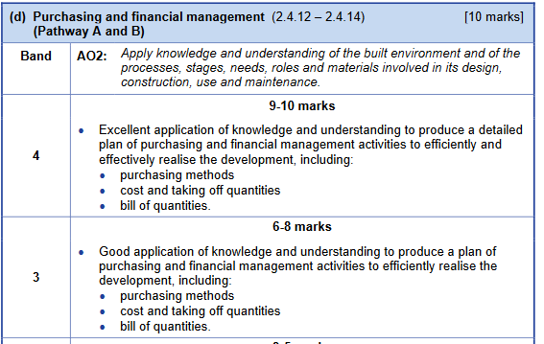
NEA Task D – Mark Scheme
Notes:
The mark scheme for task D has 4 bands, the top two bands are shown here. To access the top mark bands it is suggested that candidates use their drawings from Task A and Task B to complete a take-off list and write a Bill of Quantities. This could be accompanied by a purchasing report which details for the client the purchasing methods that would be the most beneficial to their particular context.

Slide 45
NEA – Task E
Produce an appropriate programme of activities, which includes details on how progress can be ensured
Notes:
Task D) is for candidates to provide site management details on how the site would be managed effectively and how activities on site would be programmed, including any contingencies needed. This task covers 2 areas of the specification and is worth 15 marks

Slide 46
NEA Task E – 2.4.15
In this section learners will gain knowledge and understanding of:
  Selecting the most appropriate master programme
  RAMS
  Site layout
  Site storage
  Visual monitoring tools
  Site traffic management plans
  Waste management plans
NEA Learner Expectation
  Programme of activities
Notes:
In specification area 2.4.15, candidates will be able to use their design from task B and their prior work in C and D to create a site management programme of activities. This should include the items listed in the specification section, including a site layout, traffic management plan and waste management plan.

Slide 47
NEA Task E – 2.4.16
In this section learners will gain knowledge and understanding of:
  The causes of delays and the impacts they have on projects
  Overcoming delays
  Facilitating ahead of schedule progress
  Adopting and adapting contingency plan
NEA Learner Expectation
  Programme of activities
Notes:
In specification area 2.4.16, candidates can build their programme of activities around the potential delays that could occur and create a plan which is explicit in handling unknown factors

Slide 48
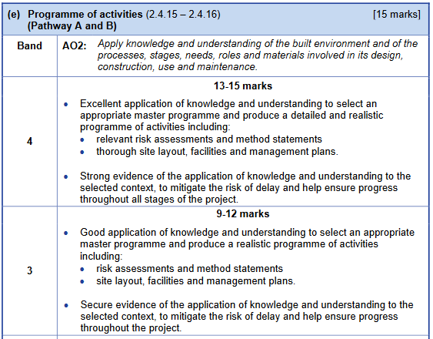
NEA Task E – Mark Scheme
Notes:
The mark scheme for task E has 4 bands, the top two bands are shown here. To access the top mark bands it is suggested that students use the information from their prior reports and their drawings to create a realistic site management strategy. Descriptions of each category are not required as candidates can demonstrate their knowledge through writing the programme activity.

Slide 49
NEA Assessment Criteria
Notes:
The assessment criteria has been shown throughout this presentation for each of the NEA tasks set. The image in this slide shows the mapping of the specification to the assignment tasks.
The mark scheme is based on each task and contains an element from each specification point, it is important to note the two options for task A give equal opportunity for the marks with 5 mark bands each and a total of 25 marks available. Both pathways give equal opportunity for students to access the remaining tasks within the NEA.
When marking the NEA, best fit should be used to place candidates within the correct band and justification given as to why they are at the top, middle or bottom of that band.

Slide 50
Exemplar Scenarios
The available scenarios for 2.4.15 practice
New build residential estate in open fields
A rear extension to a mid-terrace dwelling house
An infill extension to a hospital
A 4 storey office building in a city centre with basement and car park
Notes:
For the site management section, specification area 2.4.15, exemplar scenarios are available for candidates to practice their response to a site. These give a range of different opportunities for candidates to tackle a range of challenges that site management and project management teams face within the built environment.
For example the new build residential housing estate is on greenfield land with direct access to a B road, however the B road is on a curve and visibility can be a challenge. A different challenge is posed by scenario C which is a rear extension to a hospital which has staff, patients and visitors on site 24 hours so therefore requires no loss of parking or blocking of roads on the site. It would also require dust and noise to be kept to a minimum at all times.

Slide 51
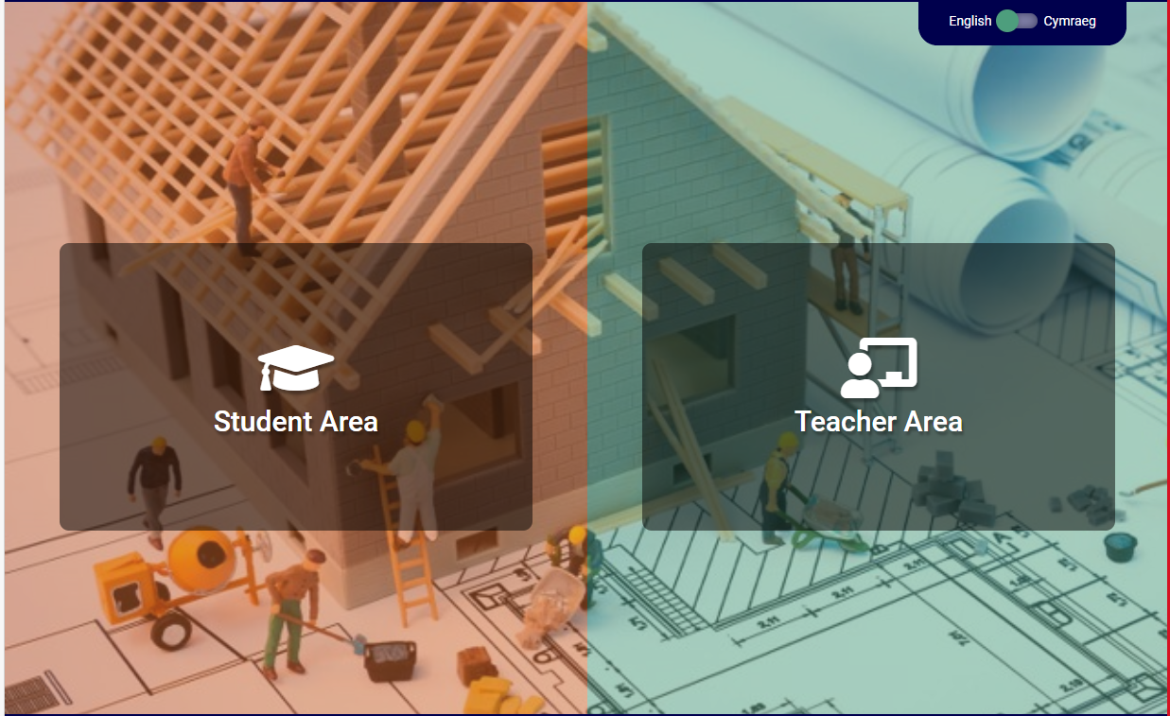
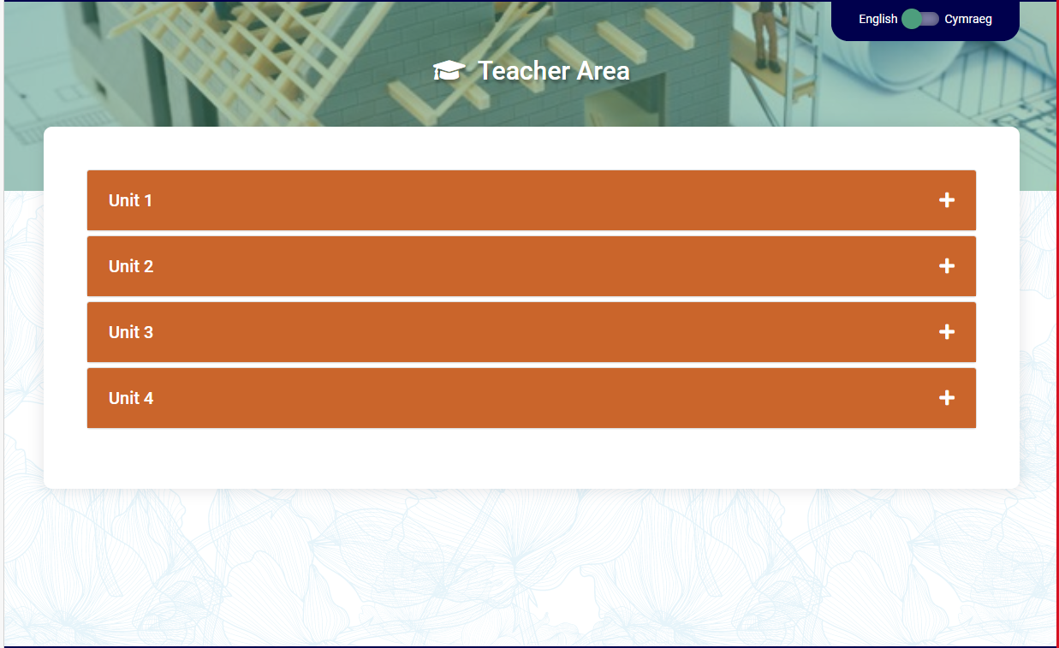

WJEC Resources
There are a wide range of resources available for teachers and students on the WJEC website.
Notes:
This slide contains a link to WJEC resources for this qualification.
There are a wide range of resources available for teachers and students on the WJEC website. Currently resources are available for Unit 1 and 2. Resources for the other units will be provided to coincide with future workshops.

Slide 52
Frequently Asked Questions
This list is not exhaustive
What equipment is needed for a building survey? | Essential Paper/Pen/Pencil Camera – phone or otherwise Voice Recorder (App on phone) Tape measure Spirit Level Desirable Laser measuring device Binoculars Moisture Meter
What equipment is needed for a land survey? | Essential Paper/Pen/Pencil Camera – phone or otherwise Voice Recorder (App on phone) Tape measure Spirit Level Desirable Theodolite Staff
Notes:
These are the two most commonly asked questions, these relate to equipment. There is no requirement for candidates to have access to expensive specialist equipment.

Slide 53


WJEC Contacts
Subject Officer
Allan Perry
construction@wjec.co.uk
Subject Support
construction@wjec.co.uk
@wjec_cbac | @cbac_wjec
cbac.co.uk | wjec.co.uk
Notes:
If you have any further questions please do get in touch.
Thank you

