Slide 1
WJEC GCE Built Environment
Workshop 3: July 2021
Unit 2: Design and Planning Practices
Notes:
Welcome to the GCE Built Environment workshop for unit 2. Design and Planning Practices.

Slide 2
Agenda
Introductions ( 5 minutes)
Agenda for workshop ( 5 minutes)
Overview of Unit 2 (30 minutes)
NEA Walk Through (45 minutes) (85 minutes)
Break (10 minutes) (10 minutes)
Virtual Modelling (15 minutes)
Marking exercise (30 minutes)
Review of marking (10 minutes)
WJEC resources (15 minutes)
Teachers
Students
Questions and Answers (10 minutes)
Contacts and the next workshop ( 5 minutes)
Notes:
The agenda for the session gives an indication of the timings for the afternoon. These are flexible and may vary depending on the issues raised and questions asked as we move through the items. We will begin with an overview of the unit 2 content and then spend some time looking at the requirements of the NEA. After a short break we will consider the modelling requirements of the unit and follow this with a practice marking exercise. The workshop will finish with a look at our resources, and dealing with any questions.

Slide 3
What Unit 2 includes
Unit 2 – Design and planning practices
Is designed to build knowledge and understanding of, and skills in:
The design process and factors that influence the design process.
Developing initial project briefs.
Producing designs and virtual modelling
Planning construction methods and techniques.
Notes:
Unit 2 contributes 50% to the AS qualification and 20% to the A level qualification. It covers the pre-construction phases of the building life cycle.

Slide 4
The content of Unit 2
2.2.1 Stages involved in the design process.
2.2.2 Factors, including legislation and government policy, that influence the design process for buildings and assets.
2.2.3 Initial project briefs.
2.2.4 Producing designs
2.2.5 Virtual modelling design
2.2.6 Planning construction methods and techniques.
Notes:
The content of Unit 2 is divided into six sections as shown on the slide. These move through the design stages of a project from identifying influencing factors and constraints, through creating the project brief and producing initial designs to virtual modelling and construction planning.
.

Slide 5
Assessment
Non-Exam Assessment (NEA)
Approximately 30 hours, 80 marks: 100UMS.
To assess knowledge, understanding and skills in relation to design and planning practices.
WJEC will set a contextualized brief each examination series.
The response to the brief will be a practical project involving planning, practical and evaluative activities.
Notes:
The unit is to be assessed via an 80 mark NEA project intended to represent approximately 30 hours work. The project will require candidates to :
Apply knowledge and understanding of the construction methods covered in Unit 1
Work through the pre-construction stages of the RIBA plan of work.
Research and report on factors that may influence their design of the building required.
Develop a project brief.
Produce initial design ideas and design drawings.
Create 2D and 3D virtual models of their designs.
Review their design in relation to the Client’s requirements and criteria listed in the NEA brief.

Slide 6
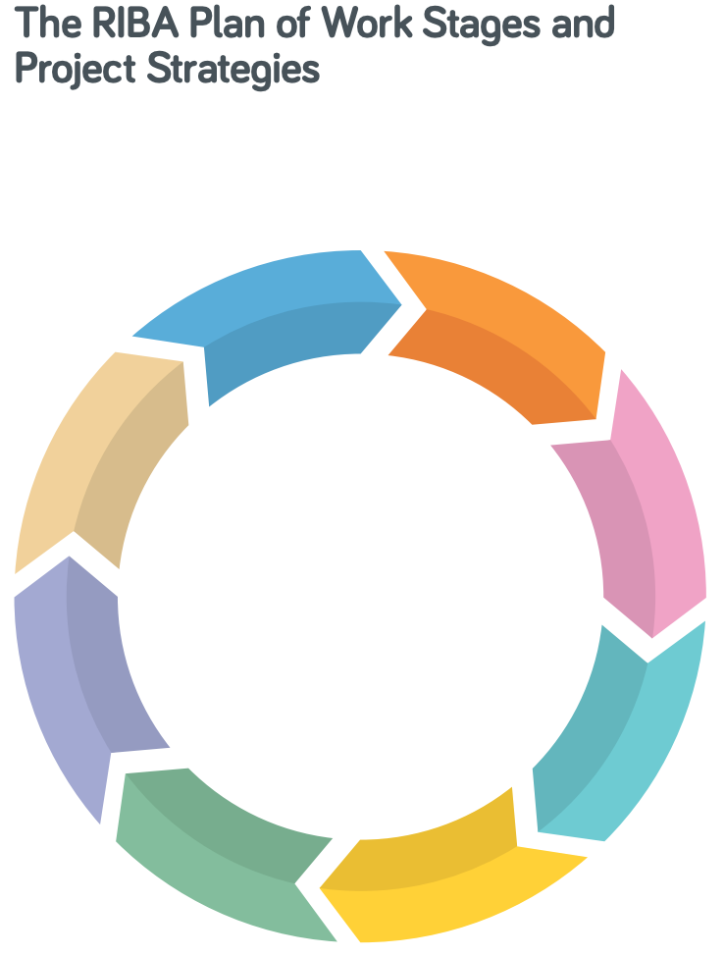
Stages involved in the design process.
Pre-construction stages 0 – 4 of the RIBA Plan of Work
Stage 0. Strategic definition
Stage 1. Preparation and brief
Stage 2. Concept design
Stage 3. Developed design
Stage 4. Technical design
Section 2.2.1(a): know the pre-construction stages.
Section 2.2.1(b): be aware of the activities undertaken at
each pre-construction stage.
Notes:
Section 2.2.1 of the unit specification covers stages 0 – 4 of the RIBA plan of work. Awareness of the nature and scope of the activities undertaken during each of the pre-construction stages of the RIBA plan will help guide and plan work for the NEA.

Slide 7
Factors that influence the design process.
Specification section 2.2.2, parts (a) – (g).
(a). Site information and constraints.
Know the information that can be obtained from the site.
Be aware of the constraints that site information may have on building design.
(b). Planning parameters and constraints
Be aware of the parameters of the planning process and of the constraints that information gathered from the planning process may have on building design.
Notes:
Section 2.2.2 of the specification is in 6 parts and covers the factors that influence and constrain design. Awareness of the influences and constraints may be gained by consideration of examples of the various factors listed. A site and planning background will need to be established for the NEA project.

Slide 8
Factors that influence the design process.
(c). Statutory requirements and constraints.
Be aware that National Building Regulations and Building Standards can constrain the design process.
Understand that the Welsh Government has responsibility for setting building regulation in Wales
Be aware that there are other requirements arising from other public bodies, including the police, fire service, highway authority and NHBC.
(d). Environmental requirements and constraints.
Be aware that environmental parameters can constrain the design process and of the constraints that environmental information may have on building design
Notes:
Awareness arising from study of the Building Regulations Approved Documents and of the areas of responsibility of other public bodies should lead to the identification of specific requirements relevant to the NEA building. Similarly awareness of the range of environmental parameters listed in the specification should lead to specific proposals for the environmental performance of the NEA building.

Slide 9
Factors that influence the design process.
(e). Social requirements and constraints.
Be aware that social requirements can constrain the design process and that public opposition and media pressure may result in limitations on development
(f). Economic constraints.
Be aware of the impact of economic constraints on the project budget and allocation of resources.
(g). Construction (Design and Management) regulations
Know that CDM regulations apply to all construction work and the design phase
Understand that CDM regulations concern the management of health, safety and welfare of construction projects and how this may be undertaken on site.
Be aware of the main duty holders and CDM processes.
Notes:
An awareness of possible constraints arising from social requirements is required and research may help to identify funding options and budgets relevant to the NEA building that can be used to inform decisions relating to quality, safety, functionality and performance.
Knowledge and understanding of the scope of and responsibilities arising from the CDM regulations is also required and may be demonstrated in the development of the project brief for the NEA work.

Slide 10
Factors that influence the design process.
NEA in relation to Specification section 2.2.2.
The requirements of the NEA state that ‘You are required to’:
consider relevant requirements and constraints that may influence the design of the conversion and extension, including:
• site
• planning
• statutory
• environmental
• social
• budgetary and economic
• construction (design and management) regulations (CDM)
• the existing building and its age/heritage
Notes:
This slide shows an extract from the sample brief NEA. This guides candidates towards the consideration of the factors outlined in this section of the specification. 12 of the 80 marks of the NEA have been assigned to this preliminary work.

Slide 11
Initial Project Briefs.
Specification section 2.2.3, parts (a) – (d).
(a). Setting project parameters.
Understand the importance of setting project parameters based on factors that influence building design.
(b). Setting project outcomes.
Understand the importance of setting project parameters for building function and performance.
(c). Outlining possible design ideas and specifications.
Be aware of alternative methods for presenting design ideas and of the iterative nature of the design process.
Be aware the content and purpose of specifications.
(d). Writing briefs for a specific and intended audience.
Understand that the project brief is the key document upon which the building design will be based
Notes:
This section of the specification covers the content of the project brief. It emphasises the importance of the brief and acknowledges that its preparation should be a collaborative process with input from the Client and members of the design team.

Slide 12
Initial Project Briefs.
.
NEA in relation to Specification section 2.2.3.
The requirements of the NEA state that ‘You are required to’:
(b) create initial project briefs for the client which:
• set parameters
• set project outcomes
• outline possible design ideas and specifications
• take account of the activities which are required in the pre-construction stages of the plan to convert and extend the existing building
Notes:
The NEA brief requires candidates to create an initial project brief and outlines suitable content. When setting project outcomes, it is important that the spatial requirements and accommodation described in the NEA brief are developed as a basis for more detailed design. 12 of the 80 marks of the NEA have been assigned to this section of the project.

Slide 13
Producing Designs.
Specification section 2.2.4, parts (a) – (c).
(a). A range of 2D and 3D sketches and drawings
Be aware of methods used to represent original ideas.
Be aware of the different types of drawings used to represent designs.
(b). The techniques, principles and conventions of manual drawing.
Understand the techniques used to produce outline and finished technical drawings manually.
Understand the principles and conventions of manual drawing.
(c). Technical component and material annotations.
Understand the types of technical, component and material annotations which may be applied to drawings.
Notes:
This section of the specification requires awareness of the methods used to present design ideas and an understanding of the techniques, principles, conventions of manual drafting and associated annotations. In addition to freehand design sketches the specification refers to the use of a drawing board with parallel motion and adjustable set square to produce outline pencil drawings and finished drawings using technical drawing pens.

Slide 14
Producing Designs.
.
NEA in relation to Specification section 2.2.4.
The requirements of the NEA state that ‘You are required to’:
(c) produce designs for the medical centre which include:
• a range of 2D and 3D sketches and drawings
• technical, component and material annotations
Notes:
The NEA brief requires candidates to produce designs for the NEA building and indicates the range of design information envisaged. 16 of the 80 marks of the NEA have been assigned to this section of the project.

Slide 15
Virtual Modelling Design.
Specification section 2.2.5, parts (a) – (c).
(a). Use of 2D and 3D virtual modelling outputs to produce different project information.
Understand the content of and likely associated outputs generated from 2D models.
Understand that a complete 3D model will involve objects with specifications and method statements attached and include all necessary information to allow the objects to be manufactured and installed or constructed.
(b). Setting up virtual modelling projects using common methodologies.
Be aware of the importance of using common methodologies with the aim of being fully collaborative.
Notes:
This section of the specification refers to the setting up and rendering of 2D and 3D virtual models with an awareness of content, associated outputs and common methodologies used to coordinate the production of information on collaborative projects.

Slide 16
Virtual Modelling Design.
(c). Producing virtual models and rendering.
Be able to produce virtual models. Use of CAD software to create 2D and 3D images of the proposed building, that can be rotated and viewed through 360 degrees.
Be able to apply rendering to generate a photorealistic digital image from a model with details on geometry, viewpoint, textures, lighting and shading.
Notes:
Part (c) of the modelling section confirms the expectation that candidates will be able to use CAD software to produce 2D and 3D virtual models of their designs and render these models to produce photorealistic images.

Slide 17
Virtual Modelling Design.
.
NEA in relation to Specification section 2.2.5.
The requirements of the NEA state that ‘You are required to’:
(d) use virtual modelling design to produce:
• 2D and 3D virtual modelling outputs for the medical centre, including rendering
Notes:
This slide confirms the NEA requirement to produce and render 2D and 3D models of the NEA building. 24 of the 80 marks of the NEA have been assigned to this section of the project. Further advice regarding the production of the virtual models is to follow later in the workshop.

Slide 18
Planning construction methods and techniques.
Specification section 2.2.6, parts (a) – (g).
(a). Primary and secondary requirements of low-rise and medium-rise buildings.
Be aware of the primary requirements of low and medium rise buildings, the components used in the superstructures of such buildings and common construction methods used in relation to secondary requirements.
(b). Requirements for working with buildings from different periods.
Be aware that historic and listed buildings require conservation, sustainable care and appropriate renewal.
Be aware that conservation may involve renovation, restoration and refurbishment.
Be aware of the conservation skills, workmanship and materials involved in the care of historic buildings.
Notes:
Section 6 of the specification for unit 2 is titled planning construction methods and techniques. The content outlines what is expected in terms of awareness of primary and secondary requirements and of requirements for working with older buildings.

Slide 19
Planning construction methods and techniques.
(c). Contemporary construction of substructures and superstructures.
Be aware of the main components of substructures including foundations, retaining walls, basements and ground bearing floors.
Be aware of the main components of superstructures including structural walls, frames, cladding, intermediate floors, vertical circulation and roofs.
(d). Sustainable construction methods, techniques and considerations.
Be aware of the main components of sustainable construction methods.
Be aware of sustainable techniques for selecting construction materials.
Be aware of sustainable considerations relating to local sourcing, energy efficiency and reducing water use.
Notes:
The section continues to describe awareness of the main components of substructures and superstructures and of sustainable construction methods, materials and associated considerations such as energy efficiency and reducing water waste.

Slide 20
Planning construction methods and techniques.
(e). Water and waste water systems.
Be aware of the regulations and considerations for rainwater and waste water removal, grey water, rainwater harvesting and SuDS.
(f). Landscape design
Know that landscape design involves the layout and specification of planting and hard landscaped areas.
Be aware that landscape design can be applied on a wider scale.
(g). Site design
Know that site design will involve the layout and specification for all external areas.
Be aware that building location and orientation will be determined with consideration of site conditions, available views and local climate.
Notes:
The final parts of this section refer to awareness of rainwater and wastewater systems and knowledge of landscape and site design.

Slide 21
Planning construction methods and techniques.
NEA in relation to Specification section 2.2.6.
The requirements of the NEA state that ‘You are required to’:
(e) consider the medical centre’s requirements, including:
• the primary and secondary requirements of the building
• how the existing building will be conserved and how the design of the extension reflects the heritage of the existing building
• construction methods for substructures and superstructures
• sustainable construction methods, techniques and considerations
• water and wastewater systems
• landscape and site design.
Notes:
This slide confirms the NEA requirement to consider the requirements of the NEA building and lists the aspects of the design to be considered in terms of how well the actual project outcomes meet the stated requirements. The list matches the content of section 6 of the specification. 16 of the 80 marks of the NEA have been assigned to this section of the project.

Slide 22
WJEC Resources
There are a wide range of resources available for teachers and students on the WJEC website. Currently resources are available for Units 1 and 2. Resources for the other units will be provided to coincide with future workshops.
http://resource.download.wjec.co.uk.s3-eu-west-1.amazonaws.com/vtc/2020-21/QW20-21_2/_multi-lang/gce-built-environment/index.html
Notes:
This slide contains a link to WJEC resources for this qualification.
There are a wide range of resources available for teachers and students on the WJEC website. Currently resources are available for Unit 1 and 2. Resources for the other units will be provided to coincide with future workshops.

Slide 23
Any Questions?
Subject Officer
Allan Perry
construction@wjec.co.uk
Subject Support Officer
Andrew O’Regan
construction@wjec.co.uk
@wjec_cbac | @cbac_wjec
cbac.co.uk | wjec.co.uk
Notes:
Time to deal with any questions arising at his stage.

