Slide 1
US election 2016: State by State and voting regions in the USA

Slide 2
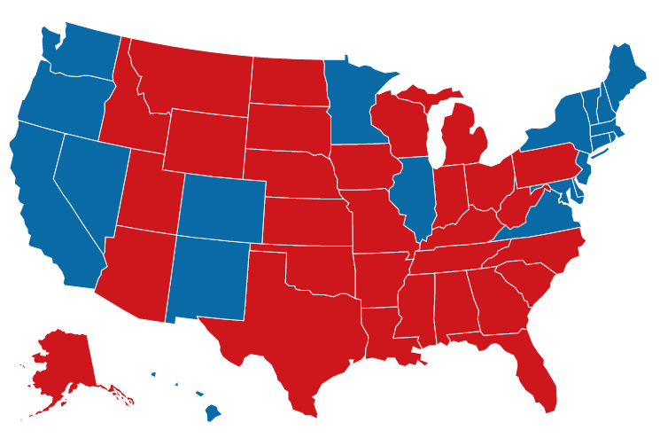
US election 2016: State by State -
showing six of the main categorisations of voting regions in the USA
Wyoming
New York
California
Illinois
Missouri
Texas
Cities
C
Rust Belt
Bible Belt
Mountain States
Southern States
Republican
Western Coastal States
Democrat
Click on the region names above to show, click again to hide.

