Slide 1
Occupational Specialism: Refrigeration Engineering
K1.11 Interpret refrigeration data from pressure-enthalpy charts
PowerPoint 1.11 How to perform calculations using data interpreted from a pressure enthalpy chart

Slide 2
Introduction
Why bother plotting a Ph chart?
What data can we determine from the plot?

Slide 3
Objectives
You should be able to:
Recall how to interpret useful data from a Ph chart.
Explain how to calculate WD, RE, COP AND THR and calculate system capacities.
You might also be able to:
Discuss how data relates to system performance.
Select and Interpret data to solve problems in relation to system design.

Slide 4
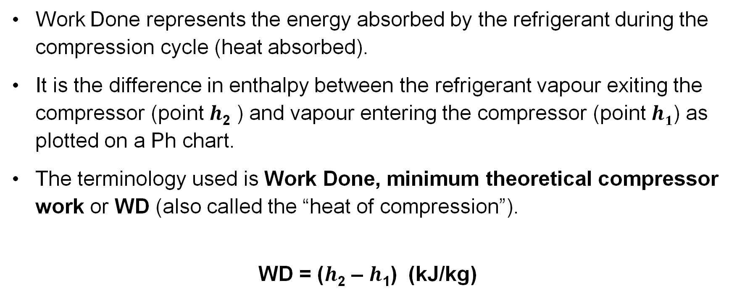
Work Done (WD)
Work Done represents the energy absorbed by the refrigerant during the compression cycle (heat absorbed).
It is the difference in enthalpy between the refrigerant vapour exiting the compressor (point $h$₂ ) and vapour entering the compressor (point $h1$) as plotted on a Ph chart.
The terminology used is Work Done, minimum theoretical compressor work or WD (also called the “heat of compression”).
WD = ($h$₂ – $h$₁) (kJ/kg)

Slide 5
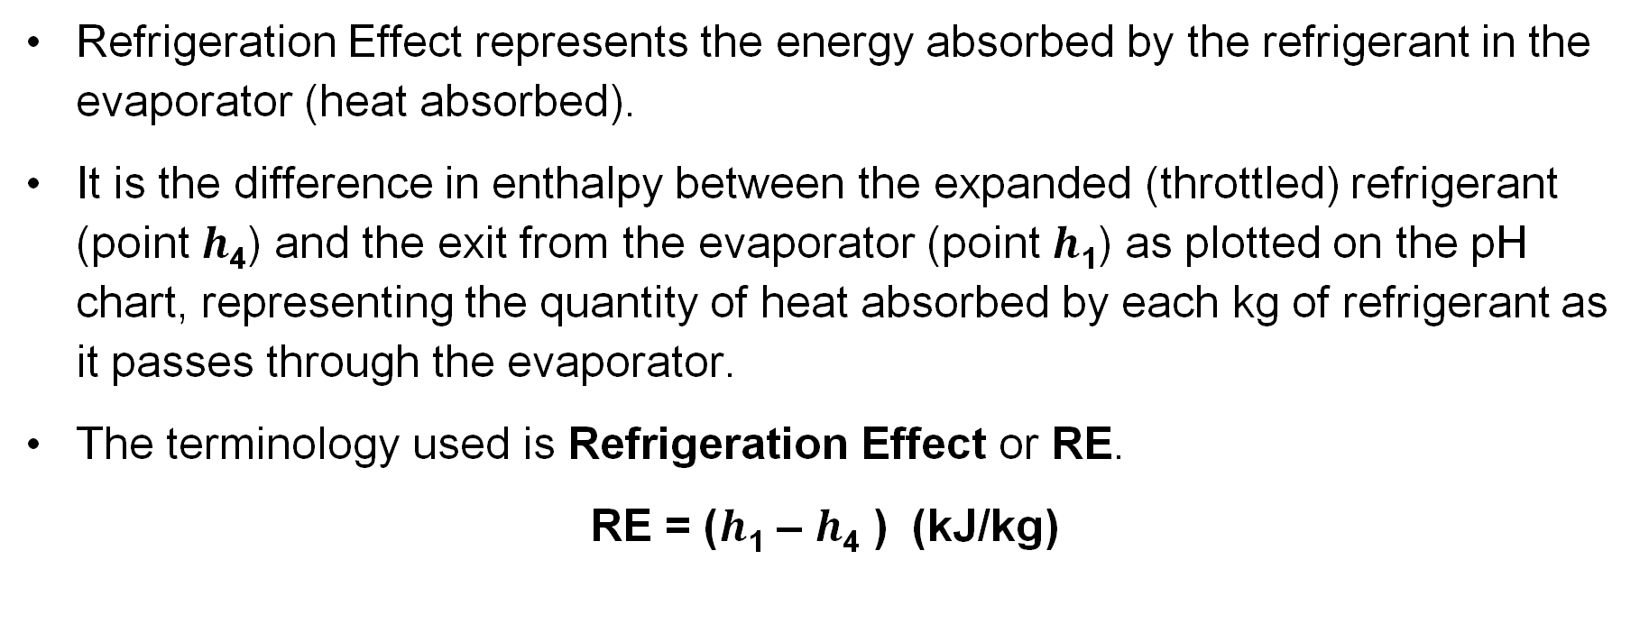
Refrigeration Effect (RE)
Refrigeration Effect represents the energy absorbed by the refrigerant in the evaporator (heat absorbed).
It is the difference in enthalpy between the expanded (throttled) refrigerant (point $h$₄) and the exit from the evaporator (point $h$₁) as plotted on the pH chart, representing the quantity of heat absorbed by each kg of refrigerant as it passes through the evaporator.
The terminology used is Refrigeration Effect or RE.
RE = ($h$₁ – $h$₄ ) (kJ/kg)

Slide 6
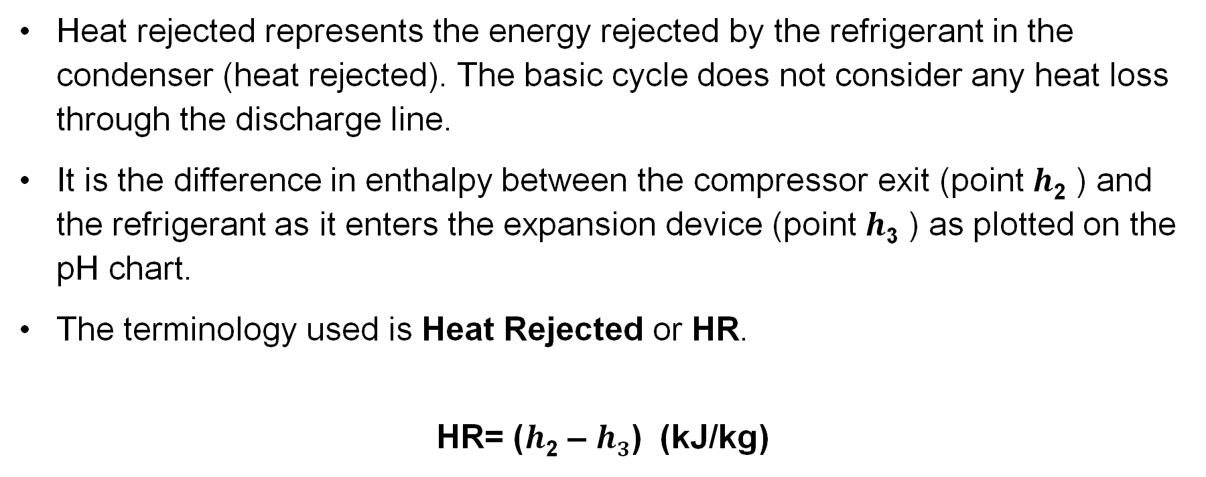
Heat Rejected (HR)
Heat rejected represents the energy rejected by the refrigerant in the condenser (heat rejected). The basic cycle does not consider any heat loss through the discharge line.
It is the difference in enthalpy between the compressor exit (point $h$₂ ) and the refrigerant as it enters the expansion device (point $h$₃ ) as plotted on the pH chart.
The terminology used is Heat Rejected or HR.
HR= ($h$₂ – $h3$) (kJ/kg)

Slide 7
Coefficient of Performance (COP)
Is the measure of the system’s performance efficiency.
It is very difficult to measure the "efficiency" of a refrigeration or similar systems. However, the ratio of energy transferred against energy required provides one useful measure of efficiency:
COP = Useful energy transferred
Energy required

Slide 8
Coefficient of Performance (COP)
This relationship is known as the Coefficient of Performance (COP).
The Coefficient of Performance is the ratio of the Refrigeration Effect to the Work Done.
COP = RE = kj/kg NO units, it’s a ratio
WD kj/kg
Note: The higher the COP, the more efficient the system.

Slide 9
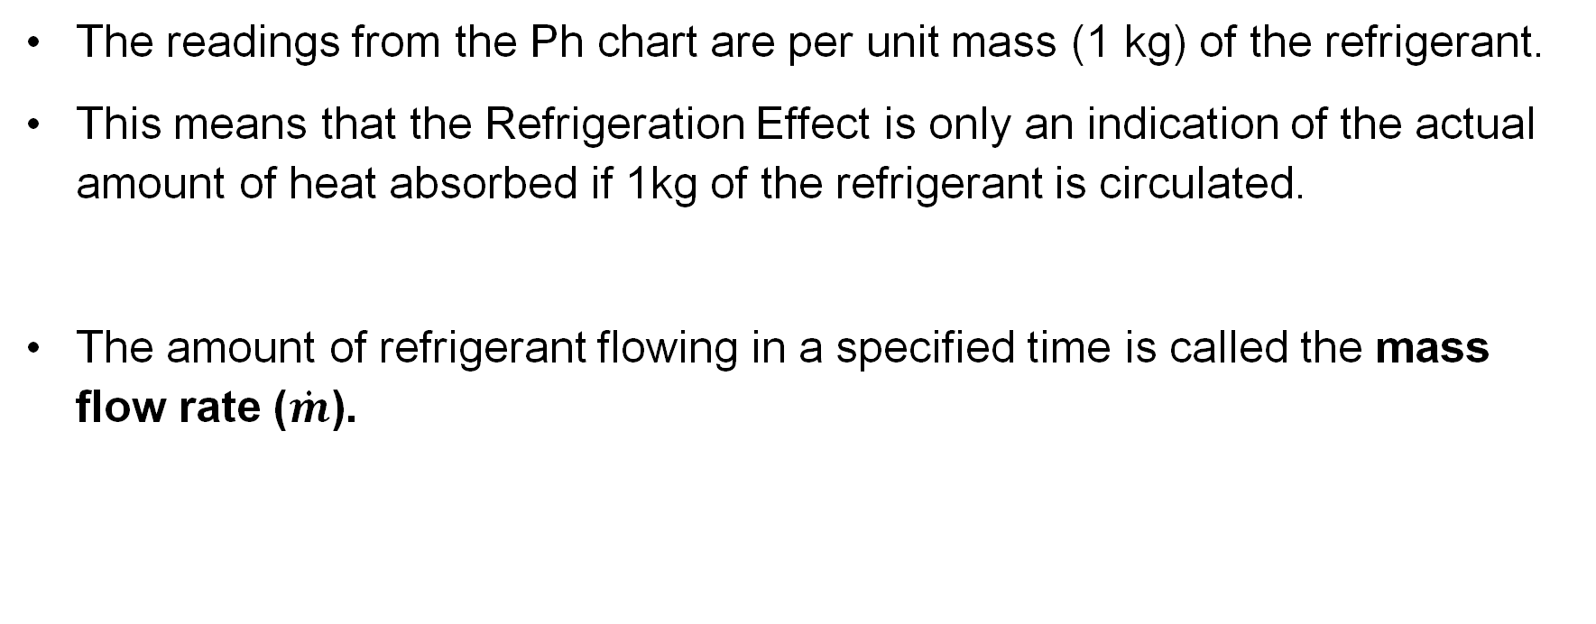
Mass flow rate
The readings from the Ph chart are per unit mass (1 kg) of the refrigerant.
This means that the Refrigeration Effect is only an indication of the actual amount of heat absorbed if 1kg of the refrigerant is circulated.
The amount of refrigerant flowing in a specified time is called the mass flow rate ($\dot{m}$).

Slide 10
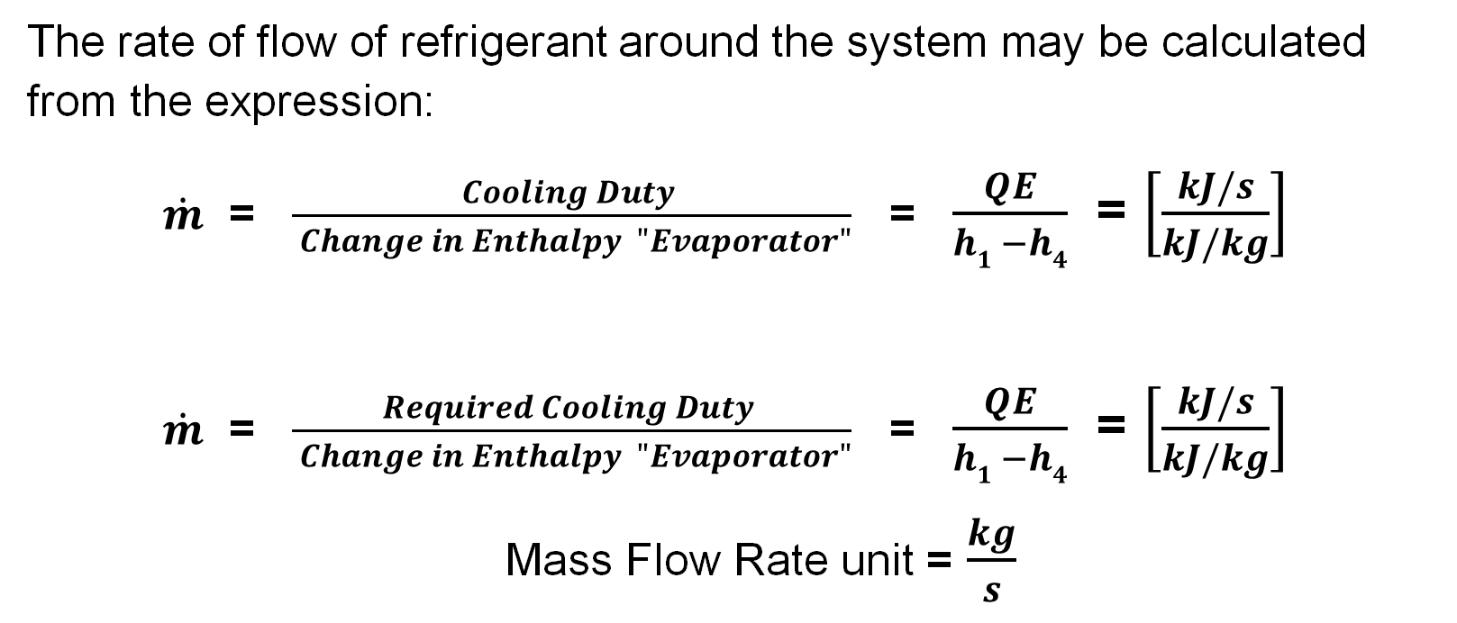
Mass flow rate
The rate of flow of refrigerant around the system may be calculated from the expression:
$\dot{m}$ = $\frac{Cooling Duty }{ Change in Enthalpy "Evaporator"}$ = $\frac{QE}{h1 −h4}$ = $\left[\frac{kJ/s}{kJ/kg}\right]$
$\dot{m}$ = $\frac{Required Cooling Duty }{ Change in Enthalpy "Evaporator"}$ = $\frac{QE}{h1 −h4}$ = $\left[\frac{kJ/s}{kJ/kg}\right]$
Mass Flow Rate unit = $\frac{kg}{s}$

Slide 11
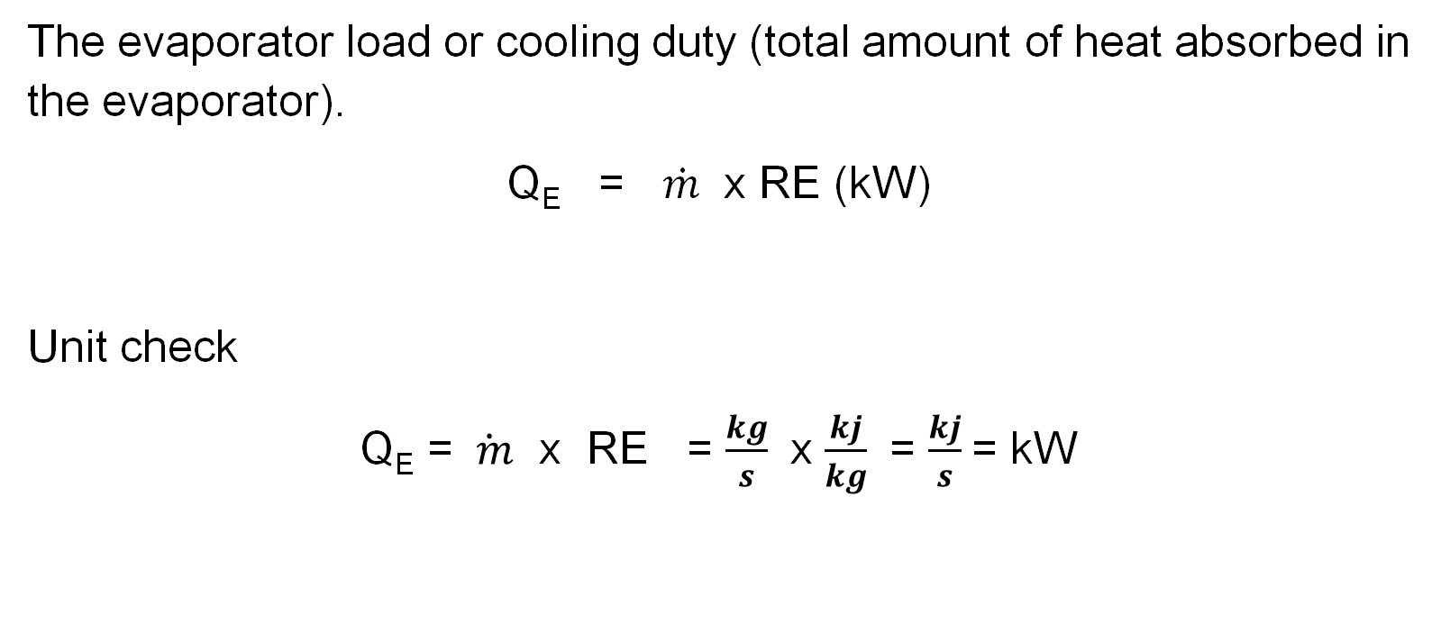
Cooling capacity
The evaporator load or cooling duty (total amount of heat absorbed in the evaporator).
Q_{E} = $\dot{m}$ x RE (kW)
Unit check
Q_{E} = $\dot{ m}$ x RE = $\frac{kg}{s}$ x $\frac{kj}{kg}$ = $\frac{kj}{s}$= kW

Slide 12
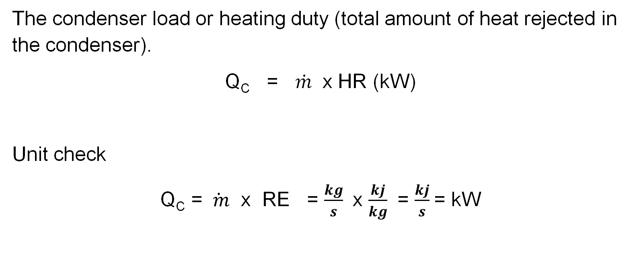
Heating capacity
The condenser load or heating duty (total amount of heat rejected in the condenser).
Q_{C} = $\dot{m}$ x HR (kW)
Unit check
Q_{C} = $\dot{ m}$ x RE = $\frac{kg}{s}$ x $\frac{kj}{kg}$ = $\frac{kj}{s}$= kW

Slide 13
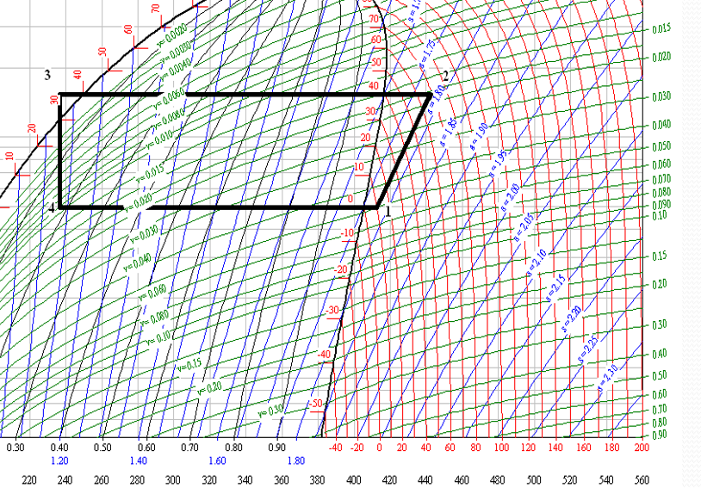
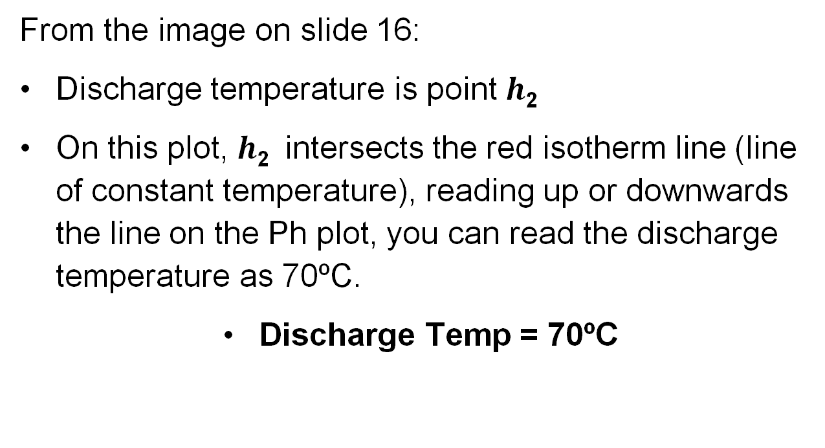

Discharge temperature
From the image on slide 16:
Discharge temperature is point $h$₂
On this plot, $h$₂ intersects the red isotherm line (line of constant temperature), reading up or downwards the line on the Ph plot, you can read the discharge temperature as 70ºC.
Discharge Temp = 70ºC
Add image here.
$h$₂

Slide 14
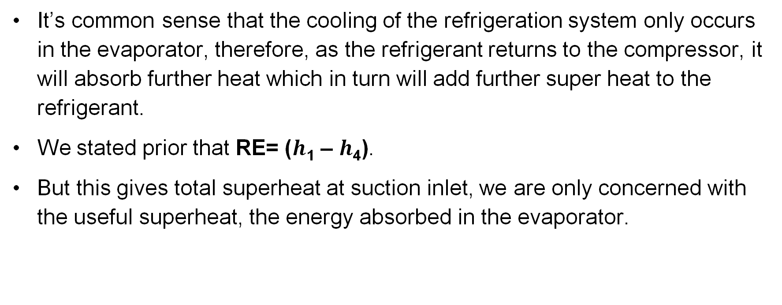
$h$₅ Exit of the evaporator - Useful Superheat
It’s common sense that the cooling of the refrigeration system only occurs in the evaporator, therefore, as the refrigerant returns to the compressor, it will absorb further heat which in turn will add further super heat to the refrigerant.
We stated prior that RE= ($h$₁ – $h$₄).
But this gives total superheat at suction inlet, we are only concerned with the useful superheat, the energy absorbed in the evaporator.

Slide 15

$h$₅ Exit of the evaporator - Useful Superheat
The more accurate measure of RE can now be written as
RE= ($h$₅ – $h$₄)

Slide 16

$h$₅ Exit of the evaporator - Useful Superheat
= $h5$ =
Useful
superheat

Slide 17
Quality of refrigerant ($𝔁)$at $h$₄
The black quality lines run parallel to the saturation lines, converging and meeting at the critical point.
Relevant to the latent (saturated mix) zone and defines the percentage of the liquid that has been evaporated.
Starting from the saturated liquid line at naught, the ratio increases progressively to 1 at the saturated vapour line.

Slide 18

Quality of refrigerant at $h$₄
= Quality of the refrigerant Dryness fraction of 0.18
$$h\text{4}$$

Slide 19
Specific Volume at suction
Specific Volume is the volume occupied by matter per unit mass. It is the ratio of a material's volume to its mass, which is the same as the reciprocal of its density.
Specific Volume means the volume occupied by 1 kg of refrigerant. (m³/kg).
Specific Volume lines have a gradient to the right of about 45º and converge in the latent zone.
Add image here.

Slide 20
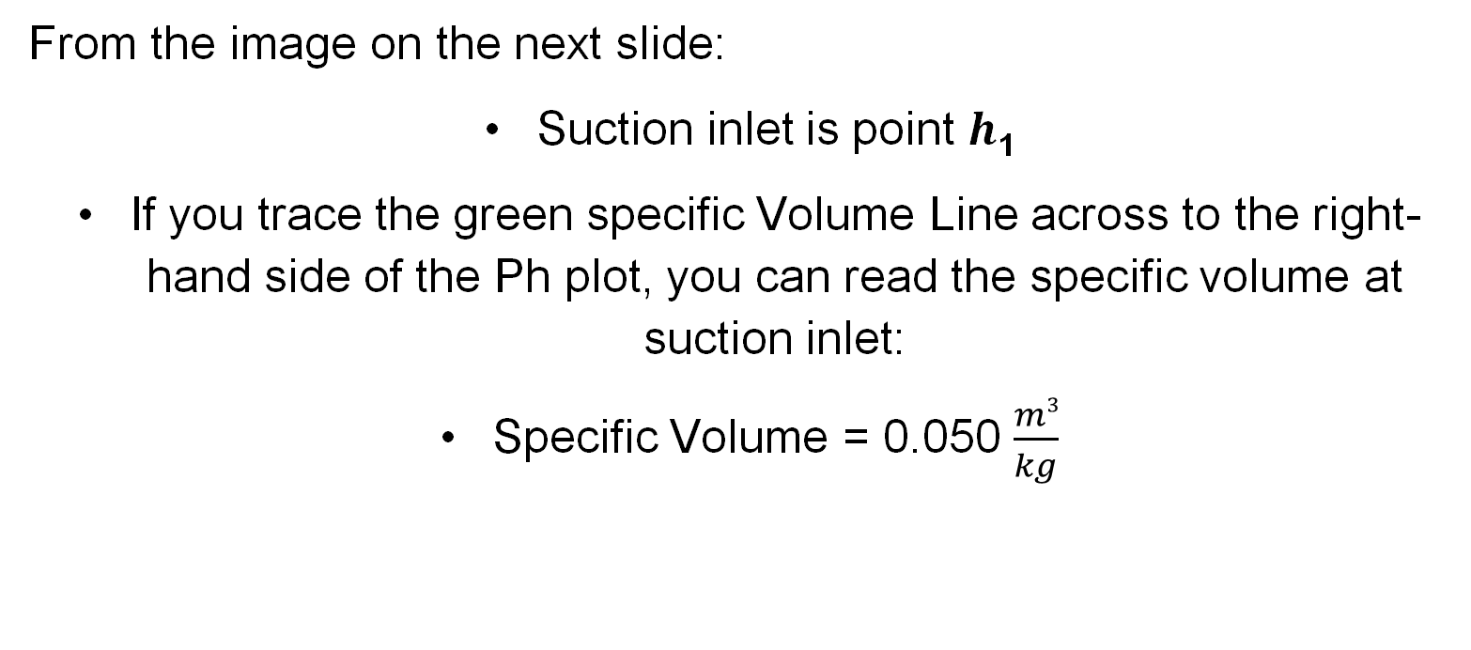
Specific Volume at suction inlet
From the image on the next slide:
Suction inlet is point $h$₁
If you trace the green specific Volume Line across to the right-hand side of the Ph plot, you can read the specific volume at suction inlet:
Specific Volume = 0.050 $\frac{m3}{kg}$

Slide 21
Specific Volume at suction inlet
= Specific Volume

Slide 22
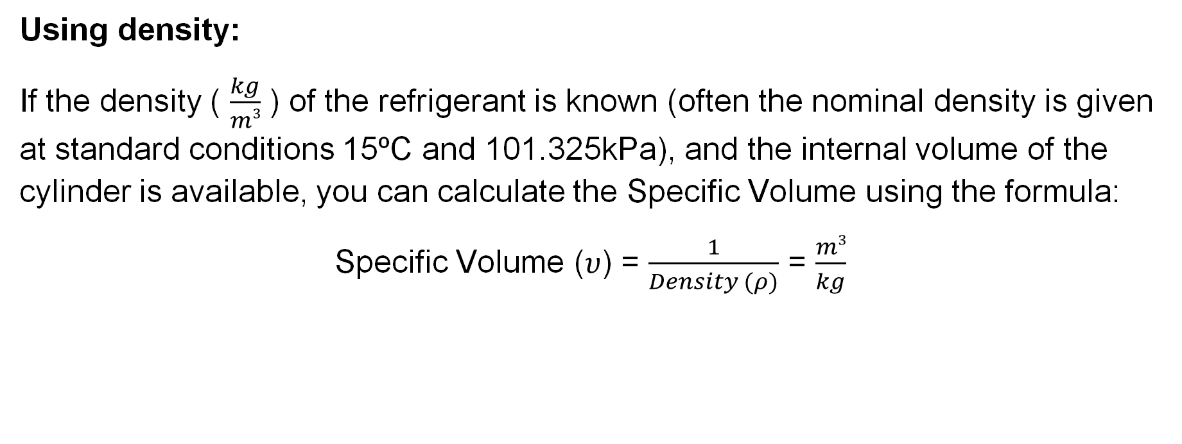
Calculating Specific Volume
Using density:
If the density ( $\frac{kg}{m3}$ ) of the refrigerant is known (often the nominal density is given at standard conditions 15ºC and 101.325kPa), and the internal volume of the cylinder is available, you can calculate the Specific Volume using the formula:
Specific Volume ($υ$) = $\frac{1}{Density (ρ)}$ = $\frac{m3}{kg}$

Slide 23
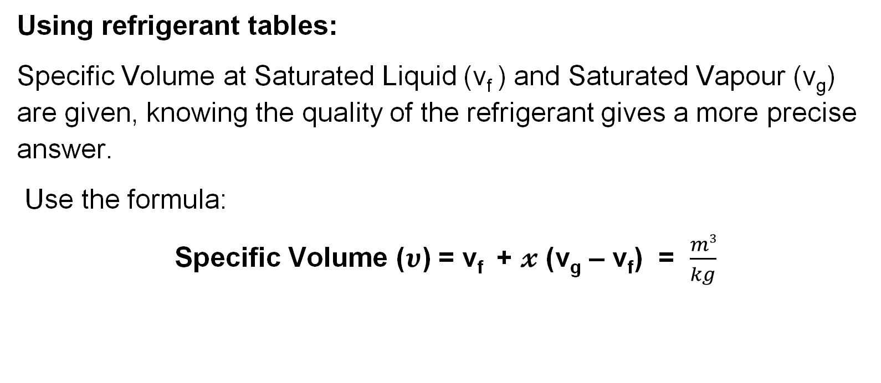
Calculating Specific Volume
Using refrigerant tables:
Specific Volume at Saturated Liquid (v_{f} ) and Saturated Vapour (v_{g}) are given, knowing the quality of the refrigerant gives a more precise answer.
Use the formula:
Specific Volume ($υ$) = v_{f} + $𝔁$ (v_{g} – v_{f}) = $\frac{m3}{kg}$
Notes:
Provide refrigerant tables from manufacturers

Slide 24
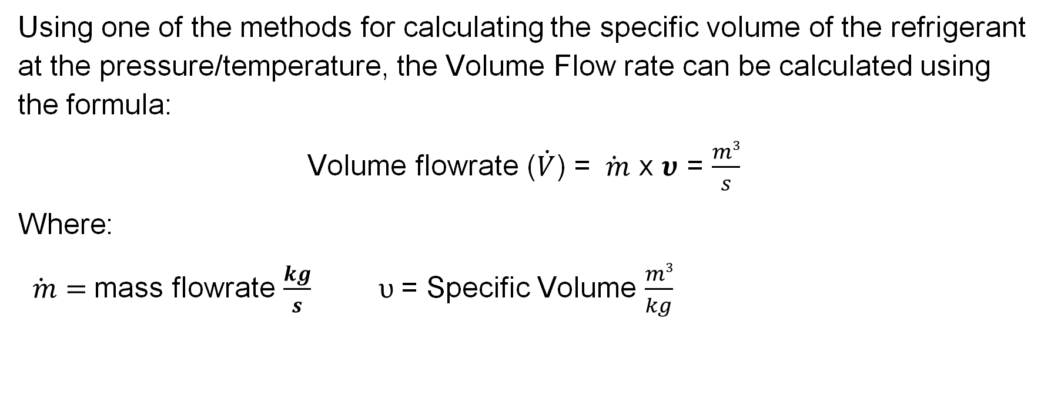
Volume Flow Rate
Using one of the methods for calculating the specific volume of the refrigerant at the pressure/temperature, the Volume Flow rate can be calculated using the formula:
Volume flowrate ($\dot{V}$) = $\dot{ m}$ x $υ$ = $\frac{m3}{s}$
Where:
$\dot{ m}=$mass flowrate $\frac{kg}{s}$ $υ$= Specific Volume $\frac{m3}{kg}$

Slide 25
Compressor Swept Volume
The Swept Volume for reciprocating compressors is the total volume displaced by the piston(s) of a compressor during one complete cycle or total volume displaced by the rotor(s) (or revolution for rotary compressors) during one complete cycle.
Rotary Compressors (e.g., Screw, Scroll):
The formula is complex and depends on the specific rotary design. It's usually provided by the manufacturer or determined through detailed geometry analysis.

Slide 26

Compressor Swept Volume
Formula: Reciprocating Compressors (Piston-Cylinder):
V_{s} = B * $\left(\frac{π D2}{4}\right)$ = m³
(where B = stroke length, D = bore/cylinder diameter)

Slide 27
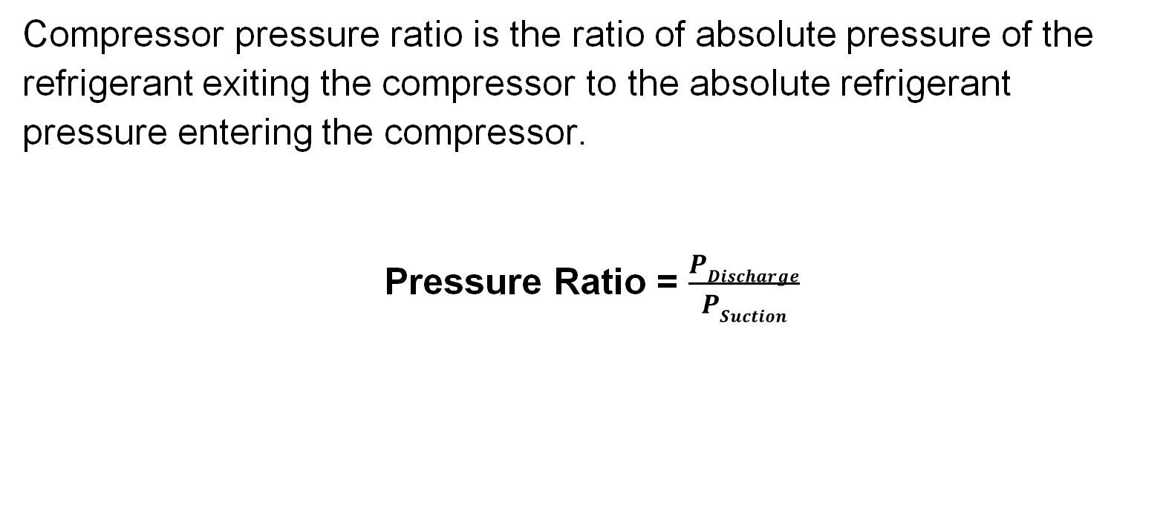
Compression (Pressure) Ratio
Compressor pressure ratio is the ratio of absolute pressure of the refrigerant exiting the compressor to the absolute refrigerant pressure entering the compressor.
Pressure Ratio = $\frac{PDischarge}{PSuction}$

Slide 28
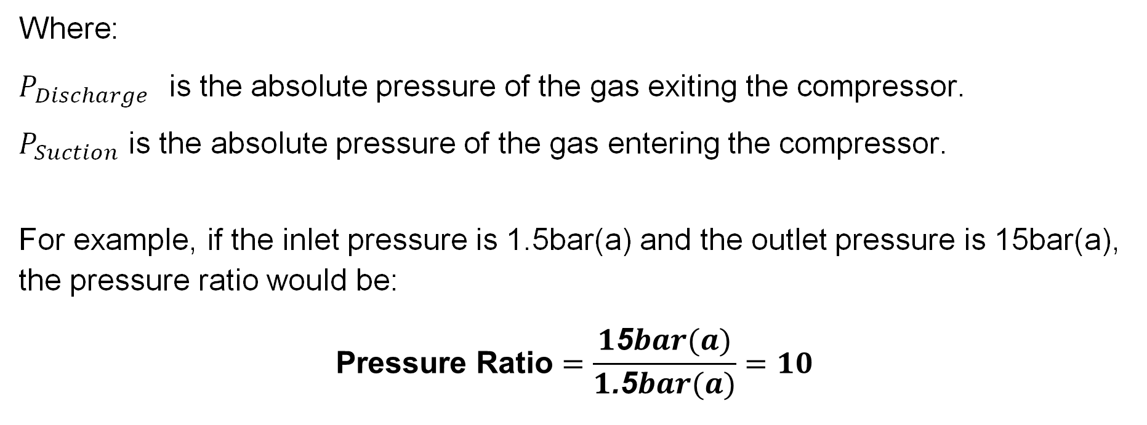
Compression (Pressure) Ratio
Where:
$P_{Discharge}$ is the absolute pressure of the gas exiting the compressor.
$P_{Suction}$ is the absolute pressure of the gas entering the compressor.
For example, if the inlet pressure is 1.5bar(a) and the outlet pressure is 15bar(a), the pressure ratio would be:
$$\text{Pressure} \text{Ratio}=\frac{1\text{5}bar(a)}{1\text{.}\text{5}bar(a)}=10$$

Slide 29
Summary
You should now be able to:
Recall how to calculate useful data from a Ph chart.
Explain how to calculate WD, RE, COP AND THR and calculate system capacities.
You might also be able to:
Discuss how data relates to system performance.
Select and interpret data to solve problems in relation to system design.

Slide 30
Any questions?
Copyright in this document belongs to and is used under licence from the Department for Education, © 2025.
‘T-LEVELS’ and ‘T Level’ are registered trademarks of the Department for Education.
WJEC is authorised by the Department for Education to develop and deliver this T Level Technical Qualification.
WJEC operates in England under the name Eduqas which is a registered trademark of WJEC.

